Slide 1
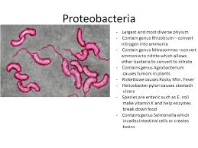
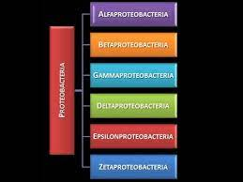
بسم الله الرحمن الرحيم
Lecture-6/ 2025
Bacterial taxonomy
The Phylum Proteobacteria

Slide 2
The Phylum: Proteobacteria
The largest phylogenetically coherent bacterial group with more than 500 genera. Remarkable diverse morphologically, physiologically, and other ways.
Volume 2 of Bergey’s Manual (2nd edition) is devoted to this group of bacteria.
This phylum of gram-negative bacteria subsequently received the name Proteobacteria. It includes many bacteria that are part of the normal human microbiota as well as many pathogens.

Slide 3
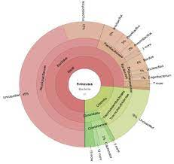
Proteobacteria may have arisen from a single photosynthetic ancestor . According 16s rRNA Proteobacteria are further divided into five classes:
1-Alphaproteobacteria
2-Betaproteobacteria
3-Gammaproteobacteria
4-Deltaproteobacteria
5-Epsilonproteobacteria

Slide 4
1-Class :Alphaproteobacteria
Classified into seven orders and 20 families, can be distinguished with the following criteria:
1-Order Rickettsiales may have been the earliest α-Proteobacteria.
2-Most of them are oligotrophic bacteria. An oligotroph is an organism that can live in an environment that offers very low levels of nutrients. Oligotrophs are characterized by slow growth, low rates of metabolism, and generally low population density. Oligotrophic environments are those that offer little to sustain life.

Slide 5
3- Most abundant bacteria in oceans.
4- Evolved to live within plants and animals resulting in genome reduction or expansion.
5-Metabolically diverse: methylotrophy, chemolithotrophs, nitrogen fixers.
Q)Give the differences between methylotropgy and chemolithotrophs?

Slide 6
Methylotrophs: are a diverse group of microorganisms that utilize reduced one-carbon (C1) compounds, such as methanol and methane, as their sole sources of carbon and energy. C1-utilizing microorganisms include bacteria, archaea, and fungi. Most methylotrophic fungi are yeasts.
Chemolithotrophs: are a group of phylogenetically diverse microbes that can obtain all the energy required for their growth from the oxidation of inorganic compounds such as hydrogen (H2), hydrogen sulfide (H2S), and reduced metals.

Slide 7
Genus :Rickettsia
1-Very small , Gram-negative, non-flagellated ,diverse morphology.
2-All species are parasitic or mutualistic grows in vertebrate erythrocytes, macrophages, vascular endothelial cells , live in blood sucking arthropods , endo symbiotic association, free living, aerobic bacterium became intracellular parasite of proto-eukaryotic cell that lacked some organelles.
3- gene reduction occurred and loss of free living ability .
4-Lack glycolytic pathway ,do not use glucose as energy source . Oxidize glutamate and TCA cycle intermediates (e.g., succinate) .Take up and use ATP and other materials from host cell.

Slide 8
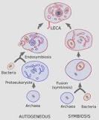
Q)Describe protoeukaryotic cell?
It means that a proto-eukaryote cell (FECA) was first developed, which emerged from the archaea lineage. These cells independently acquired most of the cell complexities found in the eukaryote cells, such as the endomembrane system and the cytoskeleton, but lack mitochondria.

Slide 9
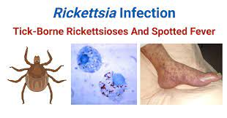
Scientific classification of Genus: Rickettsia
Domain: Bacteria
Phylum : Proteobacteria
Class: Alphaproteobacteria
Order: Rickettsiales
Family: Rickettsiaceae
Genus: Rickettsia
Species: R. typhi

Slide 10
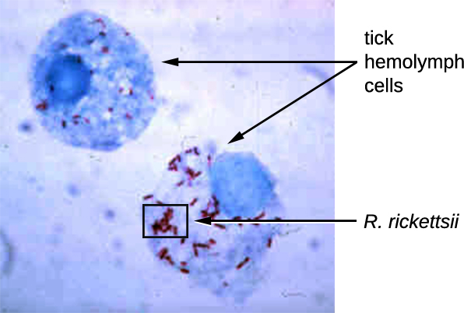
Rickettsia rickettsii

Slide 11
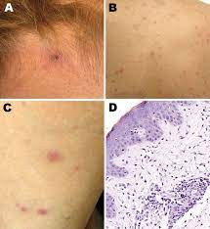
Important pathogens
Rickettsia prowazekii and Rickettsia typhi causes typhus fever .
Rickettsia rickettsii causes Rocky Mountain or Spotted Fever.
Reproduction
Rickettsia enters host by phagocytosis, escapes phagosome and reproduces in cytoplasm causing host cell bursts.

Slide 12
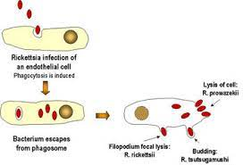
Reproduction in Rickettsia

Slide 13
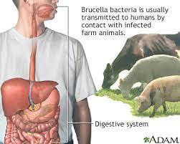
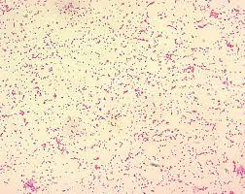
2-Genus: Brucella
Important human and animal pathogen ,it is the causative agent of undulant fever zoonosis . This bacterium appear as tiny, faintly staining Gram -negative coccobacilli.

Slide 14
2-Class :Betaproteobacteria
This group contains 7 orders and 12 families ,it is considered metabolically diverse.
1- Order Neisseriales
One family only; Neisseriaceae including15 genera .Members in this family are non -motile, Gram-negative cocci most often occur in pairs with adjacent sides flattened may have capsules and fimbriae as well as aerobic chemoorganotrophs , oxidase positive and usually catalase positive.

Slide 15
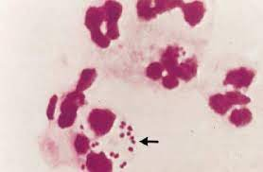
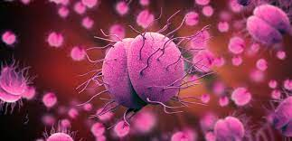
Genus :Neisseria
This genus will be explained as a representative genus for the family .
1-it may have capsules and fimbriae .
2- Inhabitants of mucous membranes of mammals
3- some species in this genus are human pathogens like Neisseria gonorrhoeae that causes gonorrhea and
Neisseria meningitides which
causes meningitis.

Slide 16
2- Order :Burkholderiales
Well –Known genera in this order including ; Burkholderia, Bordetella, Sphaerotilus, and Leptothrix .
Some members have a sheath which is hollow tube like structure surrounding chain of cells may contain ferric or manganic oxides , it's functions are:1- attachment to surfaces and
2- obtaining nutrients from slowly running water 3-as well as for cell protection.

Slide 17
1- Genus :Burkholderia
Gram-negative, non–spore-forming, straight rods , most motile with single flagellum or polar flagella. Aerobic and mesophilic. Nonfermentative, chemoorganotrophs catalase positive; often oxidase positive , most use poly-β-hydroxybutyrate as carbon reserve.
Burkholderia cepacia
Degrades >100 organic molecules, very active in recycling organic material. Plant pathogen .Has becomes a major nosocomial pathogen since it constitute particular problem for cystic fibrosis patients.

Slide 18
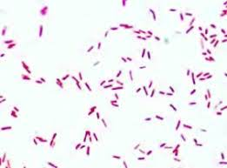
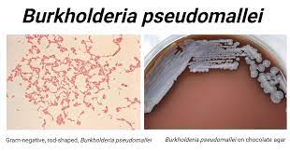
Scientific classification of Genus: Burkholderia
Domain : Bacteria
Phylum: Proteobacteria
Class : Betaproteobacteria
Order : Burkholderiales
Family: Burkholderiaceae
Genus: Burkholderia
Species: B. cepacia

Slide 19
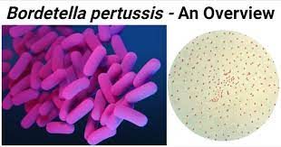
2- Genus: Bordetella
Gram-negative coccobacilli, some have capsules. Aerobic chemoorganotrophs , metabolism by respiration not fermentation ,require organic sulfur and amino acids for growth. Mammalian parasites that multiply in respiratory epithelial cells, non-motile, encapsulated species ,causing whooping cough and kennel cough.

Slide 20
3- Class :Gammaproteobacteria
Largest subgroup of Proteobacteria contains 14 orders and 28 families .
1-Very diverse physiological types some are chemoorganotrophs , others are photolithotrophs, or chemolithotrophs , as well as methylotrophs .
2-aerobic and anaerobic .
3- Many deeply branching

Slide 21
1-Order: Pseudomonadales
The typical family is Pseudomonadaceae and Pseudomonas is the most important genus in the order Pseudomonadales it is heterogenous as it is includes 60 species .
1-Gram-negative straight or slightly curved rods (0.5 - 1.0 )μm by (1.5 - 5.0 )μm in length .
2-motile by one or several polar flagella .
3-lack prosthecae or sheaths.

Slide 22
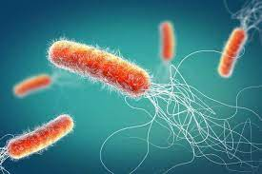
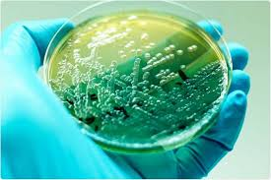
Genus :Pseudomonas
Chemoheterotrophs with respiratory metabolism, usually use oxygen as electron acceptor , sometimes use nitrate as electron acceptor , have functional TCA cycle , most hexoses are degraded by Entner-Duodoroff pathway.
Scientific classification
Domain: Bacteria
Phylum: Proteobacteria
Class : Gammaproteobacteria
Order : Pseudomonadales
Family : Pseudmonadaceae
Genus : Pseudomonas
Species :P. aeruginosa

Slide 23
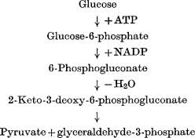
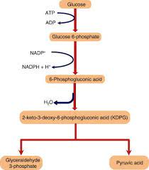
Entner-Duodoroff pathway

Slide 24
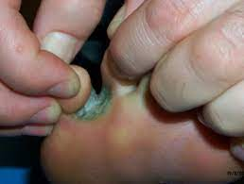
Importance of Pseudomonads
1-Degrade wide variety of organic molecules
2-Mineralization: microbial breakdown of organic materials to inorganic substrates
3-Important experimental subjects
4-Some are major animal and plant pathogens
5.Some cause spoilage of refrigerated food because can grow at 4°C

Slide 25
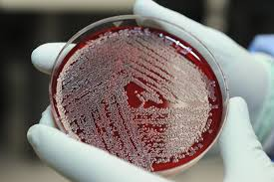
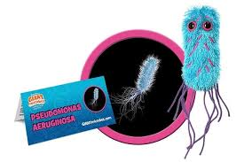
Thank You

