Slide 1
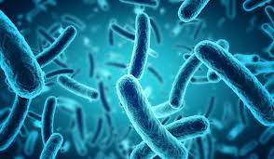
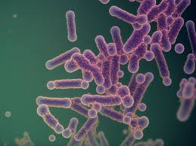
بسم الله الرحمن الرحيم
Lecture-8–
2025
Bacterial taxonomy
Phylum :Firmicutes

Slide 2
The phylum Firmicutes
The phylum Firmicutes is a collection of Gram-positive, spore-forming, obligate anaerobes and cocci- or rod-shaped bacteria, including the Enterococcaceae and Lactobacillaceae families and many other families.
Firmicutes (Latin: firmus = strong, and cutis = skin, referring to the cell wall ) are a phylum of bacteria, most of which have Gram-positive cell wall structure.

Slide 3
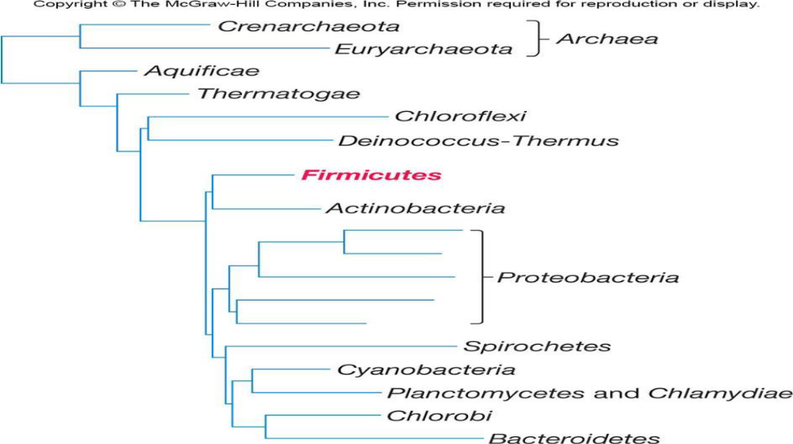
The low G + C% Gram-positive bacteria are placed in the phylum Firmicutes (Fig.below):

Slide 4
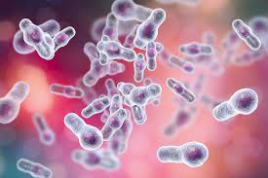
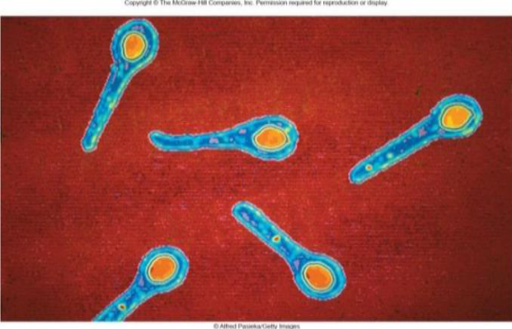
Firmicutes is divided into two classes:1- Clostridia and 2-Bacilli,
Clostridia are low G + C% endospore-forming bacteria with over 100 species.
Clostridium is the largest genus in the class. It includes obligatory anaerobic ,fermentative ,Gram-positive bacteria that form endospores (Figure.below).

Slide 5
1-Class: Clostridia
Genus Clostridium:
1- Members of this genus have great practical impact. Because they are anaerobic and form heat-resistant endospores, they are responsible for many cases of food spoilage, even in canned foods.
2-Clostridia often can ferment amino acids to produce ATP by oxidizing one amino acid while using another as an electron acceptor in a process called the Stickland reaction. This reaction generates ammonia, hydrogen sulfide, and fatty acids during the anaerobic decomposition of proteins.

Slide 6
Stickland reaction
The Stickland reaction usually involves one amino acid that acts as an electron donor (the product is shorter by one carbon atom than the original amino acid), For example: alanine with a three carbon chain is converted to acetate with two carbons. while another acts as an electron acceptor (the product has the same number of carbon atoms as the original amino acid) In this way, amino acid fermenting microbes can avoid using hydrogen ions as electron acceptors to produce hydrogen gas.
Amino acids can be Stickland acceptors, Stickland donors, or act as both donor and acceptor.

Slide 7
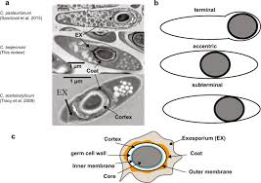
3- some clostridia are industrially valuable like
C. acetobutylicum which is used to manufacture butanol .
4-the pathogenic species that produce toxins are most well -known. For instance, C. perfringens causes gas gangrene and food poisoning.
C. botulinum is the causative agent of botulism, and C. tetani causes tetanus.

Slide 8
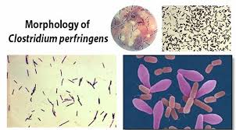
Scientific classification
Domain: Bacteria
Phylum: Firmicutes
Class: Clostridia
Order :Clostridiales
Family :Clostridiaceae
Genus :Clostridium
Species :C. botulinum & C. tetani
and C.perfringens

Slide 9
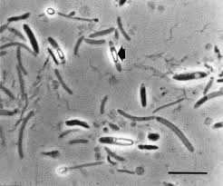
Some distinguishing groups in
Class Clostridia
Heliobacteria
1-Contains one family Heliobacteriaceae belongs to order Clostridiales .
2-The genera Heliobacterium and Heliophilum contain unusual anaerobic, phototrophic species characterized by the presence of bacteriochlorophyll (g).
3-Like the clostridia, Heliobacteria are capable of nitrogen fixation.
4- Although they have a Gram-positive cell wall, they have a low peptidoglycan content, and they stain Gram negative.
5- Some Heliobacteria form endospores .

Slide 10
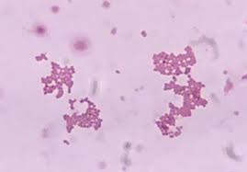
Veillonella spp.
1-Veillonella spp. Gram-negative cocci bacteria .
2- plentiful on the tongue and dental plaque of humans.
3-They are well adapted to the oral environment because they use lactic acid produced by streptococci and other oral bacteria.
4-Like many groups of anaerobic bacteria, members of the genus Veillonella have not been thoroughly studied.
5-Some species are part of the normal biota of the mouth, the gastrointestinal tract, and the urogenital tract of humans and other animals.

Slide 11
2-Class Bacilli
1-The class Bacilli is very large but includes only two orders, Bacillales and Lactobacillales.
2- These include genera representing endospore-forming rods and cocci, and non-spore forming rods.
1-Order :Bacillales
Family :Bacillaceae
The largest family in the order Bacillales.
The genus Bacillus
1- contains endospore-forming, chemoheterotrophic rods that are usually motile with peritrichous flagella.

Slide 12
2-Members of this genus are aerobic or facultative and catalase positive.
3-Many species of Bacillus are of considerable importance. They are the source of the antibiotics : bacitracin, gramicidin, and polymyxin.
4- B. cereus can cause food poisoning.
*-Bacillus subtilis
A-Bacillus subtilis is the type species for the genus, is the most well-studied Gram-positive bacterium.
B-It is a facultative anaerobe that can use nitrate as a terminal electron acceptor or perform mixed acid fermentation with lactate, acetate, and a cetoin as major end products.
C-It is nonpathogenic and a great model organism for the study of gene regulation, cell division, quorum sensing, and cellular differentiation.

Slide 13
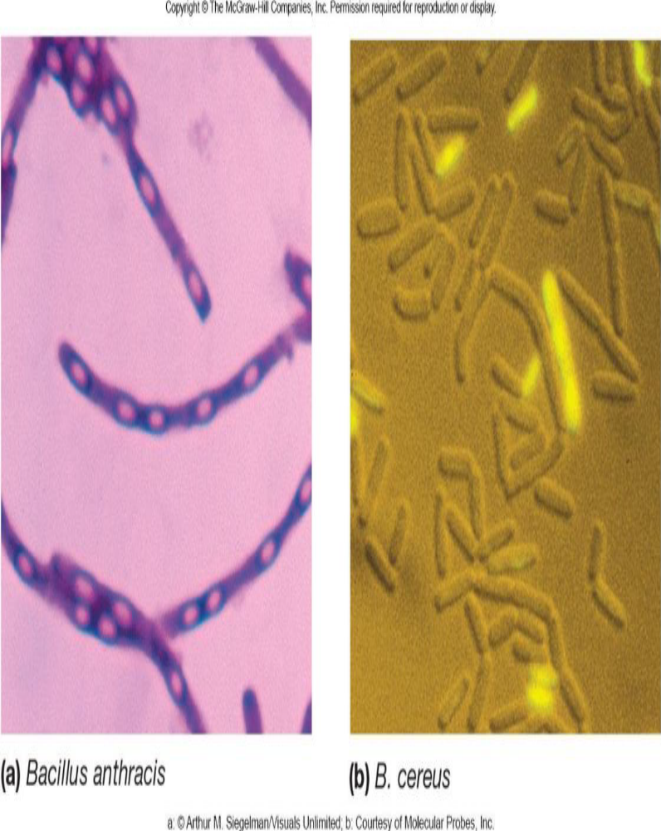
Scientific classification
Domain :Bacteria
Phylum: Firmicutes
Class: Bacilli
Order: Bacillales
Family :Bacillaceae
Genus :Bacillus
Species :B. subtilis

Slide 14
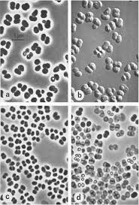
Sporosarcina
1-Sporosarcina is distinguished genus in order Bacillales it is one of five genera in the family Panococcaceae, and it contains the only known endospore-forming bacterium that has a coccoid rather than rod shape.
2-S. ureae is particularly interesting because it is tolerant of very alkaline condition(up to pH:10) ,which it creates when it degrades urea to CO2 and NH3 .Interestingly, it is easily isolated from agricultural soils on which animals frequently urinate.

Slide 15
Family :Staphylococcaceae
1-Facultative anaerobic, non-motile, Gram-positive cocci .Usually form irregular clusters.
2-Staphylococci are normally associated with the skin and mucous membranes of warm-blooded animals. 3-They are responsible for many human diseases.
4- S. epidermidis is a common skin resident that is sometimes responsible for endocarditis and infections of immune compromised patients with (e.g., wound, surgical and urinary tract infections).
5- S. aureus is the most important human staphylococcal pathogen and causes boils, abscesses, wound infections, pneumonia, toxic shock syndrome, and other diseases.

Slide 16
6-In addition to causing skin and wound infections, S. aureus is a major cause of food poisoning , The most common source is contaminated dairy products. However, because S. aureus is salt tolerant, another important source is sliced luncheon meats.
7-One important virulence factor produced by S. aureus is the enzyme coagulase, which causes blood plasma to clot.
8-Growth and hemolysis patterns on blood agar are also useful in identifying these staphylococci.

Slide 17
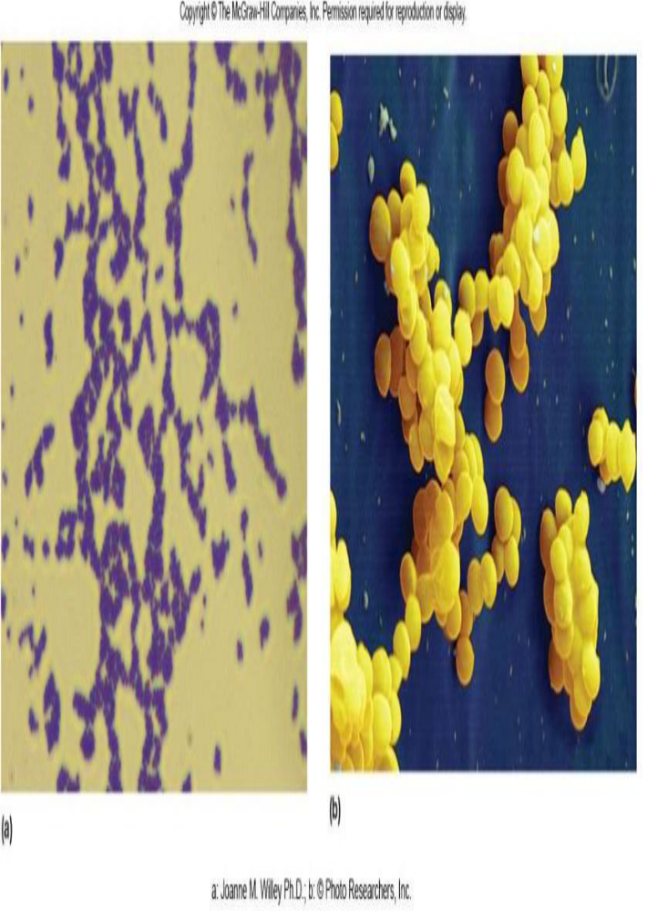
Scientific classification
Domain: Bacteria
Phylum: Firmicutes
Class: Bacilli
Order: Bacillales
Family: Staphylococcaceae
Genus :Staphylococcus
Species: S. aureus

Slide 18
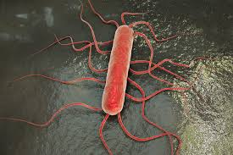
Family :Listeriaceae
1-The family Listeriaceae includes two genera: Brochothrix and Listeria.
2-Brochothrix spp. are most commonly found in meat but are not pathogenic.
3-Listeria is the medically important genus in this family. It contains short rods that are facultative anaerobic, catalase positive, and motile by peritrichous flagella. In addition to aerobic respiration, these microbes ferment glucose mainly to lactate.
4-Listeria spp. are widely distributed in nature, particularly in decaying matter. L. monocytogenes is a pathogen of humans and other animals, and causes listeriosis, an important food-borne infection.

Slide 19
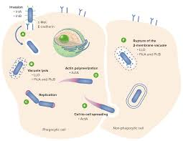
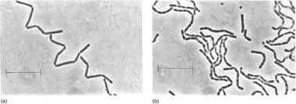
L. monocytogenes and Brochothrix sp.

Slide 20
Phylum :Firmicutes
2-Class :Bacilli
2-Order Lactobacillales
1-Many members of the order Lactobacillales produce lactic acid as their major or sole fermentation product and are sometimes collectively called Lactic Acid Bacteria (LAB); Streptococcus, Enterococcus, Lactococcus, Lactobacillus.
2-all members of this group do not form endospore.
3- are usually non motile.
4- they depend on sugar fermentation for energy.
.

Slide 21
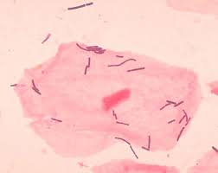
5-They lack cytochromes and obtain energy by substrate-level phosphorylation, rather than by electron transport chain and oxidative-phosphorylation.
6- Nutritionally, they are fastidious many vitamins ,acids, purines, and pyrimidines must be supplied because of their limited, biosynthetic capabilities.

Slide 22
Family :Lactobacillaceae
1-Lactic acid bacteria usually are categorized as facultative an aerobes, but can be considered
aerotolerant.
2-The largest genus in this order is Lactobacillus with about 100 species.
3-Lactobacilli include rod and some coccobacilli.
4-All lack catalase and cytochromes.
5-They produce lactic acid as their main or sole fermentation product.

Slide 23
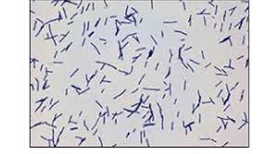
6-They grow at a pH slightly acidic between 4.5 and 6.4.
7-They found in dairy products and many other meat, water, sewage, beer, fruits.
8- Lactobacillus are part of normal flora of the human body, in particular important normal vaginal flora.

Slide 24
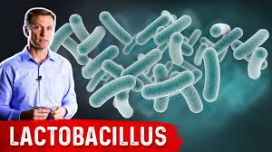
Scientific classification
Domain :Bacteria
Phylum :Firmicutes
Class: Bacilli
Order :Lactobacillales
Family :Lactobacillaceae
Genus :Lactobacillus (Type genus)

Slide 25


