Slide 1
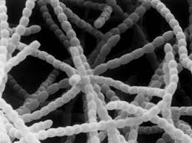
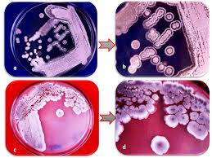
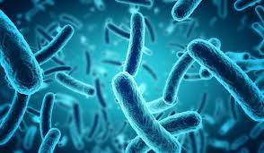
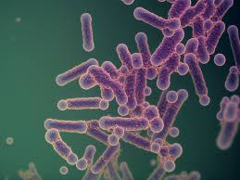
بسم الله الرحمن الرحيم
Lecture-9
2025
Bacterial taxonomy
Phylum :Actinobacteria

Slide 2
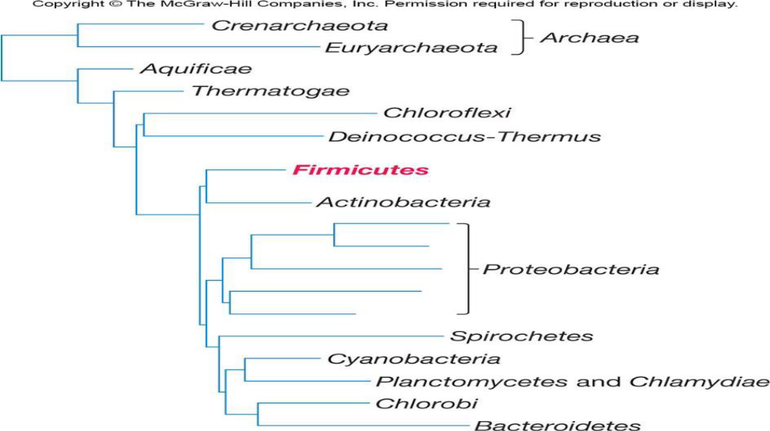
figure : demonstrates the phylogenetic position of phylum Actinobacteria

Slide 3
Phylum: Actinobacteria
The High G + C% Gram-Positive Bacteria were grouped in this phylum
16S rRNA evidence of this phylum shows :
One class only (Actinobacteria), classified into
five subclasses distributed to
six orders with
14 suborders categorized to
44 families.
Phylum Actinobacteria Consists of Actinomycetes and their high G + C % Gram-positive relatives.
Actinomycetes =the class Actinobacteria

Slide 4
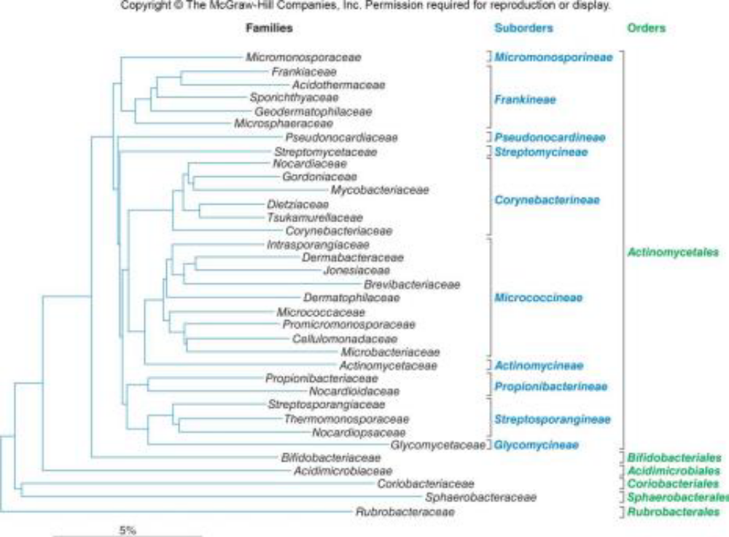

Slide 5
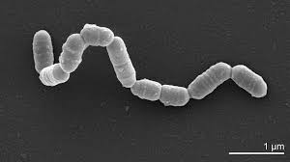
Class: Actinobacteria(Actinomycete)
Actinomycete is a heterogenous group of bacteria that are gram-positive, filamentous, with a branched growth pattern. They grow in mycelium or extensive colonies.
Though they are bacteria, they are a group of unique organisms that can be studied separately.

Slide 6
General Properties of the Actinomycetes
❖ They are prokaryotic and range in size from 1-2 µm in diameter.
❖Gram-positive, aerobic bacteria that produce filamentous cells called hyphae and differentiate into asexual spores.
❖ Adapt to climates similar to fungi.
❖ Source of most currently used antibiotics.
❖ Also produce metabolites that are anticancer, anti helminthic, and immunosuppressive.
❖ Complex life cycle.
❖ Most are not motile and motility is restricted to flagellated spores

Slide 7
.
They are mostly aerobic organisms but some can be anaerobic as well.
They inhabit the soil commonly, but may be found in marine environments as well.
The mycelium of actinomycetes sometimes breaks apart to form coccoid or rod-shaped colonies.
Many members of actinomycetes are also known to form spores with the sporangia or spore case being found on the aerial hyphae.
They are easily infected by bacteriophages, and the phages that infect actinomycetes are called actinophages.
The members of the group range from harmless bacteria to pathogenic species to extremely useful antibiotic producers.

Slide 8
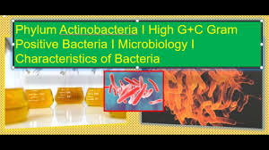
They sometimes resemble the hyphae of fungal species; however, they can be distinguished on the basis of size, the actinomycetes being much smaller.
They are able to act on different soil substrates such as less degradable insects and plant polymers such as cellulose, chitin and hemicellulose.

Slide 9
Uses
They produce a compound called geosmin, that gives the earthy colour to the soil.
They can degrade complex molecules such as cellulose and chitin.
The genus Frankia is capable of biological nitrogen fixation.
The genus Streptomyces is highly useful as it can produce antimicrobial compounds such as streptomycin, streptothricin and actinomycin.
The actinomycetes are an important source of antimicrobial compounds, they produce up to two-thirds or about 61% of the total antibiotics

Slide 10
Characteristics 0f cell wall
According to peptidoglycan structure and sugar content other than N acetylglucosamine and N-acetylmuramic acid, cell wall types were characterized.
The major components of the peptidoglycan (PG) of Actinomyces viscosus are N-acetylglucosamine, N-acetylmuramic acid, alanine, glutamic acid and lysine in the ratio 1:1:4:4:4 respectively.
cell walls consisting of a large external peptidoglycan layer threaded with teichoic acids and lipoteichoic acids.

Slide 11
Life Cycle of Actinomycetes
Involves development of filamentous cells (hyphae) and spores .Hyphae can form branching network .Aerial mycelium can form.
Reproduction
Actinomycetales have 2 main forms of reproduction: spore formation and hyphae fragmentation. During reproduction, Actinomycetales can form conidiophores, sporangiospores, and oidiospores. In reproducing through hyphae fragmentation, the hyphae formed by Actinomycetales can be a fifth to half the size of fungal hyphae, and bear long spore chains

Slide 12
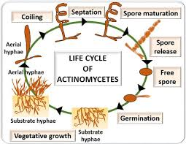

Slide 13
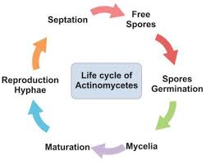

Slide 14
Ecological Significance of Actinomycetes
Widely distributed in soil .
Play important role in mineralization of organic matter.
Most are free living, but a few are pathogens .
Order Actinomycetales is divided into 10 suborders Suborder Actinomycineae This group contains one family Actinomycetaceae with five genera Irregularly shaped, Gram-positive rods ,swelling, club shapes, or other deviations from normal rod morphology. Aerobic or facultative metabolism.

Slide 15
Genus: Actinomyces
❖ Straight or slightly curved rods and slender filaments with true branching : may have swollen, clubbed, or clavate ends (with one end thicker than the other)
❖ Facultative or obligate aerobes (require CO2).
❖ Peptidoglycan contains lysine and not diaminopimelic acid or glycine.
❖ Normal inhabits of oral mucosa.
Cause of lumpy jaw in cattle, ocular infection, actinomycoses, and periodontal diseases in humans.

Slide 16
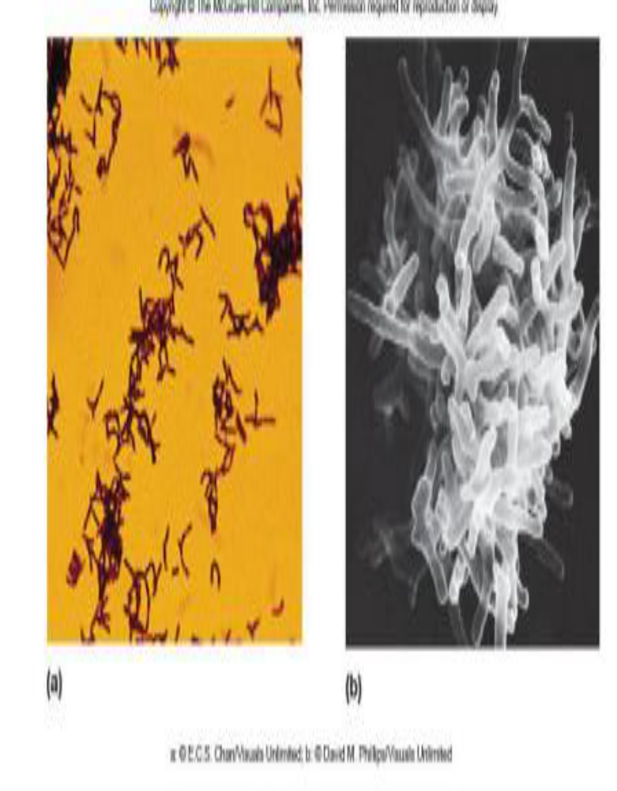
Genus Actinomyces
Scientific classification
Domain Bacteria
Phylum Actinobacteria
Class Actinobacteria
Order Actinomycetales
Suborder: Actinomycineae
Family Actinomycetaceae
Genus Actinomyces

Slide 17
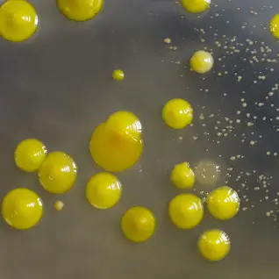

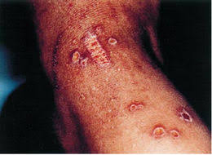
Suborder :Micrococcineae
Genus :Micrococcus
❖ Aerobic, catalase-positive rods that occur in pairs, tetrads, or irregular clusters.
❖ Usually non motile
❖ Often pigmented yellow, orange, or red
❖ Widespread in soil, water, and on human skin
M.luteus skin infection
❖ Does not undergo morphological differentiation

Slide 18
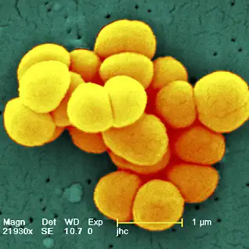
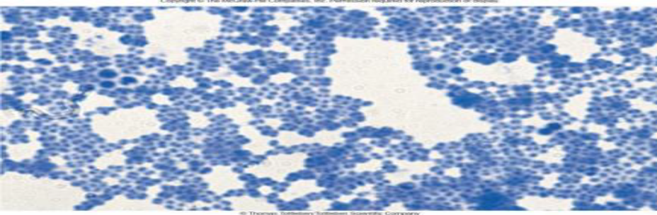
Suborder :Micrococcineae
Scientific classification
Domain :Bacteria
Phylum :Actinobacteria
Class :Actinobacteria
Order :Actinomycetales
Suborder :Micrococcineae
Family :Micrococcaceae
Genus :Micrococcus

Slide 19
Suborder :Corynebacterineae
This suborder has seven families with many known genera such as ; Corynebacterium , Mycobacterium , Nocardia
Genus :Corynebacterium
❖ Aerobic and facultative, catalase positive . Straight to curved rods with tapered ends and club shaped
❖ After snapping division bacteria often remain partially attached resulting in palisade arrangements of cells
❖ Form metachromatic granules.
❖ Cell walls have meso-diaminopimelic acid.
❖ Some are harmless soil and water saprophytes.
❖ Many are animal and human pathogens.
Most common and important genus is C. diphtheriae which causes diphtheria in human.

Slide 20
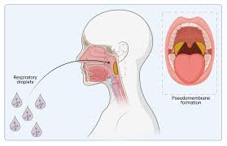
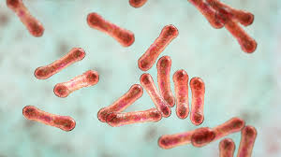
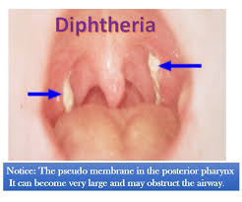
Corynebacterium diphtheriae

Slide 21
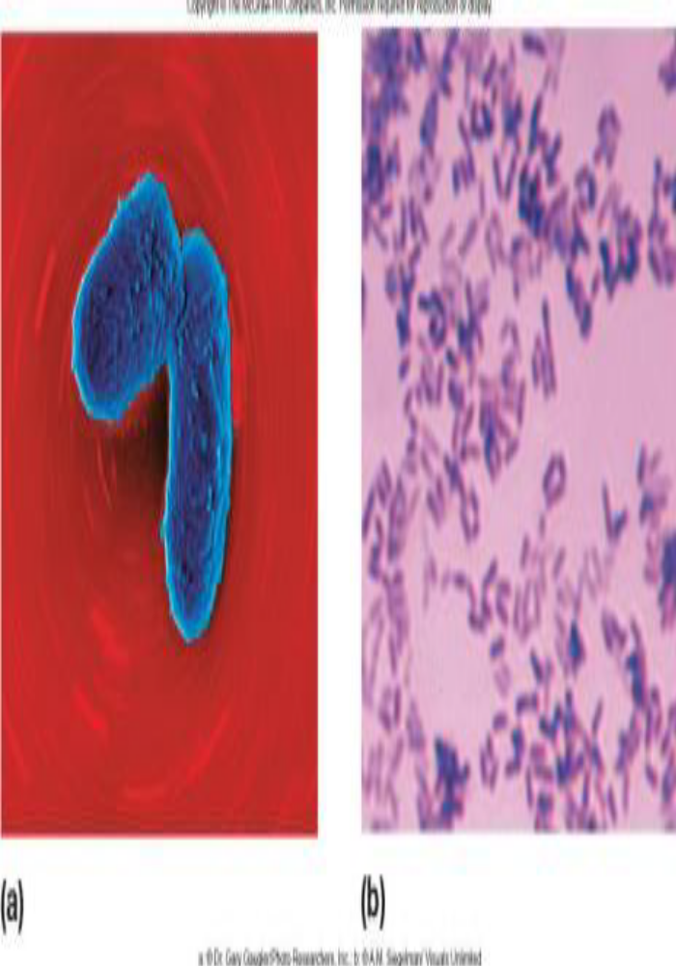
Genus :Corynebacterium
Scientific classification
Domain: Bacteria
Phylum :Actinobacteria
Class :Actinobacteria
Order :Actinomycetales
Suborder :Corynebacterineae
Family :Corynebacteriaceae
Genus :Corynebacterium
Species :C. diphtheriae

Slide 22


