Slide 1

مراجعة كيمياء الكروم
مختبر الكيمياء اللاعضوية
مرحلة ثالثة
(التعليم الالكتروني )
صباحي / أ.م. ايناس زهير الهاشمي
م.م. يسرى جليل
مسائي / ا.م. بيادر فاضل

Slide 2
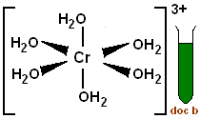
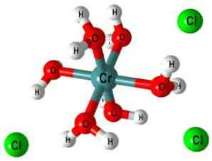
Chemistry of Chromium
(1)Detecting chromium triple ion (Cr³⁺)
Chromium triple solution can be prepared by dissolving CrCl₃.6H₂O in water to form green solution resulted from the complex ion [Cr(H₂O)₆]³⁺
CrCl₃.6H₂O + H₂O → [Cr(H₂O)₆]³⁺
Dark green solid Green clear solution
This aqueous ion has an acidic characteristic in water:
[Cr(H₂O)₆]³⁺ + H₂O ↔ [Cr(H₂O)₅OH]²⁺ + H₂O⁺ pKa= 4

Slide 3
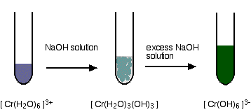
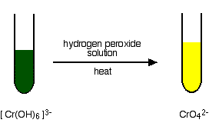
This ion can be abbreviated into (Cr³⁺) to carry out the following detections:
Put (10) drops of [Cr(H₂O)₆]³⁺ solution in a test tube, add (2) drops of NaOH, and observe the change, then add more of the detector and observe the change.
then add (2) drops of H₂O₂ , observe the change, and heat the solution for 5 mints. and observe the change and write down your notices after each addition.

Slide 4
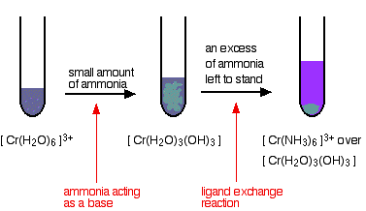
2) Put (10) drops of [Cr(H₂O)₆]³⁺ in a second test tube, add (2) drops of NH₄OH, then add more of the a ammoni conc. and observe the change. Write down your notices in both cases.

Slide 5
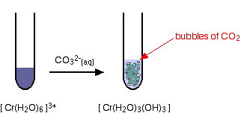
ملاحظة : هذا الكشف يكون للعنصر الذي له ايونيين M²⁺ ,M³⁺
؟
3) Put (10) drops of [Cr(H₂O)₆]³⁺ in a third test tube, add (2) drops of Na₂CO₃ or K₂CO₃, observe the change and write down your notices.

Slide 6
Question:
1) What is the distinguishable detection of Cr(III) Ion?
2) Write all question ?
عزيزي الطالب هذة الاسئلة مع المعادلات للكشوف هي اهم شيء للامتحان

Slide 7
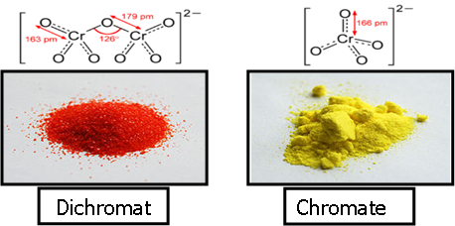
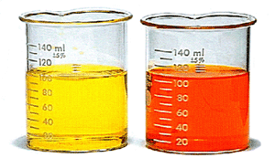
(2) Detecting anions
A balance happens for the both anions Chromate (yellow) and Dichromate (orange) when a quantity of K₂CrO₄ and K₂Cr₂O₇ is dissolved in water, according to the following equation:
CrO₄^{2–}_{(aq)} + 2H⁺ ↔ Cr₂O₇^{2–} _{(aq)} + H₂O _{(L)}
Chromate and dichromate solutions are prepared by dissolving Na₂CrO₄, Na₂Cr₂O₇, K₂CrO₄, or K₂Cr₂O₇ in water to compose a yellow or orange solution.

Slide 8
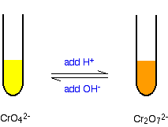
ملاحظة: استخدم هذه الصورة دائما في حل معادلات التوازن بين ايوني الكرومات وثنائي كرومات
Put (10) drops of in a test tube and add (2) drops of NaOH, observe the change and write down your notices.
Put (10) drops of in a second test tube, add (2) drops of HCl, observe the change and write down your notices.
Put (10) drops of in a third test tube, add (2) drops of Pb(NO₃)₂ or Ba(NO₃)₂, observe the change and write down your notices.
Put (10) drops of in a test tube, add (2) drops of NaOH, observe the change and write down your notices.
Put (10) drops of in a second test tube, add (2) drops of HCl, observe the change and write down your notices.
Put (10) drops of in a third test tube, add (2) drops of Pb(NO₃)₂ or Ba(NO₃)₂, observe the change and write down your notices.

Slide 9
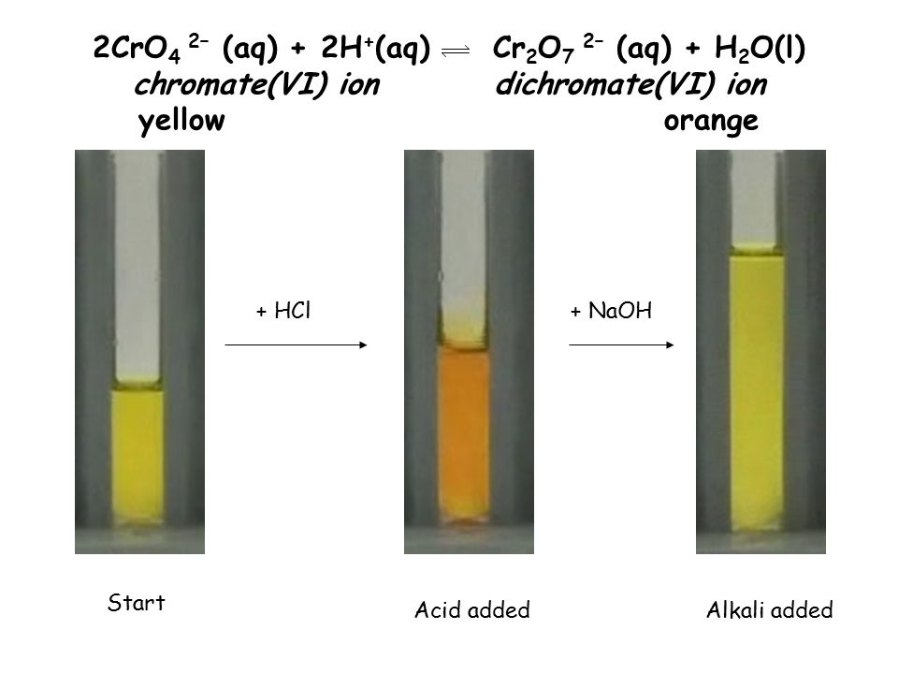
? ? ?
اعطي صيغ كيميائية للكل؟

Slide 10
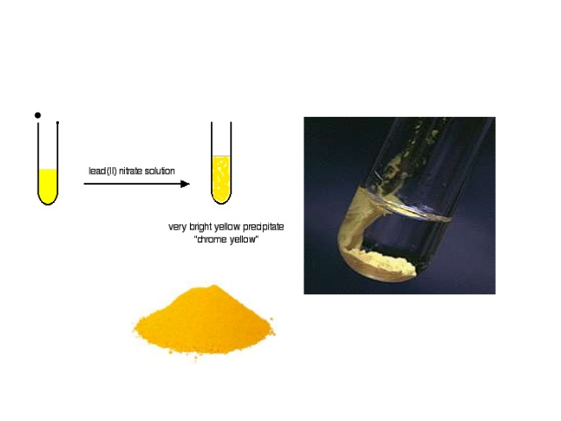
فسر الصورة التالية ؟

Slide 11
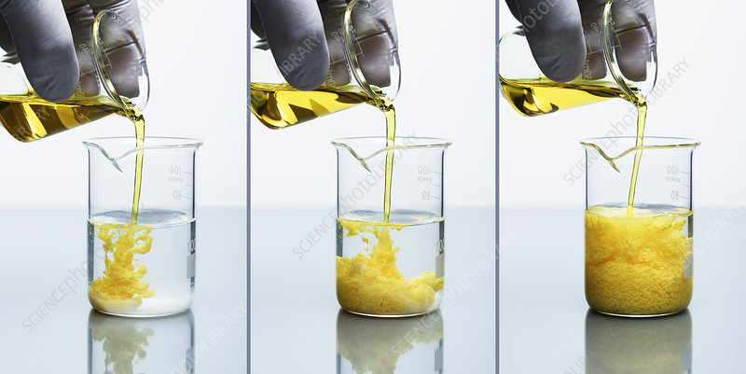
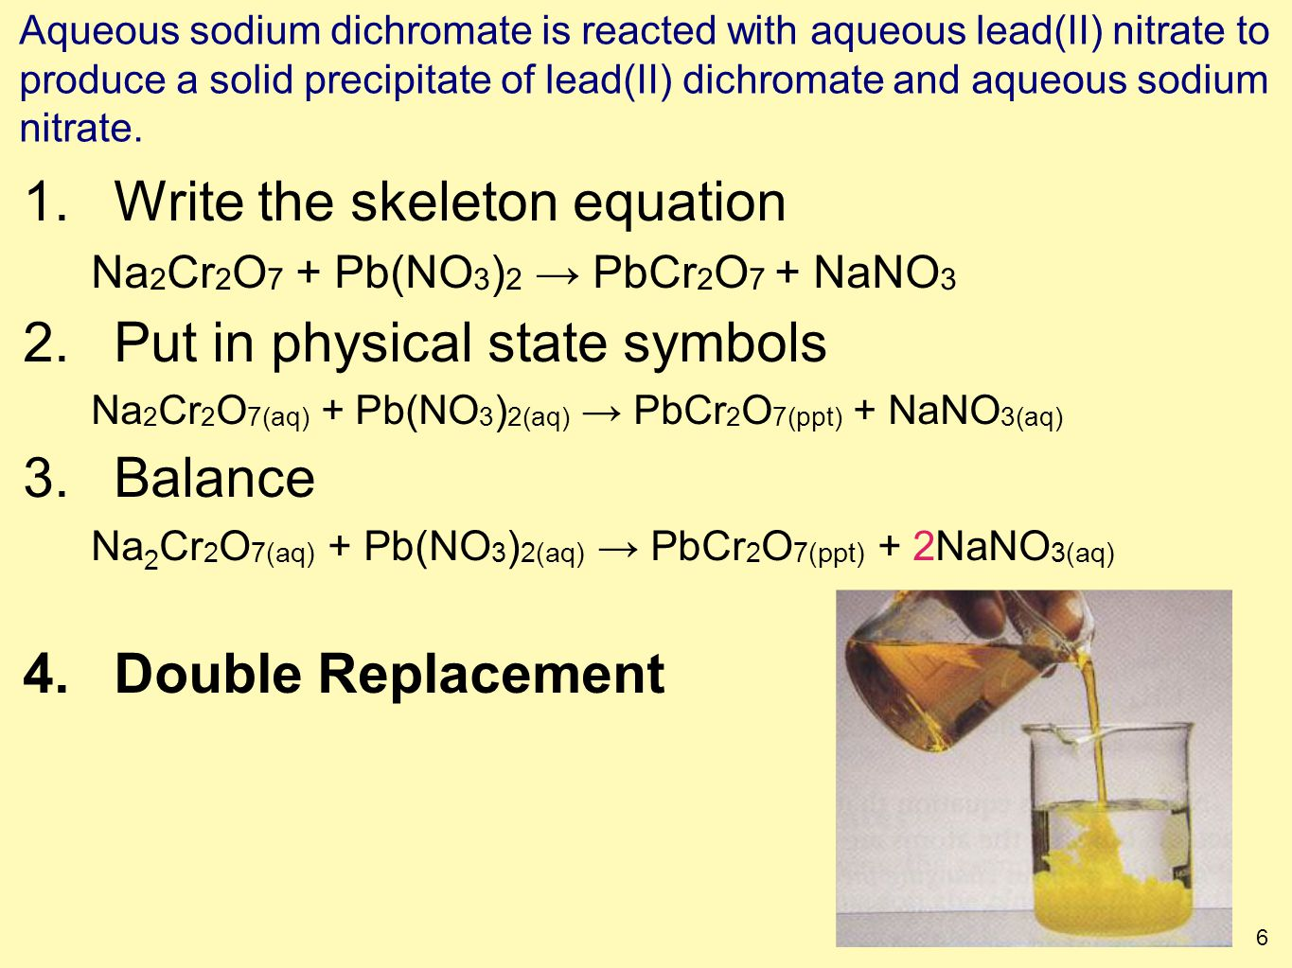

Slide 12
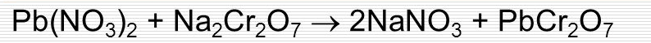
Questions
What happen when HCl is added to ion chromate ?
What happen when NaOH is added to ion chromate ?
What happen when Pb(NO₃)₂ or Ba(NO₃)₂ is added to ions?
This equation TRUE OR FALS?

Slide 13
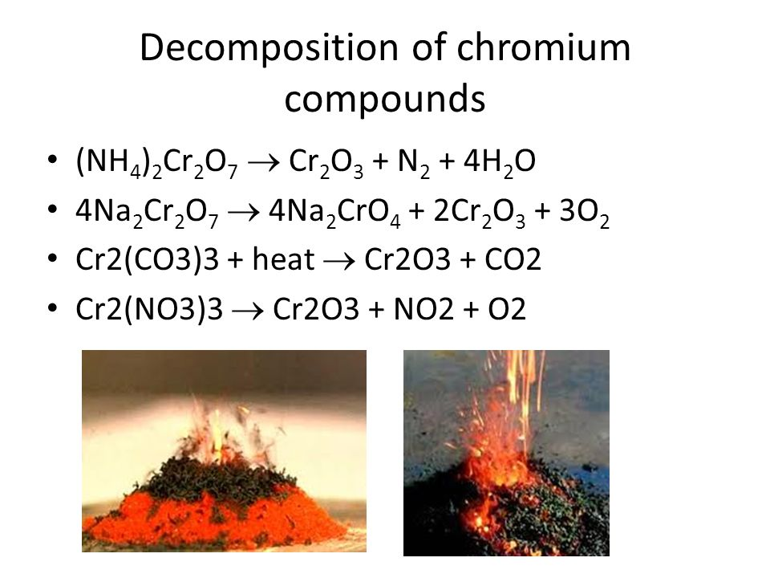
(3)Preparation of Chromic Oxide (Cr₂O₃)
Gradually put (1) gr of the orange ammonium dichromate (NH₄)₂Cr₂O₇ in a crucible on flame, very soon you will see flash at each addition. Pull the flame away from the bowl when the flashing happens.
Return the flame again after flash end until the dichromate quantity is decomposed.
Reaction Equation:
(NH₄)₂Cr₂O₇ ⎯ φ→ N₂ ↑ + Cr₂O₃ + 4H₂O

Slide 14
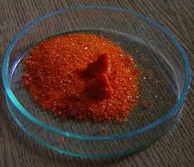
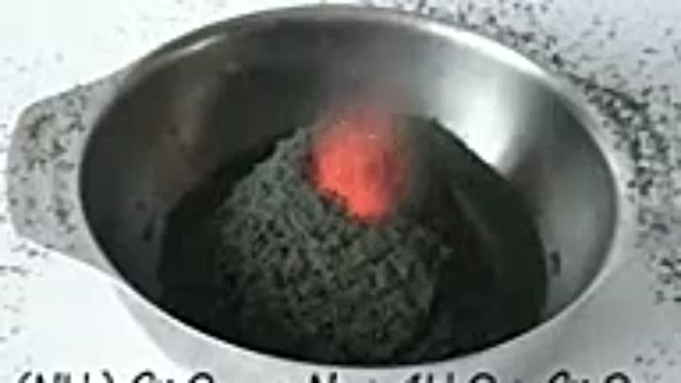
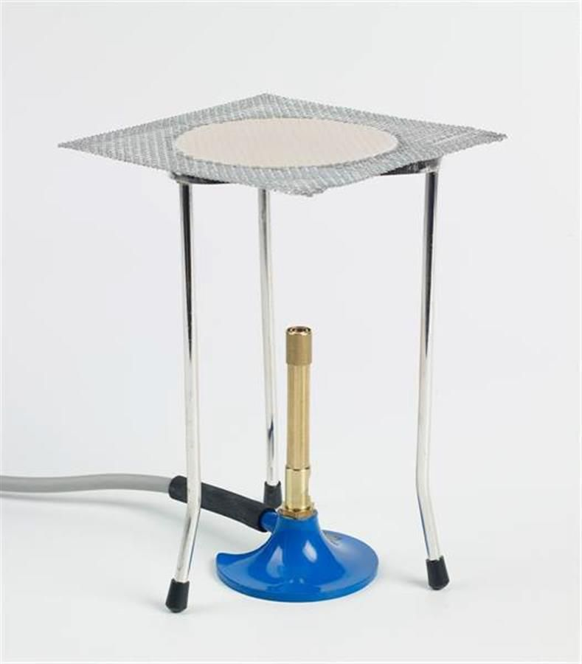
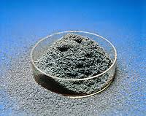

Slide 15
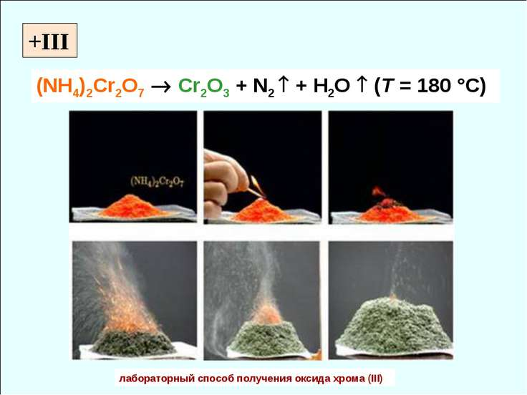
لاحظ طريقة الاشعال او الحرق ودرجة الحراة ؟
ماهو المصدر الحراري الذي استخدم في المختبر ؟؟؟؟

Slide 16
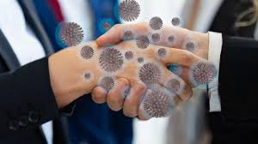
Questions:
What the flash means?
Calculate the product percentage.
Why dichromate is gradually added?
What is the principle of this reaction?

