Slide 1
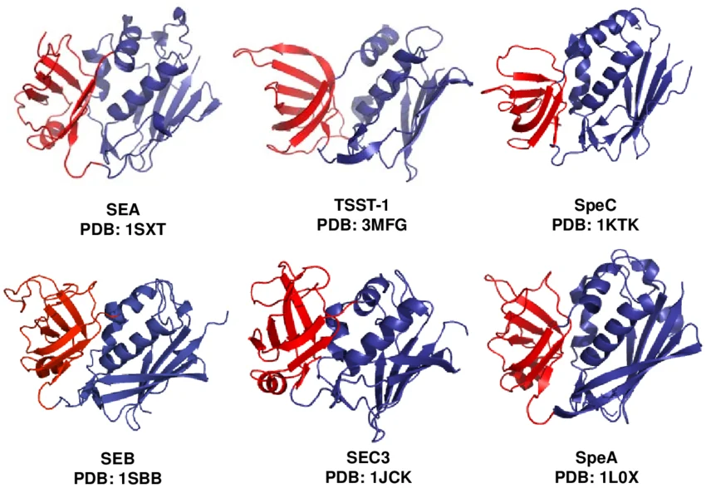
Superantigens

Slide 5
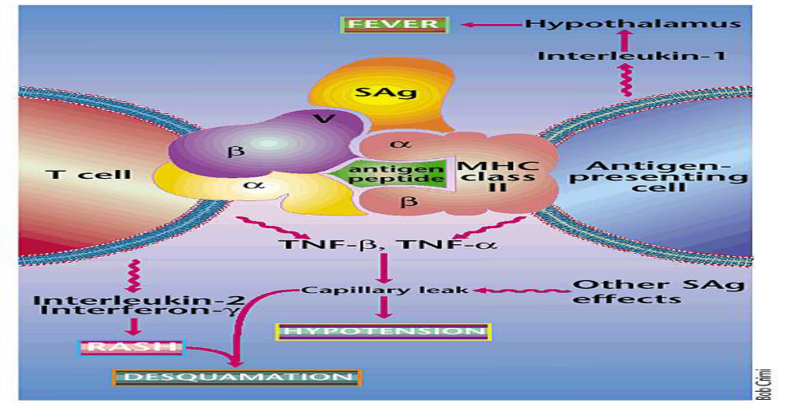
Mechanism of superantigens

Slide 7
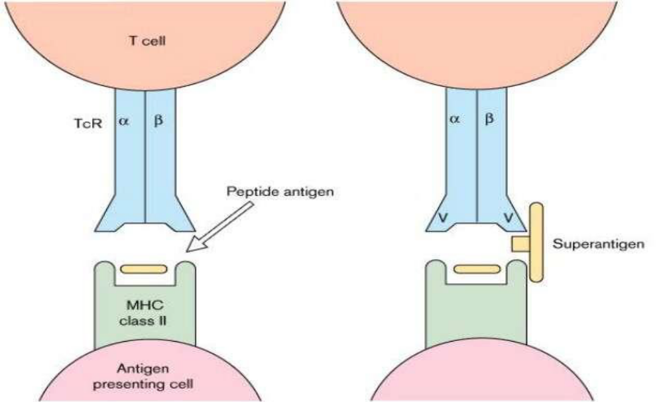
Normal antigen and superantigen

