Slide 1


Slide 2

Republic of Iraq
Ministry of Higher Education
And Scientific Research
Mustansiriyah university
College of Science
By
Assistant lecturer
Ali Shreef Maktoof
B.Sc.2015
Master 2022
Light Emitting Diode (LED)

Slide 3
Light Emitting Diode (LED)
A light emitting diode (LED) is a two-lead semiconductor light source. It is a p–n junction diode, which emits light when activated. When a suitable voltage is applied to the leads, electrons are able to recombine with electron holes with in the device, releasing energy in the form of photons. This effect is called electroluminescence, and the color of the light (corresponding to the energy of the photon) is determined by the energy band gap of the semiconductor.

Slide 4
Synopsis:
To explain the theory and the underlying principle behind the functioning of an LED Brief History:
The first known report of a light-emitting solid-state diode was made in 1907 by the British experimenter H. J. Round.
In 1920s, Russian Oleg Vladimirovich Losev independently created the first LED, although his research was ignored at that time.

Slide 5
In 1972, M. George Craford, Holonyak's former, invented the first yellow LED and 10x brighter red and red-orange LED_{s}.
Shuji Nakamura from Japan demonstrated the first high brightness blue LED based on InGaN. The 2006 Millennium Technology Prize was awarded to Nakamura for his invention.

Slide 6
Work Principle
The P-N junction emits light when electrical energy is applied to it.
The charge carriers recombine in a forward-biased P-N junction as the electrons cross from the N-region and recombine with the holes in the P-region.

Slide 7
Free electrons are in the conduction band of energy levels, while holes are in the valence energy band. Thus the energy level of the holes will be lesser than the energy levels of the electrons. some portion of the energy must be dissipated in order to recombine the electrons and the holes. This energy is emitted in the form of heat and light.

Slide 8
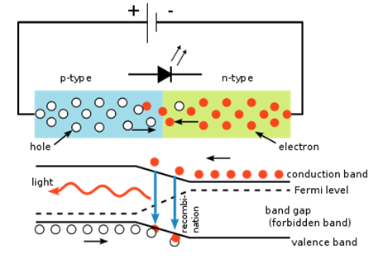
Fig.(1)The inner workings of an LED, showing circuit (top) and band diagram (bottom)

Slide 9
Physics:
The LED consists of a chip of semiconducting material doped with impurities to create a p-n junction.
current flows easily from the p-side, to the n-side, but not in the reverse direction. Charge carriers electrons and holes flow into the junction from electrodes with different voltages. When an electron meets a hole, the electron falls into a lower energy level and releases energy in the form of a photon.

Slide 10
The wavelength and color of LED
The wavelength of the light emitted, and thus its color, depends on the band gap energy of the materials forming the p-n junction. In silicon or germanium diodes, the electrons and holes usually recombine by a non-radiative transition, which produces no optical emission, because these are indirect band gap materials. The materials used for the LED have a direct band gap with energies corresponding to near-infrared, visible, or near-ultraviolet light.

Slide 11
LED development began with infrared and red devices made with gallium arsenide.

Slide 12
Applications:
LED have a lot of applications. Following are few examples.
• Devices, medical applications, clothing, toys
• Remote Controls (TVs, VCRs)
• Lighting
• Indicators and signs
• Optoisolators and optocouplers
• Swimming pool lighting

Slide 13
Advantages of using LEDs
• LEDs produce more light per watt than incandescent bulbs; this is useful in battery powered or energy-saving devices.
• LEDs can emit light of an intended color without the use of color filters.
• The solid package of the LED can be designed to focus its light.
• LEDs are ideal for use in applications that are subject to frequent on-off cycling.

Slide 14
• LEDs, being solid state components, are difficult to damage with external shock.
• LEDs can have a relatively long useful life.
• LEDs light up very quickly.
• LEDs can be very small and are easily populated onto printed circuit boards.

Slide 15
Disadvantages:
LEDs are currently more expensive.
LED performance largely depends on the ambient temperature of the operating environment.
LEDs must be supplied with the correct current.
LEDs do not approximate a "point source" of light, so they cannot be used in applications needing a highly collimated beam.

Slide 16


