Slide 1
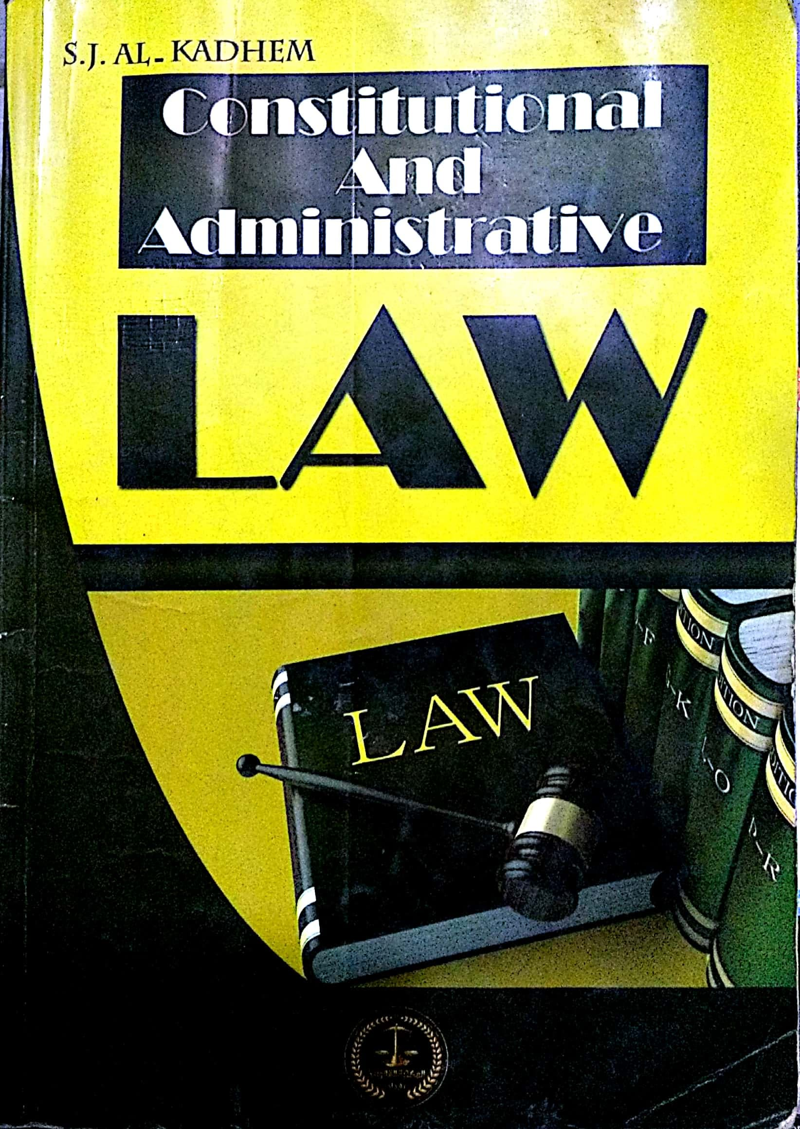
College of Law, Mustansiriyah U. Second Year Course in legal English 2017-2018
Textbook: Constitutional and Administrative Law
Author: S. J. Al-Kadhem
Instructor:
Asst. Lect. Rania Adnan Aziz

Slide 2
College of Law, Mustansiriyah U. Second Year Course in legal English
2017-2018
Instructor: Asst. Lect. Rania Adnan Aziz
Lecture 04 Part One: Constitutional Law
Chapter Two
Sources of Constitutional Law
Sources of Constitutional Law
Legislation
Conventions
Judicial Interpretation

Slide 3
College of Law, Mustansiriyah U. Second Year Course in legal English
2017-2018
Instructor: Asst. Lect. Rania Adnan Aziz
Lecture 04 Part One: Constitutional Law
Chapter Two
Sources of Constitutional Law
Introduction
The constitution is a selection of rules which define the framework of a government and postulate how it ought to operate. These rules are also a reflection of the socio-political aims of the state and society.
These rules may be legal or non-legal. The former (legislation, judicial interpretation and convention) are the most important; the latter are supplementary.

Slide 4
College of Law, Mustansiriyah U. Second Year Course in legal English
2017-2018
Instructor: Asst. Lect. Rania Adnan Aziz
Lecture 04 Part One: Constitutional Law
Chapter Two
Sources of Constitutional Law
1- Legislation; i.e. rules made by the legislature, are the first and foremost source of the constitution. A constitution does not necessarily contain the detailed rules governing the working of the institutions of a government. For example, rules of election, establishment of government departments or the organization of the judiciary may nor be included in the constitution. They are usually found in ordinary laws made by the legislature within the limits fixed by the constitution itself.

Slide 5
College of Law, Mustansiriyah U. Second Year Course in legal English
2017-2018
Instructor: Asst. Lect. Rania Adnan Aziz
Lecture 04 Part One: Constitutional Law
Chapter Two
Sources of Constitutional Law
2- Judicial interpretation
In certain countries courts and judges are empowered to interpret law; i.e. expose its meaning in disputed cases. Being part of the law, the constitution itself may be interpreted by them.
The aim of the this interpretation is to expound the true meaning of the constitutional provisions and to decide whether certain legislative enactments are compatible with them.

Slide 6
College of Law, Mustansiriyah U. Second Year Course in legal English
2017-2018
Instructor: Asst. Lect. Rania Adnan Aziz
Lecture 04 Part One: Constitutional Law
Chapter Two
Sources of Constitutional Law
Some of the important/new words and terms that appear in this section
postulate
integral
supplemented
legislation
non-legal
elections
legislature
judicial
provision
empowered
interpretation

