Slide 1
بسم الله الرحمن الرحيم

Slide 2
Projection Theory
Projection is a method to represent 3D object into 2D plane(paper…etc.)
Object View
Therefore we need at least two or three views (except for especial cases)

Slide 3
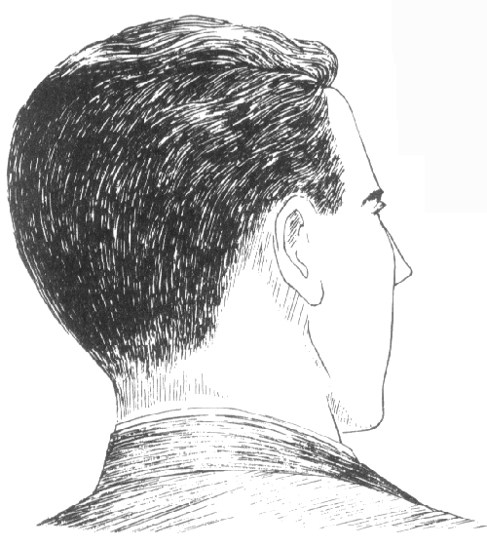
Projection Parameters
The projection theory is based on 3 variables:
1- center sight point(station point)
2- Line of sight
3- Plane of projection
Therefore
View is the image on a projection plane

Slide 4
Lines of sight
Lines of
Parallel Projection
Convergent Projection
Play
Play

Slide 5
Lines of sight
The parallel projection lines can be normal (orthogonal) or oblique to the plane of projection.
We consider only a parallel and orthogonal projection, i.e. orthographic projection.
Orthogonal
متعامد
Oblique
مائل
Play
Play

Slide 6
Views
View depends on a relative orientation between an object and a plane.
Normal
عمودى
Rotation
دوران
Tilting
امالة
Multiview Drawing
Multiview
Axonometric Drawing
Axonometric

Slide 7
PROJECTION CLASSIFICATION
Projections
Parallel
Convergent
Orthogonal
Oblique
Multiview
Axonometric
Perspective
Drawing
Pictorial drawing
Multiview drawing

Slide 8
PROJECTION METHOD
Perspective
Parallel
Oblique
Orthographic
Axonometric
Multiview

Slide 9
MULTIVIEW DRAWING

Slide 10
Projection Methods
First angle method
European countries
- ISO standard
First
quadrant
Third angle method
- Canada, USA - Japan, Thailand
Opaque
Planes
مستويات غير شفافة
Transparent
Planes
مستويات شفافة
Third
quadrant

Slide 11
First angle system
(Opaque planes)
Third angle system
(transparent planes/glass box)

Slide 12
First angle system
Third angle system
Cutting
Line
Folding
line

Folding
line

Cutting
Line

Slide 13
Arrangement of Views
TOP VIEW
First angle method
LEFT SIDE VIEW
FRONT VIEW
FRONT VIEW
LEFT SIDE VIEW
Third angle method
TOP VIEW

Slide 14
Symbols of Projection Systems
First angle system
Third angle system
d
1.7d
2.2d

