Slide 1
Welcome to Essay and Research Writing Class 1ST Lecture

Slide 2
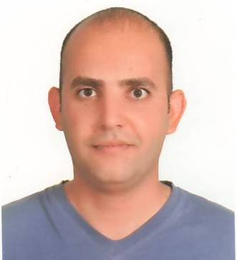
I am Ghassan Jabbar. I will be your teacher for this class.
MY TIPS/
TRY TO memorize new vocabulary. At least 20 words per day.
Arabic is different from English. SO, TRY TO think in English in order to write proper sentences.
Grammar is the structure of any language. So, try to memorize most of the structures or rules.
Do mistakes as possible as you can to learn English.
Try to communicate in English with your classmates.
Don’t be shy.

Slide 3
ACADEMIC WRITING
Grammar and Types of Sentences
A Paragraph; Parts and Types of a Paragraph.
Parts of an Essay; Introduction, Body, and Conclusion.
Narrative, Descriptive, Reflective and Argumentative Essays
Practicing the writing in the class by doing some activities. Also, doing assignments (at home).
Learning how to write a Research Paper; Documentation, summarizing, paraphrasing, etc.
Writing an essay at home (assignment) and writing a paper at the end of the year.

Slide 4
Writing a Research Paper
We are going to learn and recognize the idea of the research paper and how to write a proper one.
Also, we will deal with the concepts of documentation and plagiarism.
You are going to write at least one paper choosing any topic to practice the points we will study in this course.
You may share writing several papers during this term. Team work.

Slide 5
The Curriculum of the Class
I will teach you:
Essay and Letter Writing by L.G. Alexander.
Writing Academic English by Oshima, A. & Hogue, A.
Some chosen essays from different sources.
Some movies and clips to have fun with writing.
My way is communicative, that is to say, we will work together as groups and I will be your partner not your teacher. DO NOT PANIC.

Slide 6
Any questions

Slide 7
ACTIVITY 1
Write five things you share with your partner and five things you hate.
e.g.
I have white car and my friend does too.
I don’t like people who smoke indoor. Likewise, my friend hates this kind of people.
And so on.

Slide 8
The Aims of The Activity
This activity focuses on the idea of team work, sharing knowledge and breaking the ice among students as well as their teacher.
Also, Students may share some information about their lives after they write some sentences.
In addition, they are going to practice writing skill in the class to realize that this is about writing, not anything else.

Slide 9
ACTIVITY 2
Freewriting
I want you to start writing whatever you like to write about. Don’t worry about the spelling mistakes or grammatical ones.
You have only ten minutes. You should hurry.
Do not review your composition.
When you finish, you have to submit your papers.
Writing is done to be read. Do not think that the article is done only for you.

