Slide 1
Compound Sentences: Joining Them 3rd Lecture

Slide 2
Compound Sentences: Joining Them by Correlative Conjunctions
They are used to join words, phrases and clauses.
1. Either…..or…….
2. Neither…….nor……
3. Both…..and…….
4. Not only……..but also…….
5. Whether………or…….
Note/ Each of the pair of words should be followed by a word of the same grammatical form.
1. Either…..or…..
It is used to indicate alternatives.
e.g. Soya can be used in either fish feed or chicken feed.
Tom will buy either car or bike.

Slide 3
2. Neither……nor…..
It is used to indicate negative alternatives.
e.g. Soya is dangerous to neither humans nor animals.
I will take neither Karen nor Stephen.
3. Both……and…..
It indicates addition.
e.g. Soya protein is used in both meat and fish products.
My mother will take both Ali and Nada.
4. Not only …..but also….
It emphasizes the addition.
e.g.
This house is not only the biggest but also the most beautiful.
5. Whether…..or……
It indicates condition.
e.g. Whether he is here or he is not here, we will vote to the new chairman.
I will marry her, whether you are right or not.

Slide 4
Joining Compound Sentences: FAN BOYS

Slide 5
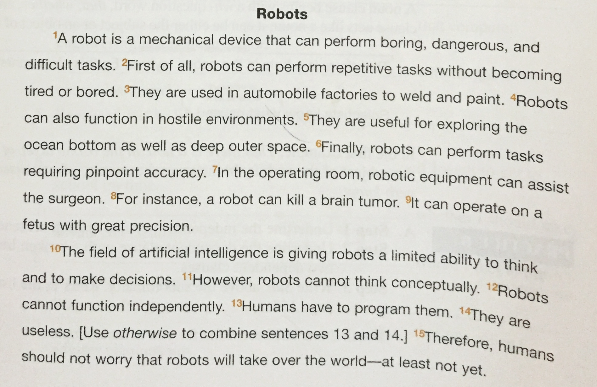

Slide 6
All the sentences are simple, so try to join them by using FAN BOYS.

