Slide 1
Complex Sentence: (2) The Noun Clauses 5th Lecture

Slide 2
The Complex Sentence: (2) The Noun Clauses
A noun clause is a subordinate clause. It has a subject and a verb, and can be used like a noun or noun phrase, either as a subject or an object.
1. As a Subject
e.g. His discovery was important.
noun phrase
(his discovery is a noun phrase, it is the subject of the sentence)
e.g. What he discovered was important.
noun clause
(what he discovered is a noun clause. It is the subject of the sentence. It has a subject he and a verb discovered)

Slide 3
2. As an Object
e.g. People believed his discovery.
noun phrase
(his discovery is a noun. It is the object of the verb believed)
e.g. People believed what he discovered.
noun clause
(what he discovered is a noun clause. It is the object of the verb ‘believed’)
Noun clauses are introduced by the following words:
When, Where, Why, How, Who/Whom, What, which, whose, whether, if, that.

Slide 4
A. Noun Clauses beginning with a question word
1. What did he discover?
I don’t know what he discovered.
2. When did he discover it?
I’m not sure when he discovered it.
3. Where did he discover it?
It is not known where he discovered it.
4. How did he discover it?
I’m not certain how he discovered it.
5. Who is Atchison?
I don’t know who he is.
6. Whose discovery is that?
It is not certain whose discovery that is.
7. What did he discover?
What he discovered is not certain.

Slide 5
B. Noun Clauses beginning with whether or if
1. Will it work?
He wonders whether it will work.
He wonders if it will work.
2. Did they believe him?
I don’t know whether they believed him.
I don’t know if they believed him.
C. Noun Clauses beginning with that
1. The world is round.
We know that the world is round.
2. The world is round.
We know the world is round.
(the word that is omitted in spoken English)

Slide 6
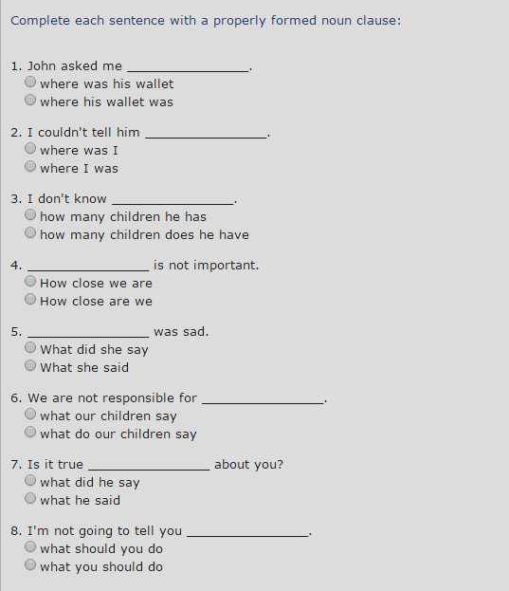
Activity

Slide 7
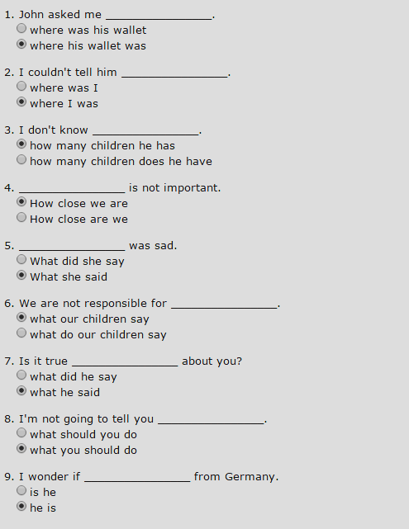
Answers

Slide 8
Complex Sentence: (3)The Adverb Clauses 6th Lecture

Slide 9
The Complex Sentence: (3)The Adverb Clauses
An Adverb Clause acts like an adverb; that is, it tells where, when, why, and how. An adverb clause begins with a subordinator, such as
when, while, because, since, as soon as, although, even though, if, so, before, after, etc.
It can come before of after an independent clause.
Although women in the United States could own property, they could not vote until 1920.
A citizen can vote in the United States when he or she is 18 years old.

Slide 10
Adverb Clauses: More about the Subordinators or Subordinating Conjunctions

Slide 11
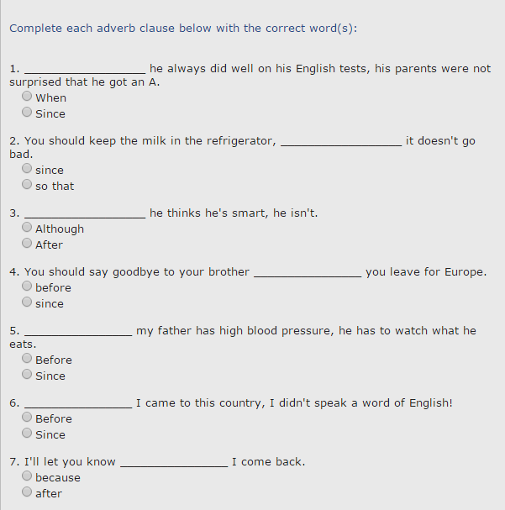
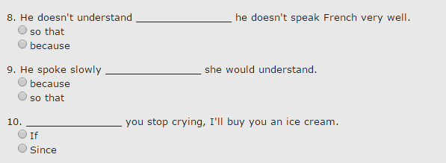
Activity

Slide 12
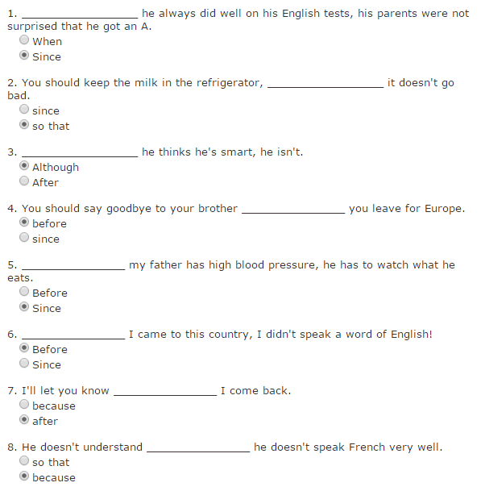
Answers

Slide 13
Adverb Clauses: More Practices

Slide 14
Adverb Clauses: More Practices

Slide 15
