Slide 1
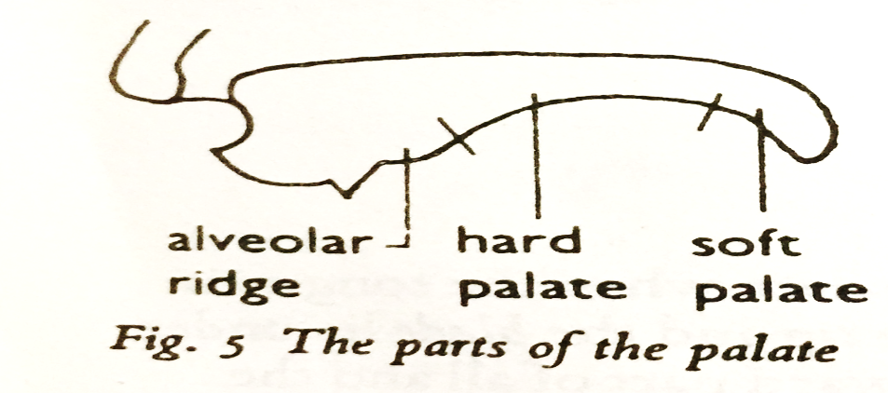
The Palate
The palate forms the roof of the mouth that separates the mouth cavity from the nose.
Parts of the Palate
The soft palate (velum) should have holes forming that function during speech sounds to separate the mouth cavity from the nose.
The hard palate is a thin horizontal bony plate of the skull located in the roof of the mouth. The interaction of the sounds between the tongue and the hard palate is essential in the formation of /s/ and /d/
The alveolar ridge is a hard ridge behind the upper front teeth. It is between the roof of the mouth and the upper teeth.

Slide 2
The Teeth
The teeth are small whitish structures found in the jaw. The teeth are responsible for creating sounds, such as /f/, /v/, etc.
The Lips
The lips can take different positions.
The can be brought firmly together so that they completely block the mouth as when producing sounds like, /p/, /b/ and /m/.
The lower lip can be drawn inwards and slightly upwards to touch the upper front teeth as in the sounds /f/ and /v/.
They can be kept apart either flat or with different amount of rounding, as in producing different kinds of vowels.

Slide 3
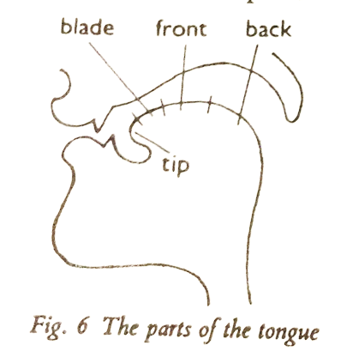
The Tongue
The tongue is the most important organ of speech because it has the greatest variety of movement.
Parts of the Tongue
The tip of the tongue.
The front of the tongue.
The back of the tongue.
The blade.

Slide 5
