Slide 1
Unit Five
Vowel Sounds in English

Slide 2
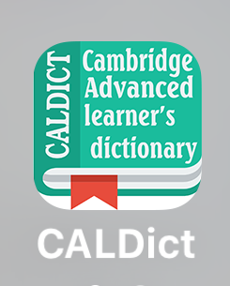
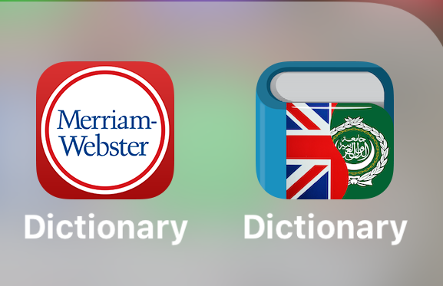
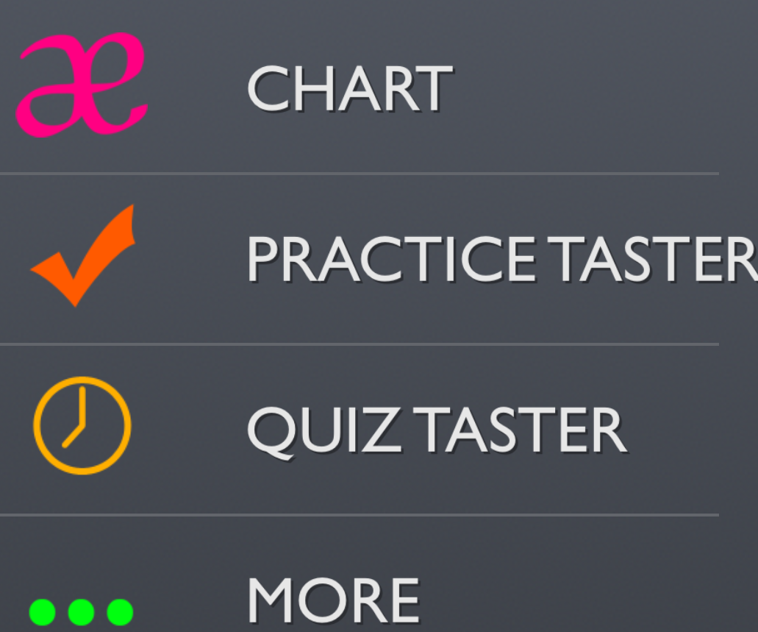

Slide 5
Types of Vowels

Slide 10
