Slide 1
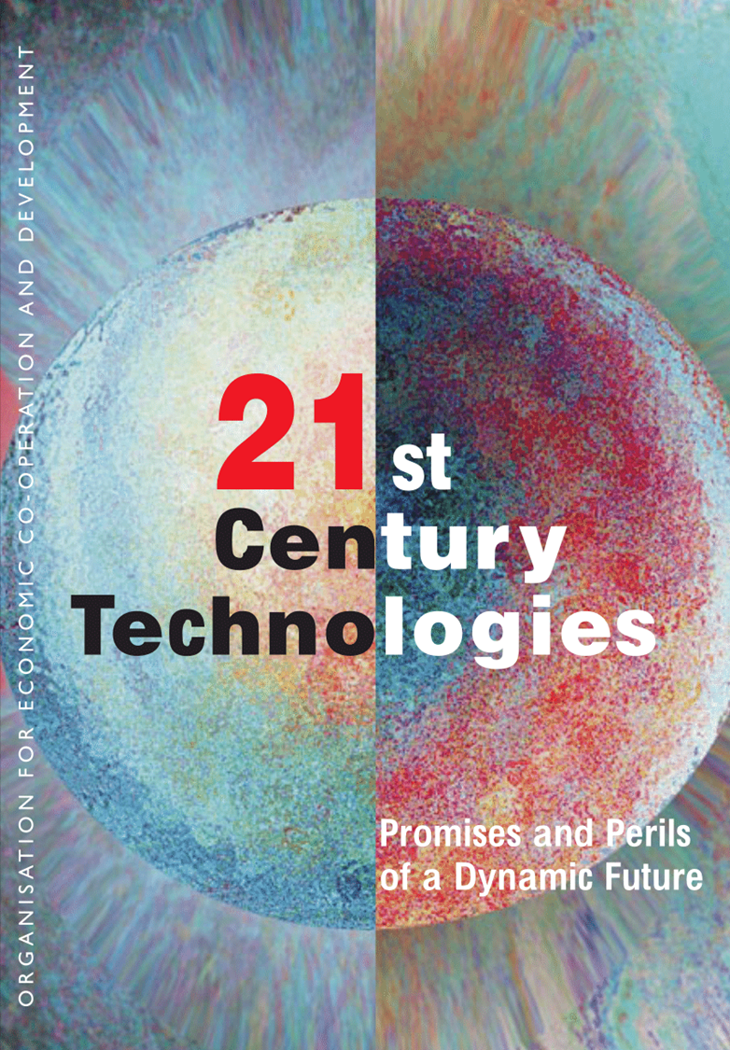
PROMISES AND PERILS OF 21st CENTURY TECHNOLOGIES

Slide 2
This year’s World Economic Forum meeting in Davos, Switzerland, addresses threats to geopolitical stability and human life, and seeks ways to accelerate the design of more effective political, economic, and technological tools to address them.

Slide 6
Among this generation’s most daunting challenges are food, water, and energy shortages; climate change and rising sea levels; and the spread of new, drug-resistant diseases.

Slide 9
Humanity has faced threats to its existence and the health of the planet before, yet we have managed to avoid the apocalypse, or at least postpone it, through ingenuity and invention.

Slide 10
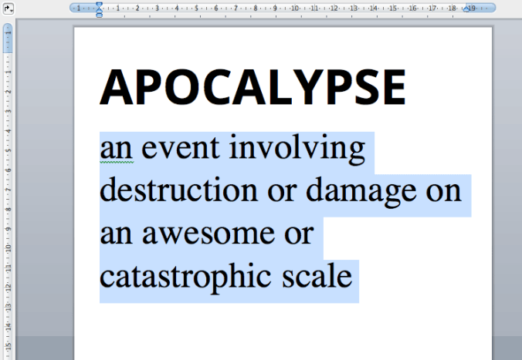

Slide 12
This year’s Davos meeting will offer a glimpse of where the next life-, planet- and economy-saving discoveries and products will come from, and where we should invest our talents and treasure to fuel the next generation of transformative technologies.

Slide 15
An accelerating convergence of the biological, physical, and engineering sciences promises a stunning array of new technological solutions. Imagine a coal-fueled power plant that emits only water and clean air.

Slide 18
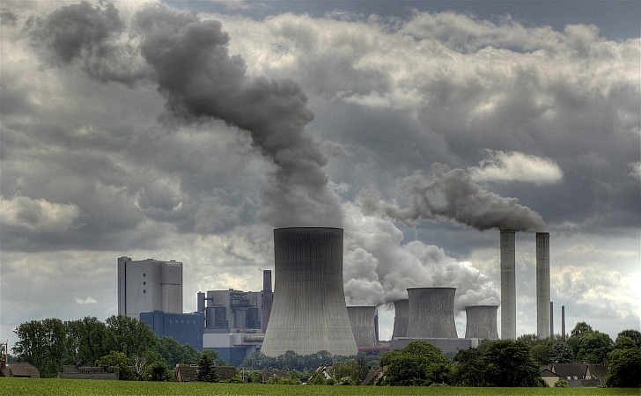

Slide 19
Inside the plant, designer yeast cells transform the carbon dioxide released during the coal’s combustion into raw materials for floor tiles and other construction supplies.

Slide 20
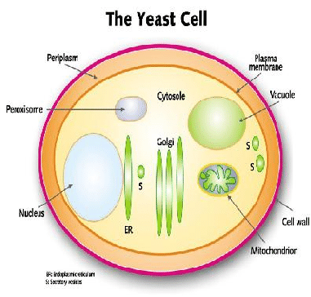

Slide 22
Or imagine a simple and inexpensive urine test that can diagnose cancer, eliminating the need for a surgical biopsy. And, when cancer treatment is needed, its toxic punch hits cancer cells selectively, with far fewer damaging side effects.

Slide 25
Or imagine a future with plentiful food and fuel crops. Through improved seed stocks and more efficient water management, we can have crops that require less water, grow at higher density, and thrive in wider temperature ranges.

Slide 26
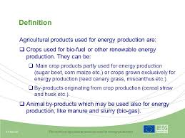

Slide 28
These advances will enable us to feed and provide power – at a lower economic and environmental cost – to the anticipated 2050 population of nine billion people.

Slide 30
Just as the twentieth century’s convergence of physics and engineering transformed our lives, the accelerating convergence of biology and engineering is driving unprecedented discoveries that promise to create another platform for innovation, the rise of new industries, and economic growth.

