Slide 1
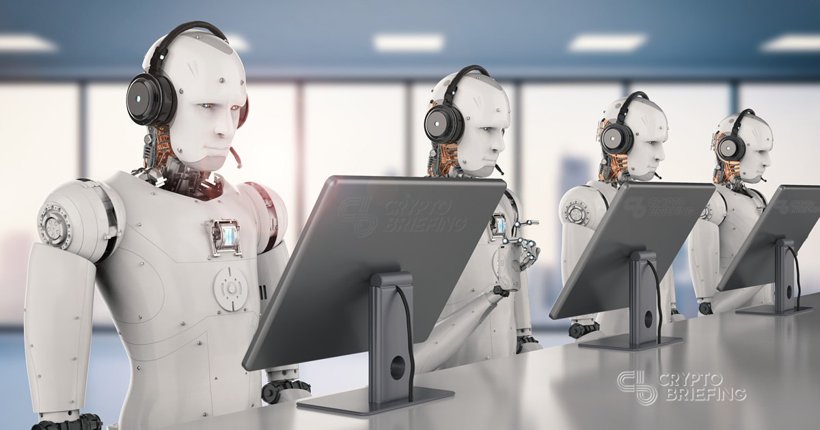
AI and robotics: the opportunities for European businesses

Slide 2
Artificial Intelligence, robotics and big data are revolutionising the way we live and work.

Slide 3
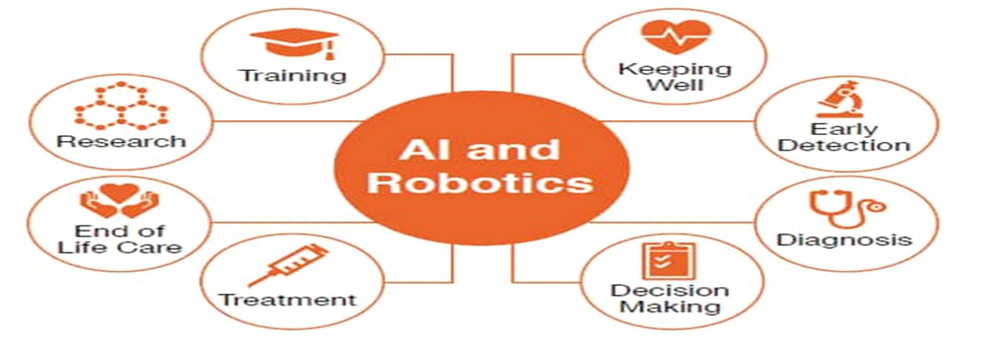

Slide 4
Right now, Artificial Intelligence can be used to automate business processes, production processes and build smart services. In the long run, the power is going to be absolutely transformative. It’s going to change the way we do business.

Slide 5
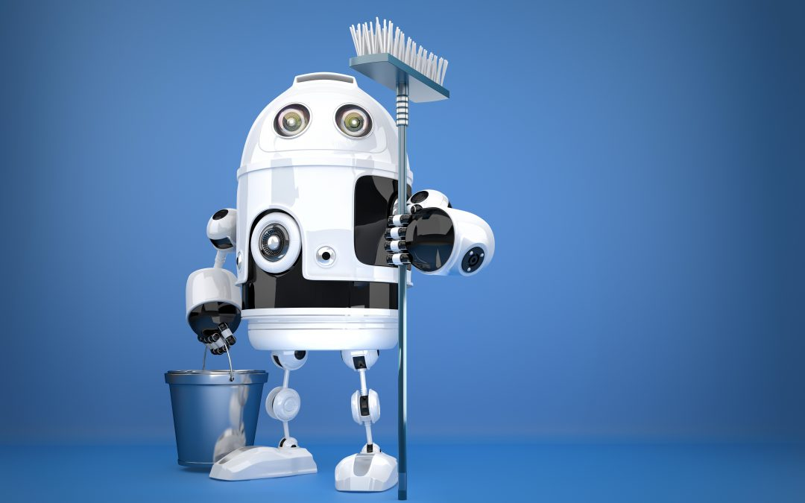
The industry potential is huge and robots can be everywhere. At home, in school, in clinics, in shopping malls.

Slide 6
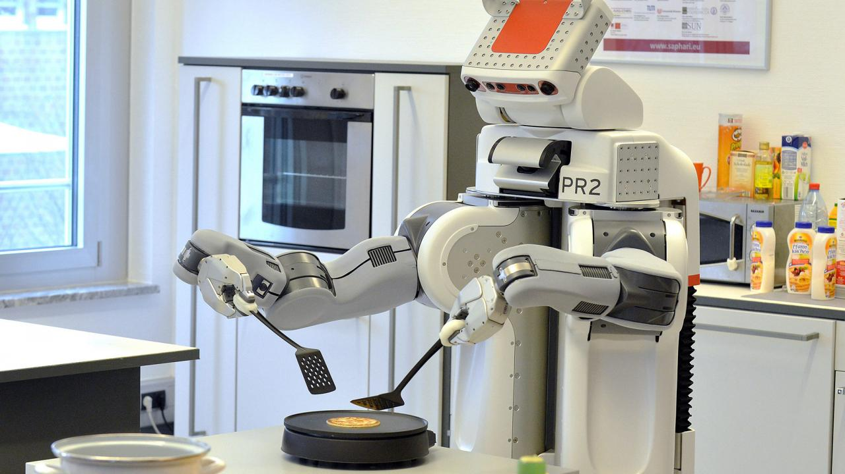

Slide 7
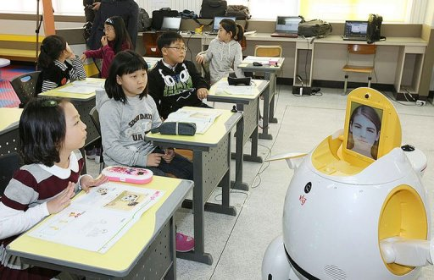

Slide 8
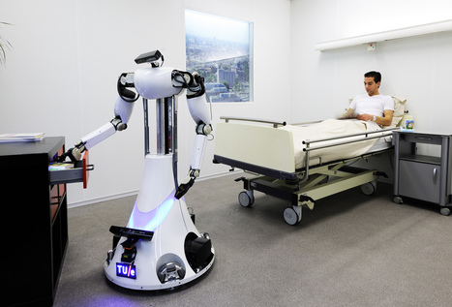

Slide 9
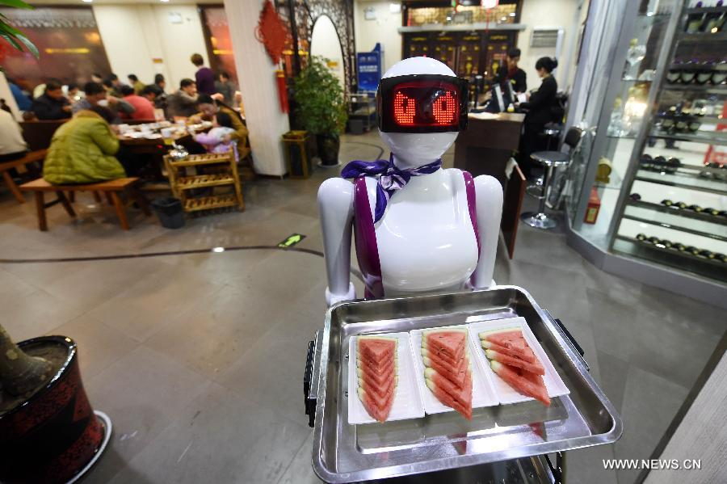
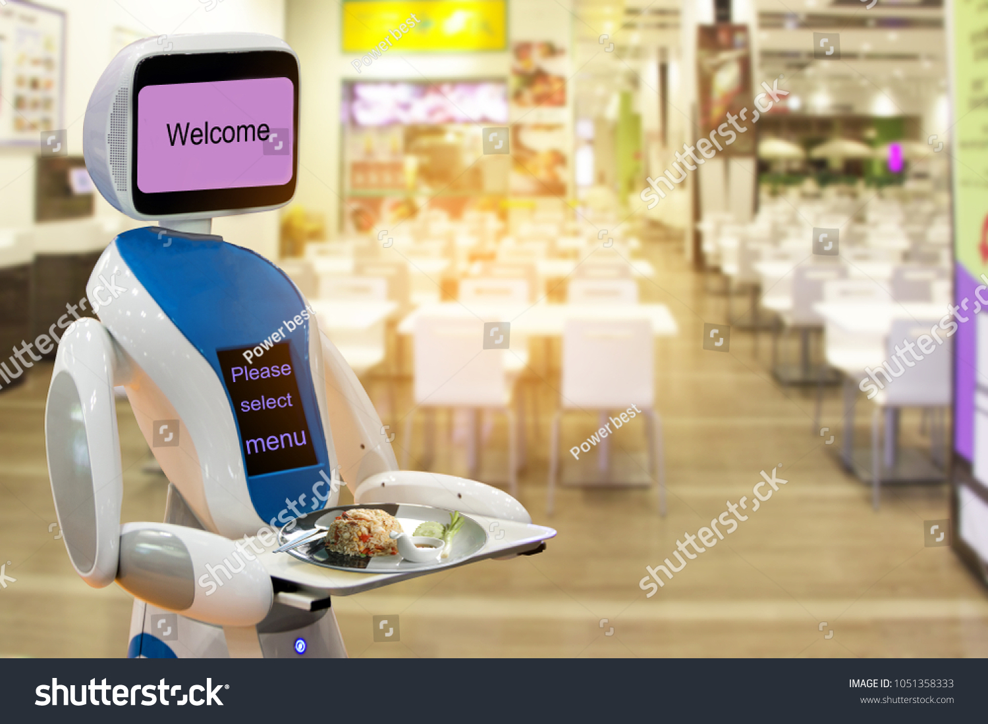

Slide 10
The European Union has just unveiled a new plan to boost investment in AI. The measures also seek to create the right environment to ensure trust in the technology.

Slide 11
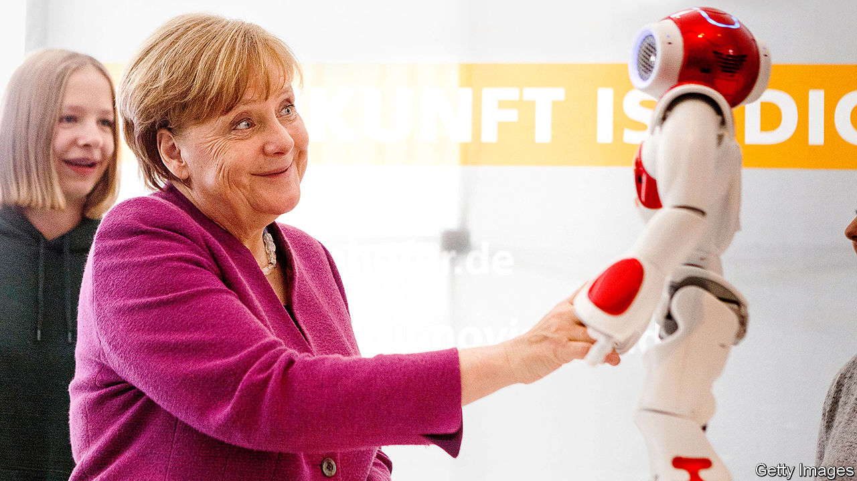

Slide 13
AI has the potential to provide solutions to major challenges, such as treating chronic diseases or anticipating cybersecurity threats, which creates new opportunities for innovative businesses.

Slide 14
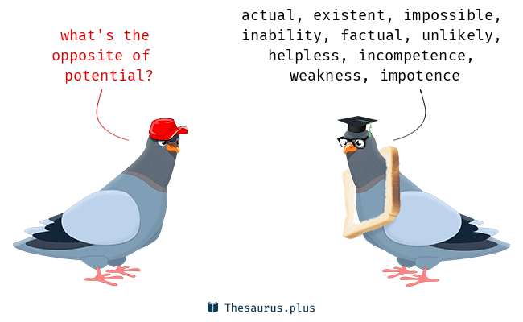

Slide 17
To help people and businesses make the most of AI, in April 2018 [25 April] the EU put forward its plan to boost investment in AI, make more public data available, support the development of digital skills and ensure that an appropriate ethical and legal framework is in place.

Slide 19
Robots are nothing new, but their brains are getting bigger and better. AI technology is one area where the EU wants to see more investment during its next budget period. It hopes to see pledges of at least 20 billion euros per year, through public and private cash.

Slide 21
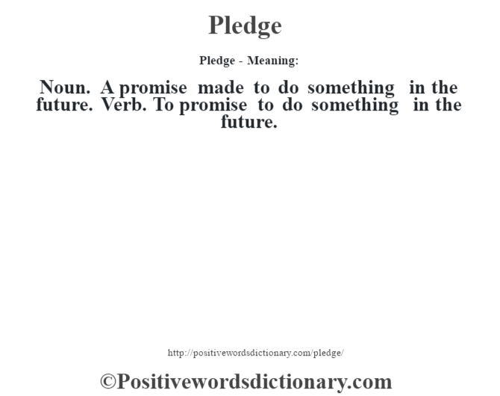

Slide 22
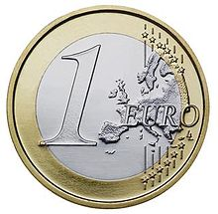

Slide 24
Developers say we shouldn't be afraid of AI, highlighting that it's designed to make our lives easier. But there are sure to be mounting questions about ethics and privacy as its role increases.

Slide 25
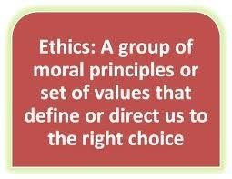

Slide 26
There are a lot of fears surrounding AI and Robotics. Some of the fears are valid, like what’s going to happen to the human workforce as processes become fully automated.

Slide 29
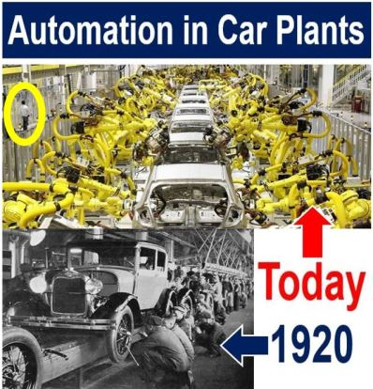

Slide 30
