Slide 1
Discourse And Pragmatics
Represented by: Shahad Osama

Slide 2
Outline of the presentation
1. Definition of Discourse
2. Definition of Pragmatics
3. In pragmatics, four types of context can be found
4. Austin’s ( 1962 ) How to Do Things With Words and Searle’s ( 1969 ) Speech Acts
5. Communication across cultures- pragmatics
6. What is discourse analysis?
7. The relation between pragmatics and discourse analysis
8. Importance of pragmatic and discourse

Slide 3
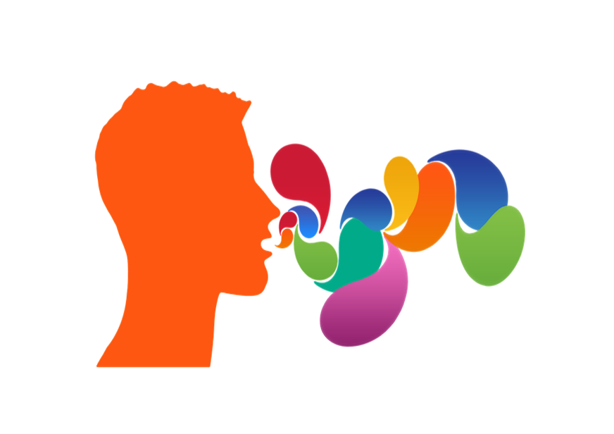
1- Definition of Discourse According to David Crystal
Discourse(n.) is a term used in linguistics to refer to a continuous stretch of (especially spoken) language larger than a sentence.
It is a set of utterances which constitute any recognizable speech event e.g. a conversation, a joke, a sermon, an interview..etc...

Slide 4
2-Definition of Pragmatics According to David Crystal
Pragmatics: is the study of meaning in relation to the context in which a person is speaking or writing. This includes social, situational and textual context.
It is applied to the study of language from the point of view of the users.

Slide 5
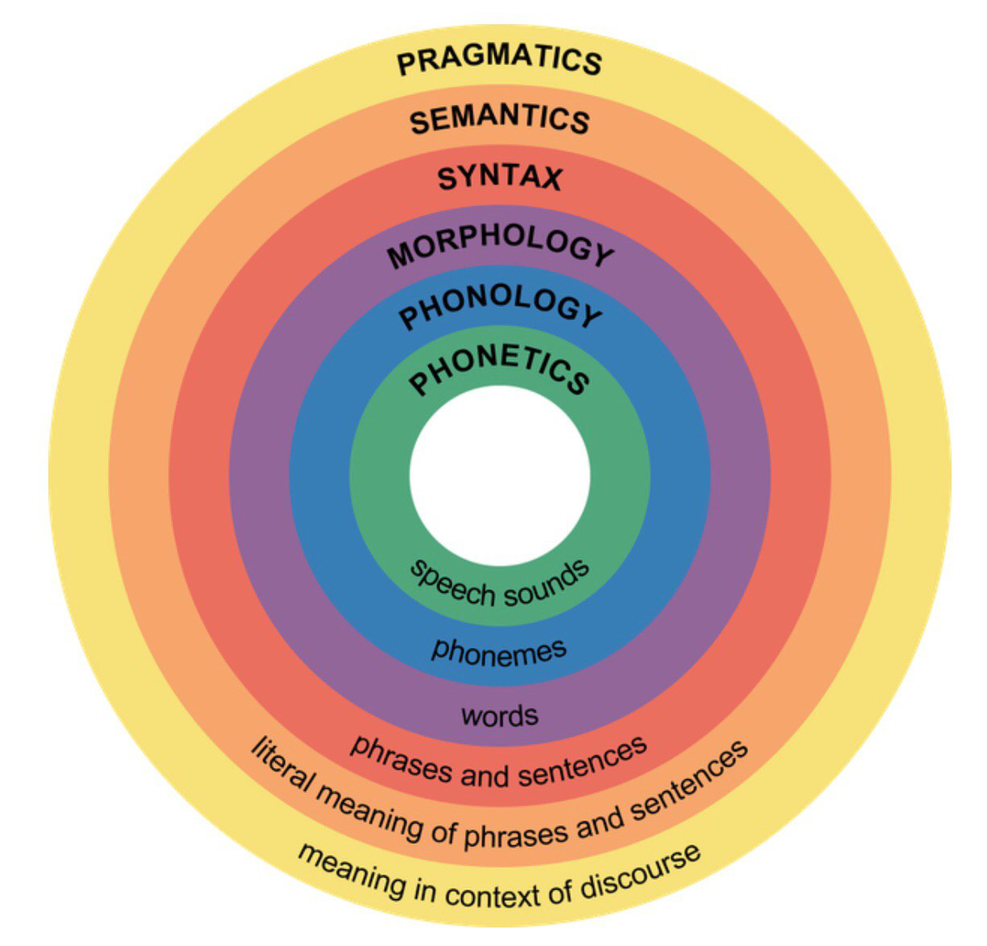
Pragmatics exceeds the basic level of linguistic units (phonemes, morphemes, lexems, sign, sentence…etc.) by including context in its analysis.

Slide 6
3. In pragmatics, four types of context can be found
Physical context location, situation and timing of a given word.
Epistemic context what speakers know the world
Linguistics context what has been already said in the utterance
Social context social relationship among speakers and hearers

Slide 7
Physical context : location, situation and timing of a given word

Slide 8
Epistemic context
Refers to what speakers know about the world

Slide 9
Linguistics context
what has been already said in the utterance

Slide 10
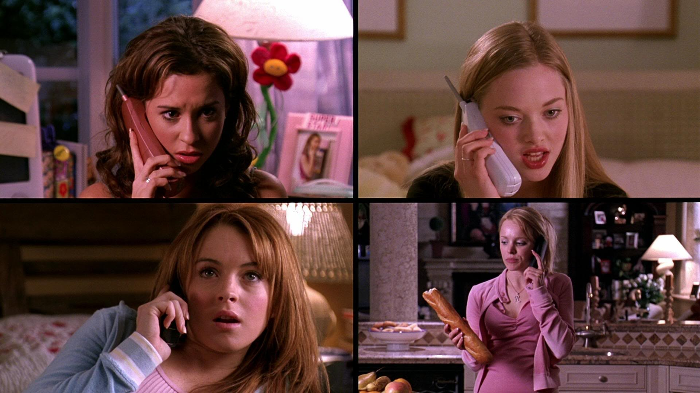
Social context
social relationship among speakers and hearers

Slide 11
4. Austin’s ( 1962 ) How to Do Things With Words and Searle’s ( 1969 ) Speech Acts
language is used to ‘do things’.
In the same way that we perform physical acts, we also perform acts by using language.
There is a relationship between literal meaning and an illocutionary meaning.
there are three kinds of acts which occur with everything we say. These are the locutionary act , the illocutionary act and the perlocutionary act .

Slide 12
5. Communication across cultures- pragmatics
Different languages and cultures, then, often have different ways of dealing with pragmatic issues, as well as different ways of observing Grice’s maxims

Slide 13
6. What is discourse analysis?
Discourse analysis is the study of language in use. It is the study of the meanings we give language and the actions we carry out when we use language in specific contexts.
Discourse analysis is also sometimes defined as the study of language above the level of a sentence.

Slide 14
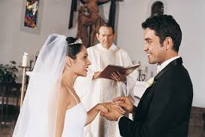
However, even a single sentence or utterance can be analyzed as a “communication” or as an “action,” and not just as a sentence structure whose “literal meaning” flows from the nature of grammar.
Grammar can tell us what “I pronounce you man and wife” literally means, but not when and where it actually means you are married.

Slide 15
7. The relation between pragmatics and discourse analysis
Pragmatics as many other social and human sciences could be used as an approach to study discourse.
The relationship between linguistic form and communicative function is of central interest in the area of pragmatics, is highly relevant to the field of discourse analysis.
For example, if someone says ‘The bus was late’.

Slide 16
8. Importance of pragmatic and discourse
The importance lies in our need to know what a particular meaning is in order to understand, at a broader level, what people typically say and do as they perform particular genres in particular social and cultural settings.

Slide 17
References:
Crystal, D. (2003). A Dictionary of Linguistics & Phonetics. Blackwell publishing Ltd.
Gee, J. P., & Handford, M. (Eds.). (2013). The Routledge handbook of discourse analysis. Routledge.
Paltridge, B. (2012). Discourse analysis: An introduction. Bloomsbury Publishing.
https://www.quora.com/What-is-the-difference-between-pragmatics-and-discourse-analysis
https://www.slideshare.net/mehwishnazar77/pragmatics-presentation-36657885

