Slide 1
Historical Overview and Precursors of Stylistics

Slide 2
Overview
Rhetoric and Stylistics
Russian Formalism
Functional Stylistics

Slide 3
Rhetoric and Stylistics
The origin of modern stylistic analysis can be traced back to traditional rhetoric and poetics.
The study of style is one of the traditional canons of rhetoric.
The traditional study of figures of speech in literary texts is the core of stylistic analysis.

Slide 4
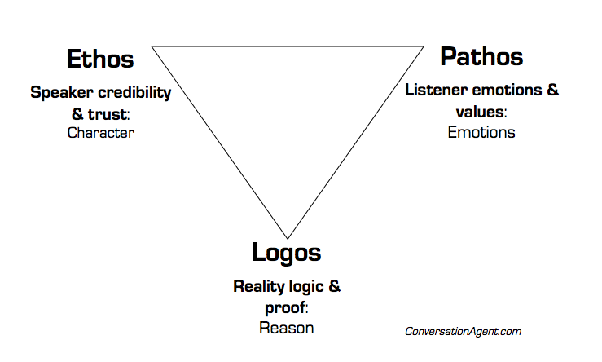
Rhetoric and Stylistics
The traditional Aristotelian concepts of logos, pathos and ethos are intimately related to the study of style.

Slide 5
Rhetoric and Stylistics
Style as a language-based force that has the power to delight, engage and transport readers and hearers to states of bliss (cf. Aristotelian concept of catharsis)
The relation between Horace’s concept of decorum and that of defamiliarization and relevance
Stylistics may be thought of as part of rhetoric or as rhetoric itself; or even as two co-existing and overlapping disciplines (Hamilton, 2014).

Slide 6
Rhetoric and Stylistics
Traditional rhetoric is often criticized for being too prescriptive.
Stylistics is descriptive but it can make use of the analytical toolkit developed in the rhetoric.

Slide 7
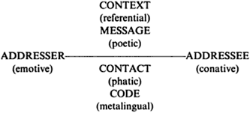
Russian Formalism
Jakobson’s model of communication and language functions

Slide 8
Russian Formalism
Jakobson’s poetic function is of special significance to stylistic analysis.
Poetic function “projects the principle of equivalence from the axis of selection into the axis of combination”
Style for Jakobson is a series of paradigmatic and syntagmatic choices.

Slide 9
Russian Formalism
Shklovsky’s concept of defamiliarization
Literary texts defamiliarize/make strange “the familiar to make us re-perceive what we have stopped noticing because of its familiarity” (Nørgaard, 2010: 24).
Defamiliarization makes texts cognitively salient and optimize relevance.
Defamiliarization gives literary texts their literary effects.

Slide 10
Russian Formalism
Criticism to formalist stylistics concentrates on:
Its overriding interest in linguistic forms at the expense of functions of these forms (Nørgaard, 2010: 25).
Its overlook of the psychological and cognitive impacts of literary text on the readers.
Its tendency to investigate literature in isolation from contextual factors (Nørgaard, 2010: 25).
Its theoretical premise that texts are self-contained worthy of analysis in their own rights.

Slide 11
Functional Stylistics
Functionalism has started with Malinowski and Firth who both emphasizes the role of context in understanding functionality
In Functional linguistics, text’s functional significance acts as a gateway to its interpretation.
Functional approaches to stylistic analysis focus on meaning-making in context.

Slide 12
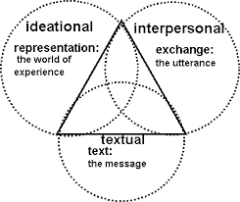
Functional Stylistics
Functional approaches to stylistic analysis are influenced by Halliday’s Systemic Functional Grammar
Functional approaches to stylistic analysis concentrate on the three language metafunctions, i.e. ideational, interpersonal and textual (Canning, 2014).

Slide 13
Functional Stylistics
Functionalism gave rise to various contextually and/or ideologically oriented branches of stylistics such as feminist stylistics, critical stylistics and pragmatic stylistics (Nørgaard, 2010: 26)

Slide 14
Functional Stylistics
Functional stylistics is often criticized for conceptualizing context in terms of co-text with little attention to sociopolitical and cognitive aspects of contexts (Lin, 2016).
Fish (1973) criticizes functional stylistics as being circular in methodology and argument and arbitrary in its interpretative ascription of meaning to prominent linguistic patterns.

Slide 15
References
Canning, P. (2014). ‘Functionalist Stylistics’. In Burke, M. (Ed.) The Routledge Handbook of Stylistics. London: Routledge.
Fish, S. (1973), ‘What is stylistics and why are they saying such terrible things about it?’, in S. Chatman (ed.), Approaches to Poetics. London and New York: Columbia University Press.
Halliday, M.A.K. and R. Hasan. (1976). Cohesion in English. London: Longman
Lin, B. (2016). ‘Functional Stylistics’, in Sotirova, V. (ed.) The Bloomsbury Companion to Stylistics. London: Bloomsbury.
Nørgaard, N.; Busse, B. & Montoro, R. (2010). Key Terms in Stylistics. London & New York: Continuum.
Simpson, P. (2004). Stylistics: A resource book for students. London: Routledge.
Hamilton, C. (2014). ‘Stylistics as Rhetoric’, in Peter Stockwell & Sara Whiteley (Eds.) The Cambridge Handbook of Stylistics. Cambridge: Cambridge University Press.

