Slide 1
LECTURE 1: Being Professional through Work Ethics
A Curriculum prepared to Iraqi EFL University Students/Al-Mustansiriya University / College of Arts/ Department of English Language and Literature/

Slide 2
Profissionalisim
What do we mean when we say ,
Act Like A Professional ?

Slide 3
Professionalism is defined by:
Who You Are
(inner character).
What You Do
(behavior exhibited )
How Other Perceive You
(image projected)

Slide 4
One basic issue is required to be a professional :

Slide 6
Generally Speaking, Work ethic is the ability to maintain proper moral values within the workplace.
Particularly, Work Ethics are a set of standards and rules that are required by an individual for satisfactory work performance

Slide 8
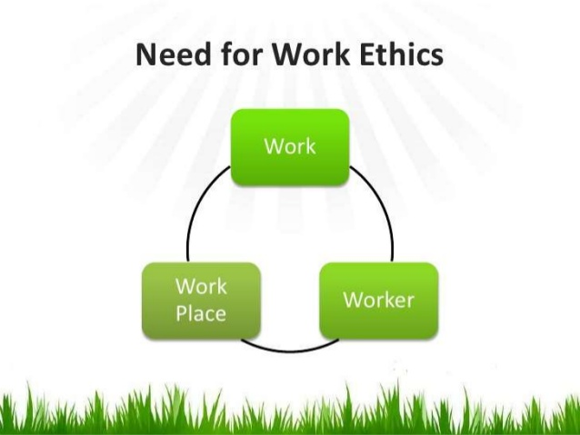

Slide 9
