Slide 1


Slide 2
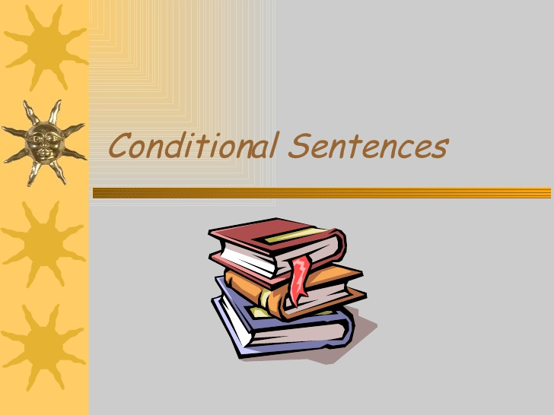
THIS LECTURE WILL DISCUSS:

Slide 3
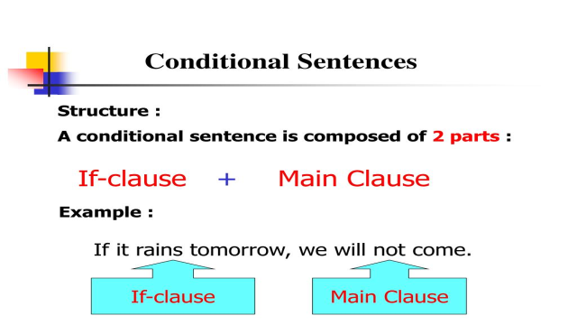
English Conditional Sentences

Slide 4
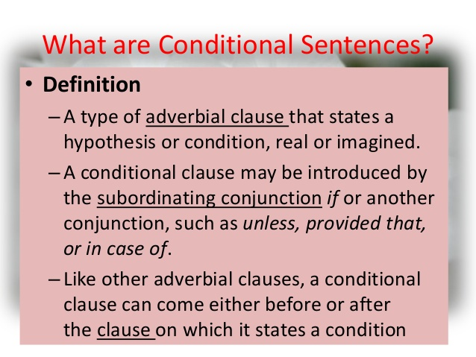

Slide 5

English conditional sentences can be of many types:
1-Real Condition:
This type of condition refers to possible situations in the present or future. These situations take place if a certain condition is met. It is possible and also very likely that the condition will be fulfilled.
Form:
If + Simple Present + Simple Future

Slide 6
EXAMPLES
If I have enough time, I'll watch a football match.
If he leaves , he will catch the train.
If I find her address, I will send her an invitation.
If I don’t see him this afternoon, I will phone him in the evening.

Slide 7
2-Unreal Condition in the present:
Often called the "unreal" conditional because it is used for unreal, impossible or improbable situations. This conditional provides an imaginary result for a given situation. It is very unlikely that the condition will be fulfilled.
Form:
if + Simple Past + would + base verb

Slide 8

EXAMPLES
If I were a millionaire, I would buy a castle.
If I had a lot of money, I would travel around the world.
If I won the lottery, I would be a millionaire.
She would help the poor if she became rich.
If I were you , I would not resign.

Slide 9
3-Unreal Condition in the past:
This condition is impossible or contrary – to – the – fact in the past. It describes a past situation that did not happen.
It is impossible that the condition will be met because it refers to the past.
Form:
if + Past Perfect, + would + have + Past Participle

Slide 10
EXAMPLES
If he had had enough money, he would have bought a new car.
If you had worked hard, you would have passed the exam.
If they had taken him to hospital earlier, he wouldn't have died.
He wouldn't have missed the bus, if he had woken up earlier.
The accident wouldn't have occurred if the driver hadn't been driving fast.

Slide 11

4. Condition with (unless):
The other conditional subordinator besides (if) is (unless).
It is used in a negative condition and means (except if):
I am not going out unless it stops raining.
It means the same as:
I am not going out if it doesn’t stop raining.

Slide 12

5. Conditional without ( if):
English has conditional sentences without the conditional subordinator (if):
The absence of (if) triggers subject – auxiliary inversion rule:
Had she arrived, I would have seen her.
Should they arrive late, there will be no one to receive them.
Should you need my advice, you can call me.
Should you see Tom, please tell him to phone me.
Had I not been ill, I would have come.

Slide 13
6. Factual condition (talking about facts ):
In factual conditionals that are general truths, we normally use a present tense in both clauses:
If we boil water, it evaporates.
It is possible, however, to use modals (will) , for example, adds the idea of absolute certainty:
If you heat ice, it will melt.

Slide 14
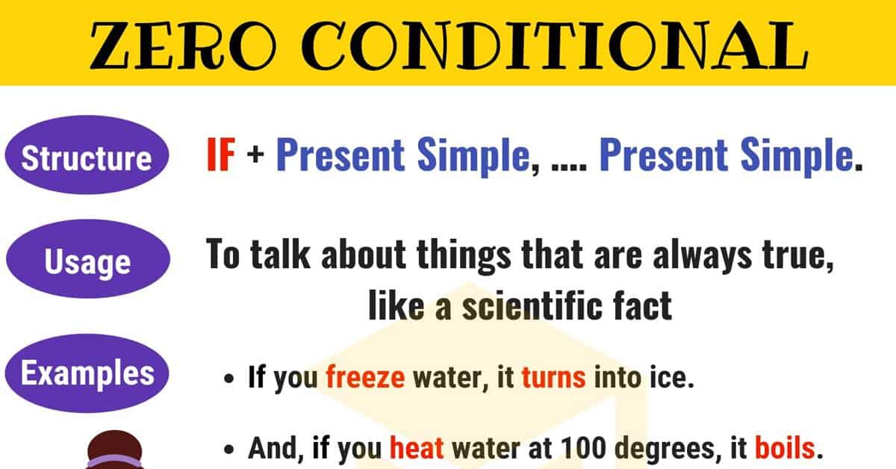

Slide 15
ARABIC CONDITIONAL SENTENCES
An Arabic conditional sentence consists of two clauses : الشرط (condition) and الجواب (answer).
The conditional clause الشرط normally precedes the main clause
الجواب
Arabic has three conditional particles: إن/ إذا / لو
These particles determine the type of the condition expressed.

Slide 16
TYPES OF CONDITIONALS IN ARABIC
Fulfillable Conditions:
ان: expresses possible condition with the verb of the conditional clause in the perfect or imperfect tense:
إن تدرس تنجح
ان جاء فسأخبره عنك
اذا: expresses probability. The verb of the conditional clause must be in the perfect tense:
إذا حضرَ فأخبرهُ عن الحادثِ

Slide 17
2. Unfulfillable / Contrary - to - fact Conditions:
The particle لو is used in unfulfillable conditions:
لو حضرَ أخبرته ُ عن الحادث
لو جئتني لاكرمتك
لو اجتهدت لنجحت

Slide 18

Also, Arabic has other conditional particles called :
أسماء الشرط الجازمة / nouns of condition:
مَن ، ما ، مهما ، متى ، أيّان ، أنى ، حيثما ، كيفما ، أي
مَن يجتهد ينجح
ايُّ عمل تعملْ تحاسبْ عليه
مهما تعمل يعلمه الله
متى تأتِ أكرمْك
حيثما يذهب يجد صديقا
كيفما تكن يكن قرينك
أيانَ تزرني أُكرِمْكَ

Slide 19
CONTRAST
The following differences hold between English and Arabic conditional sentences:
In English , the conditional clause may precede or follow the main clause, whereas in Arabic the conditional clause typically precedes the main clause.
في اللغة الإنجليزية ، قد تسبق العبارة الشرطية العبارة الرئيسية أو تتبعها ، بينما في اللغة العربية تسبق العبارة الشرطية العبارة الرئيسية
If I had won the lottery, I would have bought a house.
I would have bought a house if I had won the lottery.
لو فزت باليانصيب، لاشتريت منزلا

Slide 20

(2) In Arabic, the use of the different conditional particles determine the type of condition , whereas in English , condition type is determined by the sequence of verb forms.
في اللغة العربية ، يحدد استخدام ادوات الشرط المختلفة نوع الشرط ، بينما في اللغة الإنجليزية ، يتم تحديد نوع الشرط من خلال تسلسل أزمنة الفعل.
In fulfillable conditions, إن /إذا are used.
In unfulfillable conditions, لو is used.
If + Simple Present + Simple Future
if + Simple Past + would + base verb
if + Past Perfect + would + have + Past Participle

Slide 21
(3) The English conditional subordinator "if" has three counterparts in Arabic : إن ، إذا ، لو
(4) Only English has sentences without conditional subordinator "if".
(5) The main clause in Arabic conditional clauses may consist of an equational (verbless) clause, this is not possible in English:
قد تتكون العبارة الرئيسية في الجمل الشرطية العربية من جملة (غير فعلية)
إن تصبر فهو خيرُ لكَ
إن كنت مريضا فليس عليك حرج

Slide 22


Slide 23


Slide 24


