Slide 1
Pragmatics By Dr. Salah Al Bahadily
Content adapted from Yule (2010)
Copyright © 2014 Haifa Alroqi

Slide 2
Pragmatics
In the previous chapter, we talked about:
Referential meanings Lexical relations
There are other aspects of meaning that depend more on:
Context
The intended meaning of speakers.
•
•
•
•
Communication clearly depends on not only recognizing the meaning of words in an utterance, but recognizing what speakers mean by their utterances.
The study of the invisible meaning as communicated by speakers-writers and interpreted by hearers-readers is called pragmatics.

Slide 3
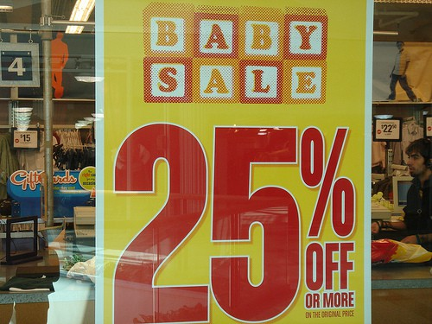
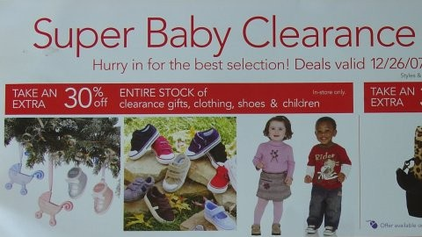
Invisible meaning
What does this mean?!
Fall Baby Sale

Slide 4
Invisible meaning
Are they selling babies?
We understand the message although the word ‘clothes’ is not there.
-Teacher: It is too cold here! (the literal meaning is it is cold here)
- Student: I will shut the windows. (the pragmatic meaning as understood by the student is shut the windows)

Slide 5
Context
There are different kinds of context
1- Linguistic context (co-text)
The co-text of a word is the set of other words used in the same phrase or sentence.
The surrounding co-text has a strong effect on what we think the word probably means.
•
•
•
Bank (a homonym)
A- I need to withdraw some cash from the bank.
B- Most of Ancient Egypt's historical sites are located along the banks of the Nile River.
•
•

Slide 6
Context
2. Physical context
Classroom Setting
Conversation:
Student (pointing to the board): "What does that mean?"
Teacher: "Oh, this formula represents Newton’s Second Law."
Physical Context: The student is pointing at something on the board. Without the pointing gesture and classroom setting, "that" would be unclear.
The physical location will influence our interpretation

Slide 7
Deixis
Some very common words cannot be interpreted unless the physical context of the speaker is known.
Examples: here and there, this or that, now and then, yesterday, today
or tomorrow, as well as pronouns such as you, me, she, him, it, them.

Slide 8
Deixis
Some sentences are impossible to understand if we don’t know who is speaking, about whom, where and when.
You’ll have to bring it back tomorrow, because she isn’t here today.
Out of context, this sentence is vague. (pronoun reference ambiguity)
It contains a large number of expressions that rely on knowledge of the immediate physical context for their interpretation
These expressions are technically known as deictic expressions, from the Greek word deixis, which means “pointing” via language.

Slide 9
Deixis
Deixis (deictic expressions): Using words such as this or here as a way of “pointing” with language.
We use deixis to point to:
things people location time
(it, this, these boxes)
(him, them, those idiots) [Person deixis]
•
(here, there, near that) (now, then, last week)
[Spatial deixis] [Temporal deixis]
•
•
All these deictic expressions have to be interpreted in terms of which person, place or time the speaker has in mind.

Slide 10
Reference
Reference: an act by which a speaker/writer uses language to enable a listener/reader to identify someone or something
We can use:
Proper nouns: (Chomsky, Ahmed)
Nouns in phrases: (the cat, a writer, my friend, the war) Pronouns: (he, she, it)
We invent references: for example when you call your fat friend lunchbox as in :
Did you call Lunchbox yesterday? They say he is sick.
•
•
•
•
•
•
•

Slide 11
Inference
•
A successful act of reference depends more on the listener's ability to recognize what we mean than on the listener’s dictionary’s knowledge of the word we use.
•
We can use names associated with things to refer to people
Where’ s the caesar salad sitting?
He’s sitting by the door.
We can use names associated with people to refer to things
Can I borrow your Chomsky? Sure it’ s on the table We saw Shakespeare in London.
•
An inference is additional information used by the listener to create a connection between what is said and what must be meant.

Slide 12
Anaphora
•
We usually make a distinction between
introducing new referents (a puppy)
and referring back to them (the puppy, it)
•
•
We saw a funny home video about a boy washing a puppy in a small bath.
The puppy started struggling and shaking and the boy got really wet. When he let go, it jumped out of the bath and ran away.
In this type of referential relationship,
•
•
•
The 1st mention is called antecedent. (a puppy/ a boy, a small bath) The 2nd (subsequent) referring expression is an example of anaphora ("referring back"). (the puppy/ it/ the boy/ he/ the bath)
Anaphora: a subsequent reference to an already introduced entity.
•
•

Slide 13
Anaphora
The connection between an antecedent & an anaphoric expression is created by use of:
A pronoun (it)
Repetition of the noun with the (the puppy)
Another noun that is related to the antecedent in some way (The little dog ran out of the room).
The connection between antecedents and anaphoric expressions is often based on inference, as in these examples,
We found a house to rent, but the kitchen was very small.
I caught a bus and asked the driver if it went near the downtown area.

Slide 14
Presupposition
Why did you arrive late?
Presupposition = you arrived late.
When did you stop smoking?
Presupposition 1 = the speaker supposes that you used to smoke.
Presupposition 2 = the speaker supposes that you no longer smoke.
We design our linguistic message on the basis of assumptions about what our listeners already know.
What a speaker assumes is true or known by the listener can be described as a presupposition

Slide 15
Presupposition
Questions like this, with built-in presuppositions, are very useful devices for interrogators or trial lawyers.
Okay, Mr. Buckingham, how fast were you going when you ran the red light?
Negation test
My car is old My car isn’t old
The underlying presupposition = (I have a car)/ It remains true although the two sentences have opposite meanings. (constancy under negation)
•
•

Slide 16
Speech acts
Speech acts (e.g. requesting/ commanding/ questioning/ informing)
We can define a speech act as the action performed by a speaker with an utterance.
e.g.
I’ ll be here at five.
You are not just speaking, you are performing the speech act of ‘promising’

Slide 17
Direct and indirect speech acts
We usually use certain syntactic structures with the functions listed beside them in the following table
When an interrogative structure such as Did you..?, Are they..?, Can we….? is used with the function of a question, it is described as a direct speech act.
When we don’t know something and we ask someone to provide the information, we usually produce a direct speech (Can you ride a bicycle?)

Slide 18
Direct and indirect speech acts
Can you pass the salt?
Is it the same syntactic structure as (Can you ride the bicycle?)
Does it have the same function that (Can you ride the bicycle?) has (i.e. asking about your ability?)?
No, it’s a request not a question. (Indirect speech act)

Slide 19
Direct and indirect speech acts
Whenever one of the structures in the set is used to perform a function other than the one listed beside it on the same line, the result is an indirect speech act.
You left the door open (What structure? What function?)
You left the door open (for someone who has just come in and it’s really cold outside.)
(= close the door) request but without using an imperative structure?

Slide 20
Direct and indirect speech acts
It is possible to have strange effects if one person fails to recognize another person’s indirect speech act.
Consider the following scene. A visitor to a city, carrying his luggage, looking lost, stops a passer-by.
VISITOR: Excuse me. Do you know where the Ambassador Hotel is? PASSER-BY: Oh sure, I know where it is. (and walks away)
The passer-by is acting as if the utterance was a direct speech act instead of an indirect speech act used as a request for directions.
•
•
Could you open that door for me? Function = request not question
Why do we use the indirect speech?
It’s more polite. Open that door for me!
•
•

Slide 21
Politeness
In the study of linguistic politeness, the most relevant concept is ‘face’
Your face, in pragmatics, is your public self-image. This is the emotional and social sense of self that everyone has and expects everyone else to recognize.
Politeness can be defined as showing awareness of and consideration of
another person’s face.

Slide 22
Politeness
If you say something that represents a threat to another person’s self image, that is called a face-threatening act.
e.g. Give me that paper!
behaving as if you have more social power than the other person. If you don’t actually have that power (your mom, a military officer), then you are performing a face-threatening act.
If you say something that lessens the possible threat to another’s face, it can
be described as a face-saving act.
Indirect speech act (Could you pass me that paper?) removes the assumption of social power.

Slide 23
Negative and positive face
Negative face: the need to be independent, free from imposition
A face-saving act that emphasizes a negative face will show concern about imposition:
I’m sorry to bother you… I know you’re busy but… If you’re free,…
•
•
Positive face: the need to be connected, to be a member of the group
A face-saving act that emphasizes a person’s positive face will show solidarity and draw attention to a common goal:
Let’s do this together…
You and I have the same problem, so

