Slide 1
Iraqi Union Catalog
Prepared by the student
Ahmed iedan Mohammad
Supervisor
Prof. Dr. Ahmed Qadoury Abed

Slide 2
Introduction.
The Iraqi Union Catalog aims to establish a unified framework for collaborative work among Iraqi libraries academic, public, and specialized—in order to promote resource sharing, reduce costs, and standardize the rules and technologies used in cataloging and classification processes. Additionally, the catalog seeks to develop a scientific mechanism for identifying, documenting, and preserving Arab and Islamic heritage, both published and unpublished, which is widely dispersed across Arab and non-Arab libraries around the world.

Slide 3
Establishment.
In collaboration between the Iraqi Society for Information Technology and the Center for Intellectual and Cultural Affairs of the Holy Shrine of Imam Hussein, the Iraqi Union Catalog was launched on December 29, 2016, with an initial dataset comprising the holdings of the Library of the Holy Shrine of Imam Hussein and four university libraries: the University of Technology Library, the University of Baghdad Library, the University of Karbala Library, and the University of Babylon Library.
One year after its launch, the number of libraries that had contributed their data to the catalog's database exceeded 20 libraries, most of which were academic institutions. The number of cataloged records reached approximately 400,000 entries, representing more than 800,000 print and digital resources.

Slide 4
Accessing the Iraqi Union Catalog Website.
We can access the Iraqi Union Catalog website through the following link: https://iquc.org/.
This catalog operates using the Koha Integrated Library System (ILS), which enables the integration of multiple libraries into a unified working environment. It also provides users with the ability to search across the entire catalog's holdings or select a specific library for a more focused search.
The Iraqi Union Catalog supports two languages for searching and use: Arabic and English, allowing users to choose their preferred language based on their needs and preferences.
Upon accessing the link above, the homepage of the Iraqi Union Catalog will appear. It features a search box that enables users to search for topics they are interested in to retrieve relevant information resources.

Slide 5
a collection of topics is displayed below the search box, allowing users to browse and select from them. The number of available resources for each topic is also shown, as illustrated in the following figure.

Slide 6
below the search box, a collection of topics is displayed. Users can view all the topics covered by the Iraqi Union Catalog by clicking on the "View All Topics" option. Upon doing so, a table will appear displaying all the topics, along with the number of available resources under each topic, as shown in the following figure.

Slide 7
Searching the Catalog
The Iraqi Union Catalog offers two types of searches: Basic Search and Advanced Search.
1)Basic Search:
This type of search requires no prior experience from the user. All the user needs to do is enter a search term into the search box displayed on the homepage. The system will then display the results that match the query.

Slide 8
if a user searches for a topic or term such as "Information", the results will be presented in a list format, including multiple records of information resources. The user can choose from these results after selecting the relevant library, and each record will also display the barcode associated with the resource, as shown in the following figure.

Slide 9
2. Advanced Search: Advanced Search provides more sophisticated options to customize the search process, allowing users to obtain more precise results compared to the Basic Search described above. To perform an advanced search, users need to return to the system’s homepage and click on the link located at the bottom of the page, as shown in the following figure.

Slide 10
After clicking the link at the bottom of the homepage, the user will be directed to a new page that includes a variety of advanced search options. These options include Advanced Search, Authority Search, Tag Cloud, and a section displaying the most frequently searched resources (also known as Most Popular).

Slide 11
After clicking the link at the bottom of the homepage, the user will be directed to a new page that includes a variety of advanced search options. These options include Advanced Search, Authority Search, Tag Cloud, and a section displaying the most frequently searched resources (also known as Most Popular).

Slide 12
Additionally, users have the ability to narrow their search by specifying particular fields, which allows for more focused and efficient retrieval of information, as illustrated in the following figure:

Slide 13
To perform an Advanced Search, the user must click on the “Advanced Search” option located at the top left corner of the page. Upon clicking this option, a set of filters and search parameters will appear, allowing the user to narrow down the search criteria and obtain more accurate and relevant results, as shown in the following figure:

Slide 14
After specifying the keywords, subject, and author's name, the user can then click on the Search button to display the results based on the selected criteria — as shown in the following figure:

Slide 15
After conducting the search—where the author's name (Mohammed) was specified, along with the subject and keywords related to information and libraries—the results appeared according to the selected criteria.
However, Advanced Search does not stop there. It also allows users to filter results by the type of information resources they wish to retrieve. For instance, users may choose to view only books, theses and dissertations, journals, manuscripts, or other types of resources. This added level of filtering enhances the precision of the search, as illustrated in the following

Slide 16
After conducting the search—where the author's name (Mohammed) was specified, along with the subject and keywords related to informatio

Slide 17
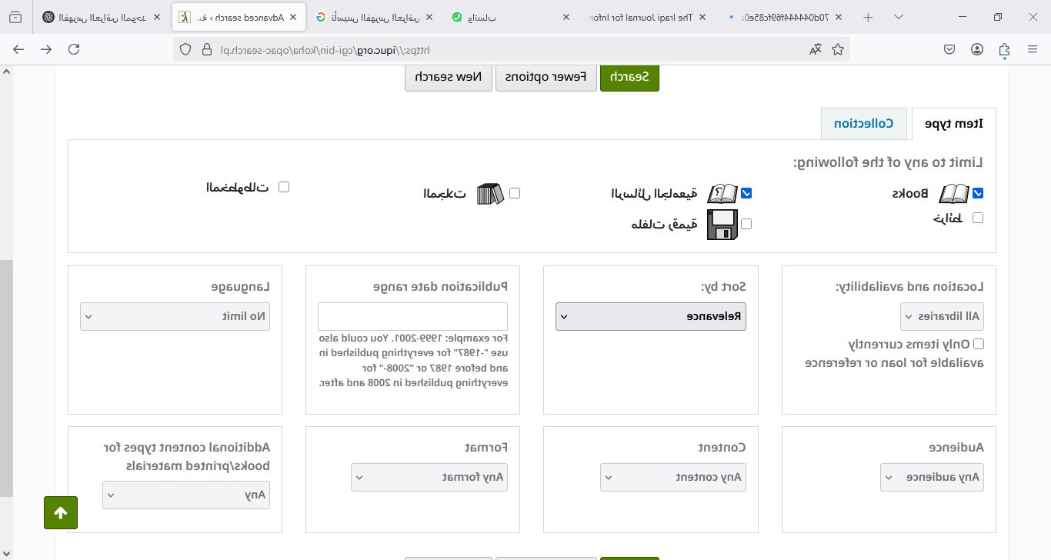
select the type of resource

