Slide 1
Grammar
Past Continuous Tense
Arabic Department
Prepared By:
Arwa Harith Hasan

Slide 2
Past Continuous
Tense

Slide 3
Past Continuous Tense ( I was doing something) which means that I was in the middle of doing something at a certain time ; the action or situation had already started before this time, but hadn’t finished :
I started doing ( I was doing ) I finished doing
____ ____________ __________ __________ ________ past past now

Slide 4
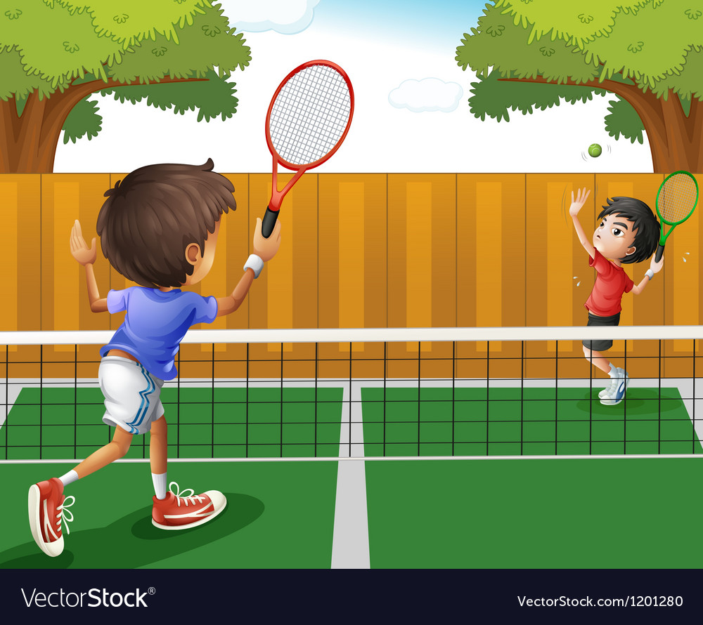
Yesterday Karen and Jim played tennis.
They began at 10 o’clock and finished at 11.30.
So, at 10.30 they were playing tennis.
(They were playing= they are in the middle of playing. They hadn’t finished playing.)

Slide 5
Past Continuous Tense
( was/were+(v.+ing)
Positive and
Negative Form
Question Form
v.+ing | Be (negative) | Be(positive) | subject
working | Wasn’t | was | I/He/she/it
working | weren’t | were | We/you/they
v.+ing | subject | be | Wh-question
working? | I He/she/it We/you/they | Was Was were | What Where When Why Who

Slide 6
Examples:
This time last year I was living in Babylon.(positive)
They were waiting for the bus when the accident happened.
Caroline was skiing when she broke her leg.
When we arrived he was having a bath.
When the fire started I was watching television.
I waved to Helen, but she wasn’t looking. (negative)
What were you doing at 10 o’clock last night? (wh-question)
Yesterday at 10 PM I was eating my dinner.

Slide 7
Tail- questions and short answers
Be (was,were)+Subject+(v.+ing)+ Complement of the sentence?
Ex. She was writing a letter to her parents last night.(positive)
Was she writing a letter to her parents last night ? (Tail- questions)
Yes, she was. (positive short answer)
No, she wasn’t. (negative short answer)
Ex. They were swimming in the pool .
Were they swimming in the pool ? (Tail- questions)
Yes, they were. (positive short answer)
No, they weren’t. (negative short answer)

Slide 8
Comparison between the past continuous ( Iwas doing) and past simple(I did)
We often use the past simple and the past continuous together to say that something happened in the middle of something else:
Matt phoned while we were having dinner.
I hurt my back while I was working in the garden.
Past simple | Past continuous
Complete action | In the middle of an action
I walked home after the party last night. (all the way , completely) | I was walking home when I met Dave. (In the middle of an action)
Kate watched television a lot when she was ill last year. | Kate was watching television when we arrived.

Slide 9
Thank you for listening

