Slide 1
Chapter (5)
On the move

Slide 2
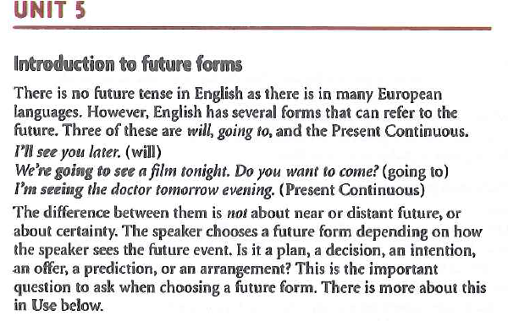

Slide 3
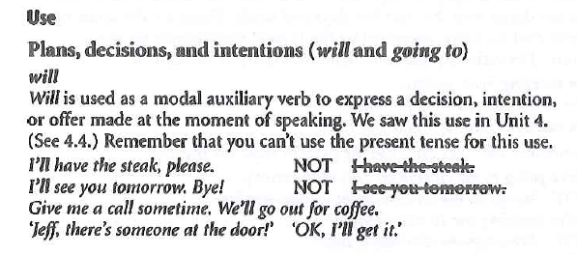

Slide 8
