Slide 1
Headway
Pre- Intermediate
المرحلة الثانية/قسم التاريخ
المادة: اللغة الانكليزية
استاذة المادة: م.م اية فليح حسن
المحاضرة 1

Slide 2
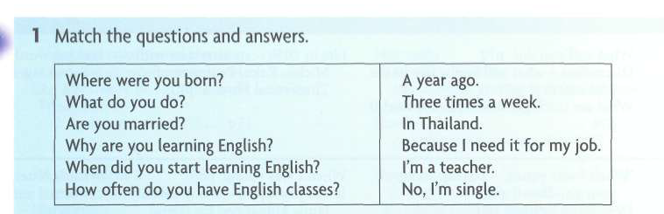
Getting to know you

Slide 3
READING
Communication
1 How many different ways can people
communicate?
Your teacher will give you some ideas to
communicate, but you can't use words!
Mime to your partner, and your partner
has to guess what they are.
Read the text quickly and match the
headings to the paragraphs.
A HISTORY OF COMMUNICATION

Slide 4
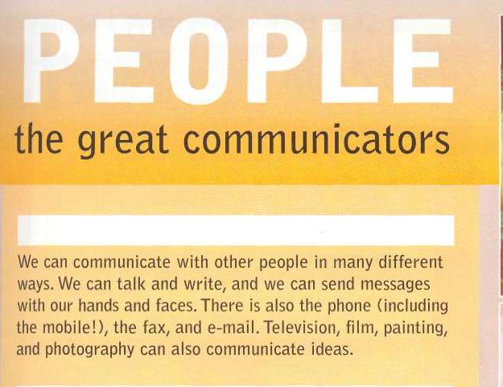

Slide 5
Animals have ways of exchanging information, too. Bees
dance and tell other bees where to find food. Elephants
make sounds that humans can't hear. Whales sing songs.
Monkeys use their faces to show anger and love. But this
is nothing compared to what people can do. We have
language - about 6000 languages, in fact. We can write
poetry, tell jokes, make promises, explain, persuade, tell
the truth, or tell lies. And we have a sense of past and
future, not just present.

