Slide 1
2nd Year- 18th Lecture
Asst. Lect. Noor Majeed Majli

Slide 2
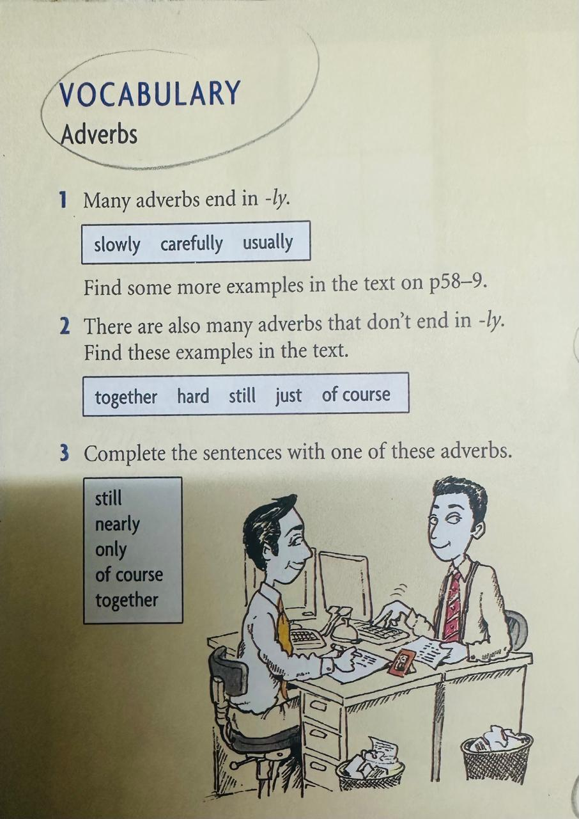

Slide 3
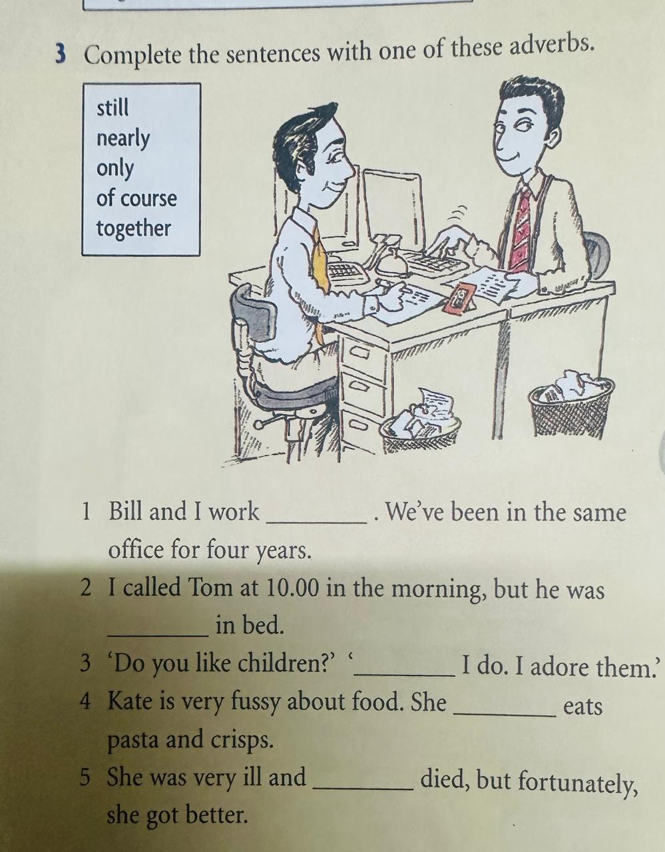

Slide 4
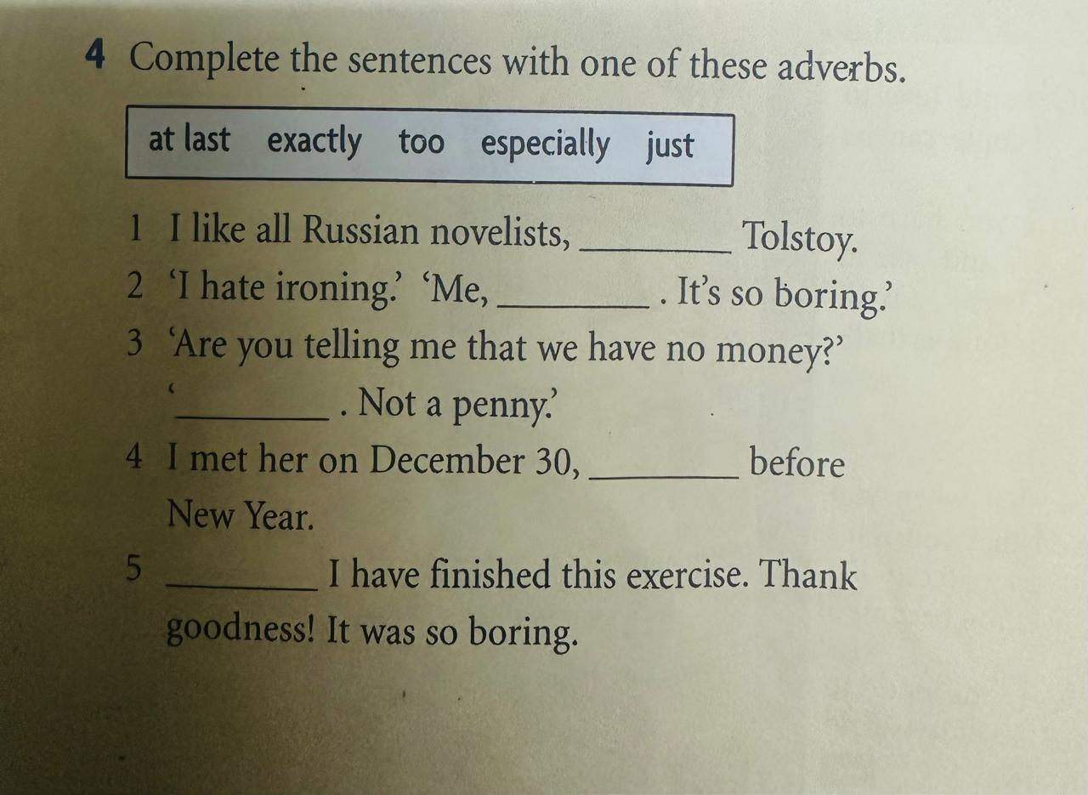

Slide 5
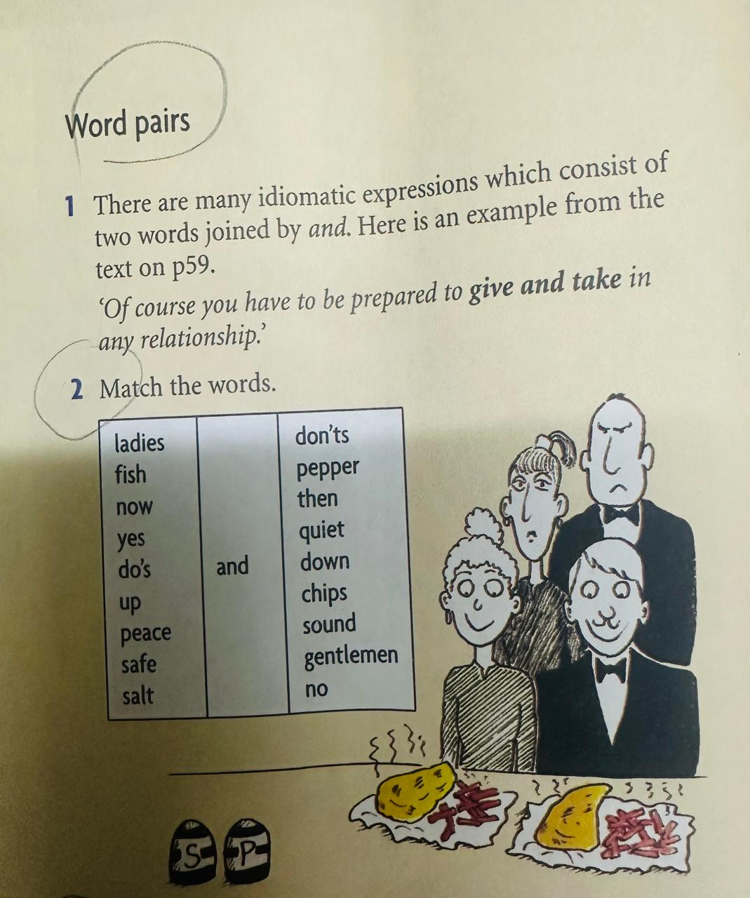

Slide 6
