Slide 1
1st Year- 1st Lecture
Asst. Lect. Noor Majeed Majli

Slide 2
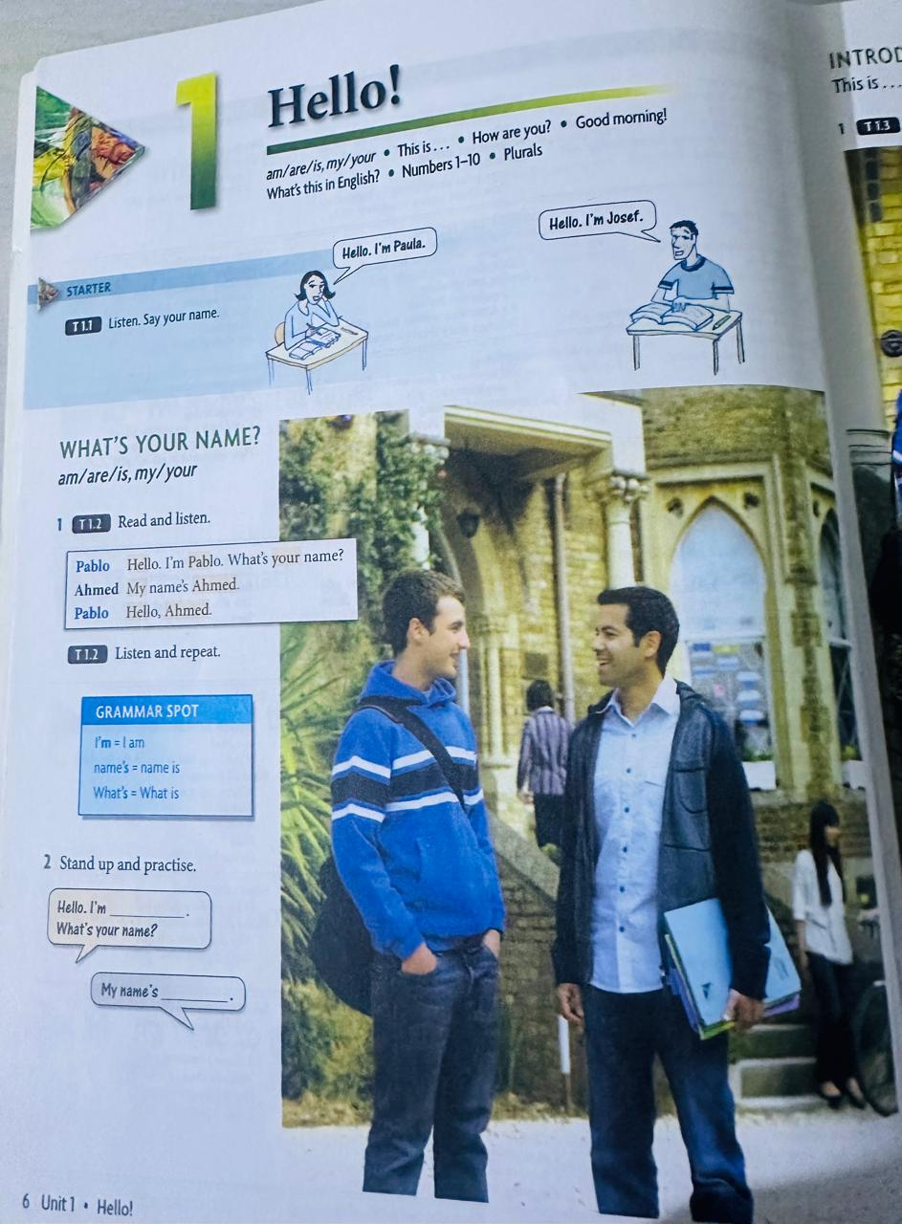

Slide 3
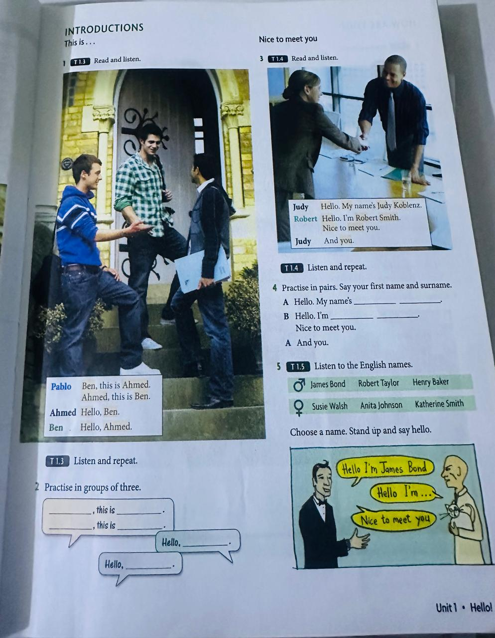

Slide 4
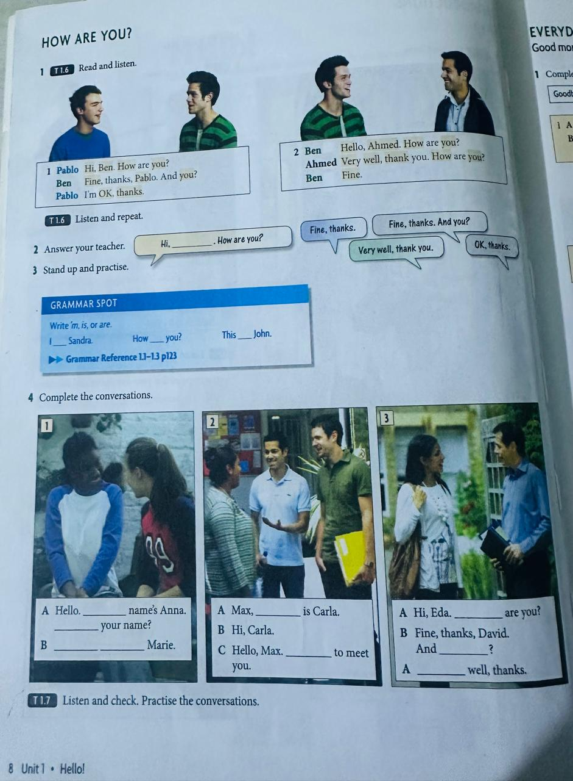

Slide 5
