Slide 1
1st Year- 8th Lecture

Slide 2
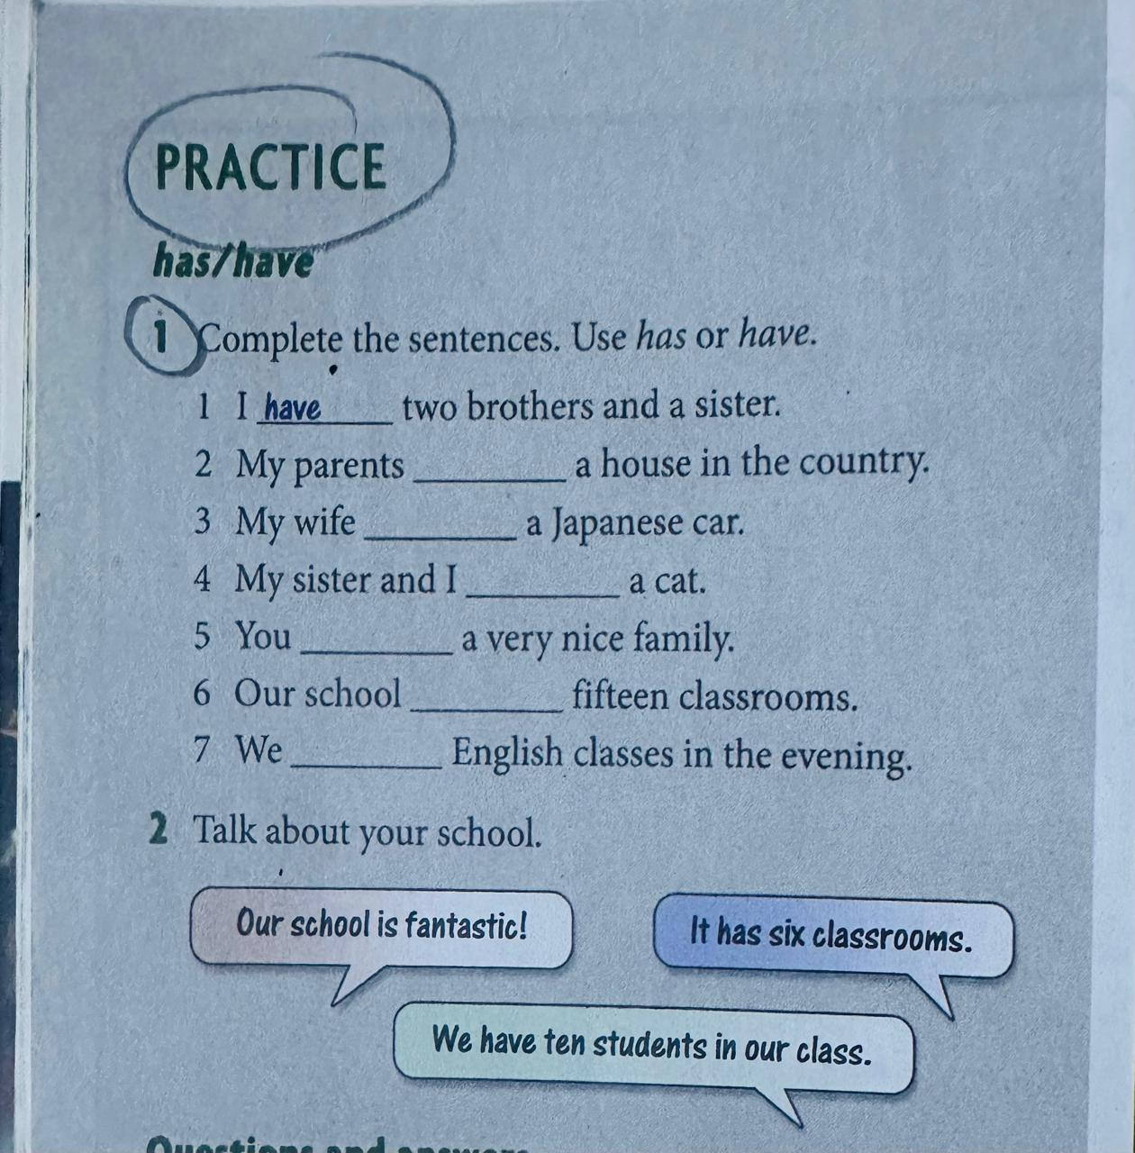

Slide 3
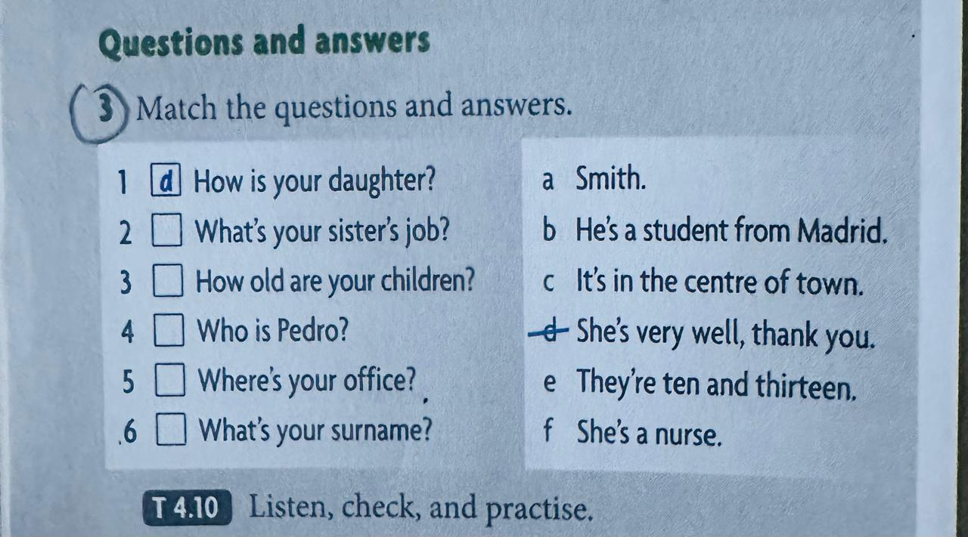

Slide 4
