Slide 1
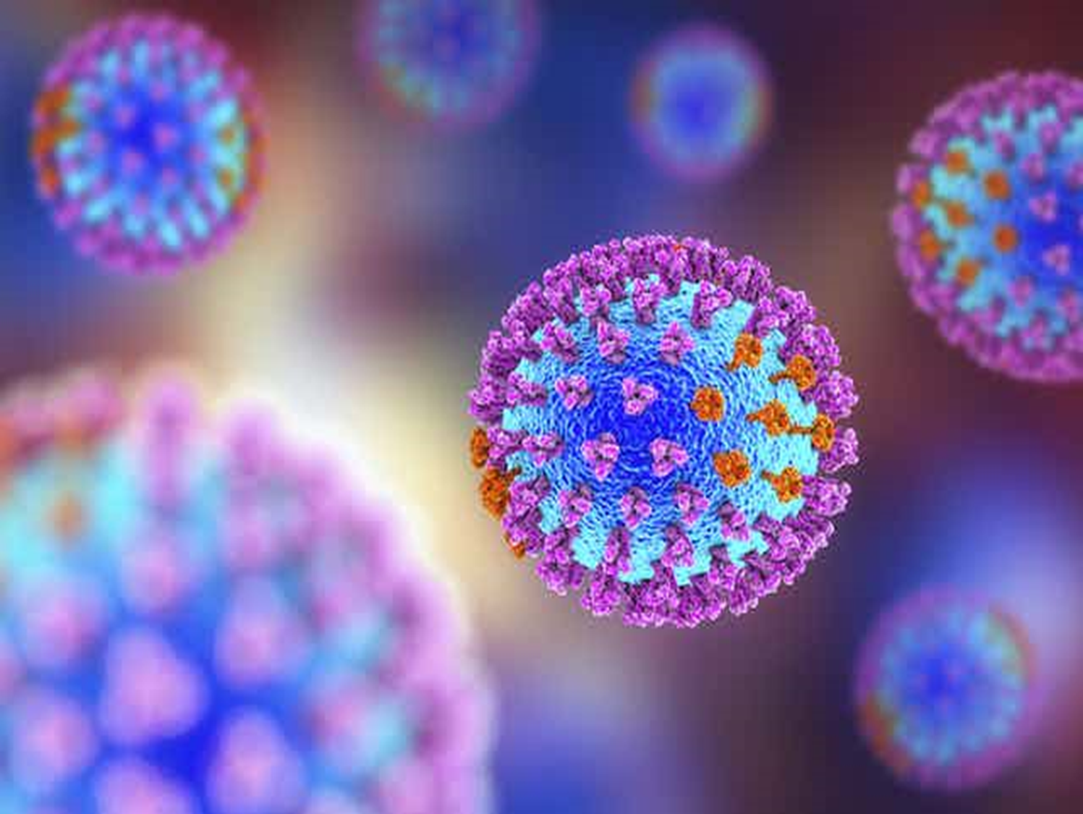
Diagnosis of Viral Infection

Slide 2
Virus Isolation
Viruses require a living host cell for replication. Infected host cells (eukaryotic or prokaryotic) can be cultured and grown, and then the growth medium can be harvested as a source of virus.
Virions in the liquid medium can be separated from the host cells by either centrifugation or filtration. Filters can physically remove anything present in the solution that is larger than the virions; the viruses can then be collected in the filtrate.

Slide 3
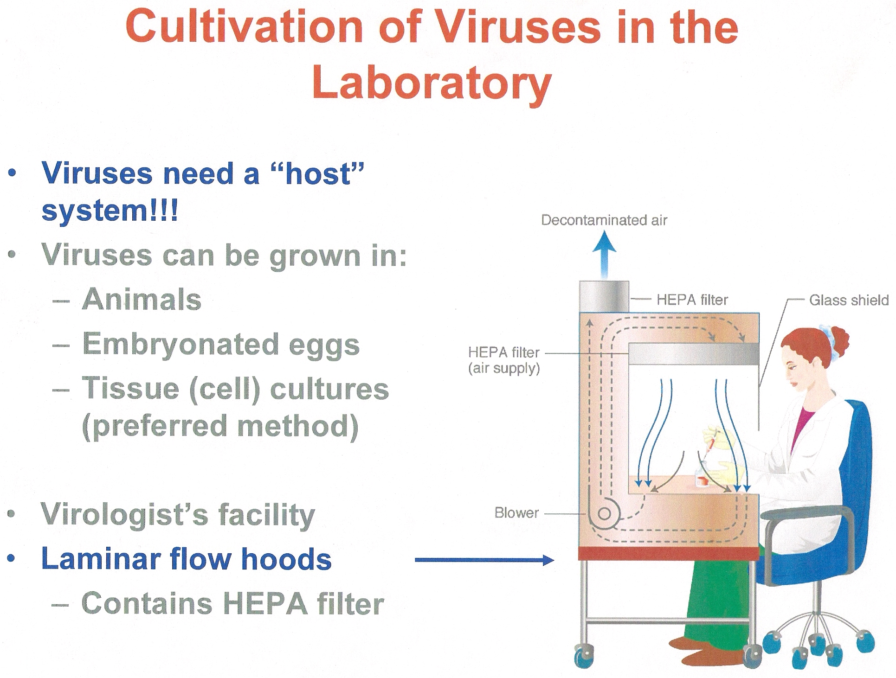
High –efficiency particular air

Slide 4
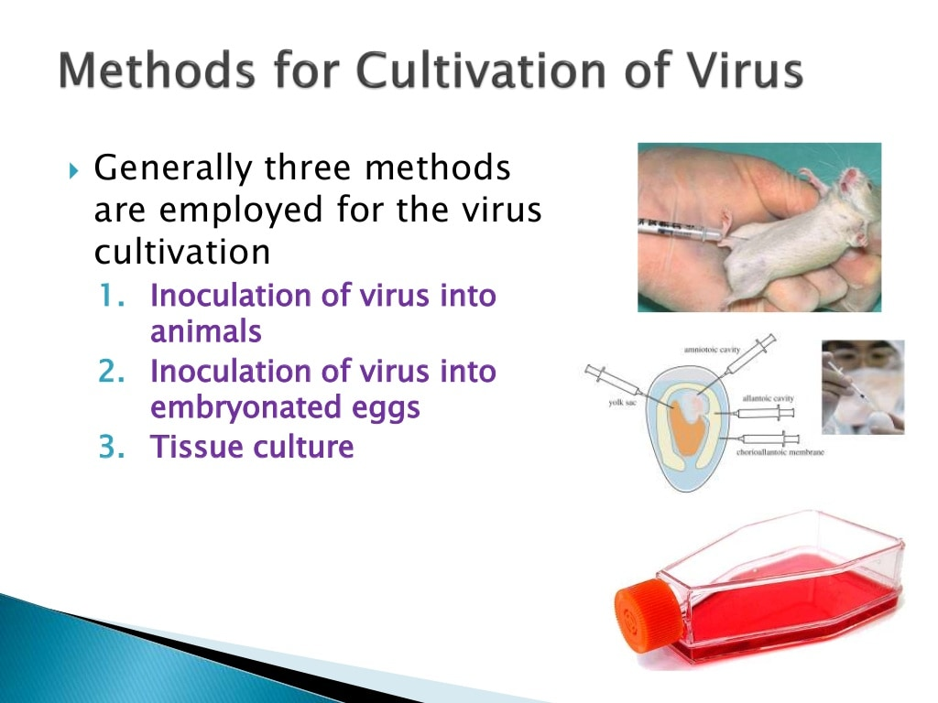

Slide 5
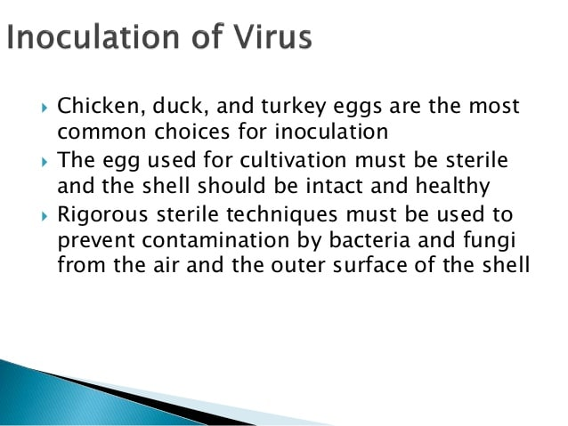
Inculation of viruse in embryonated eggs

Slide 6
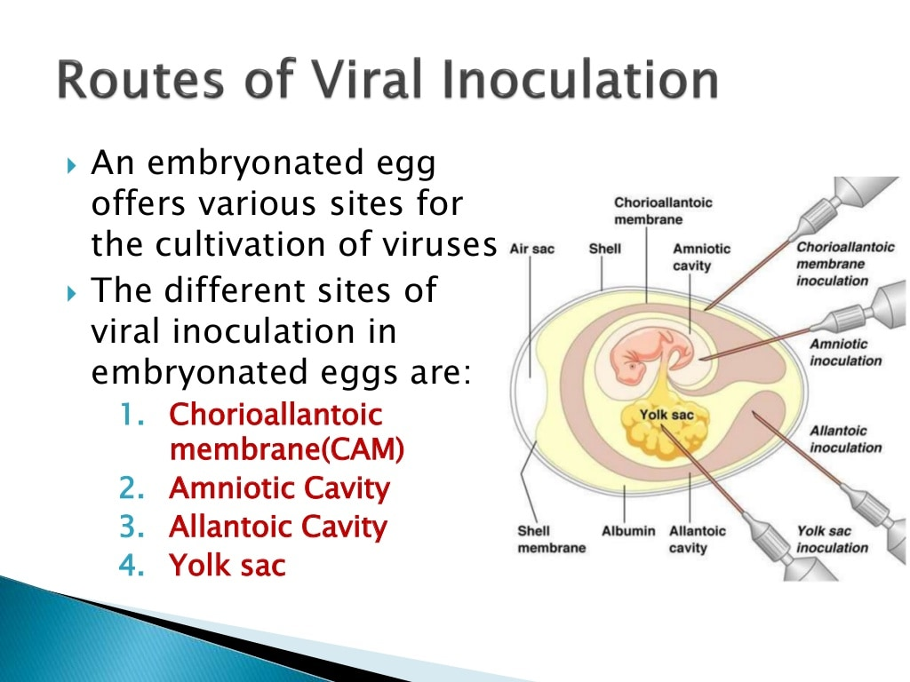

Slide 7
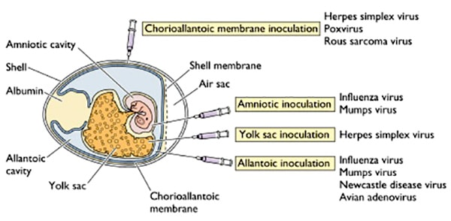

Slide 8
USE OF FERTILE EGGS
Three parts of the egg are of use
A The amniotic cavity:
B The allantoic cavity:
Both are useful for the cultivation of viruses, particularly
    orthomyxoviruses (e.g., influenza) and paramyxoviruses (e.g., mumps).
C The chorio-allantoic membrane : Dermatropic viruses (poxviruses and some herpes viruses) will grow on this membrane, and at low concentrations, will give discrete foci of infection which consist of centres of cell proliferation and necrosis (pocks). The membrane may therefore be used to assay these viruses. In addition, different viruses cause pocks of different colour and morphology, and this is of diagnostic value for distinguishing between different poxviruses.

Slide 9
2.cell culture
Is the process by which cells are grown under controlled conditions, isolated from living tissue they can subsequently be maintained under carefully controlled conditions. consist of:
Growth medium or culture medium is a solid, liquid, or semi-solid .
Essential nutrients (amino acids, carbohydrates, vitamins, minerals), growth factors, hormones, and gases (CO2, O2)

Slide 10
Virus isolation and cultivation In cell culture prepared as monolayer
Primary cultures –unable to grow for more than a few passages in culture; monkey, rabbit kidney, embryonic cells.
  Diploid cell lines –semi –continuous, up to 50 passages, Embryonic tissue origin derived from human, mice fibroblasts, HSV, CMV, VZV, rhinoviruses.
Heteroploid cell lines (established, continuous)- Permanent cell lines
Spontaneous mutation of diploid cell lines.
Oncogenic cell lines → suspension → immortal derived from malignant tissue;(HeLa -human cervix carcinoma and Hep-2 -human larynx carcinoma)

Slide 11
Virus Isolation
Primary cell culture are widely acknowledged as the best cell culture systems available since they support the widest range of viruses. However, they are very expensive and it is often difficult to obtain a reliable supply. Continuous cells are the most easy to handle but the range of viruses supported is often limited.

Slide 12
Medium Constituents
* Balance salt solution : Phosphate buffer, Mg²⁺, Ca²⁺
Inorganic ions and trace elements
for membrane potential and osmotic pressure
Buffer* Energy source : glucose, glutamine
* Amino acid : metabolism and biological synthesis
Role of Serum
Buffer, Chelator, Carrier proteins
Protease inhibitor
Promotes attachment of cell to substratum
Source of Intermediate metabolites, hormone and growth factor

Slide 13
Preparation of cell suspension from intact tissue (cont.)
1. Removal of tissue and place in Isotonic
(or growth medium with antibiotic)
2. Trim off unwanted parts and cut into smaller pieces
3. Dissociate cells using enzyme
4. Remove large debris and wash cells

Slide 14
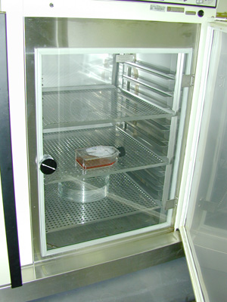
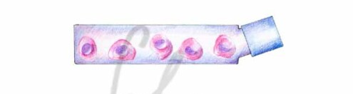
Preparation of cell suspension from intact tissue (cont.)
5. Suspend cells in growth medium accordingly
6. Pipette into culture vessel and incubate

Slide 15
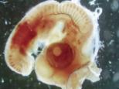

Primary cell culture
+ enzymes
time

Slide 16


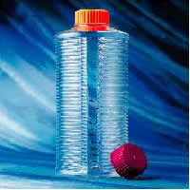
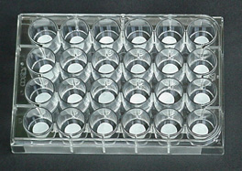
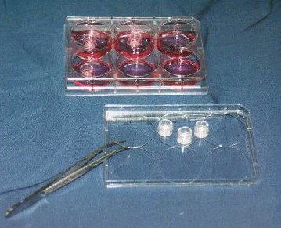
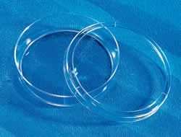
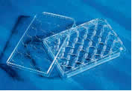
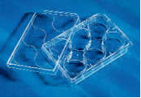
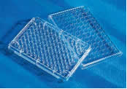
Culture flask
Culture Plate

Slide 17
Common Cell line (cont.)
HeLa : 1952
: from Henrietta Lach; cancer tissue
: harbors HPV type 18 genome
Vero : 1962
: from African green monkey kidney
: preparation of Poliovirus vaccine

Slide 18
virus cultivation is important for :
1) identification and diagnosis of pathogenic viruses in clinical specimens
2) production of vaccines.
3) basic research studies.
In vivo host sources can be a developing embryo in an embryonated bird’s egg (e.g., chicken, turkey) or a whole animal. For example, most of the influenza vaccine manufactured for annual flu vaccination programs is cultured in hens’ eggs.

Slide 19
Detection of virus in cell culture:
•Cytopathic effect -CPE:changed monolayer architecture, the entire cell/ nucleCytopathic effect -CPEus thickening and shrinking (pycnosis), inclusion bodies formation, giant cell (syncytia)formation, nucleolar displacement,rearangement and margination of the nuclear chromatin,vacuolization,the type of CPE depends on virus specifity and the kind of cells, polio virus, adeno virus, HSV, CMV;

Slide 20
Detection of virus in cell culture:
Viral hemagglutination–direct reaction with red cells, influenza;
•Hemadsorption –adsorption of erythrocytes to infected cells;parainfluenza, influenza
•Plaques effect –clear areas appear in culture (PFU)due to cell lysis;

Slide 21
Cytopathic Effect
Syncytium formation in cell culture caused by RSV (top), and measles virus (bottom).
(courtesy of Linda Stannard, University of Cape Town, S.A.)

Slide 22
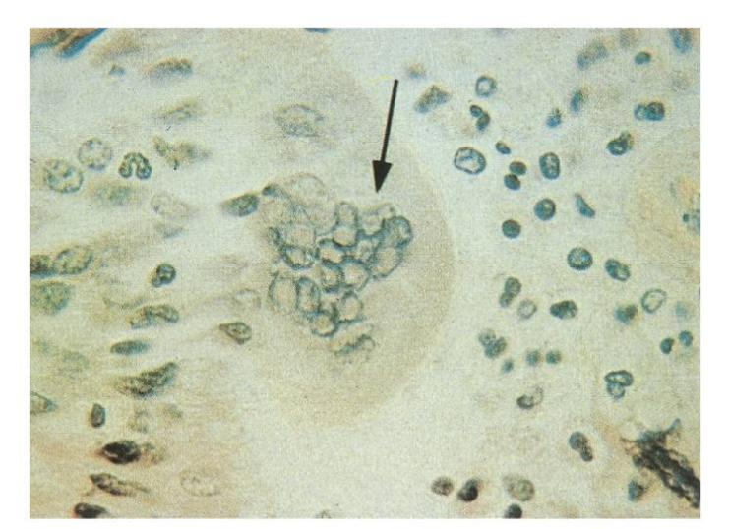
Cytolology: CPE
Syncytium formation by measles virus. Multinucleated giant cell (arrow) visible in a histologic section of lung biopsy tissue from a measles virus-induced giant cell pneumonia in an immunocompromised child.

Slide 23
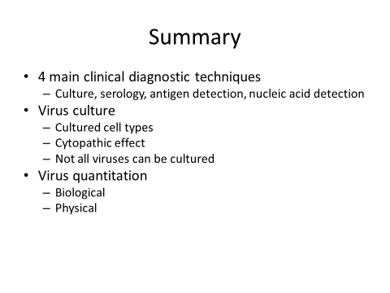

Slide 24


