Slide 1
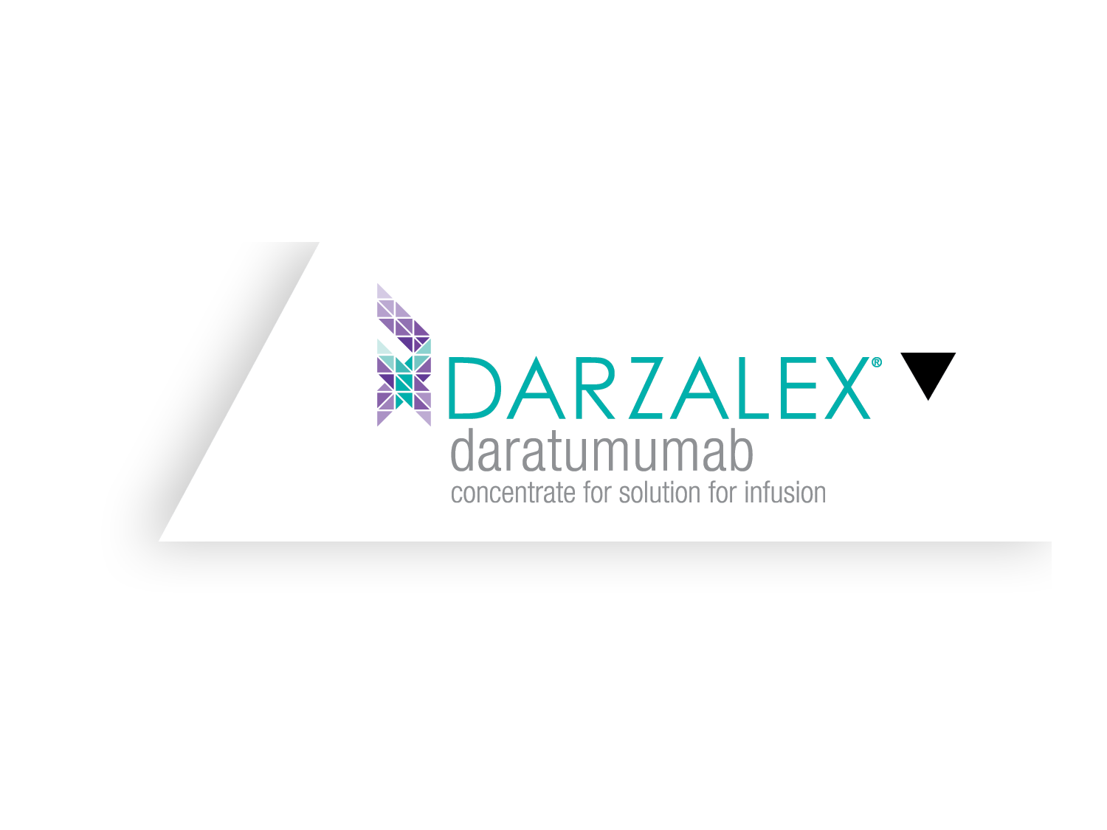

At earliest
opportunity for prolonged
survival.¹
First on the
dance floor.
DARZALEX® in combination with Rd or Vd is approved for Relapsed Refractory Multiple Myeloma.²
References: 1. DARZALEX® (daratumumab) EU Summary of Product Characteristics, Feb 2023. 2. Dimopoulos MA, et al. Ann Oncol. 2021;32(3):309–322.
Rd: Revlimid and dexamethasone | Vd: Velcade and dexamethasone
CP-594467

Slide 2
INDICATIONS
DARZALEX ® (daratumumab) is indicated:¹
in combination with lenalidomide and dexamethasone or with bortezomib, melphalan and prednisone for the treatment of adult patients with newly-diagnosed multiple myeloma who are ineligible for autologous stem cell transplant.
in combination with bortezomib, thalidomide and dexamethasone for the treatment of adult patients with newly diagnosed multiple myeloma who are eligible for autologous stem cell transplant.
in combination with lenalidomide and dexamethasone, or bortezomib and dexamethasone, for the treatment of adult patients with multiple myeloma who have received at least one prior therapy.
as monotherapy for the treatment of adult patients with relapsed and refractory multiple myeloma, whose prior therapy included a proteasome inhibitor and an immunomodulatory agent and who have demonstrated disease progression on the last therapy.
.
1. DARZALEX® (daratumumab) EU Summary of Product Characteristics, Feb 2026.

Slide 3
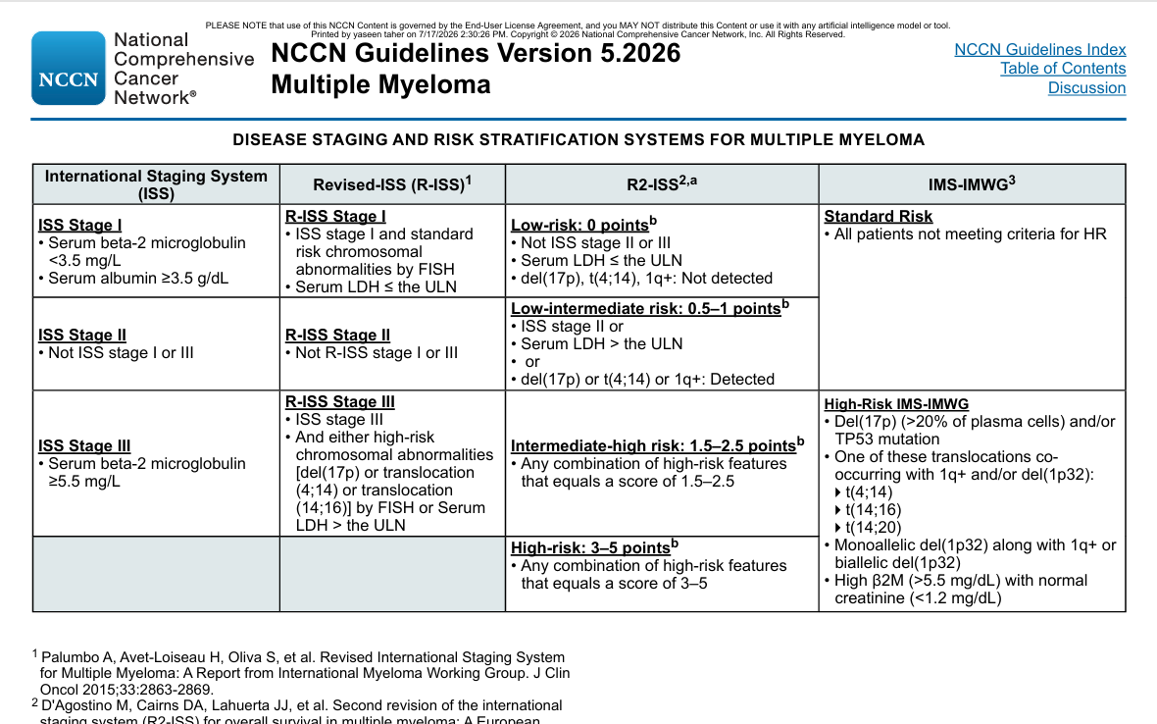

Slide 4
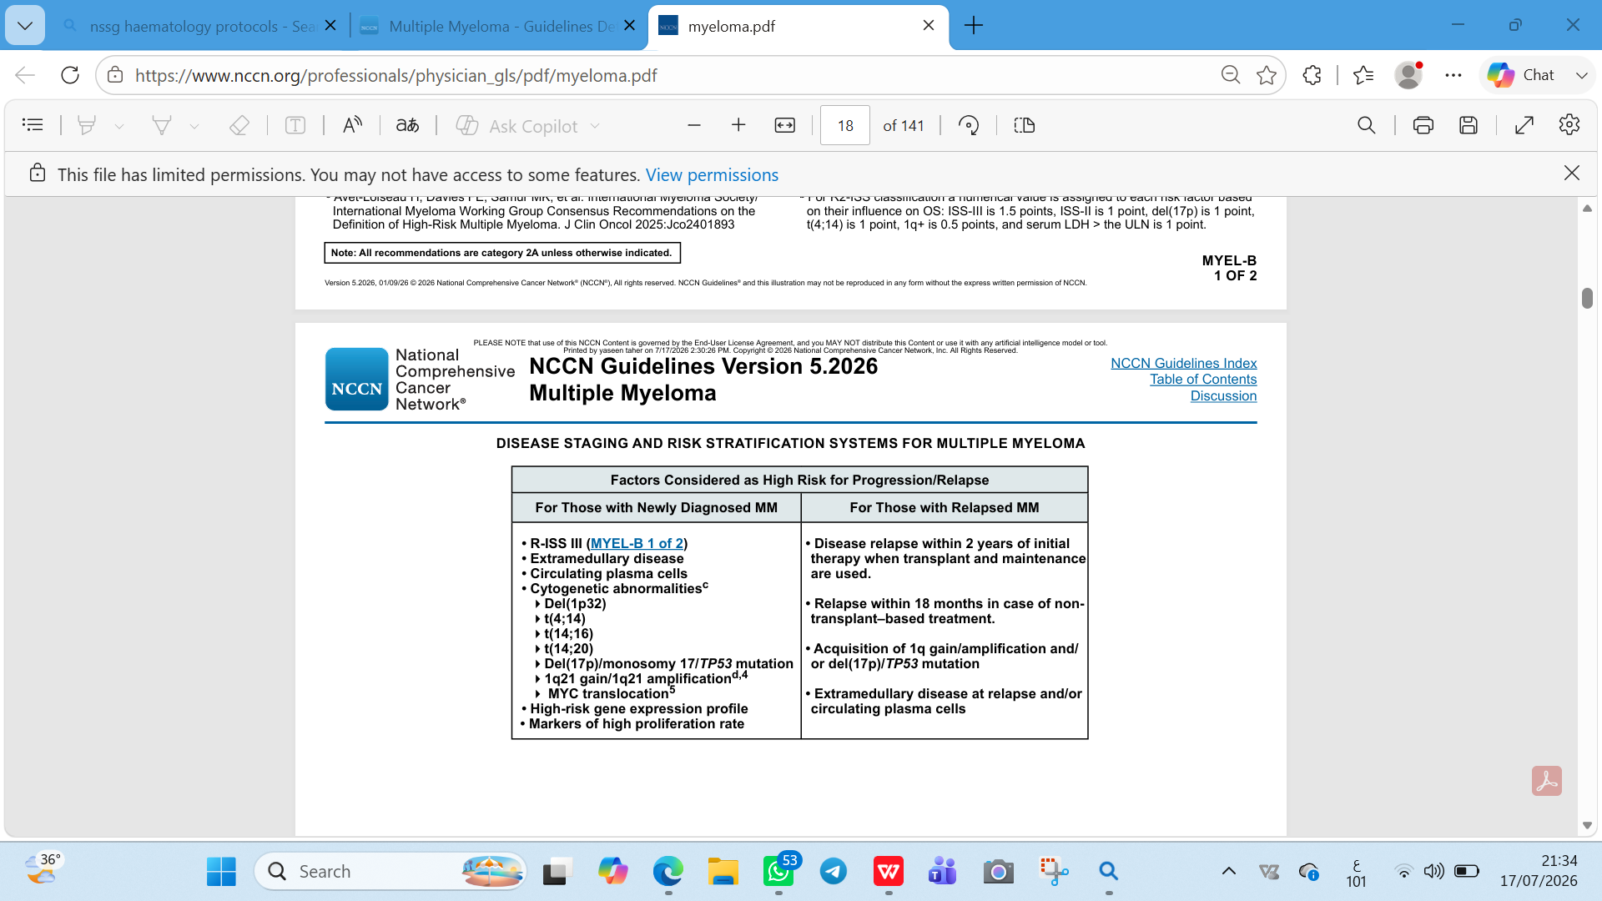

Slide 5
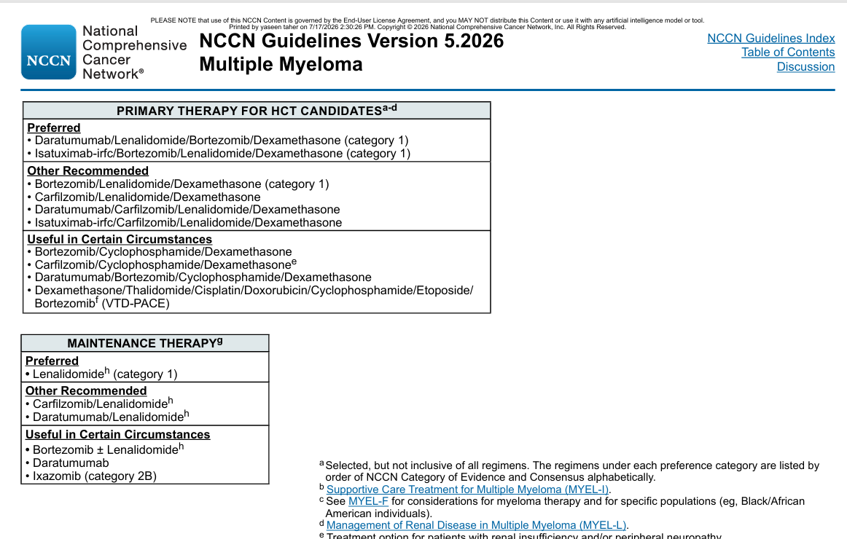

Slide 6
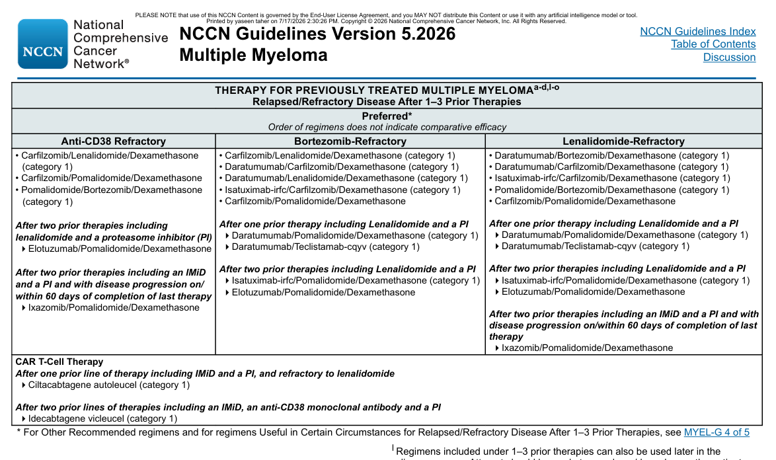

Slide 7
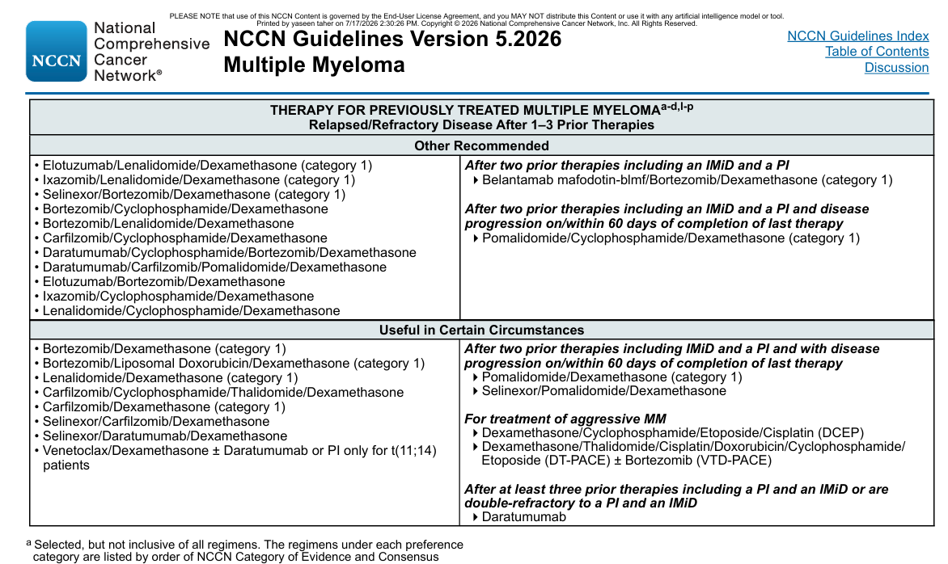

Slide 8
WHEN A PATIENT WITH
MULTIPLE MYELOMA RELAPSES
FOR THE FIRST TIME…
WHAT DO YOU TELL THEM?
HOW DOES IT MAKE THEM FEEL?
HOW DOES IT MAKE YOU FEEL?

Slide 9
Relapse is considered inevitable in almost all MM patients^{1–3}
Each and every relapse worsens a patient’s prognosis and makes their disease harder to treat
Recurrence of myeloma is typically more aggressive with each relapse,
leading to the development of treatment-refractory disease and shorter survival^{2,3}
Estimated median overall survival upon relapsing or becoming refractory to novel agents^{4,5}
22
16
11
7.5
months
months
months
months
Lenalidomide⁴
Thalidomide⁴
Bortezomib⁴
Both PI and IMiD⁵
PI, proteasome inhibitor; IMiD, immunomodulatory drug.
Cejalvo MJ, de la Rubia J. Expert Rev Hematol. 2017;10:383–392.
Dimopoulos MA, et al. Nat Rev Clin Oncol. 2015;12:42–54.
Kurtin SE. J Adv Pract Oncol. 2013;4(Suppl 1):5–14.
Kumar SK, et al. Leukemia. 2012; 26:149–157.
Usmani S, et al. Oncologist. 2016;21:1–7.

Slide 10
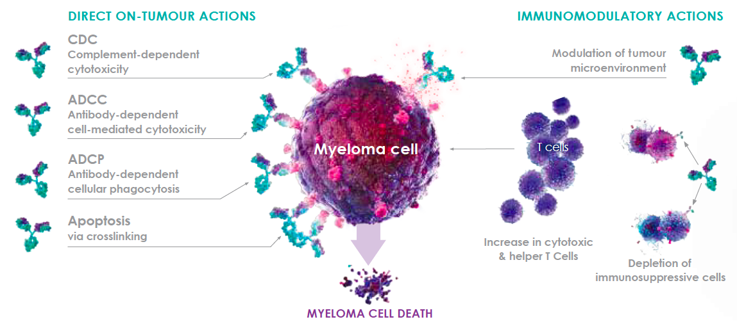
DARZALEX® induces myeloma cell death in multiple ways
Promotes myeloma cell death both through direct on-tumour activity and
a systemic immunomodulatory role^{1,2}
Illustration adapted from McKeage et al. 2016.²
DARZALEX® (daratumumab) EU Summary of Product Characteristics. Feb 2026..
McKeage K, Lyseng-Williamson KA. Drugs Ther Perspect. 2016;32:463–469.

Slide 11
CAN DARZALEX DELAY
FURTHER RELAPSE EARLIER IN
THE TREATMENT PATHWAY?
TWO PHASE III TRIALS WERE UNDERTAKEN TO FIND OUT…

Slide 12
Two phase 3 studies exploring the potential of DARZALEX® in patients with ≥1 prior therapy
The POLLUX trial¹ | The CASTOR trial²
DARZALEX + lenalidomide/dexamethasone (DRd) versus Rd alone | DARZALEX + Velcade® (bortezomib)/dexamethasone (DVd) versus Vd alone
N = 569 | N = 498
Median lines of prior therapy: 1 | Median lines of prior therapy: 2
Patients had progressed on or after their last regimen and had received and responded to at least one prior therapy
Treatment groups balanced in terms of patient and disease characteristics
Primary endpoint: progression-free survival (PFS)
Additional endpoints: time to disease progression; overall response rate; rate of very good partial
response or better; minimal residual disease; time to and duration of response; overall survival
Dimopoulos MA, et al. N Engl J Med. 2016;375:1319–1331.
Palumbo A, et al. N Engl J Med. 2016;375:754–766.

Slide 13
Remarkable efficacy in relapsed patients vs. SOC
Remarkable progression-free survival benefit and levels of response in relapsed MM patients
with ≥1 prior therapy when combined with standard of care^{1,2}
median PFS rates^{1,2}
Overall response rates^{1,2}
More
POLLUX
data
17.5
45.0
76%
93%
months
months
Rd
DRd
Rd
DRd
More
CASTOR
data
7.1
16.7
63%
85%
months
months
Vd
DVd
Vd
DVd
SOC, standard of care.
1. Kaufman JL, et al. Poster presented at the 61st annual meeting of the American Society of Hematology (ASH). Orlando, FL, December 7–10 2019. #1866. 2. Weisel K, et al. Poster presented at the 61st annual meeting of the American Society of Hematology (ASH). Orlando, FL, December 7–10 2019. # 3192.

Slide 14
POLLUX
DARZALEX + LENALIDOMIDE + dexamethasone (DRd) versus Rd alone

Slide 15
Baseline Demographics and Clinical Characteristics
Characteristic | DRd (n = 286) | Rd (n = 283)
Age, median (range); yr ≥75 yrs | 65 (34-89) 10% | 65 (42-87) 12%
ISS stage, %ª I II III | 48 33 20 | 50 30 20
Median (range) time from diagnosis, yr | 3.48 (0.4-27.0) | 3.95 (0.4-21.7)
Creatinine clearance (mL/min) N >30-60 >60 | 279 28 71 | 281 23 77
Prior lines of therapy, % Median (range) 1 2 3 >3 | 1 (1-11) 52 30 13 5 | 1 (1-8) 52 28 13 7
ªISS stage is derived based on the combination of serum β2-microglobulin and albumin.
Dimopoulos MA, et al. N Engl J Med. 2016;375(14):1319-1331

Slide 16
Baseline Demographics and Clinical Characteristics
Characteristic | DRd (n = 286) | Rd (n = 283)
Prior ASCT | 63% | 64%
Prior PI | 86% | 86%
Prior IMiD Prior lenalidomide | 55% 18% | 55% 18%
Prior PI + IMiD | 44% | 44%
Refractory to PI | 20% | 16%
Refractory to last line of therapy | 28% | 27%
ASCT= autologous stem cell transplant.
Dimopoulos MA, et al. N Engl J Med. 2016;375(14):1319-1331

Slide 17
REMARKABLE improvements in
Progression-free survival
POLLUX: updated analysis with a median follow-up of 54.8 months¹
PFS was prolonged with D-Rd versus Rd
In patients receiving 1 prior line of therapy (1PL)
  Median: 53.3 vs 19.6 months (HR, 0.42; 95% CI, 0.31-0.58; P <0.0001)
% surviving without progression
In patients who were refractory to bortezomib
  Median: 34.3 vs 11.3 months (HR, 0.42; 95% CI, 0.25-0.71; P = 0.0008)
In patients with high or standard cytogenetic risk
Standard risk median: 52.0 vs 18.6 months (HR, 0.42; 95% CI, 0.32-0.56; P <0.0001)
High risk median: 26.8 vs 8.3 months (HR, 0.37; 95% CI, 0.18-0.76; P = 0.0056)
Adapted from Kaufman JL, et al. 2019.
1. Kaufman JL, et al. Poster presented at the 61st annual meeting of the American Society of Hematology (ASH). Orlando, FL, December 7–10 2019. #1866.

Slide 18
REMARKABLE improvements in
Progression-free survival
POLLUX: updated analysis with a median follow-up of 54.8 months¹
100
48 mo
80
56% reduction in the risk of progression or death in patients receiving D-Rd
60
% surviving without progression
40
DRd median:
45.0 months
20
Rd median:
17.5 months
HR: 0.44
(95% Cl: 0.35-0.54; p<0.0001)
0
0
3
6
9
12
15
18
21
24
27
30
33
36
39
42
45
48
51
54
57
60
63
No. at risk
Months
DRd
286
266
249
238
229
215
204
195
184
168
156
151
143
136
134
131
125
115
76
16
3
0
Rd
283
249
206
181
160
144
127
112
102
91
83
75
66
63
53
48
45
40
28
5
1
0
Adapted from Kaufman JL, et al. 2019.
1. Kaufman JL, et al. Poster presented at the 61st annual meeting of the American Society of Hematology (ASH). Orlando, FL, December 7–10 2019. #1866.

Slide 19
Patients receiving DARZALEX® early enjoy the greatest PFS benefit (DRd vs. Rd)
POLLUX: patients who had received only 1 prior line of therapy¹
48 mo PFS rate*
100
80
60
54%
58%
reduction in risk of progression or death¹
% surviving without progression
DRd median:
53.3 months
40
24%
20
Rd median:
19.6 months
HR: 0.42
(95% Cl: 0.31-0.58; p<0.001)
0
0
3
6
9
12
15
18
21
24
27
30
33
36
39
42
45
48
51
54
57
60
63
No. at risk
Months
Rd
146
132
110
100
90
78
71
64
60
52
45
40
36
35
30
27
26
21
16
2
1
0
DRd
149
137
129
123
118
113
107
103
99
94
89
85
83
79
77
76
73
67
50
8
2
0
Adapted from Kaufman JL, et al. 2019.
1. Kaufman JL, et al. Poster presented at the 61st annual meeting of the American Society of Hematology (ASH). Orlando, FL, December 7–10 2019. #1866.

Slide 20
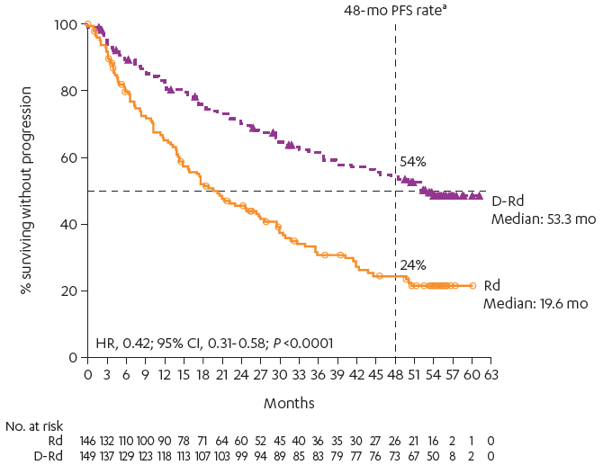
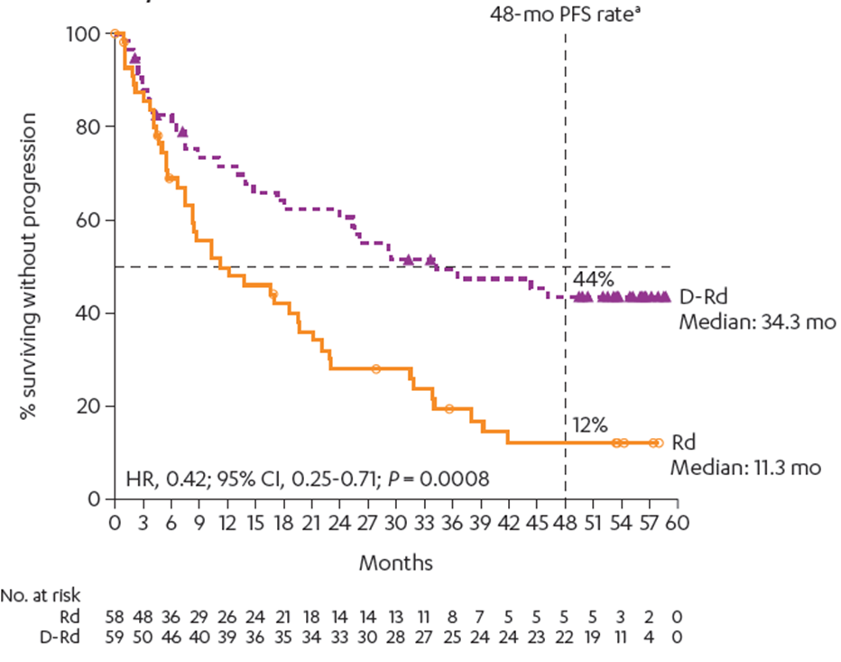
Exploratory Analysis of PFS in Patient Subgroups
Patients With 1 Prior Line of Therapy at Baseline
Patients Refractory to Bortezomib
D-Rd: 149/286 (52%)
Rd: 146/283 (52%)
D-Rd: 241/286 (84%)
Rd: 238/283 (84%)
D-Rd prolonged PFS versus Rd among patients who received 1 prior line of therapy
D-Rd also prolonged PFS versus Rd among patients who were refractory to bortezomib
Kaufman J, et al. American Society of Hematology (ASH). 2019. Poster 1866.

Slide 21
Meaningful responses when adding DARZALEX® to lenalidomide/dexamethasone*
Rapid and deep responses^{1,2}
Median time to response
for DRd was 1.0 month¹
Higher ORR, ≥CR rate, and ≥VGPR rate with D-Rd
58%
of patients achieved ≥CR with DRd²
Data from Kaufman JL, et al. 2019.
CR, complete response; PR, partial response; sCR, stringent complete response; VGPR, very good partial response.
Dimopoulos MA, et al. N Engl J Med. 2016;375:1319–1331. Supplementary appendix.
2. Kaufman JL, et al. Poster presented at the 61st annual meeting of the American Society of Hematology (ASH). Orlando, FL, December 7–10 2019. #1866.

Slide 22
MRD detection continues to improve
MRD-negativity is fast gaining prominence as a potential marker for long-term survival in multiple myeloma^{1–3}
Traditionally, the sensitivity of MRD analysis has been 10⁻⁴
  Able to detect a single malignant cell from a sample of 10,000⁴
The new IMWG-recommended standard is 10⁻⁵
  Able to detect a single malignant cell from a sample of 100,000⁴
The POLLUX and CASTOR trials investigated MRD-negativity up to 10⁻⁶
  Able to detect a single malignant cell from a sample of 1,000,000⁵
“Deep and sustained MRD negativity represents a critical milestone on the path to
developing a cure for patients with multiple myeloma.”
Landgren & Iskander. J Intern Med. 2017³
Munshi NC, et al. JAMA Oncol. 2017;3:28–35.
Harousseau J-L. J Clin Oncol. 2017;35:2863–2865.
Landgren O, Iskander K. J Intern Med. 2017;281:365–382.
Kumar S, et al. Lancet Oncol. 2016;17:e328–e346.
Avet-Loiseau H, et al. Poster presented at the 60th annual meeting of the American Society of Hematology (ASH). San Diego, December 1–4 2018. #3272.

Slide 23
DARZALEX® achieved exceptional levels of MRD-negativity* in THE POLLUX TRIAL¹
ITT and 1PL populations
Adapted from Kaufman JL, et al. 2019.
*MRD testing was performed on ficolled bone marrow aspirate samples via the clonoSEQ® assay V2.0 (Adaptive Biotechnologies, Seattle, WA) at a sensitivity threshold of 10^{–5} (1 cancer cell per 100,000 nucleated cells)
at the time of suspected CR/stringent CR (sCR; blinded to treatment group). Median follow-up; 54.8 months.
1. Kaufman JL, et al. Poster presented at the 61st annual meeting of the American Society of Hematology (ASH). Orlando, FL, December 7–10 2019. #1866.

Slide 24
Patients receiving Darzalex® achieved sustained
MRD-negativity*¹
ITT population
Significantly more patients were
MRD-negative at ≥6 months and
also at ≥12 months with DRd vs. Rd¹
Adapted from Kaufman JL, et al. 2019.
*MRD testing was performed on ficolled bone marrow aspirate samples via the clonoSEQ® assay V2.0 (Adaptive Biotechnologies, Seattle, WA) at a sensitivity threshold of 10^{–5} (1 cancer cell per 100,000 nucleated cells).
1. Kaufman JL, et al. Poster presented at the 61st annual meeting of the American Society of Hematology (ASH). Orlando, FL, December 7–10 2019. #1866.

Slide 25
MRD-negativity* is associated with superior progression-free survival¹
POLLUX subgroup analysis: PFS according to MRD status at 10⁻⁵ threshold¹
PFS was prolonged in patients
who achieved MRD negativity¹
PFS was prolonged in patients
with sustained MRD negativity ≥6 months compared with patients who did not achieve sustained MRD negativity, regardless of treatment arm¹
Adapted from Avet-Loiseau H, et al. 2018.
* MRD was assessed using bone marrow aspirate samples and evaluated via NGS using the clonoSEQ® assay V2.0; Adaptive Biotechnologies, Seattle, WA).
1. Avet-Loiseau H, et al. Poster presented at the 60th annual meeting of the American Society of Hematology (ASH). San Diego, December 1–4 2018. #3272.

Slide 26
Patients treated with darzalex® have prolonged pfs on their subsequent line of therapy¹
Progression-free survival on the subsequent line of therapy (PFS2)*¹
47%
reduction in risk of progression or death
on the subsequent
line of therapy^{†1}
Back
Adapted from Kaufman JL, et al. 2019.
*PFS2 is defined as time from randomization to disease progression after the next line of subsequent therapy or death.
†DRd vs. Rd alone.
1. Kaufman JL, et al. Poster presented at the 61st annual meeting of the American Society of Hematology (ASH). Orlando, FL, December 7–10 2019. #1866.

Slide 27
POTENTIAL BENEFIT FOR ALL MM PATIENTS
Consistently high efficacy outcomes across multiple patient subgroups
  Subgroup analyses show that advantages in terms of progression-free survival and response are maintained for DRd vs. Rd alone^{1–5}
  These include the following:
High cytogenic risk
Treatment-free interval
≤12 months
Treatment-free interval
>12 months
Prior lenalidomide exposure
Prior Velcade® exposure
Velcade® refractory
1. Dimopoulos MA, et al. Haematologica. 2018; 103(12):2088-2096. 2. Bahlis NJ, et al. Poster presented at the 60th annual meeting of the American Society of Hematology (ASH). San Diego, December 1–4 2018. #1996.
3. Usmani SZ, et al. Poster presented at the 60th annual meeting of the American Society of Hematology (ASH). San Diego, December 1–4 2018. #3288. 4. Kaufman JL, et al. Poster presented at the 61st annual meeting of the American Society of Hematology (ASH). Orlando, FL, December 7–10 2019. #1866. 5. Kaufman JL et al. Poster presented at the annual meeting of the American Society of Clinical Oncology (ASCO); May 31-June 4, 2019; Chicago, Illinois #8038.

