Slide 1
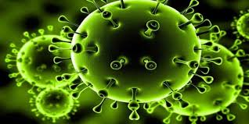
L
المدرس المساعد :علياء كريم عبود
قسم العلاج التجريبي
المركز العراقي لبحوث السرطان والوراثة الطبية /الجامعة المستنصرية /المادة فايروسات /المرحلة الاولى

Slide 6
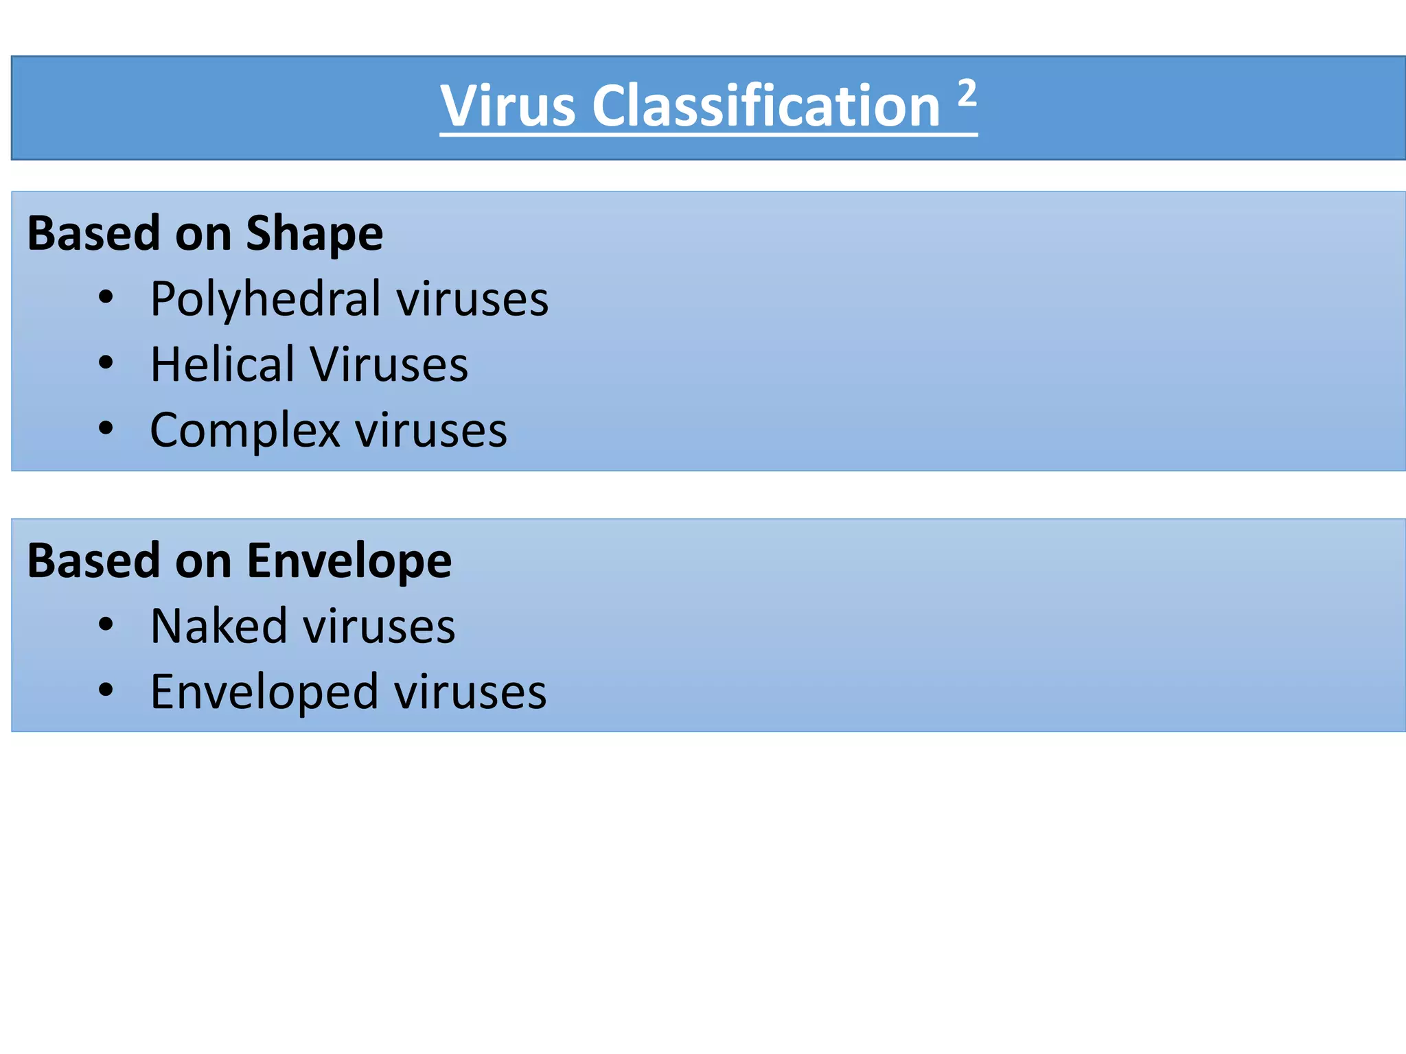

Slide 10
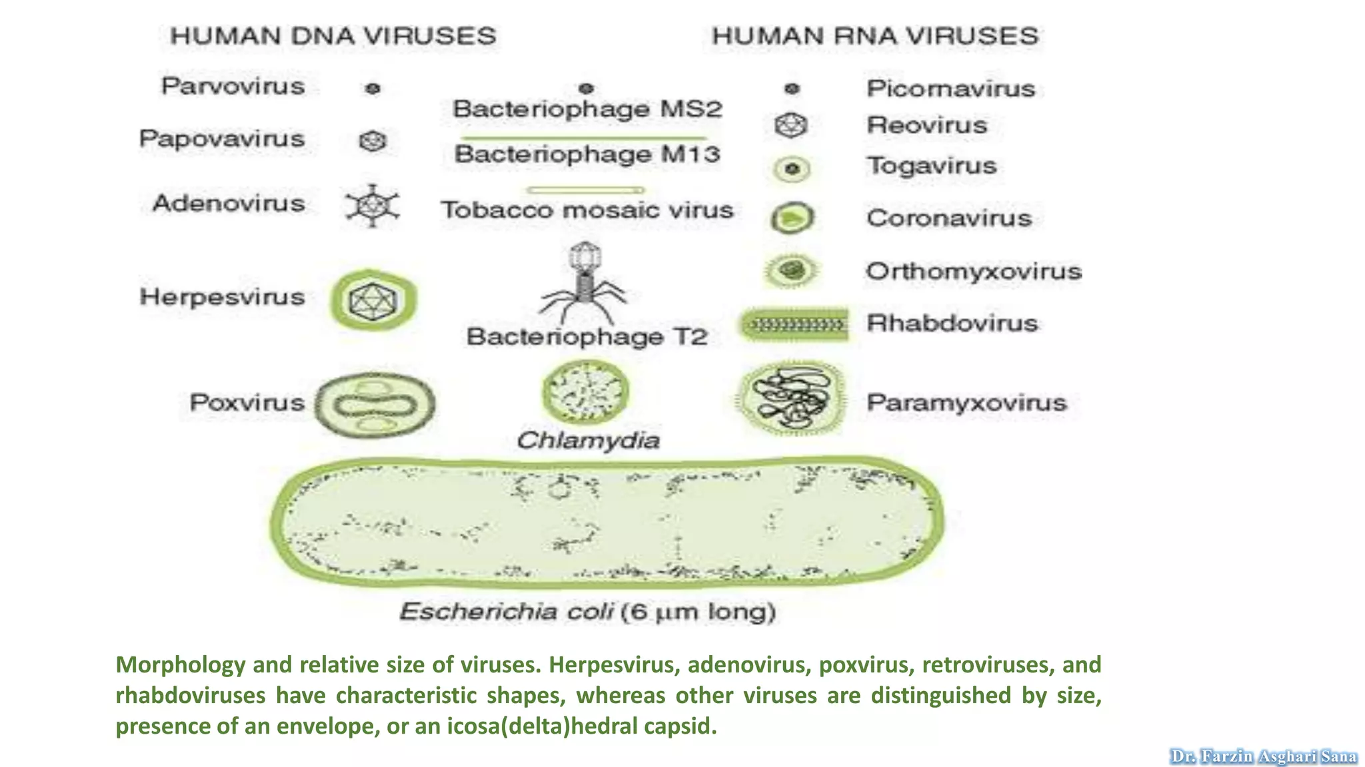

Slide 13
References :
1-Fenner, Frank, et al. "Structure and Composition of Viruses." Veterinary Virology (1987): 3.
2-Horsfall, F. L., & Tamm, I. (1965). Viral and rickettsial infections of man. In Viral and rickettsial infections of man (pp. xvi-1282).‏
3-Daniels, R. S., Douglas, A. R., Skehel, J. J., & Wiley, D. C. (1983). Analyses of the antigenicity of influenza haemagglutinin at the pH optimum for virus-mediated membrane fusion. Journal of General Virology, 64(8), 1657-1662.‏
4-Choppin, Purnell W., and Richard W. Compans. "Reproduction of paramyxoviruses." Comprehensive Virology: Reproduction: Large RNA Viruses. Boston, MA: Springer US, 1975. 95-178.‏
5-KAARIAINEN, LEEVI, and MARJA PESONEN. "Virus Glycoproteins and Glycolipids: Structure, Biosynthesis, Biological Function." The Glycoconjugates V4: Glycoproteins, Glycolipids and Proteoglycans (2012): 191.
6-‏Ludwig, Hanns. "Bovine herpesviruses." The Herpesviruses: Volume 2. Boston, MA: Springer US, 1983. 135
214.‏
7-Galinski, Mark S., and Steven L. Wechsler. "The molecular biology of the paramyxovirus genus." The paramyxoviruses. Boston, MA: Springer US, 1991. 41-82.‏
‏

