Slide 1
Medicinal Chemistry of Anticancer Agents

Slide 2
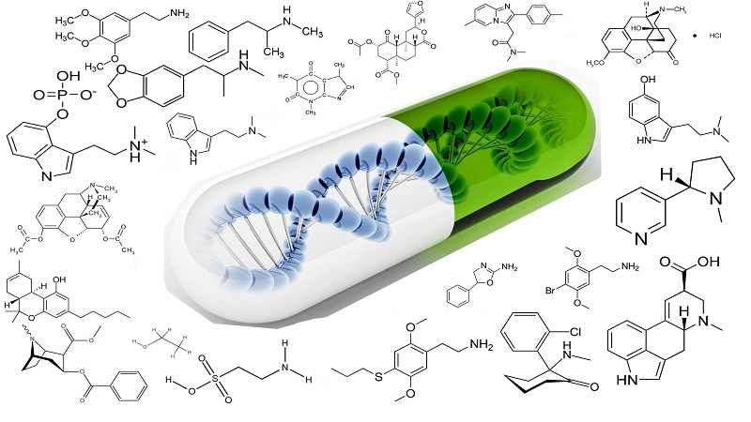
Medicinal chemistry
is a scientific discipline at the intersection of chemistry, pharmacology, and biology. It involves the design, synthesis, and development of pharmaceutical agents or bio-active molecules. Here is an overview of the key aspects of medicinal chemistry.

Slide 3
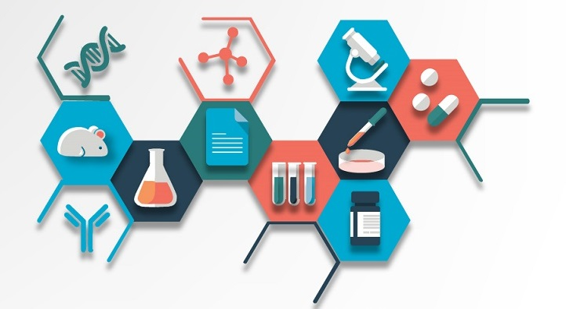
Medicinal chemistry applications
1. Drug Design and Discovery:
- Target Identification: Understanding biological targets such as proteins, enzymes, or genes that are associated with diseases.
- Lead Compound Identification: Screening and identifying compounds that have a desired biological effect.

Slide 4
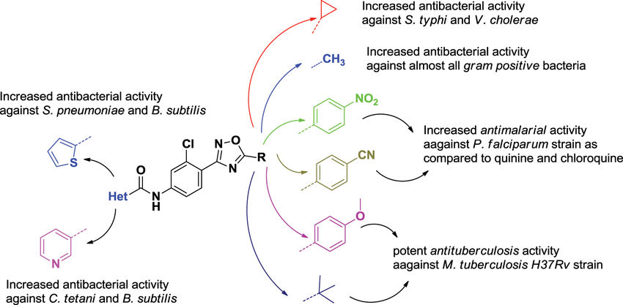
-Structure-Activity Relationship (SAR):
Studying the relationship between the chemical structure of a molecule and its biological activity to optimize efficacy and reduce side effects.

Slide 5
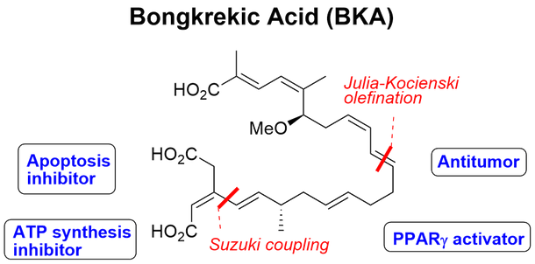
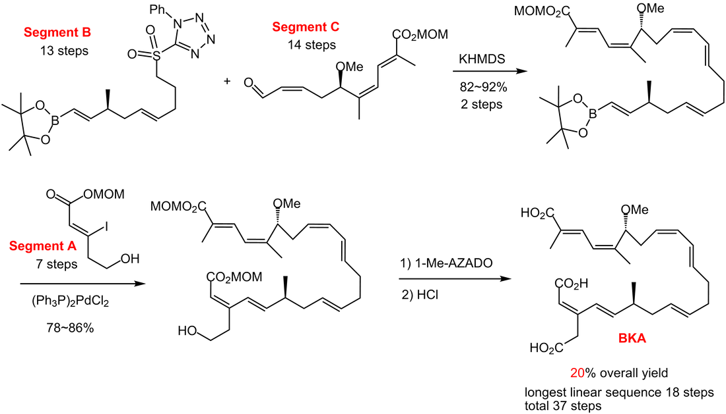
2. Synthesis of Bio-active Compounds:
- Chemical Synthesis: Developing methods to chemically synthesize the target molecules in an efficient and scalable manner.
- Optimization: Modifying the chemical structure of lead compounds to improve their properties, such as potency, selectivity, and pharmacokinetic profile.

Slide 6
3. Pharmacokinetics and Pharmacodynamics:
- Pharmacokinetics (PK): Studying the absorption, distribution, metabolism, and excretion (ADME) of drugs.
- Pharmacodynamics (PD): Understanding the biochemical and physiological effects of drugs and their mechanisms of action.
4. Drug Development and Safety:
- Preclinical Testing: Evaluating the safety and efficacy of drug candidates in vitro (cell-based) and in vivo (animal) models.
- Clinical Trials: Conducting trials in humans to assess the drug's safety, efficacy, dosage, and side effects.
5. Regulatory Affairs:
- Approval Process: Navigating the regulatory environment to gain approval from agencies such as the FDA (Food and Drug Administration) or EMA (European Medicines Agency).

Slide 7
Cancer :
is a term used for diseases in which abnormal cells divide without control and are able to invade other tissues. Cancer cells can spread to other parts of the body through the blood and lymph systems, this process is called metastasis.
Characteristics of Cancer Cells :
Cancer involves the development and reproduction of abnormal cells
Cancer cells are usually nonfunctional Cancer cell growth is not subject to normal body control mechanisms
Cancer cells eventually metastasize to other organs via the circulatory and
lymphatic systems.
Types of Tumors:
Benign: non cancerous and not an immediate threat to life, even though treatment eventually may be required for health.
Malignant: tending to worsen and cause death, invasive and metastasis

Slide 9
The field of medicinal chemistry in anticancer agents
involves designing and synthesizing molecules that can selectively target and inhibit the growth of cancer cells. These agents often work by interfering with specific biological pathways or processes that are crucial for cancer cell survival and proliferation, such as DNA replication, cell cycle progression, or angiogenesis. Researchers also focus on optimizing the pharmacokinetic properties of these molecules to improve their effectiveness and minimize side effects.
Mechanisms of Action
DNA Replication Inhibitors: Many anticancer agents work by interfering with the DNA replication process. For example, drugs like cisplatin and carboplatin form cross-links within DNA, preventing the DNA strands from unwinding and replicating. This ultimately leads to cell death.

Slide 10
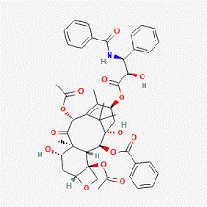
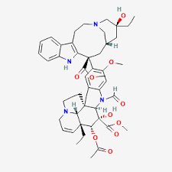
Cell Cycle Progression Inhibitors:
These agents disrupt the cell cycle, which is the process that cells go through to divide and proliferate. Agents like taxanes (e.g., paclitaxel) and vinca alkaloids (e.g., vincristine) inhibit microtubule function, essential for mitotic spindle formation during cell division, effectively arresting the cell cycle and leading to apoptosis.
paclitaxel
vincristine

Slide 11
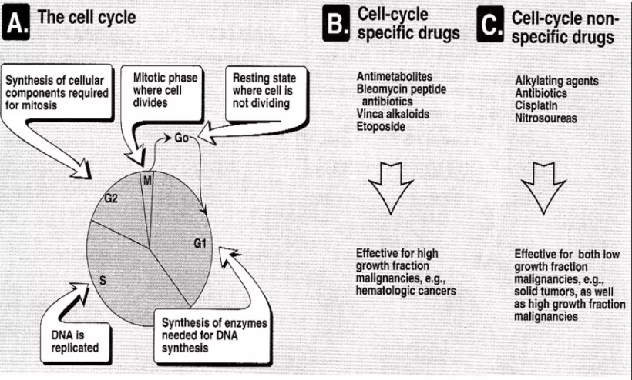

Slide 12
Angiogenesis Inhibitors:
Tumors require a blood supply to grow and spread. Angiogenesis inhibitors, such as bevacizumab, block the growth of new blood vessels to the tumor, effectively starving it of nutrients and oxygen.

Slide 13
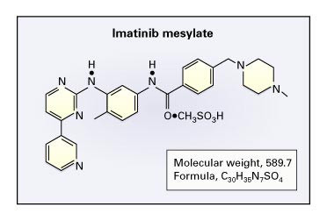
Targeted Therapies:
These are designed to specifically target molecular markers associated with cancer cells. For instance, imatinib targets the BCR-ABL tyrosine kinase in chronic myeloid leukemia, while trastuzumab targets the HER2 receptor in certain breast cancers.

Slide 14
Recent Advances
Prodrug Strategies: Inactive compounds that are metabolized into active agents within the body, often designed to improve solubility, absorption, and targeted delivery.
Nanotechnology: Utilizing nanoparticles to deliver drugs directly to tumor cells, enhancing the specificity and reducing off-target effects.
Biological Agents: Including monoclonal antibodies and small molecule inhibitors that specifically target cancer cell antigens or intracellular pathways.
Combination Therapies: Using multiple drugs with different mechanisms of action to enhance overall efficacy and reduce the likelihood of resistance.

Slide 15
Challenges and Future Directions
Resistance Mechanisms: Cancer cells can develop resistance to treatments, necessitating the development of agents that can overcome or bypass resistance mechanisms.
Selective Targeting: Improving the selectivity of agents to target only cancer cells while sparing normal, healthy cells to reduce side effects.
Personalized Medicine: Tailoring treatments based on individual genetic and molecular profiles of patients’ tumors to improve outcomes.

Slide 16
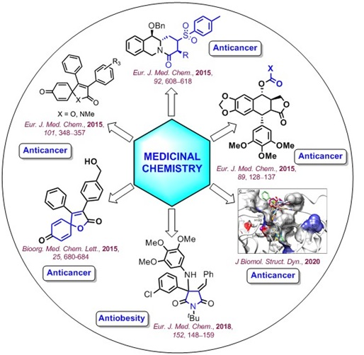
The field of medicinal chemistry in anticancer agents is continually evolving, driven by advances in our understanding of cancer biology and the development of innovative technologies and approaches to drug design and delivery. The ultimate goal remains to develop safer, more effective treatments that can improve survival and quality of life for cancer patients.

