Slide 1
Genotoxicity
دكتورة زينب سعد عبد الغني
قسم الاحياء الجزيئي
المركز العراقي لبحوث السرطان والوراثة الطبية
الجامعة المستنصرية

Slide 2
What is Genotoxicity?
In genetics, genotoxicity is a term that describes the properties of chemicals pertaining to their ability to cause damage to genetic material. This can lead to mutations and, possibly, various types of cancer.
Genotoxicity is similar to and can be confused with mutagenicity except that all mutagenic substances are genotoxic, whereas, conversely, not all genotoxic substances are mutagenic.

Slide 3
Genotoxicity can lead to indirect or direct effects on the DNA including mutation induction, mistimed event activation, and direct DNA damage which leads to mutations. It causes direct, heritable changes that can be passed to future generations of cells.
Whereas this would normally be mitigated by the organism via DNA repair or the process of apoptosis (controlled cell death) the damage may not always be fixed, which leads to mutagenesis.

Slide 4
Genotoxins can include chemical substances and radiation.
Depending on their effects within an organism, genotoxins can be categorized thusly:
Carcinogens (cancer-causing agents) may be natural, such as aflatoxin, which is produced by a fungus and sometimes found on stored grains, or manmade, such as asbestos or tobacco smoke. Carcinogens work by interacting with a cell's DNA and inducing genetic mutations.
Mutagens (mutation-causing agents) is a chemical or physical phenomenon, such as ionizing radiation, that promotes errors in DNA replication. Exposure to a mutagen can produce DNA mutations that cause or contribute to diseases such as cancer.
Teratogens (birth defect causing agents) are substances that may produce physical or functional defects in the human embryo or fetus after the pregnant woman is exposed to the subustance

Slide 5
There are two different effects of a genotoxic agent in a eukaryotic organism depending on which type of cell is affected.
In somatic cells, genetic damage may lead to malignancy (cancer)
whereas in germ cells heritable mutations may occur leading to birth defects.

Slide 6
Common damage caused by genotoxic agents includes:
single and double-strand breaks in DNA,
structural and numerical chromosomal aberrations,
point mutations, and
loss of excision repair.
Knowledge of the potential effects of the chemical is vital if public safety is to be assured.

Slide 7
Genotoxicity Testing:
Evaluation of the genotoxicity effects of various materials for use as drug components is vital.
For example, chromium, which is a transition metal, can cause DNA lesions which can lead to carcinogenesis.

Slide 8
Many different techniques can be used to test for the genotoxicity of a substance:
These can either be in-vivo or in-vitro tests and include:
Ames Assay – This commonly used technique uses multiple bacterial strains of Salmonella typhimurium to compare different genetic changes and assess the genotoxicity of a substance.
The bacteria are incubated with histidine, which they need but cannot produce. Any strains which are left alive at the end of the test will, therefore, have mutated to synthesize histidine, which indicates that the chemical is potentially genotoxic.
This technique is useful for identifying frameshift and point mutations.

Slide 9
Comet Assay (Single-cell gel electrophoresis) – : commonly used technique that measures DNA strand breaks in cells.
Cells are embedded in agarose and are lysed with detergents and high salt. Comet-like structures are formed (hence the name) with damaged DNA strands containing double-strand breaks migrating toward the anode.
This technique is advantageous as it can detect low levels of DNA damage and is a relatively simple and cheap procedure that produces quick results.
However, a comet assay does not reveal the underlying mechanism for the genotoxic effect of the chemical.

Slide 10
Micronucleus Test (MN) – This is a toxicological technique that is widely recognized as one of the most reliable and successful assays for genotoxic studies.
A micronucleus is an erratic nucleus containing chromosomal fragments that are formed during the anaphase of mitosis or meiosis during cell replication.
By studying the number of micronuclei produced in cells that have been exposed to the chemical under analysis, potential genotoxic and mutagenic properties can be evaluated.

Slide 11
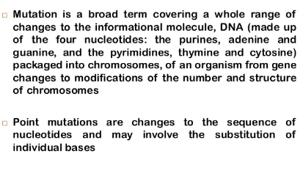

Slide 12
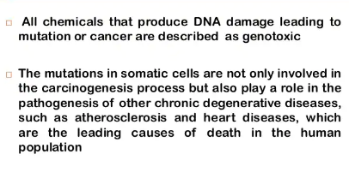

Slide 13
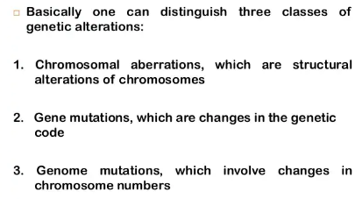

Slide 14
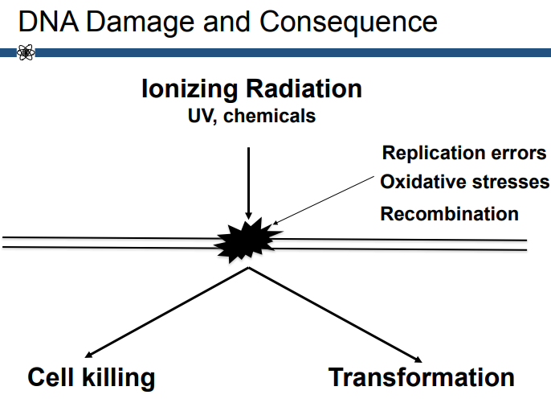

Slide 15
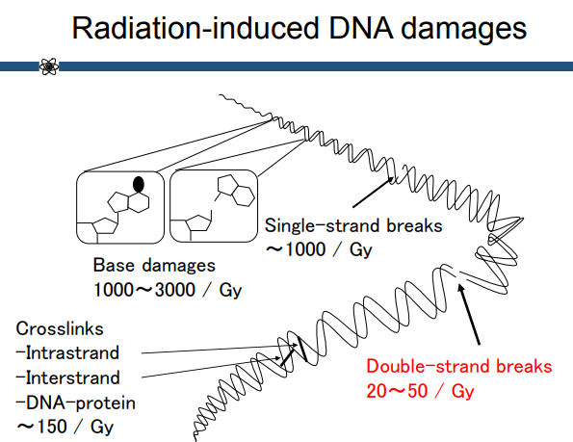

Slide 16
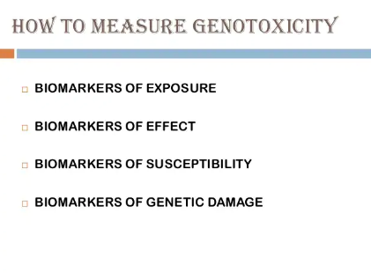

Slide 17
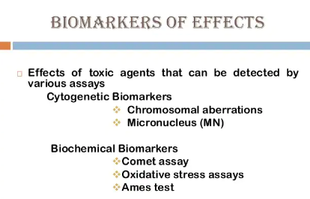

Slide 18
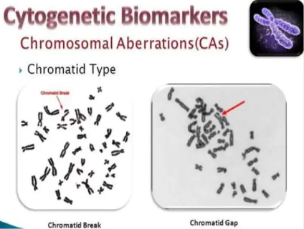

Slide 19
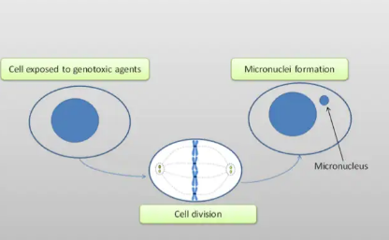

Slide 20


Slide 21
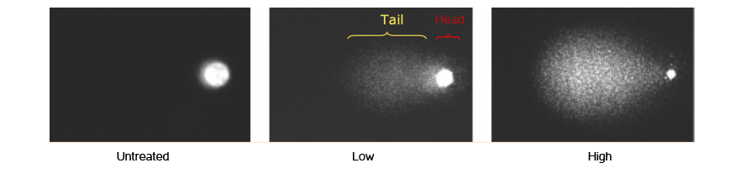

Slide 22
