Slide 1
Cytogenetic analysis for AML
Submitted by
DR. Amal Mohammed Ali
2024

Slide 2
AML
Acute myeloid leukemia (AML) is a hematopoietic disorder in which there are too many immature blood-forming cells accumulating in the bone marrow and interfering with the production of normal blood cells.
It is characterized by malignant clonal proliferation and differentiation of immature myeloid progenitor cells that differentiate into malignant myeloblasts that cannot function like normal blood cells.
The majority of patients are found to relapse, therapy resistant cells are believed to be the origin of the relapse.

Slide 3
One of traditional technique for follow up AML patients is cytogenetic techniques, it consider to be one of the most important valuable prognostic determinators in AML.
Leukemogenesis arises from a series of transformational events leading to chromosomal abnormalities.

Slide 4
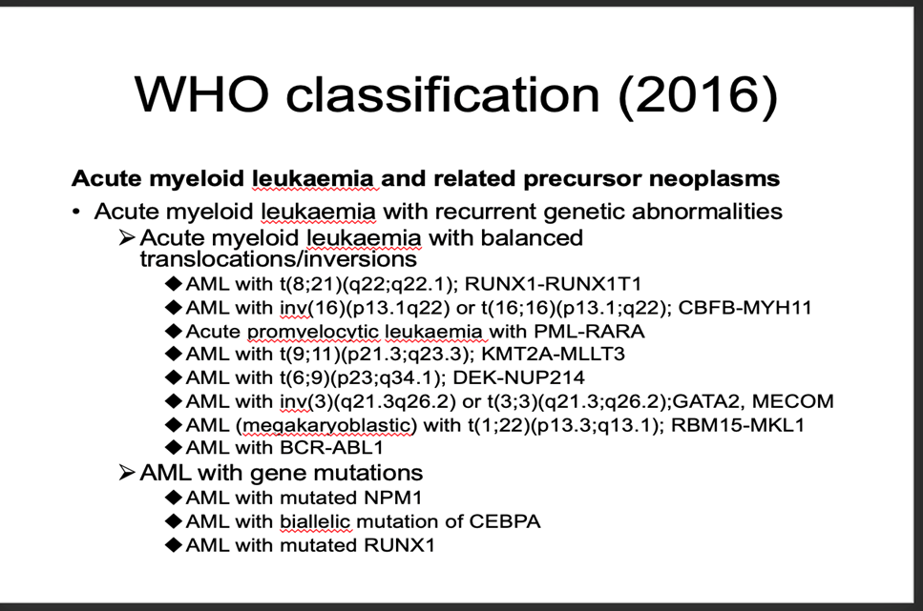
different subclasses of acute myeloid leukemia according to the FAB classification system

Slide 5
This classification system based on gene expression analysis and next-generation sequencing that can improve the disease diagnostic as well as the prognostic relevance of structure which divided AML to seven groups, focusing on cytogenetic and molecular genetic differences between these groups

Slide 6
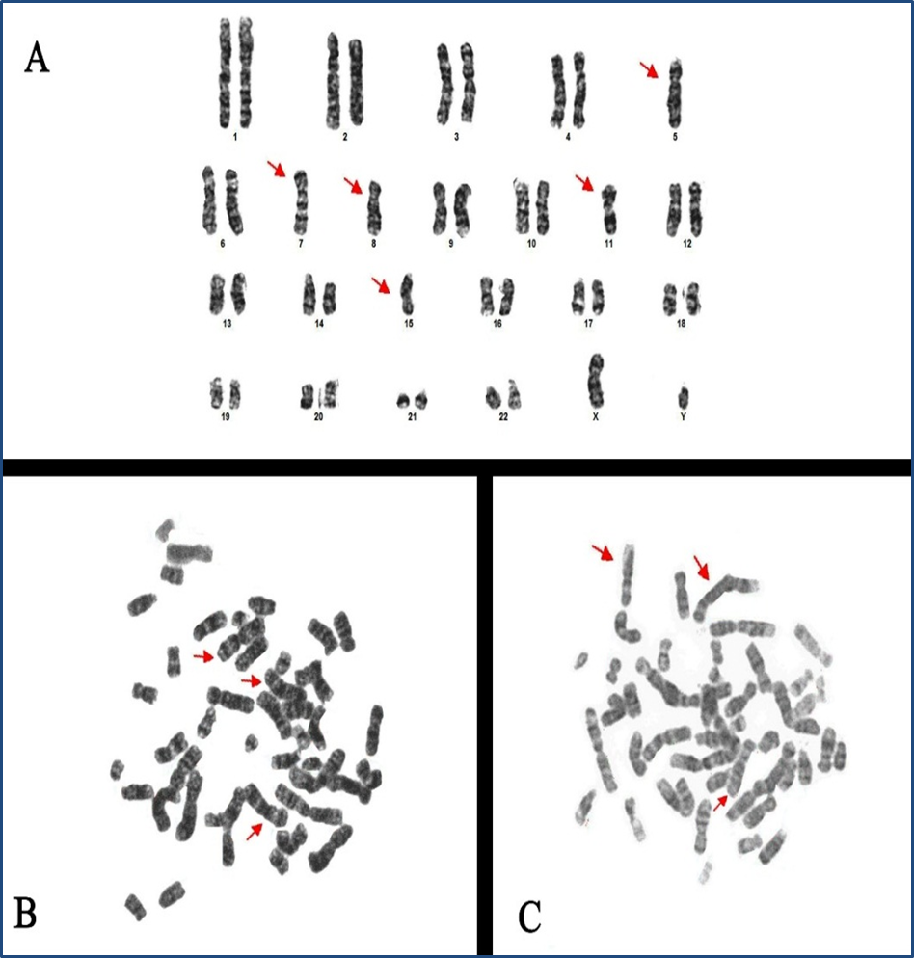
Monosomy chromosomes 5, 7,8,11 and 15 B: Trisomy chromosome 3 and C: Trisomy chromosome 6 (red arrows) in Acute myeloid leukemia groups .

Slide 7
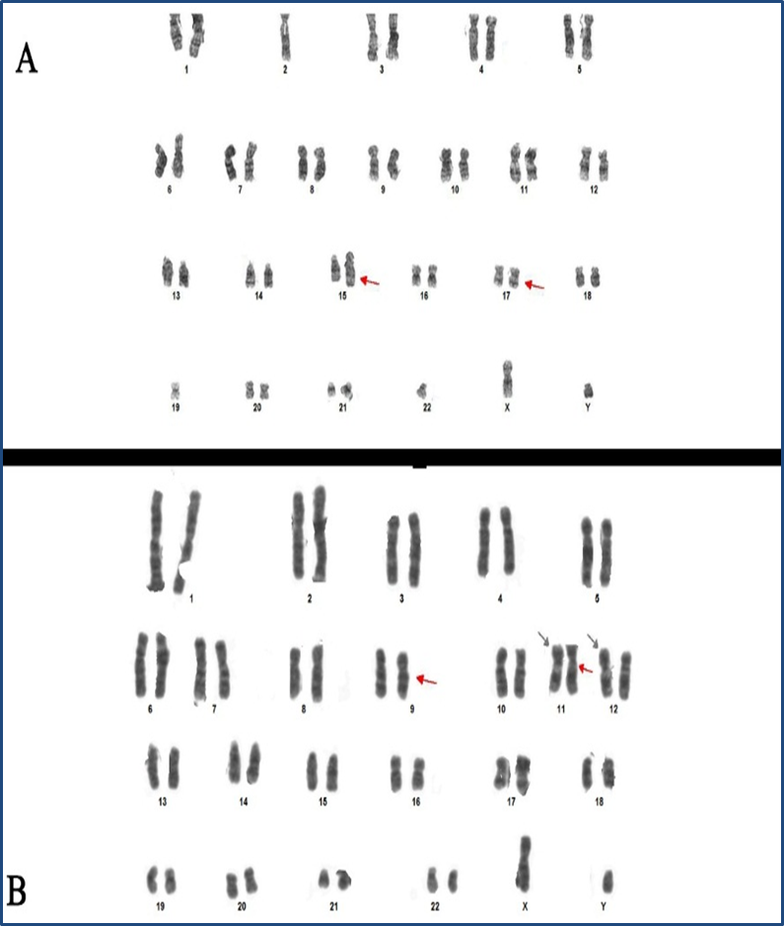
Translocation 15:17 B: Translocation 9:11 (red arrows) C: translocation 11:12 (black arrows) in Acute myeloid leukemia groups .

Slide 8
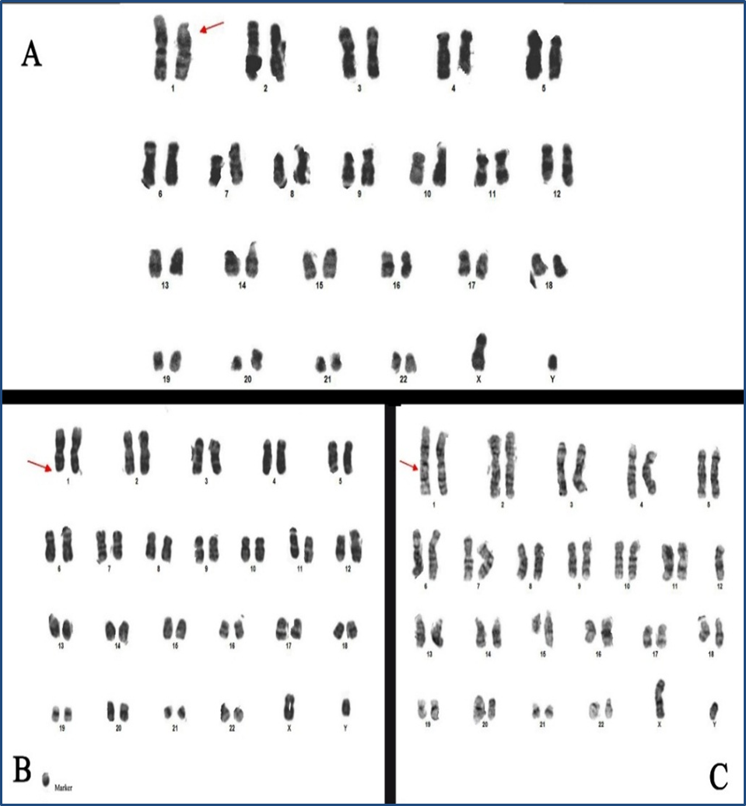

Slide 9
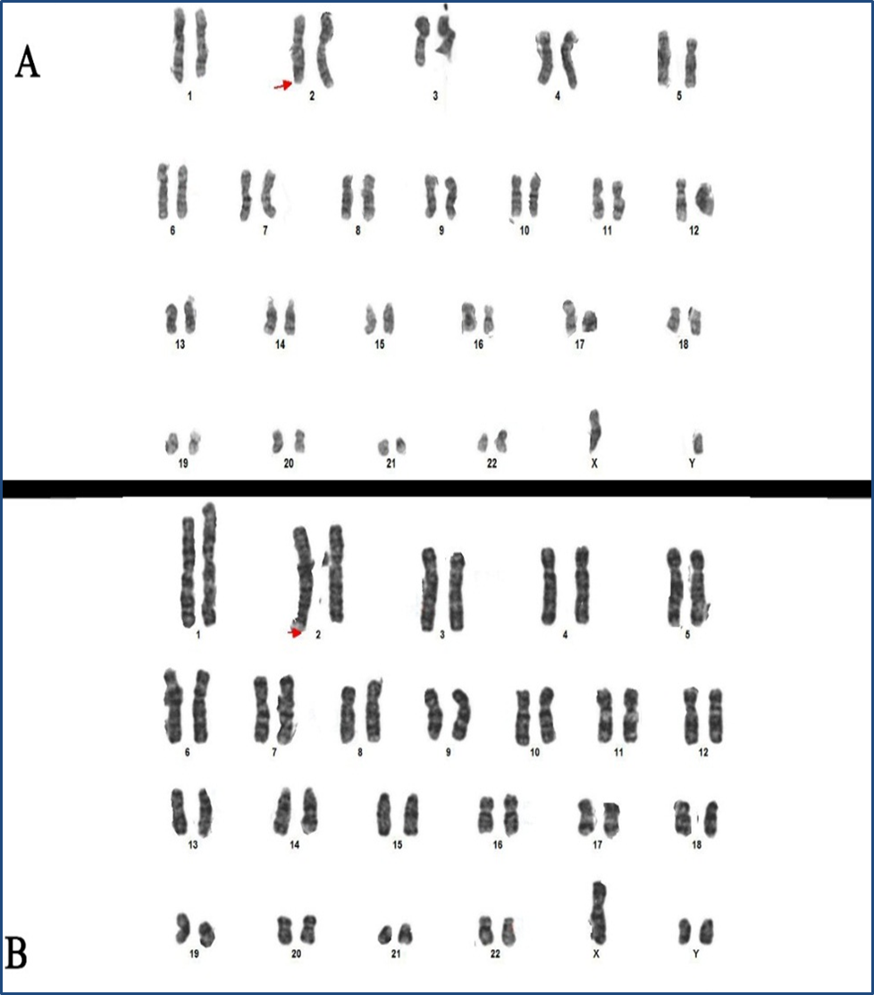

Slide 10
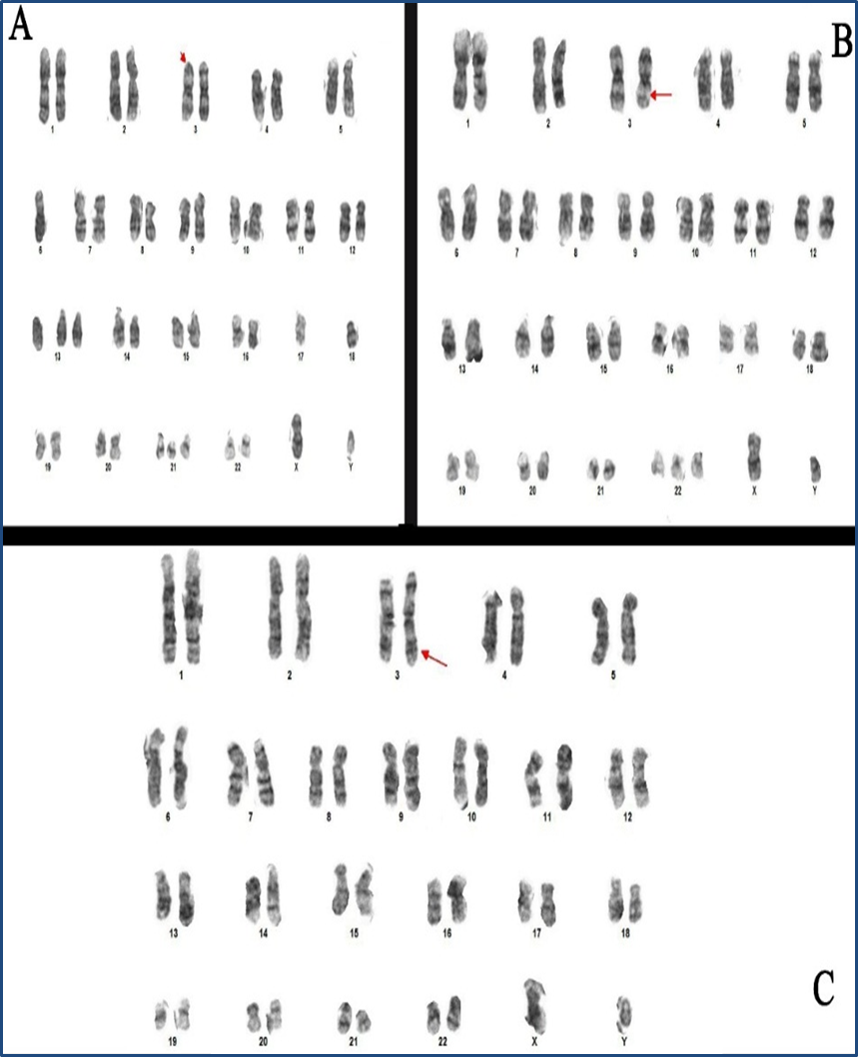

Slide 11
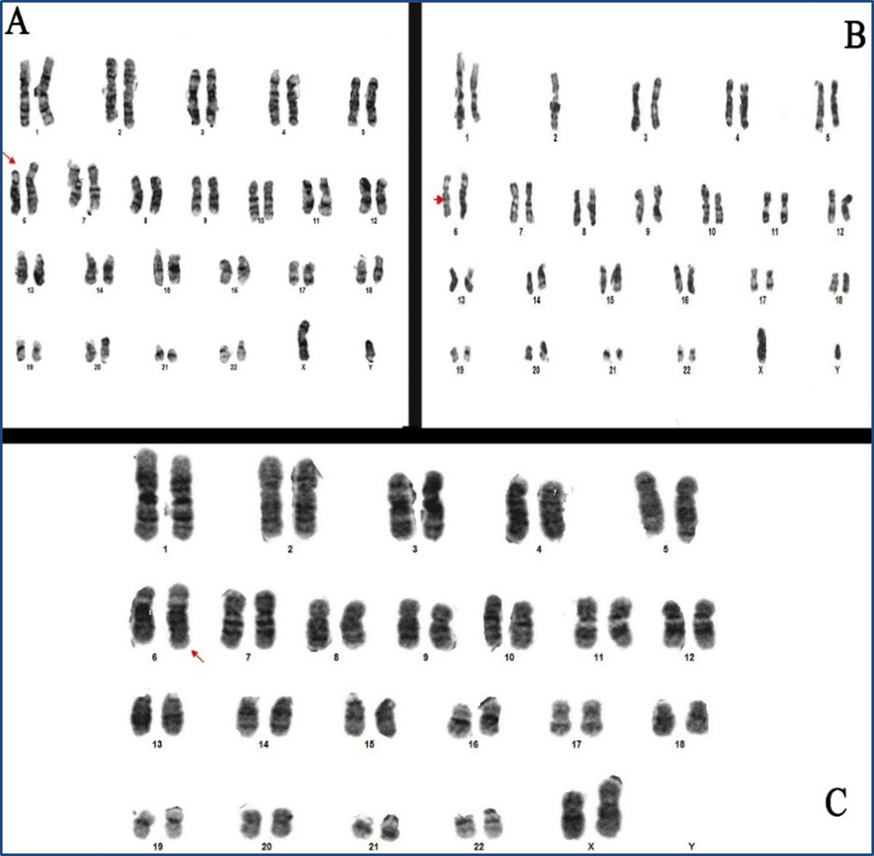

Slide 12
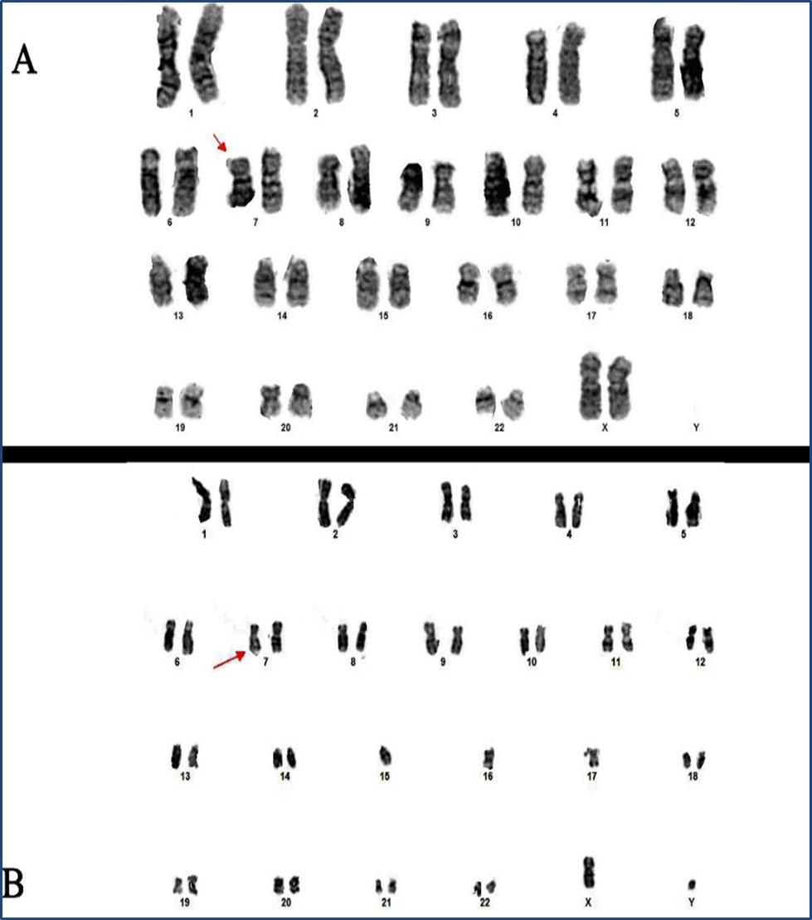

Slide 13
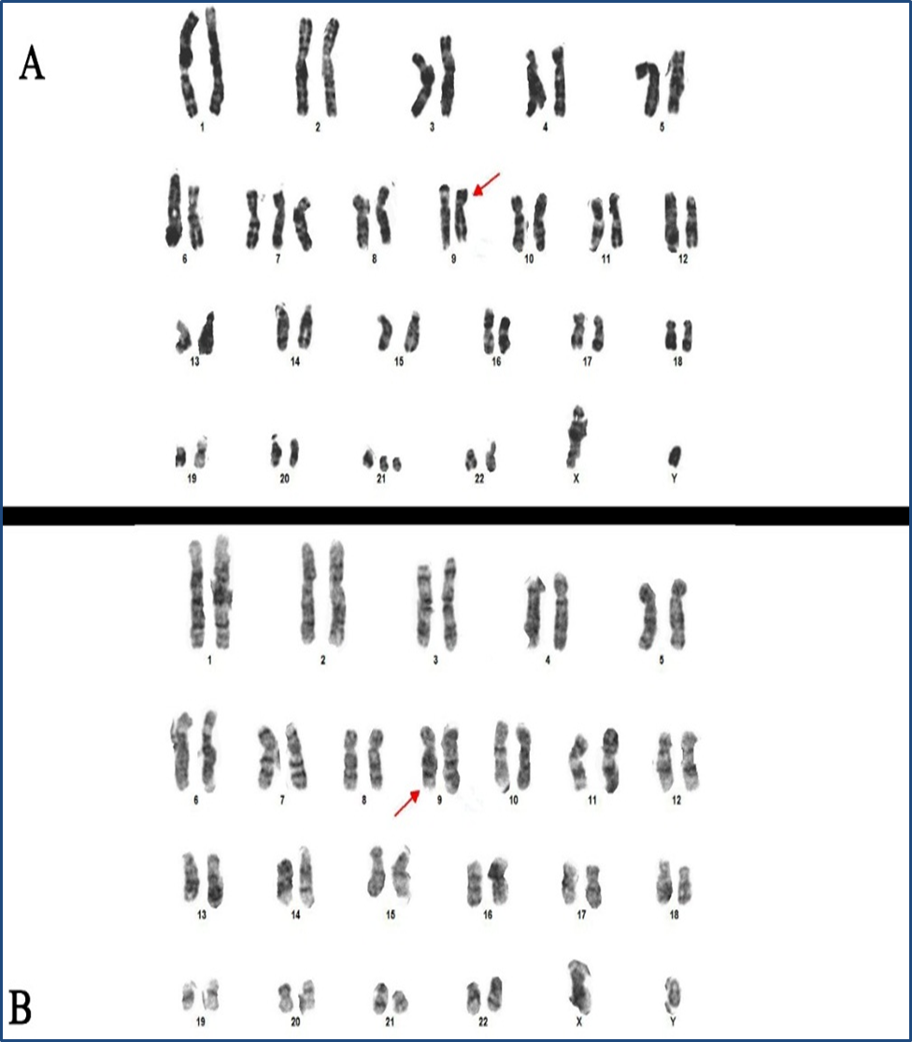

Slide 14
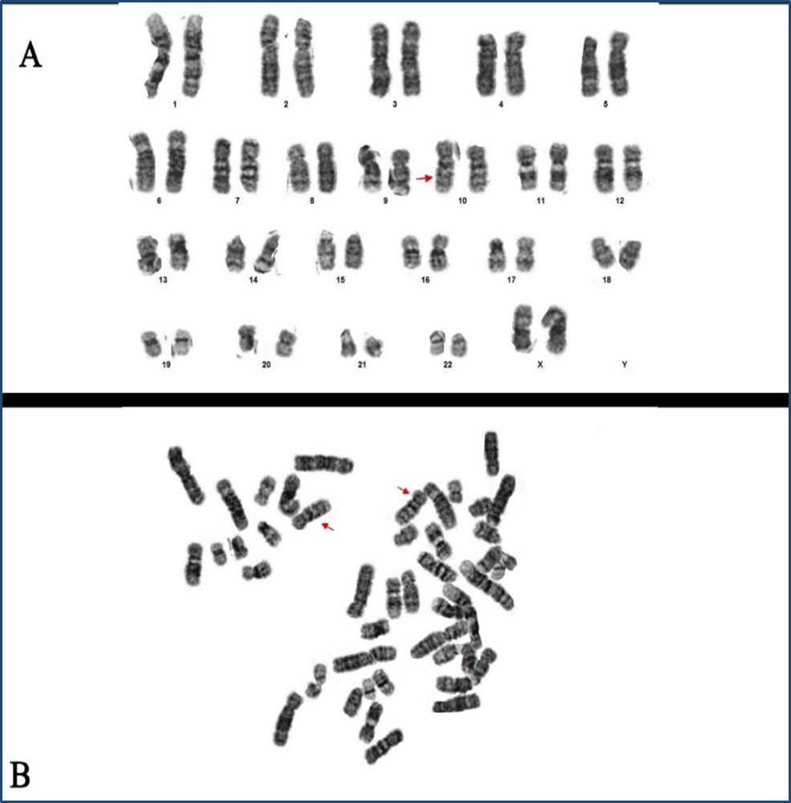

Slide 15
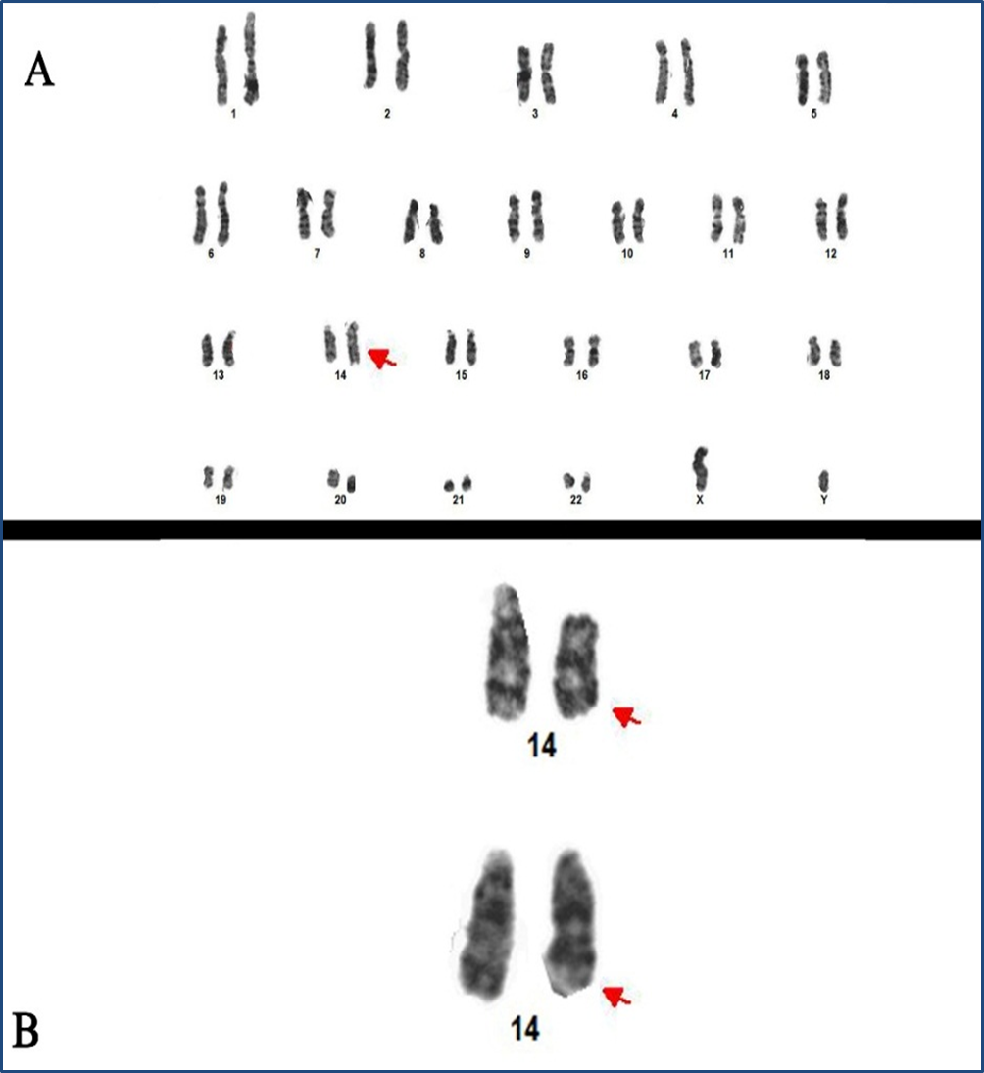

Slide 16
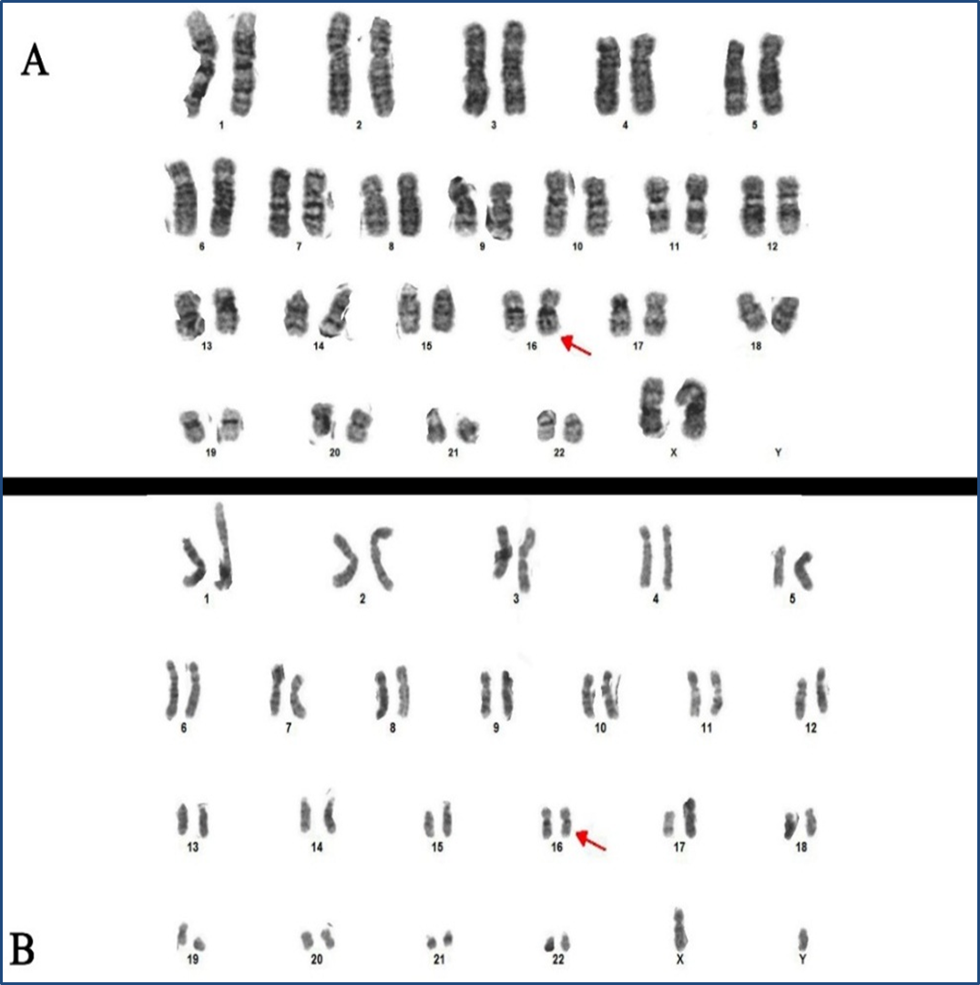

Slide 17
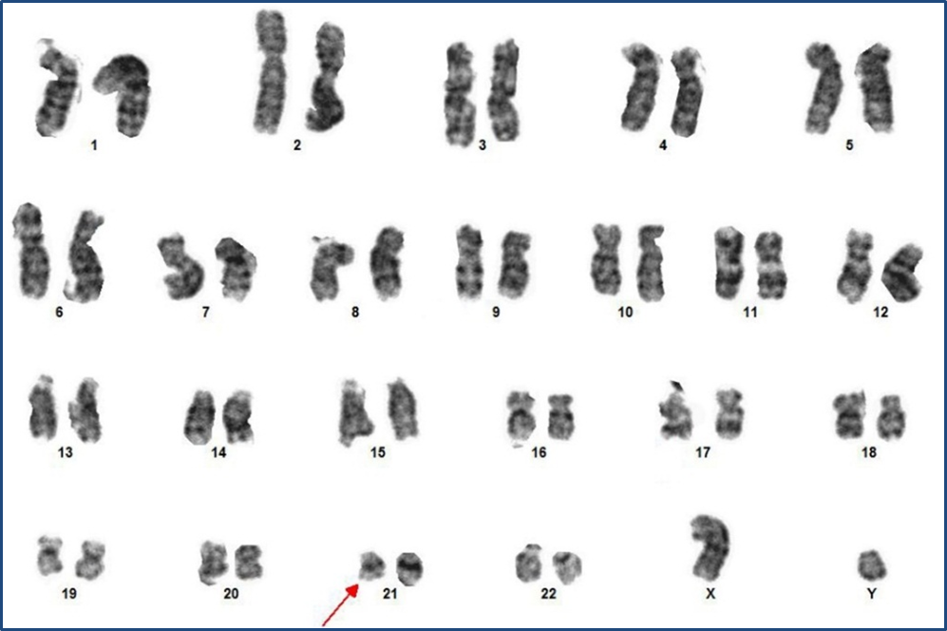

Slide 18
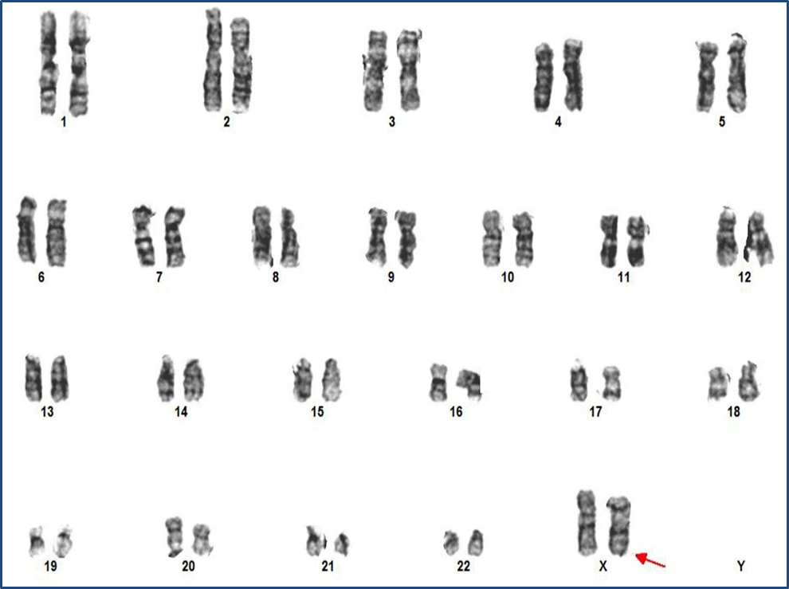

Slide 19
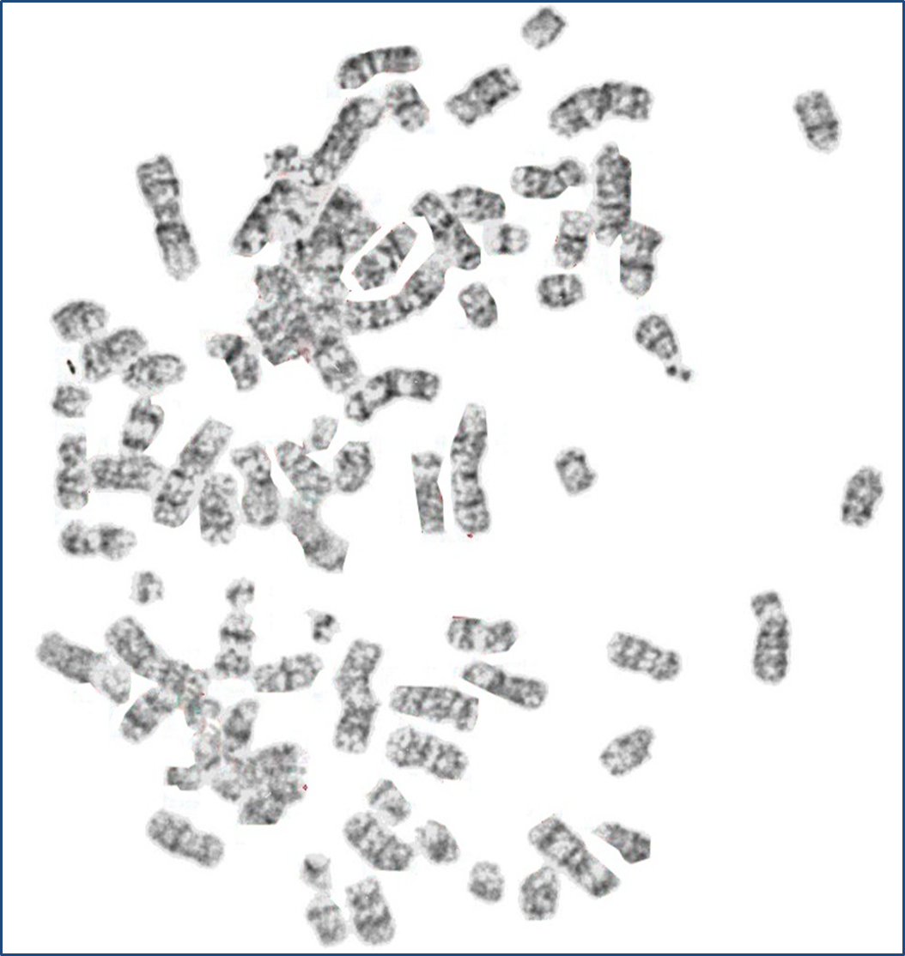

Slide 20
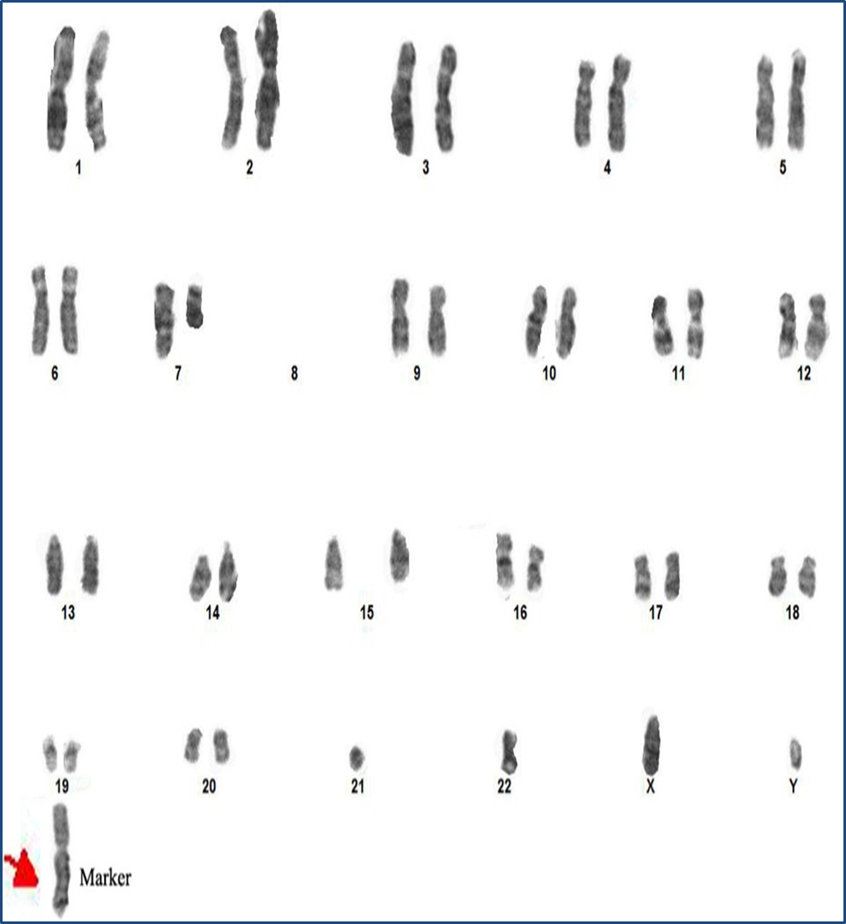

Slide 21
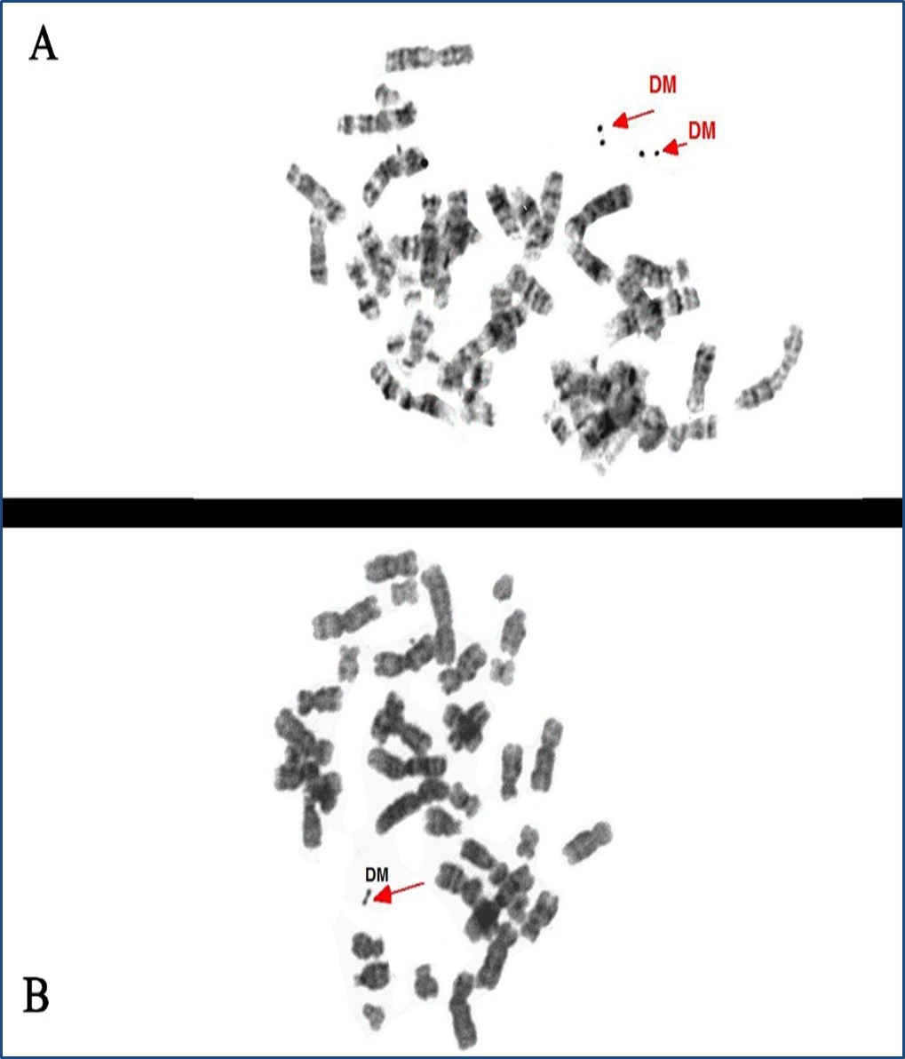

Slide 22
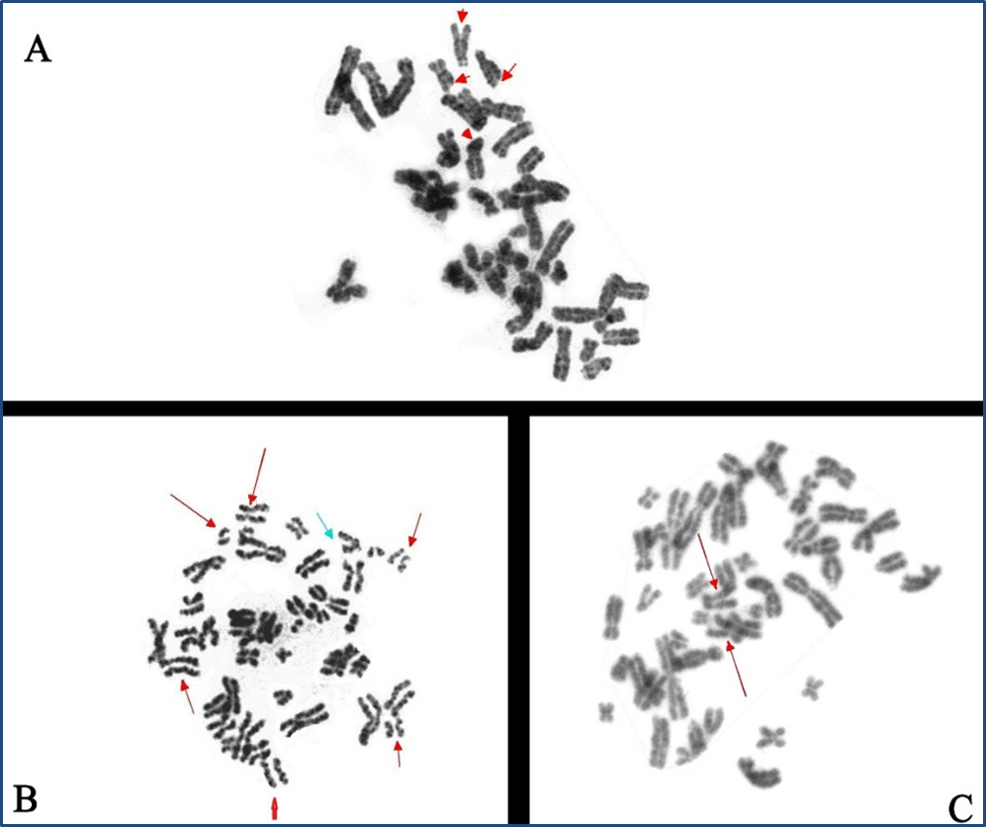

Slide 23
Thank you

