Slide 1
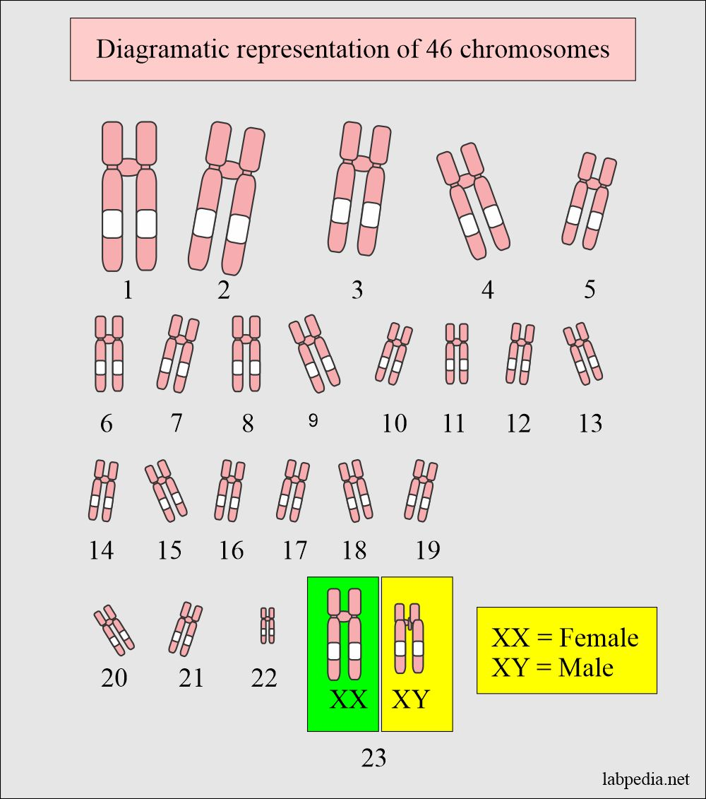
Human Chromosome
By
Lectural
Dr.Amal M Ali
2023

Slide 2
Cytogenetics
Cytogenetic : study of genetic material of cell and study of chromosome also the related disease states caused by abnormal chromosome number and structure.

Slide 3
Chromosomes
are the cellular structures that carry genes,
(protein and DNA)
two chromatids that are joined at centromere.
two arms: a short arm (P) and a long arm (q)
P
q

Slide 4
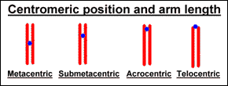
Nomenclature of chromosomes

Slide 5
Chromosomes are divided into 7 groups, A………G
Group A: 1,2,3
Group B: 4,5
Group C: 6-12, x
Group D: 13,14,15
Group E: 16,17,18
Group F: 19,20
Group G: 21,22,Y

Slide 6
Karyotype

Slide 7
Chromosomal aberrations

Slide 8
Chromosomal aberrations

Slide 9
Deletion

Slide 10
Deletion

Slide 11
Deletion 5q

Slide 12
Deletion 7q

Slide 13
AML Iraqi patient
Del 11q

Slide 14
Translocation

Slide 15
Translocation

Slide 16
T 9:22 in CML

Slide 17
Translocation

Slide 18
Tra 8:21 in Lymphoma

Slide 19
Inversion

Slide 20
Inversion

Slide 21
Inversion

Slide 22
Inv 16 in AML

Slide 23
Isochromosome

Slide 24
Ring chromosome

Slide 25
Derivative chromosome
Aberration in two arms of chromosome

Slide 26
Marker chromosome in AML

Slide 27
Double minutes (d min)
gene amplification and overexpression of some oncogenes,

