Slide 1
Notes about Real-Time PCR technique
Presented by
Dr. Zaynab Saad
Researcher at molecular biology dep.

Slide 2
The ongoing evolution of qPCR
The polymerase chain reaction (PCR) is usually described as a simple, sensitive and rapid technique that uses oligonucleotide primers, dNTPs and a heat stable Taq polymerase to amplify DNA.
It was invented by Kary B. Mullis and co-workers in the early eighties, who were awarded the 1993 Nobel Prize for chemistry for this discovery.
With the discovery of real-time PCR in the nineties the method took an important hurdle towards becoming “fully quantitative”.
The addition of an initial reverse-transcription (RT) step produced the complementary RT-PCR, a powerful means of amplifying any type of RNA.
It monitors the amplification of a targeted DNA molecule during the PCR, i.e. in real-time, and not at its end, as in conventional PCR.
Real-time PCR can be used quantitatively (quantitative real-time PCR), and semi-quantitatively, i.e. above/below a certain amount of DNA molecules (semi quantitative real-time PCR).

Slide 3
Today quantitative PCR (qPCR) is widely used in research and diagnostics, with numerous scientists contributing to the pre-eminence of PCR in a huge range of DNA-, RNA- (coding and non-coding) based applications.
PCR was regarded as the “gold standard” in the quantitative analysis of nucleic acid, because of its high sensitivity, good reproducibility, broad dynamic quantification range, easy use and reasonable good value for money .
qPCR has substantial advantages in quantifying low target copy numbers from limited amounts of tissue or identifying minor changes in mRNA or microRNA expression levels in samples with low RNA concentrations or from single cells analysis.
The extensive potential to quantify nucleic acids in any kind of biological matrix has kept qPCR at the forefront of extensive research efforts aimed at developing new or improved applications.

Slide 4
Methods for the detection of PCR products in real-time PCR
non-specific fluorescent dyes that intercalate with any double-stranded DNA, SYBR green
sequence-specific DNA probes consisting of oligonucleotides that are labelled with a fluorescent reporter which permits detection only after hybridization of the probe with its complementary sequence, Taqman probe

Slide 5
The polymerase chain reaction (PCR) is a common method for amplifying DNA;
for RNA-based PCR the RNA sample is first reverse-transcribed to complementary DNA (cDNA) with reverse transcriptase.
using a DNA template, at least one pair of specific primers, deoxyribonucleotides, a suitable buffer solution and a thermo-stable DNA polymerase.
Estimation errors arising from variations in the quantification method can be the result of DNA integrity, enzyme efficiency and many other factors. For this reason a number of standardization systems (often called normalization methods) have been developed.
Some have been developed for quantifying total gene expression, but the most common are aimed at quantifying the specific gene being studied in relation to another gene called a normalizing gene, which is selected for its almost constant level of expression.

Slide 6
100
Melting
94 ºC
Temperature
50
0
T i m e
3’
5’
Heat
5’
3’

Slide 7
100
Melting
94 ºC
Temperature
Annealing
Primers
50
50 ºC
0
T i m e
3’
5’
5’
5’
5’
3’

Slide 8
100
Melting
94 ºC
Extension
Temperature
Annealing
Primers
72 ºC
50
50 ºC
0
T i m e
3’
5’
5’
5’
5’
3’

Slide 9
100
Melting
94 ºC
Extension
Temperature
Annealing
Primers
72 ºC
50
50 ºC
0
T i m e
3’
5’
5’
5’
5’
3’

Slide 10
100
Melting
Melting
94 ºC
Extension
94 ºC
Temperature
Annealing
Primers
72 ºC
50
50 ºC
0
T i m e
3’
5’
Heat
5’
5’
Heat
5’
3’

Slide 11
30x
100
Melting
Melting
94 ºC
Extension
94 ºC
Temperature
Annealing
Primers
72 ºC
50
50 ºC
0
T i m e
3’
5’
Heat
5’
5’
Heat
5’
3’

Slide 12
30x
100
Melting
Melting
94 ºC
Extension
94 ºC
Temperature
Annealing
Primers
72 ºC
50
50 ºC
0
T i m e
3’
5’
5’
5’
5’
3’

Slide 13
100
Melting
Melting
94 ºC
Extension
94 ºC
Temperature
Annealing
Primers
72 ºC
50
50 ºC
0
T i m e
3’
5’
5’
5’
5’
3’

Slide 14
30x
100
Melting
Melting
94 ºC
Extension
94 ºC
Temperature
Annealing
Primers
72 ºC
50
50 ºC
0
T i m e
3’
5’
5’
5’
5’
5’
5’
5’
5’
3’

Slide 15
100
Melting
Melting
94 ºC
Extension
94 ºC
30x
Temperature
Annealing
Primers
72 ºC
50
50 ºC
0
T i m e
3’
5’
5’
5’
5’
5’
5’
5’
5’
3’

Slide 16
30x
100
Melting
Melting
94 ºC
Extension
94 ºC
Temperature
Annealing
Primers
72 ºC
50
50 ºC
0
T i m e
3’
5’
5’
5’
5’
5’
3’
Heat
5’
5’
Heat
5’

Slide 17
30x
100
Melting
Melting
94 ºC
Extension
94 ºC
Temperature
Annealing
Primers
72 ºC
50
50 ºC
0
T i m e
3’
5’
5’
5’
5’
5’
5’
3’
5’
5’
5’
5’
5’
5’

Slide 18
100
Melting
Melting
94 ºC
Extension
94 ºC
30x
Temperature
Annealing
Primers
72 ºC
50
50 ºC
0
T i m e
3’
5’
5’
5’
5’
5’
3’
5’
5’
5’
Fragments of defined length
5’
5’
5’
5’

Slide 19
DNA Between The Primers Doubles With Each Thermal Cycle
Number
1
2
4
8
16
32
64
0
Cycles
1
2
3
4
5
6

Slide 20

Theoretical Yield Of PCR
Theoretical yield = 2^{n} x y
Where y = the starting
number of copies and
n = the number of thermal cycles
If you start with 100 copies, how many copies are made in 30 cycles?
2^{n} x y
= 2³⁰ x 100
= 1,073,741,824 x 100
= 107,374,182,400

Slide 21
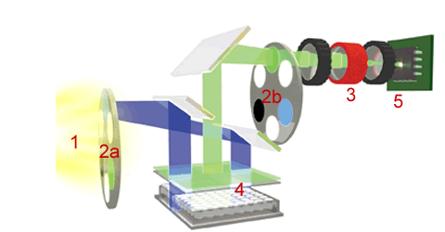
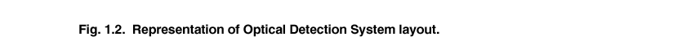
Real-Time PCR machine design
3. intensifier
5. ccd detector 350,000 pixels
1. halogen tungsten lamp
2b. emission filters
2a. excitation filters
4. sample plate
www.biorad.com

Slide 22
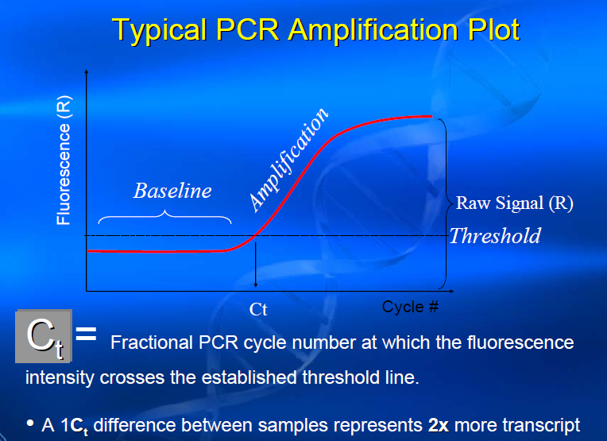

Slide 24
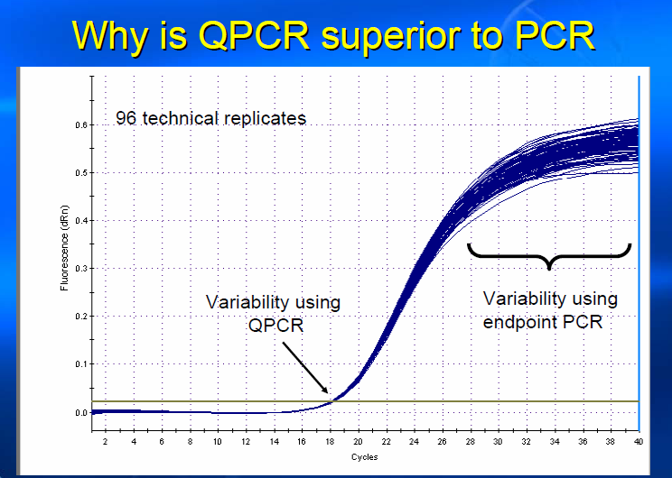

Slide 25
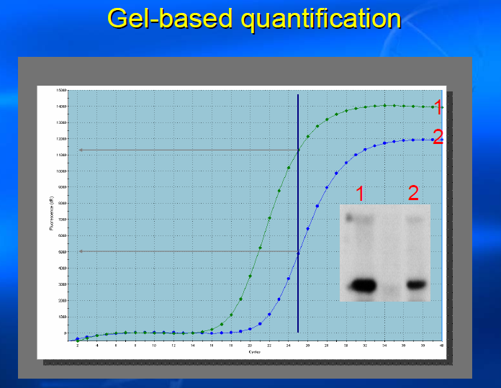

Slide 26
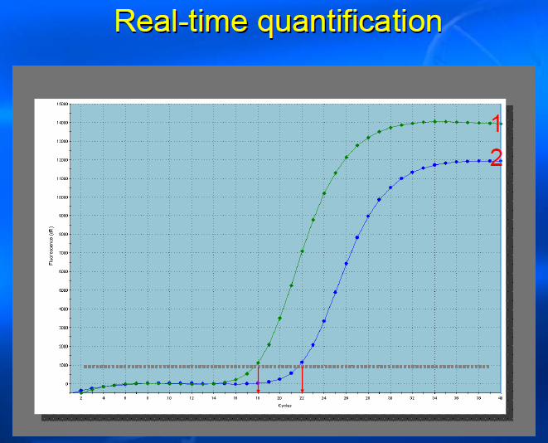

Slide 27
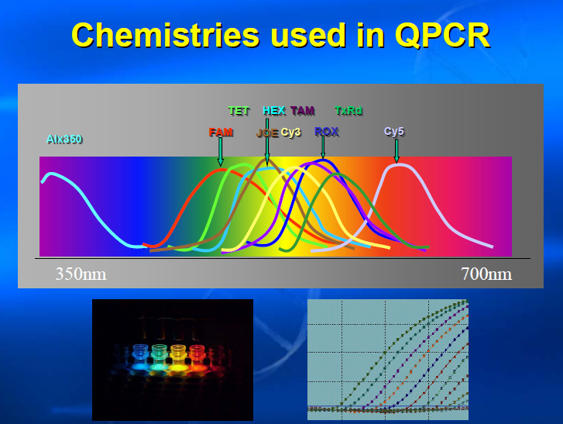

Slide 28
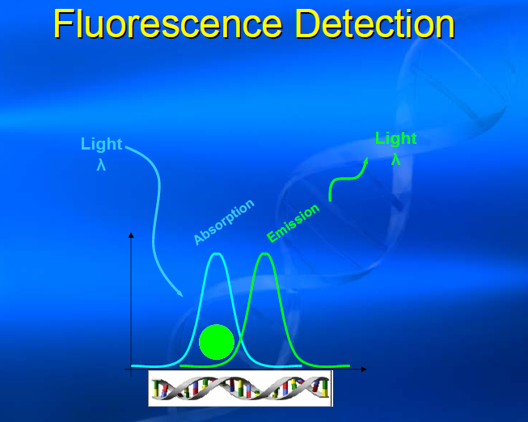

Slide 29
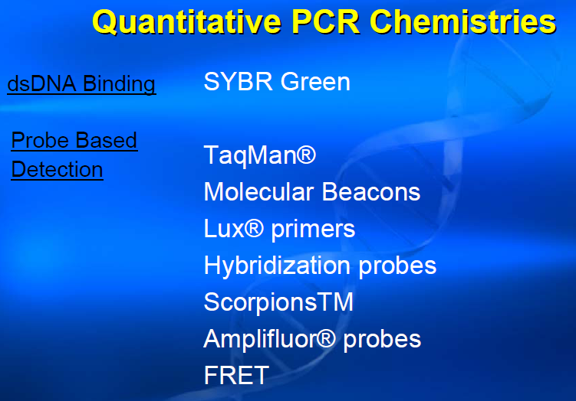

Slide 30
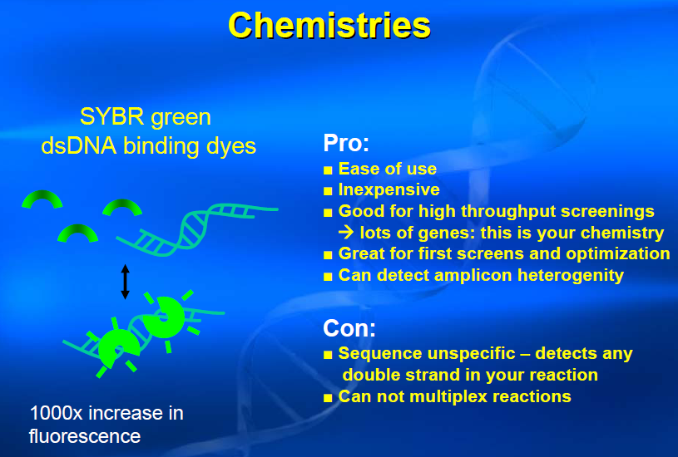

Slide 31
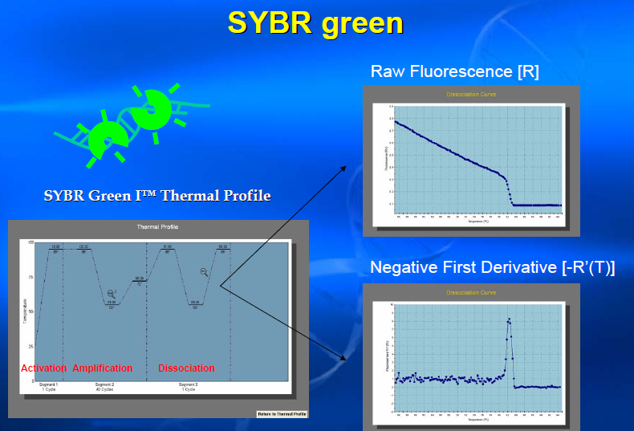

Slide 32
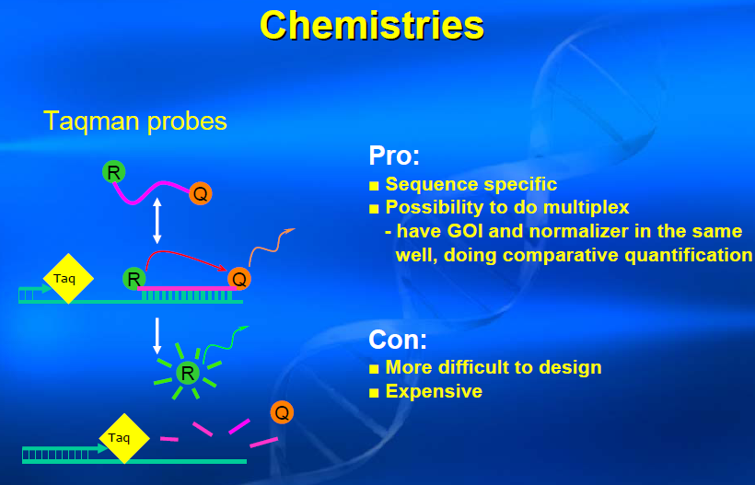

Slide 33
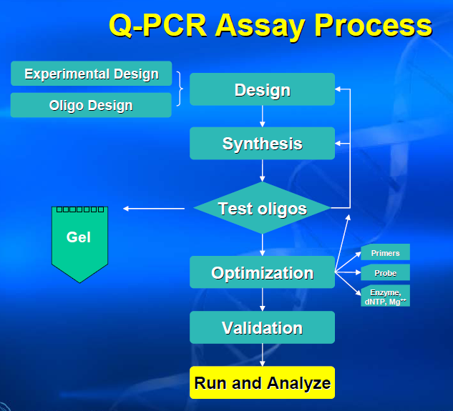

Slide 34
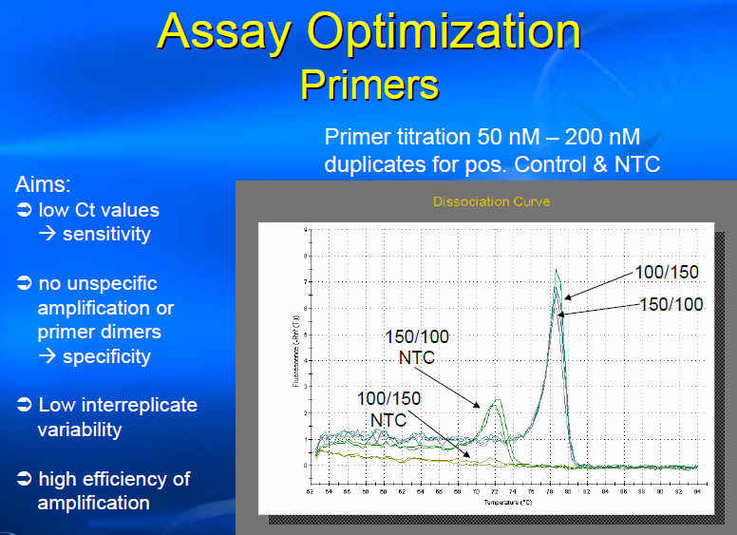

Slide 35
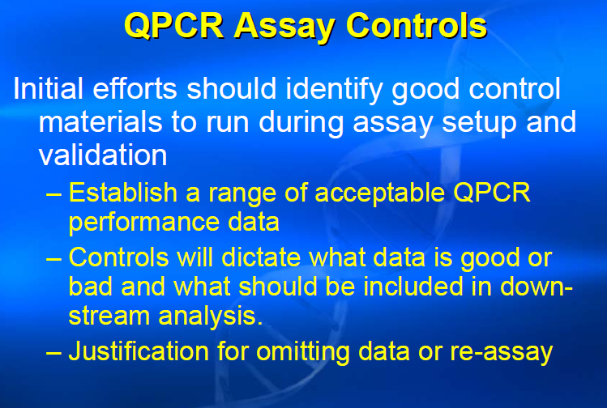

Slide 36
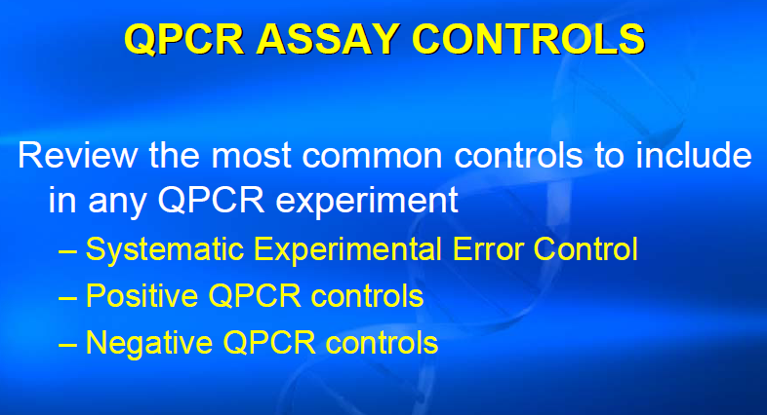

Slide 37
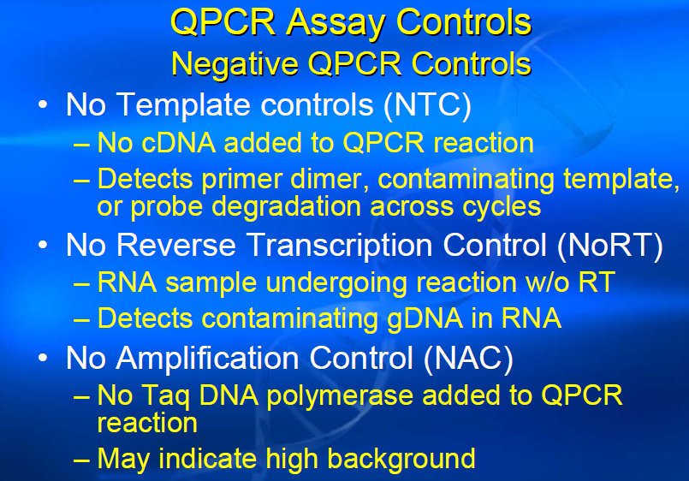

Slide 38
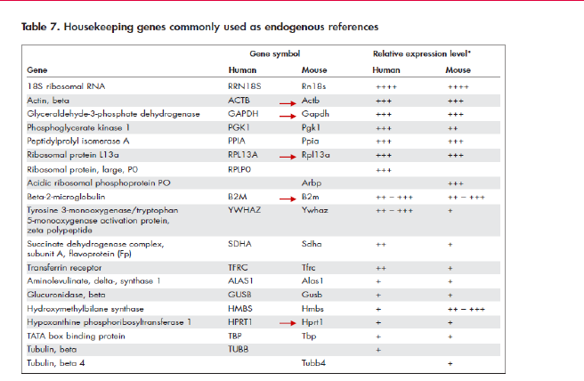

Slide 39
Instrument program
Allelic Discrimination (AD).
Isothermal Assays.
Dissociation.
Absolute Quantification (AQ).
Relative Quantification (RQ).
Plus/Minus Assays.
Back Ground.

Slide 40
Allelic Discrimination (AD)
Its multiplexed assay
that detect variant of single nucleic acid sequence.
The presence of two primer/prob pair in each reaction allows genotyping of the two possible variants at the single-nucleic polymorphism (SNP) site in target sequence.
The actual quantity of target sequence is not determined.
Its mainly consist of 2 dyes one for Allele 1 and the other for Allele 2 ,either Heterozygous or Homozygous.

Slide 41
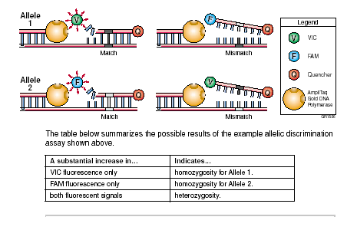

Slide 42
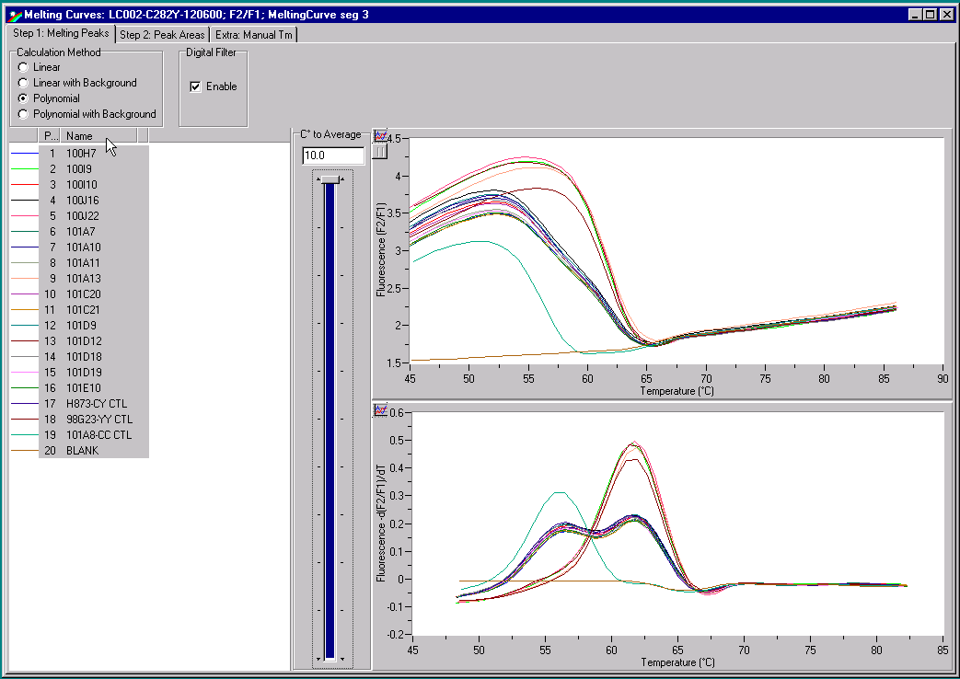

Slide 43
Relative Quantification (RQ)
Its determine the changes in gene expression (target) in a test sample relative to the sample sequence in a calibrator sample.
The calibrator sample can be an untreated control or sample at time zero in time-course study.
RQ provides accurate comparison between the initial level of template without requiring the exact copy number of the template.

Slide 44
Absolute Quantitation (AQ)
It’s a process that determines the absolute quantity of a single nucleic acid target sequence within an unknown sample.
By monitoring the PCR process and use the cycle number when there is actual increase in target copy number (CT) and compare it to a standard curve .

Slide 45
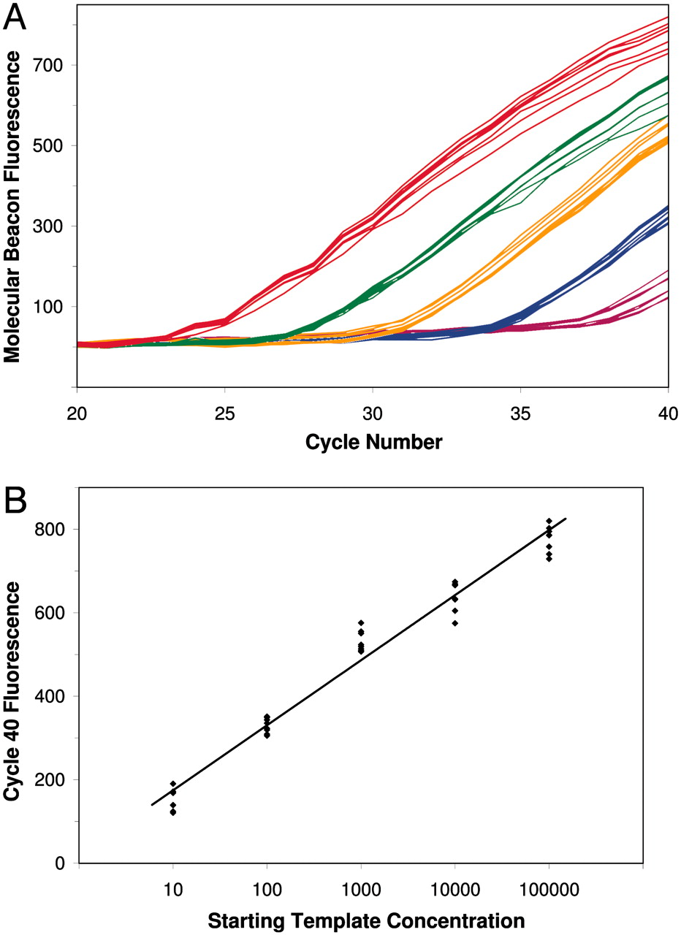

Slide 46
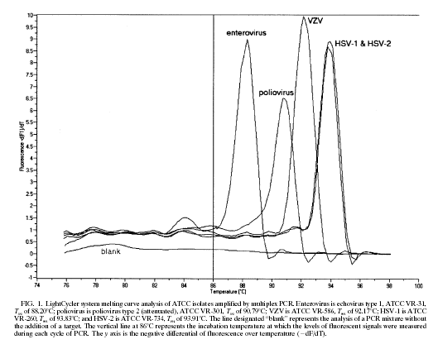

Slide 47
Plus/Minus Assays: Used to determine if there is a target (plus) or not found (minus). Not quantitative [present (+) or not (-)]. Taq-man used. DNA conc. must be at least 1.7. Data collected at the end-point of PCR . In the mix there is unknown, IPC, IPC+ and NTC used. | Allelic Discrimination (AD): Used for genotyping for 2 possible variants at SNP site in target sequence but actual quantity is not determined. Not quantitative (Hetrozygus or Homozygus). Taq-man used. DNA conc. must be at least 1.7. Data collected at the end-point of PCR . In the mix only the unknown and NTC used.
Absolute Quantification (AQ): Used when quantity is needed and give absolute amount of the target ( singlelex or multiplex). Quantitative. Taq-man and sybergreen. RNA conc. must be at least 1.9. Data collected at the end point of PCR. In the mix there is unknown, standard and NTC. | Relative Quantification (RQ): Used for comparison between two cases or for follow up after specific condition with standard. Quantitative . Taq-man used. RNA conc. must be at least 1.9. Data collected throughout the PCR process. In the mix there is target and Endogenous control .

Slide 48
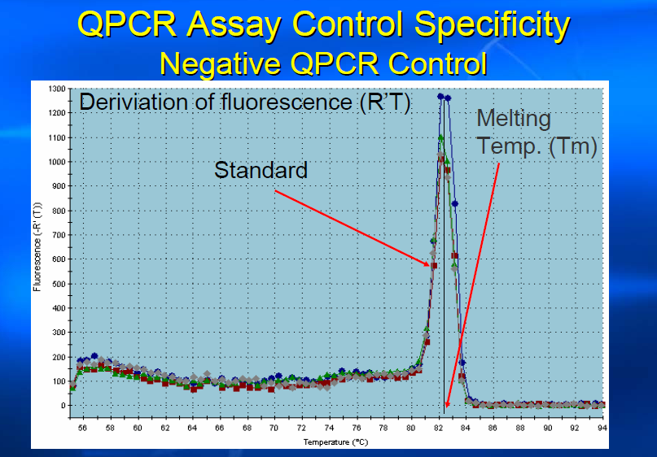

Slide 49
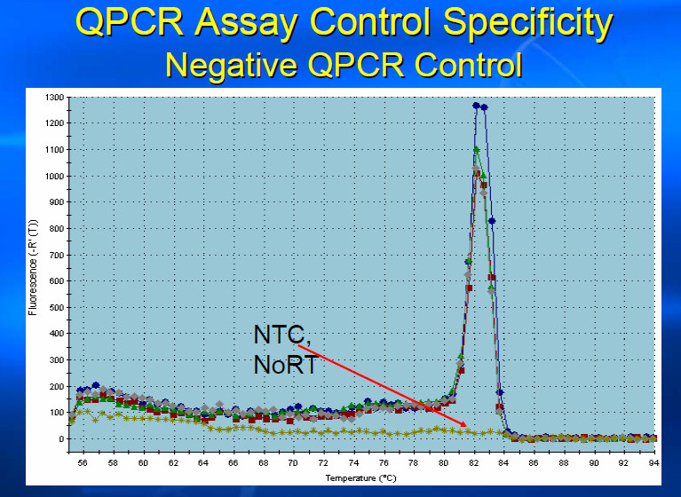

Slide 50
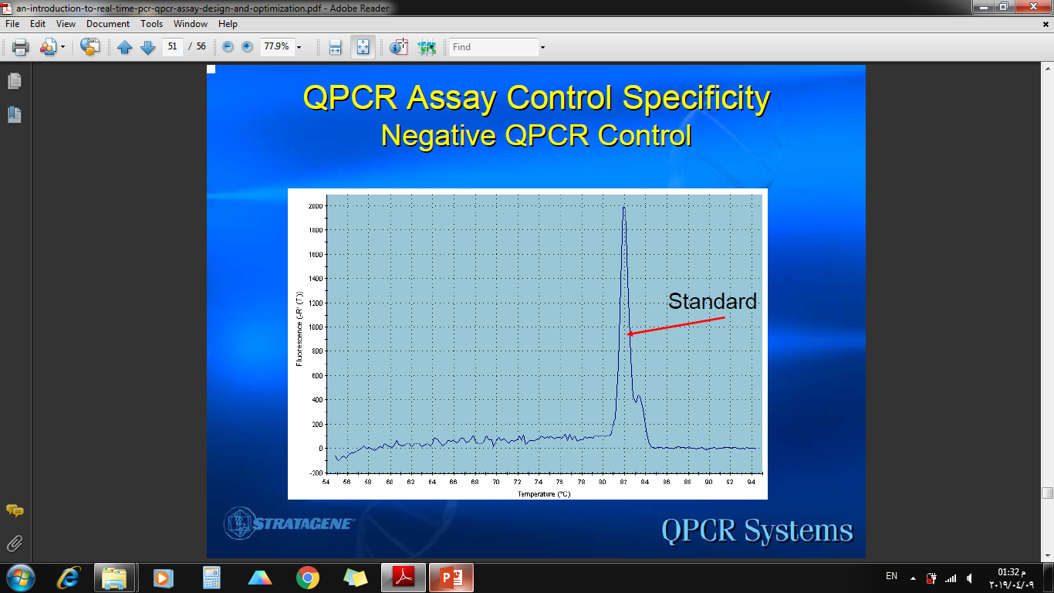

Slide 51
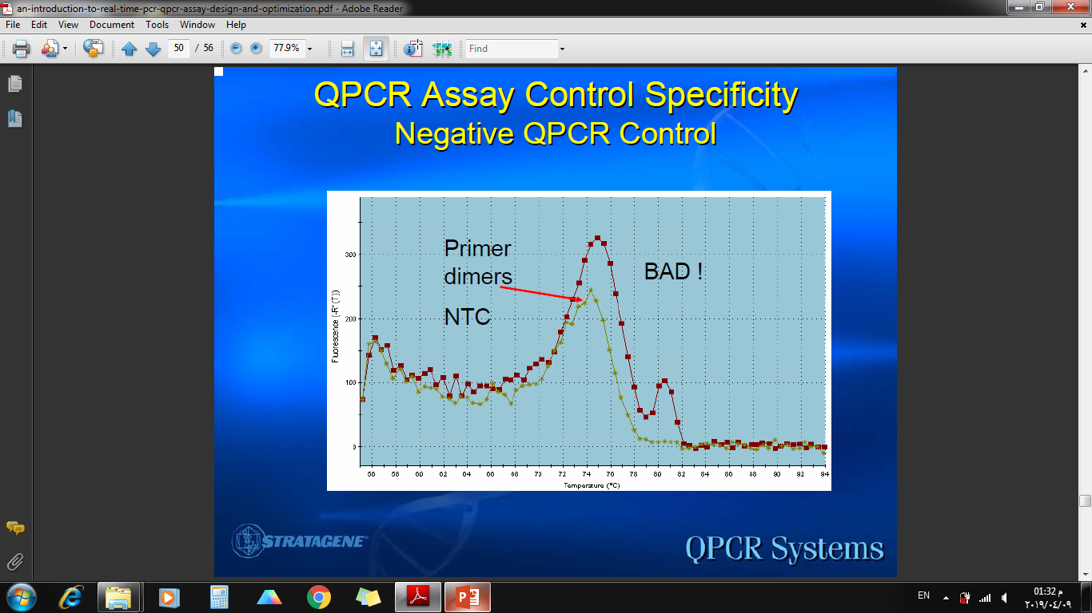

Slide 52
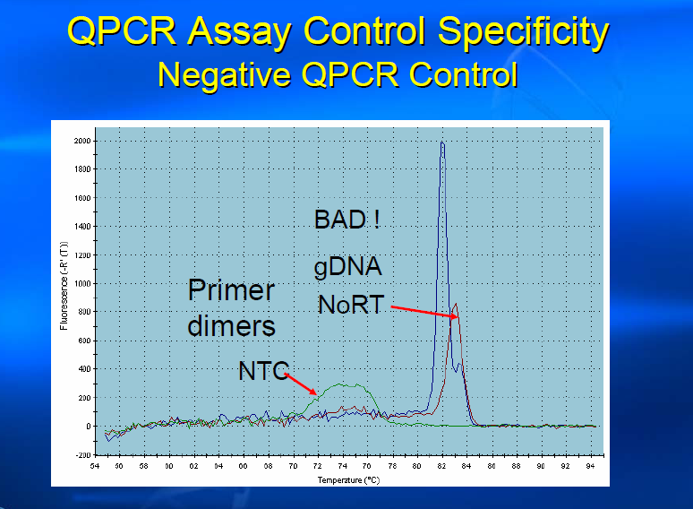

Slide 53
