Slide 1
"Special Stains in Cancer Diagnosis: Focus on Epithelial and Connective Tissue Tumors"
Dr . Alaa Saadi Abbood
Iraqi Center For Cancer and Medical Genetics Research/ Cancer Research Department

Slide 2
Objective
To provide a comparative overview of the special histochemical stains used in the diagnosis of epithelial and connective tissue tumors, emphasizing their principles of action and clinical diagnostic utility.
And to provide pathologists, laboratory technologists, and students with hands-on knowledge about special stains used in cancer diagnosis. When diagnosing cancer, the pathologist will look at the cells in the biopsy or cytology and blood samples under a microscope.
Special stains play a critical role in the precise classification of epithelial tumors. They aid in identifying molecular markers, evaluating tumor behavior, and guiding therapeutic strategies. These stains are essential tools in modern histopathology, bridging the gap between morphology and molecular diagnostics.

Slide 3
Special stains are essential tools in pathology for differentiating between epithelial and connective tissue tumors. Their diagnostic value lies in their ability to highlight specific cellular structures, guide tumor classification, and support treatment decisions.
When used in conjunction with routine H&E staining and immunohistochemistry, these stains offer a comprehensive understanding of tumor pathology.

Slide 4
Epithelial Tissues
Epithelial tissue is one of the four primary tissue types in the human body. It forms the lining of internal and external surfaces, including the skin, gastrointestinal tract, respiratory passages, and glands. Epithelial cells are characterized by:-
Cellularity: Densely packed cells with minimal extracellular matrix
Polarity: Distinct apical (top) and basal (bottom) surfaces
Avascularity: Lack of direct blood supply (nutrition via diffusion)
High regenerative capacity
Function: Protection, secretion, absorption, and selective permeability
In oncology, epithelial tissues are the origin of carcinomas, which are among the most common types of malignant tumors.

Slide 5
Importance of Special Stains in Epithelial Tumor Diagnosis
Standard hematoxylin and eosin (H&E) staining provides general architectural and nuclear detail but may not be sufficient for:
Differentiating subtypes of carcinomas
Identifying mucin production
Confirming epithelial origin
Visualizing intracellular substances like glycogen or glycoproteins
To address these limitations, special stains are employed to selectively highlight chemical components unique to epithelial cells or their secretions.

Slide 6
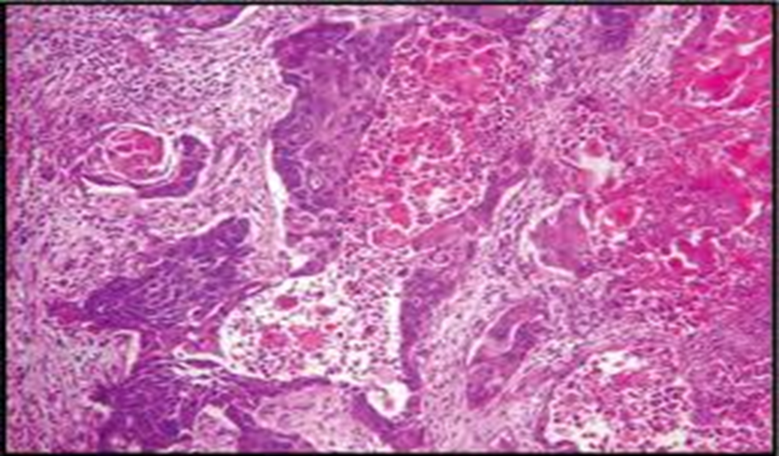
Hematoxylin & Eosin (H&E)
Principle of Action:- Hematoxylin stains nuclei (blue); eosin stains cytoplasm and extracellular proteins (pink).
Diagnostic Use:-General morphology; foundational stain for all cancer diagnostics.
Adenocarcinoma

Slide 7
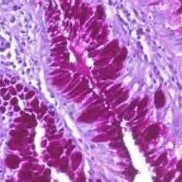
PAS (Periodic Acid-Schiff)
Principle of Action :- Oxidizes carbohydrates to aldehydes that react with Schiff reagent to produce a magenta color
Diagnostic Use :- Identifies glycogen and mucopolysaccharides in mucin-producing tumors and fungal infections .
The PAS stain is designed to detect polysaccharides (e.g., glycogen), neutral mucins, glycoproteins, and basement membranes. In pathology, it is also used to highlight fungal organisms in tissue
Principle of PAS
Oxidation: Periodic acid oxidizes adjacent hydroxyl groups on carbohydrates into aldehydes.
Schiff Reaction: These aldehydes react with Schiff reagent (containing basic fuchsin), producing a bright magenta color.
Counterstaining: Usually with hematoxylin, resulting in blue nuclei
Mucin-producing adenocarcinomas

Slide 8
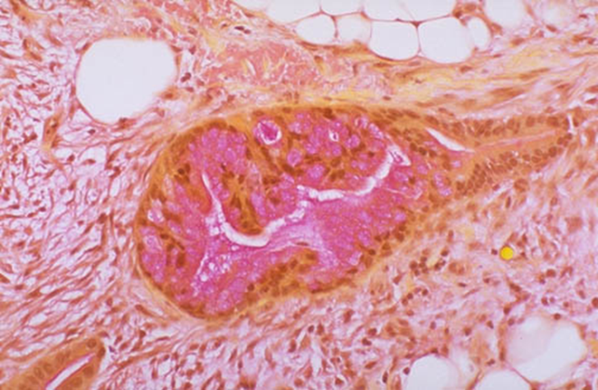
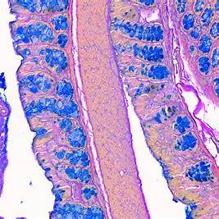
Stain | Principle of Action | Diagnostic Use
Mucicarmine | Binds to acidic mucopolysaccharides in epithelial mucin, producing a rose-red color. | Detects epithelial mucin in adenocarcinomas of the lung, GI tract, and other mucinous tumors.
Colloidal Iron | Colloidal ferric ions bind to acid mucins forming a blue complex under acidic pH. | Highlights acidic mucins in mucinous adenocarcinomas.
Colonic adenocarcinoma stained with mucicarmine.
Mucinous Adenocarcinoma of the Colon or Stomach

Slide 9
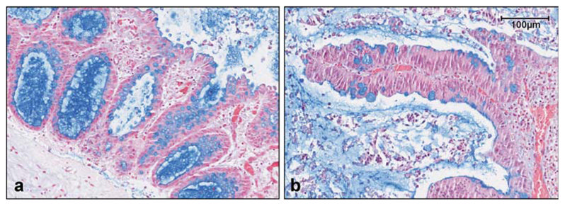
Alcian Blue Stain Purpose: Detects acidic mucins and glycosaminoglycans.Common Uses:Characterizing mucinous carcinomas or identifying specific tumor types with mucin production.
Alcian Blue staining of normal and neoplastic colon tissue in organ culture. Normal (a) and a sessile adenoma (b) continue to express mucin after 2 d in culture. Original magnification, ×300.

Slide 10
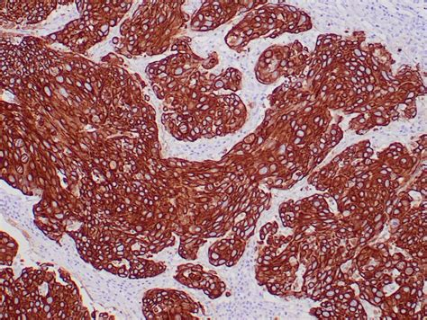
Cytokeratin (Pankeratin)
Principle of Action :- Immunohistochemical stain binding to cytokeratin intermediate filaments in epithelial cells.
Diagnostic Use :- Confirms epithelial origin of tumors, especially when the primary is unknown.
Immunohistochemical staining for Pan‑Cytokeratin (AE1/AE3) in a colorectal

Slide 11
Connective Tissue
overview of Connective Tissue
Connective tissue is one of the four fundamental tissue types in the human body. Unlike epithelial tissue, it consists of cells embedded in an abundant extracellular matrix composed of fibers (collagen, elastin, reticulin) and ground substance. It plays essential roles in:
Structural support
Tissue repair and defense
Transport of nutrients and waste
Connecting and anchoring other tissues
The cell types within connective tissue include fibroblasts, adipocytes, macrophages, mast cells, and plasma cells.

Slide 12
Connective Tissue Tumors (Sarcomas)
Tumors that originate from connective tissue are termed sarcomas. These include:
Fibrosarcoma (from fibroblasts)
Liposarcoma (from adipose tissue)
Leiomyosarcoma (from smooth muscle)
Osteosarcoma (from bone)
Chondrosarcoma (from cartilage)
Because these tumors arise from diverse mesenchymal origins, special histochemical stains are essential to identify tissue-specific components and guide diagnosis.

Slide 13
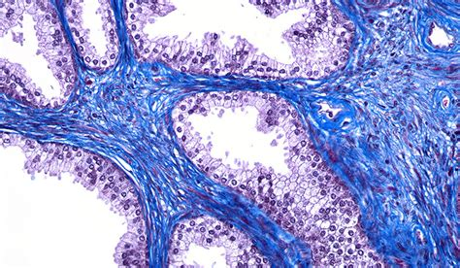
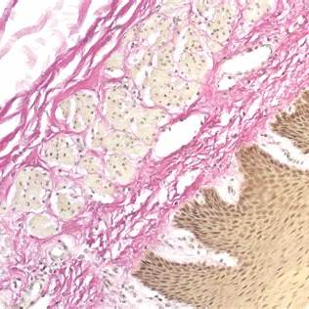
Stain | Principle | Diagnostic Use
Masson's Trichrome | Differentiates muscle (red), collagen (blue), and cytoplasm (pink-red) | Evaluates fibrosis, desmoplastic reaction, muscle vs collagen content
Van Gieson | Stains collagen pink/red and muscle yellow using picric acid and acid fuchsin | Highlights collagen in fibrous tumors
Van Gieson-stained section of colorectal cancer
Masson’s Trichrome stain in colorectal cancer

Slide 14
Stain | Principle | Diagnostic Use
Reticulin (Silver Stain) | Stains reticular fibers black via silver impregnation | Used in sarcomas, liver tumors, and hematologic neoplasms
Verhoeff–Van Gieson (VVG) | Stains elastin black and collagen red | Identifies elastic fibers in vascular tumors and sarcomas

Slide 15
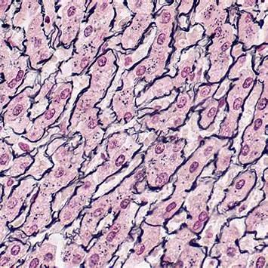
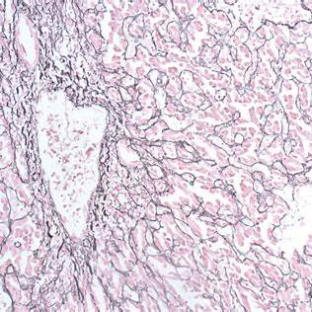
Reticulin (Silver Stain)
Displays a liver tissue section—reticulin fibers form delicate black meshworks around hepatocyte plates and portal tracts — commonly used to assess liver architecture and detect hepatocellular carcinoma (HCC)
Likely from tumor stroma, possibly a sarcoma or metastatic carcinoma, where reticulin fibers outline tumor cell clusters and vascular networks. Such silver staining helps define growth patterns

Slide 16
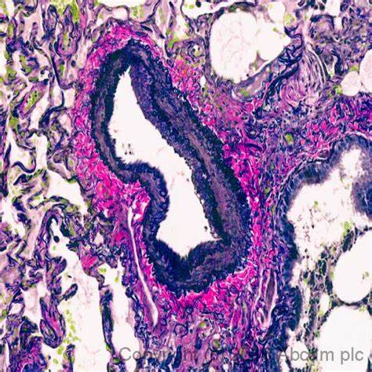
This slide most likely represents a section of angiosarcoma .a malignant tumor of blood vessel lining—where elastic fibers of vessel walls are stained black, making tumor infiltration of vasculature clearly visible.
VVG stain is particularly useful for distinguishing blood vessels from lymphatic vessels in tumor sections, since elastic fibers are present in veins and arteries but absent in lymphatics.
Verhoeff–Van Gieson stain in a vascular connective tissue tumor (e.g., angiosarcoma)

Slide 17
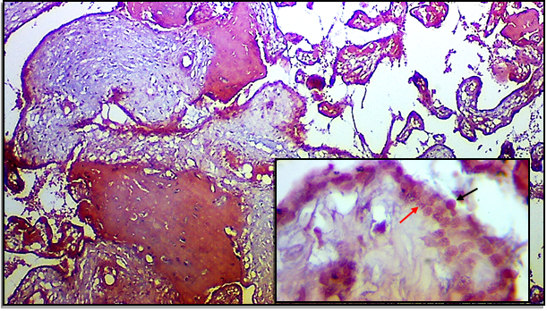
Congo Red Stain Purpose: Detects amyloid deposits, which can be present in certain cancers. Common Uses: Diagnosing amyloidosis, which may be associated with certain cancers like multiple myeloma.
Congo Red | Binds amyloid; appears apple-green under polarized light | Detects amyloid in plasma cell tumors and systemic amyloidosis

Slide 18
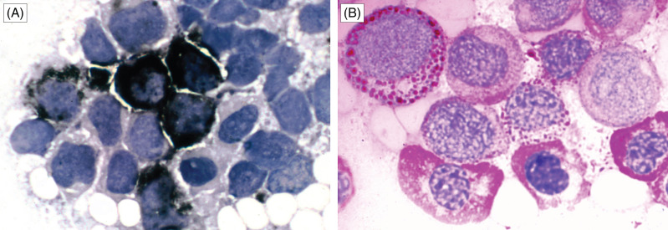
Lipid Stains (Oil Red O, Sudan Black B)Purpose: Detects lipids in tissue sections.Common Uses:Identifying lipid-containing tumors like liposarcomas.
Bone marrow smears subject to cytochemical stains. (A) Sudan black B stain shows dense darkly stained cytoplasmic granules in myeloid cells. (B) Dysplastic erythroid precursors show coarse PAS-positive cytoplasmic granules.

Slide 19
THANK YOU

