Slide 1
Technical Applications and Troubleshooting strategies in IHC
Dr . Alaa Saadi Abbood
Iraqi Center For Cancer and Medical Genetics Research Cancer Research Department

Slide 2
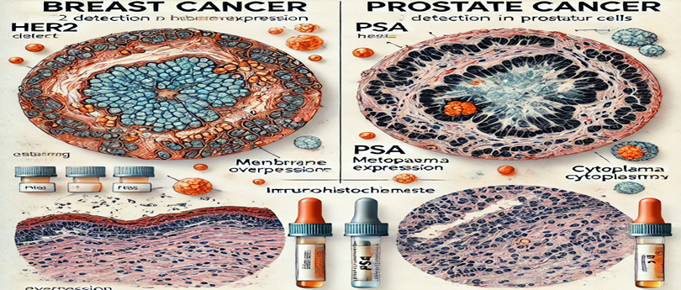
Applications of IHC
Pathology and Diagnostics:
Cancer Diagnosis: IHC is commonly used to identify tumor markers and determine cancer types , subtypes and origins (e.g., HER2 in breast cancer, PSA in prostate cancer also CD3 , CD20 IN Lymphoma and p40 in lung cancer ).

Slide 3
Applications of IHC
Prognostic and Predictive Biomarkers: Evaluating biomarkers that predict response to treatment (e.g., PD-L1 in immunotherapy) and p53 in mutation .
Research:
Understanding tissue-specific protein expression. Studying cellular localization of proteins. Validating knockdown or overexpression in experimental models and signal pathway such Foxp3 , CD8 , vimentin .

Slide 4
Applications of IHC
Infectious diseases diagnosis :- CMV , HPV , COV-2 virous And bacterial infection H .pylori also fungal ( Candida , Aspergillus ) and parasite like toxoplasmosis .

Slide 5
Applications of IHC
Developmental Biology:
Tracking cell differentiation and lineage markers.
Neuroscience:
Detecting specific neuronal or glial proteins.
Drug Development:
Assessing target engagement in tissues during preclinical studies.

Slide 6
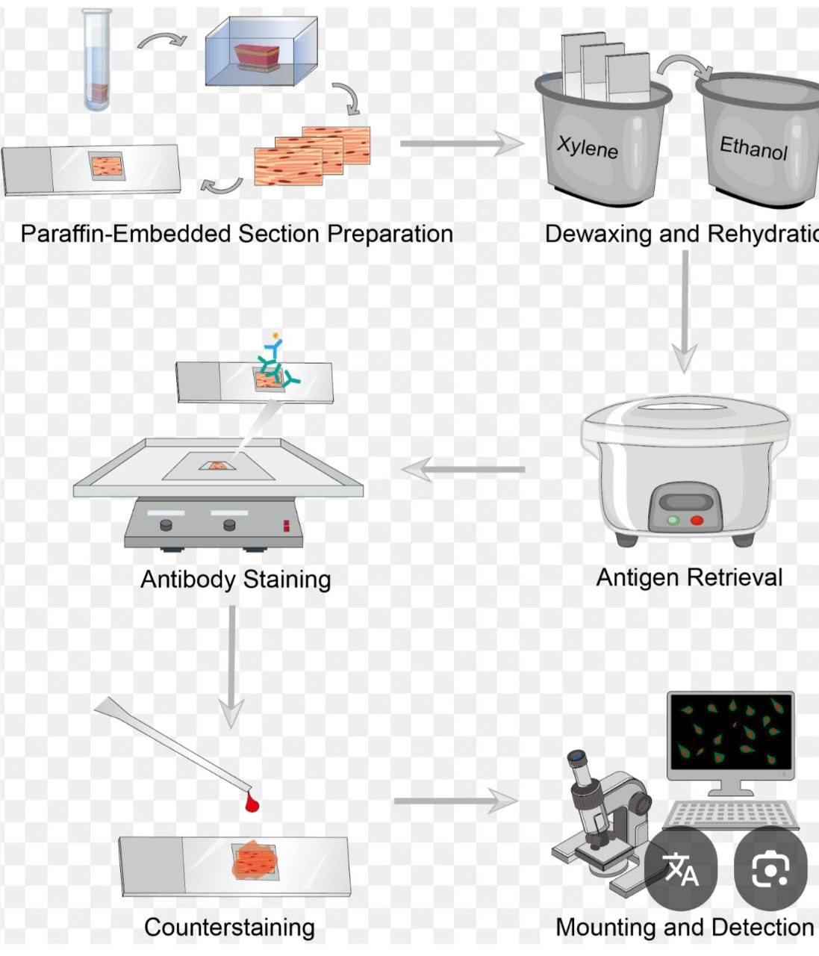

Slide 7
Troubleshooting IHC
1- Staining
Weak or No Staining
Problem: Target antigen not detected.
Solutions:
Optimize antigen retrieval (e.g., adjust pH or duration of heat-induced retrieval).
Increase primary antibody concentration or incubation time.
Ensure tissue preservation and storage were appropriate (e.g., avoid long storage in paraffin).
Use a more sensitive detection system.
Edge Effects
Problem: Strong staining at the edges but weak in the center.
Solutions:
Ensure even drying and consistent section thickness.
Avoid excessive heating during antigen retrieval.

Slide 8
Troubleshooting IHC
Non-Specific Staining
Problem: Antibody binding to unintended targets.
Solutions:
Use an appropriate isotype control to check specificity.
Validate antibodies in known positive and negative tissues.
Include a negative control without the primary antibody.

Slide 9
Troubleshooting IHC
High Background Staining
Problem: Non-specific binding or endogenous enzyme activity.
Solutions:
Use blocking solutions (e.g., serum, BSA) to reduce non-specific binding.
Quench endogenous enzymes like peroxidases (e.g., H₂O₂ for endogenous peroxidase).
Optimize washing steps to remove unbound antibodies.

Slide 10
Troubleshooting IHC
Uneven Staining
Problem: Inconsistent staining across tissue sections.
Solutions:
Ensure even application of reagents.
Check that tissue sections are well-adhered to the slides.
Use fresh reagents and ensure proper washing between steps.
Overstaining
Problem: Signal is too intense, masking details.
Solutions:
Reduce primary antibody concentration or incubation time.
Shorten the chromogen development time.

Slide 11
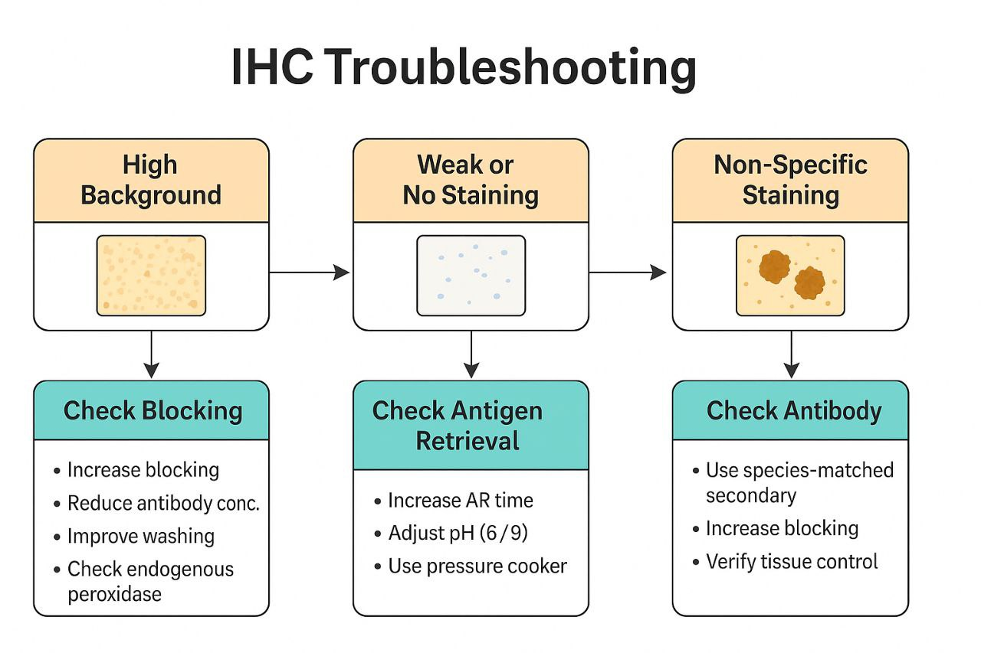

Slide 12
Troubleshooting IHC
2- Tissue Damage or Loss
Problem: Tissue falls off or is damaged during the process.
Solutions:
Use charged slides or tissue adhesives.
Avoid over-drying tissue sections before staining. also fixation process .
3- Sample Storage or Dry Tissue Sections
Slides for IHC may lose signal over time in storage. The storage process can be variable and depends on the protein target. The effect of slide storage on staining has not been established for every protein; therefore, it is best practice that slides are freshly cut before use. If slides must be stored, do so at 4°C; we do not recommend baking slides before storage. It is vital that the tissue sections remain covered in liquid throughout the staining procedure.

Slide 13
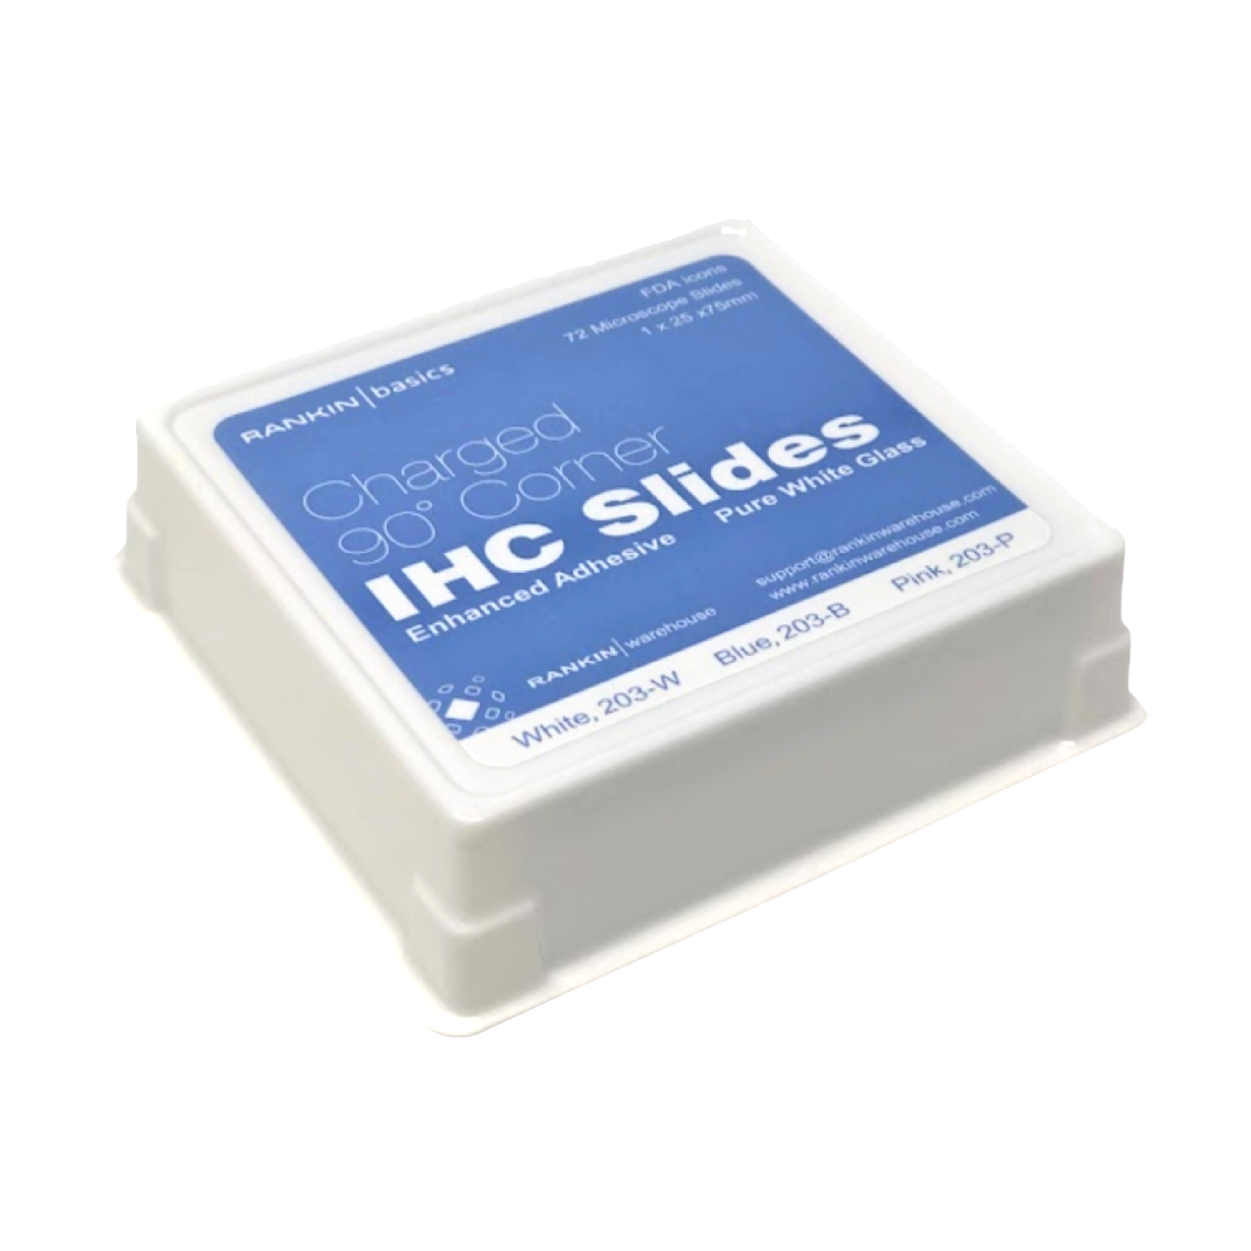
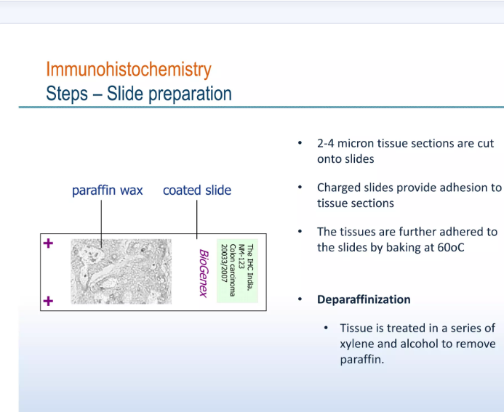
4-Slide Preparation
Inadequate deparaffinization may cause spotty, uneven background staining in your IHC experiment. If this is the case, we recommend repeating the experiment with new tissue sections using fresh xylene. section are too thick or thin can lead to misleading signals . And insufficient deparaffinization .

Slide 14
5-Antigen Unmasking/Retrieval Buffer
Fixed tissue sections used for IHC have chemical crosslinks between proteins that, depending on the tissue and antigen target, may prevent antibody access or mask antigen targets. Antigen unmasking protocols may utilize a hot water bath, microwave, or pressure cooker. Antigen unmasking protocols utilizing a water bath are not recommended. Antigen unmasking performed with a microwave is preferred, though staining of particular tissues or antigen targets may require the use of a pressure cooker.
Reduce the length of fixation step , use different antigen retrieval ..
The protein is not present in the tissue or not sufficiently expressed .
.

Slide 15
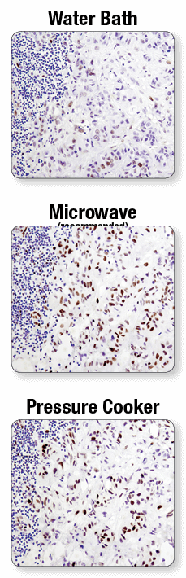
Troubleshooting IHC
A microwave oven is recommended for antigen retrieval. IHC analysis of paraffin-embedded human lung carcinoma using Phospho-Stat3 (Tyr705) (D3A7) XP® Rabbit mAb #9145 after antigen retrieval using a water bath (top), microwave oven (middle), or pressure cooker (bottom). A clear difference in performance is seen when using a microwave as compared with a water bath. For some antibodies, using a pressure cooker may enhance signals beyond those obtained with a microwave.

Slide 16
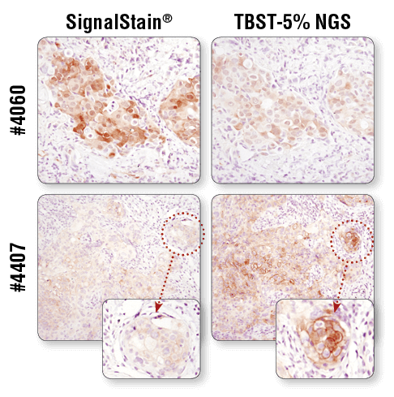
6-Antibody concentration
Antibody Concentration is too high:
Dilute the primary and/or secondary antibody further .
number of factors, including the use of inappropriately high antibody concentration, and "pseudospecific" signal that is in the wrong compartment of the cell. False-negative signal can result from factors such as use of a nonoptimized epitope retrieval method

Slide 17
8- Incubation Time
incubation time is too short:
Increase the duration of incubation of the primary antibody with the sample

Slide 18
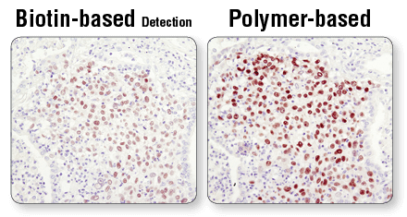
Troubleshooting IHC
Detection System
Polymer-based detection reagents, such as Signal Stain® Boost IHC Detection Reagents ,in conjunction with Signal Stain® DAB Substrate Kit (#8059), are more sensitive than avidin/biotin-based detection systems. Standard secondary antibodies directly conjugated with HRP may not provide sufficient signal amplification. In addition, always verify the expiration date of the detection reagent prior to use.
As shown, polymer-based detection offers enhanced sensitivity and results in more robust staining.

Slide 19
10- Blocking
Biotin Block
Using biotin-based detection systems with samples that have high levels of endogenous biotin, such as kidney and liver tissues, can be problematic. In this case, use a polymer-based detection system such as SignalStain® Boost IHC Detection Reagents (#8114 and #8125). A biotin block may also be performed after the normal blocking procedure prior to incubation in primary antibody.
Antibody Dilution/Diluent
Product-specific recommendations for dilution and diluent are available on the data sheet and product page of all IHC-validated antibodies. Keep in mind that titration of the antibody may be required if a reagent other than the one recommended is used.

Slide 20
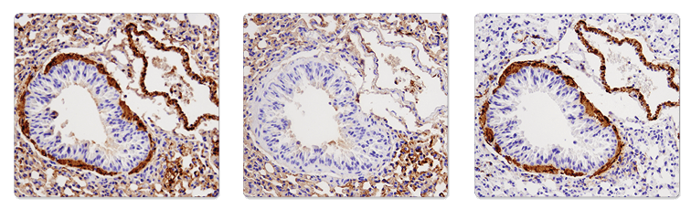
Troubleshooting IHC
11- Secondary Cross-Reactivity
A secondary antibody may bind endogenous IgG, causing high background, in some samples where the secondary antibody is raised in the same species as the sample being tested (for example, in mouse-on-mouse staining).

Slide 21
Troubleshooting IHC
12-Washes
Adequate washing is critical for contrasting low background and high signal. Washing slides 3 times for 5 minutes with TBST (#9997) after primary and secondary antibody incubations is recommended. Proper washing of the tissue between steps is critical. Ensure you are following the protocol guidelines for wash steps
13- How to use for the worker .

Slide 22
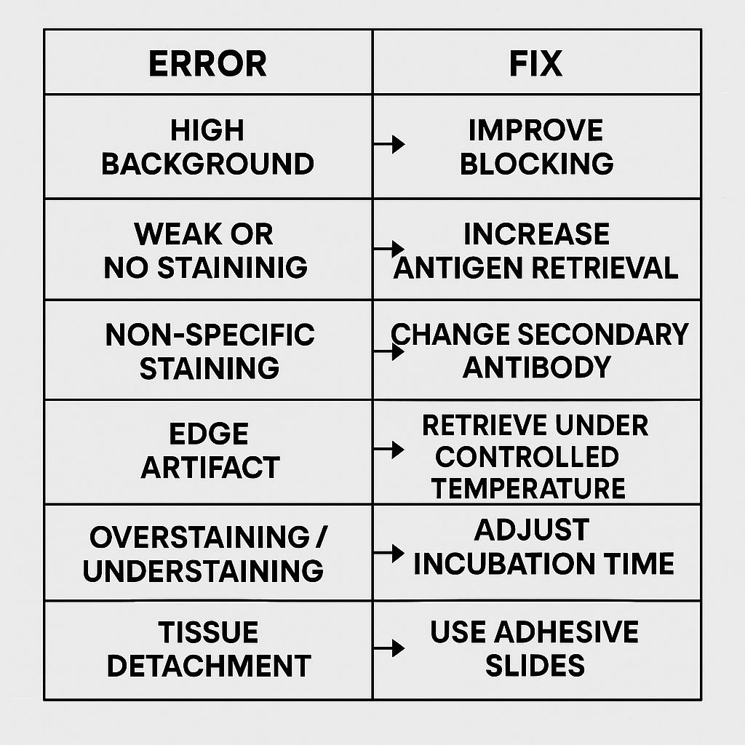

Slide 23
THANK YOU

