Slide 1
Immunohistochemistry (IHC)
Dr . Alaa Saadi Abbood
Iraqi Center For Cancer And Medical Genetics Research
Cancer Research Department

Slide 2
Immunohistochemistry (IHC) combines anatomical, immunological and biochemical techniques to image discrete components in tissues by using appropriately-labeled antibodies to bind specifically to their target antigens.
IHC is a commonly used technique because it is inexpensive to perform, doesn't require special equipment, and generally quite accurate.

Slide 3
The basic principles of immunology-the antigen-antibody reaction, that is, the binding between the antibody and the antigen is highly specific.
First, a certain chemical substance in the tissue or cell is extracted as an antigen or semi-antigen. Specific antibodies are then obtained by immunizing the animals, and the antibodies are used to detect similar antigenic substances in tissues or cells. Because the complex of antigen and antibody is colorless, it is necessary to display the site where the antigen and antibody bind by means of histochemical methods (fluorescein, enzyme, metal ion, isotope)

Slide 4
The Application of IHC in Pathological Diagnosis
1-Judgment of benign and malignant tumors
2-Determine tumor staging
3-Judgment of cell properties
4-Determine the primary site of metastatic tumors of unknown origin
5-Classification of "undifferentiated" malignant tumors
6-Further classify tumors at the junction of different organs and tissues
7-Further classify tumors at the junction of different organs and tissues
8-Timely and accurate detection of micrometastasis
9-Diagnosis of infectious diseases

Slide 5
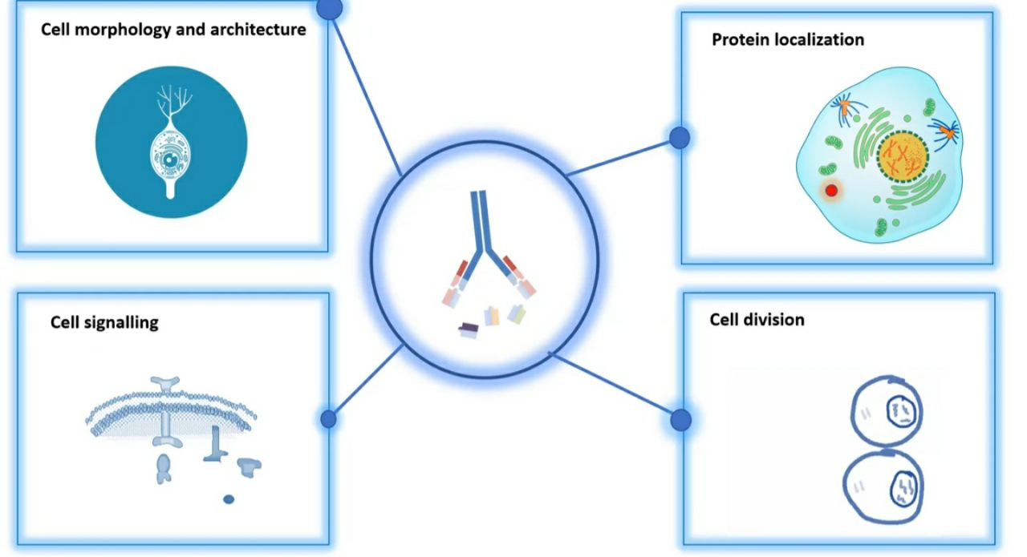

Slide 6
Immunohistochemistry (IHC) Types
Immunohistochemistry (IHC) combines anatomical, immunological and biochemical techniques to image discrete components in tissues by using appropriately-labeled antibodies to bind specifically to their target antigens in situ.
IHC makes it possible to visualize and document the high-resolution distribution and localization of specific cellular components within cells and within their proper histological context. While there are multiple approaches and permutations in IHC methodology, all of the steps involved are separated into two groups: sample preparation and sample staining.

Slide 7
immunohistochemistry (IHC) using monoclonal and polyclonal antibodies is a useful diagnostic method for detecting pathogen antigens in fixed tissues, complementing the direct diagnosis of infectious diseases by PCR and culture on fresh tissues.
IHC plays an important role in diagnostic of infectious diseases in tissue samples.

Slide 8
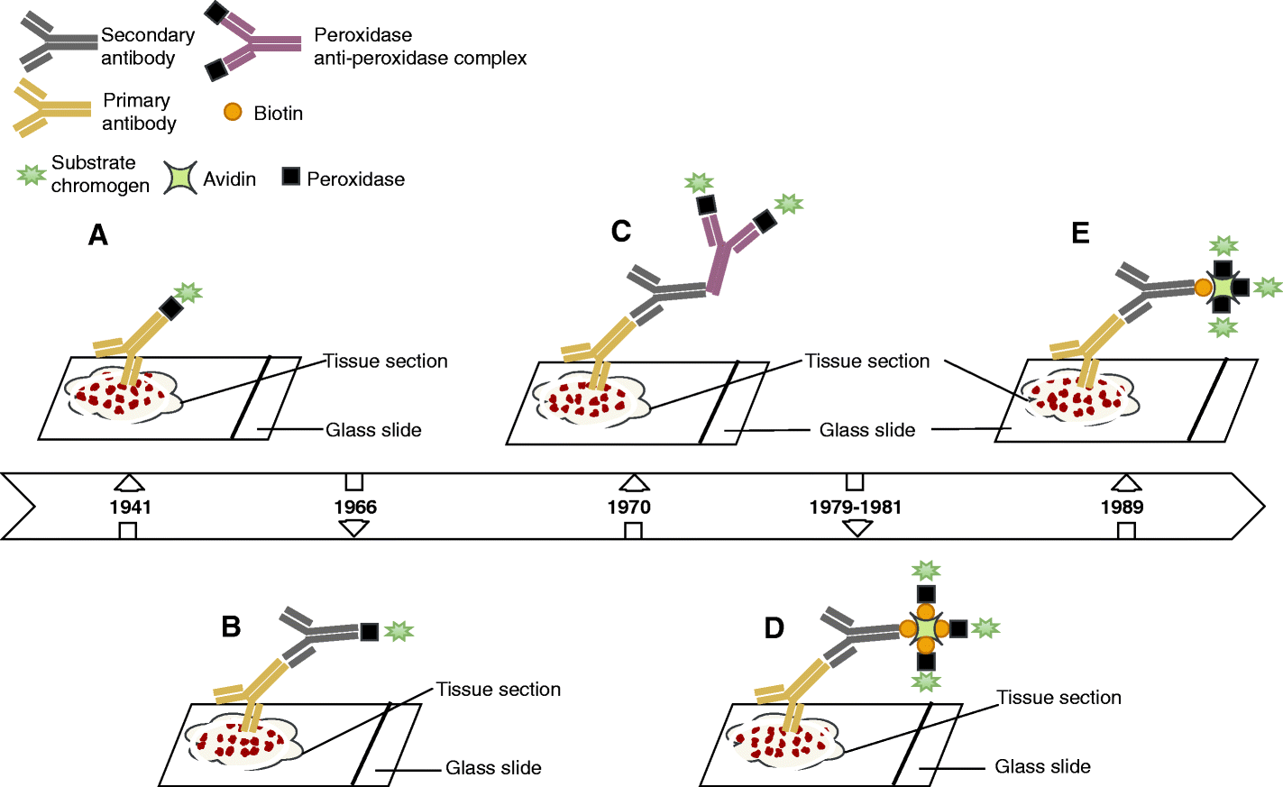
Schematic representation of immunohistochemical methods. A: direct method, B: indirect method, C: PAP complex procedure, D: ABC procedure, E: LAB procedure

Slide 9
There are two strategies used for the immunohistochemical detection of antigens in tissue,
the direct method and the indirect method. In both cases, the tissue is treated to rupture the membranes, usually by using a kind of detergent called Triton X-100.
The direct method is a one-step staining method, and involves a labeled antibody (e.g. FITC conjugated antiserum) reacting directly with the antigen in tissue sections. This technique utilizes only one antibody and the procedure is therefore simple and rapid. However, it can suffer problems with sensitivity due to little signal amplification and is in less common use than indirect methods.

Slide 10
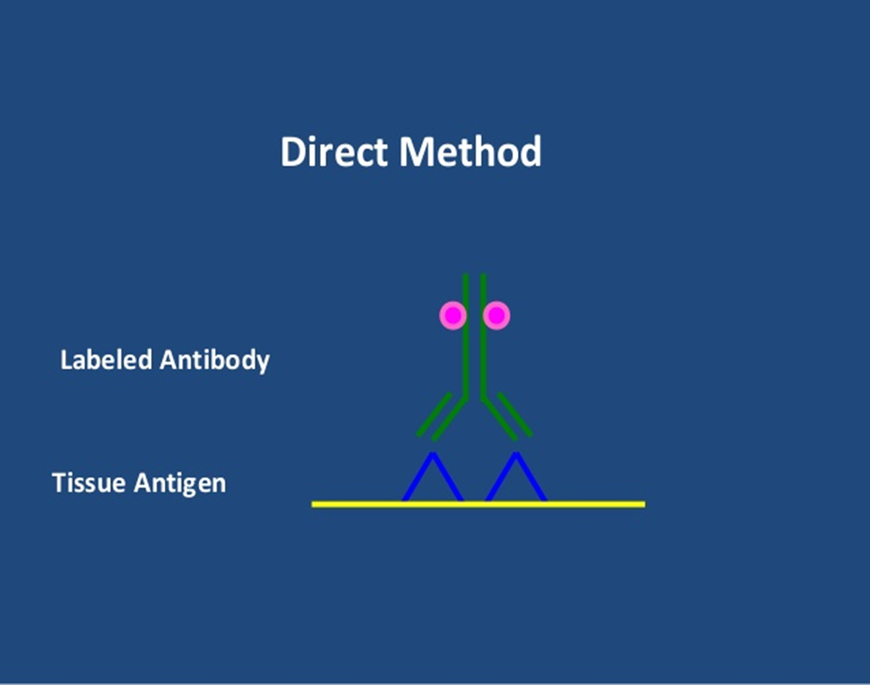
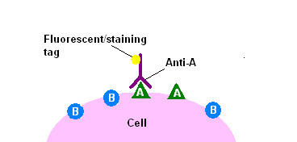

Slide 11
The indirect method involves an unlabeled primary antibody (first layer) which reacts with tissue antigen, and a labeled secondary antibody (second layer) which reacts with the primary antibody. (The secondary antibody must be against the IgG of the animal species in which the primary antibody has been raised.) This method is more sensitive due to signal amplification through several secondary antibody reactions with different antigenic sites on the primary antibody. The second layer antibody can be labeled with a fluorescent dye or an enzyme.

Slide 12
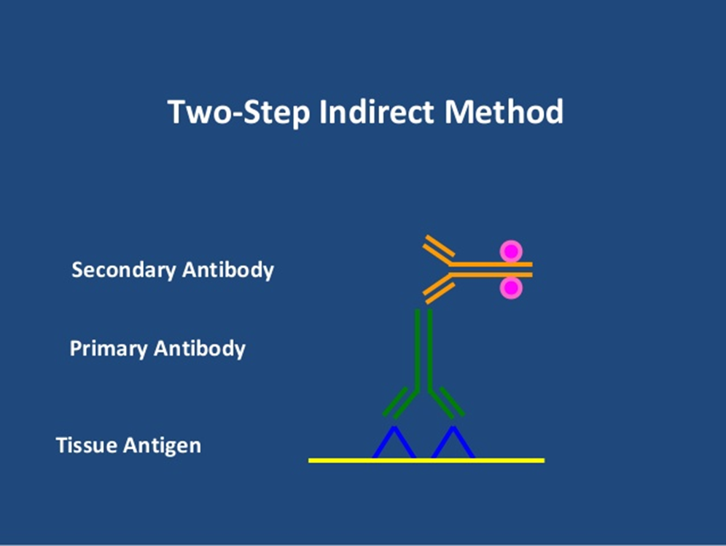
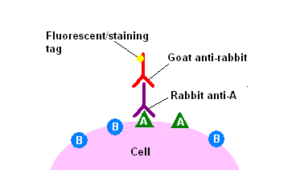
TYPES OF IHC

Slide 13
Figure 1: Immunohistochemical staining method detection of CD3 /lymphocyte in placenta tissue (A) Strong (+3) positive cytoplasmic expression. (B) Moderate (+2) positive cytoplasmic expression (C) Mild (+1) positive cytoplasmic expression (D) Negative (0) expression (x10).

Slide 14
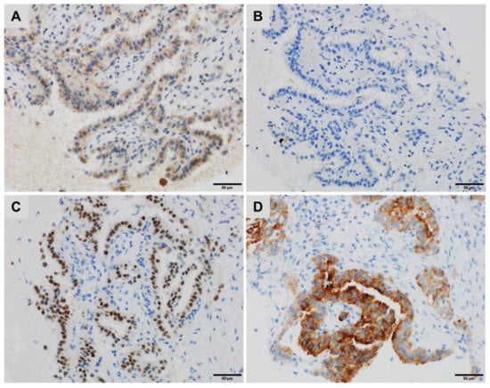
Figure 2: A lung metastasis of a thyroid carcinoma with a micropapillary component showing (A) cytoplasmic staining for Napsin A, (B) negative staining for Thyroglobulin, (C) diffuse, strong nuclear staining for PAX8 and (D) strong cytoplasmic staining for BRAFV600E (immunoperoxidase, clone VE1).

Slide 15
https://youtu.beHdBgTAAi3rU?si=BiNwTeO6GU_-M3M4

Slide 16


