Slide 1
Nucleic Acids
DNA & RNA

Slide 2
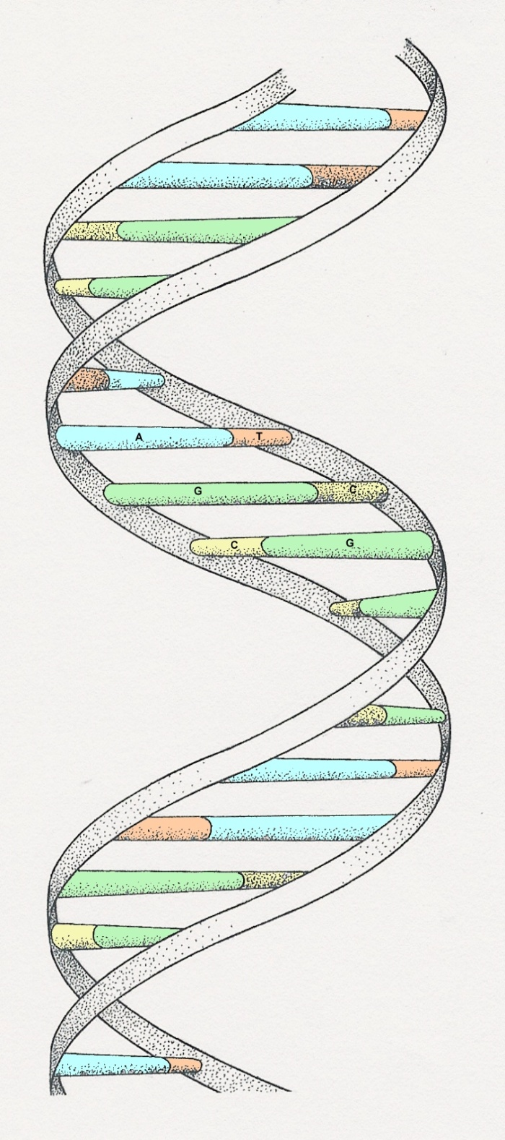
DNA
Notes:
The illustration is a ‘model’ of the double helix forming part of a DNA molecule
(Slide 14)

Slide 3
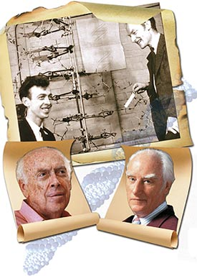
Watson
Crick
Died in 2004

Slide 4
DNA
DNA stands for deoxyribose nucleic acid
This chemical substance is present in the nucleus
of all cells in all living organisms
DNA controls all the chemical changes which
take place in cells
The kind of cell which is formed, (muscle, blood,
nerve etc) is controlled by DNA

Slide 5
DNA molecule
DNA is a very large molecule made up of a long
chain of sub-units
The sub-units are called nucleotides
Each nucleotide is made up of
a sugar called deoxyribose
a phosphate group -PO₄ and
an organic base

Slide 6
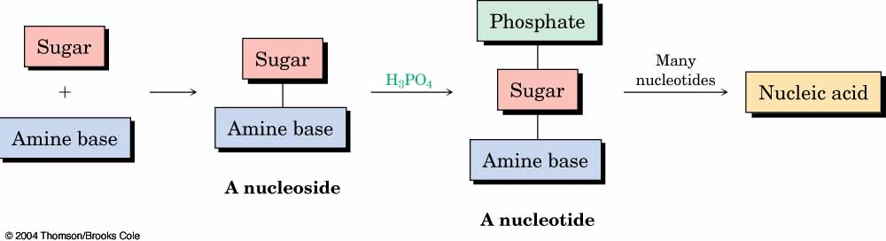
Nucleic Acids and Nucleotides
Deoxyribonucleic acid (DNA) and ribonucleic acid (RNA), are the chemical carriers of genetic information
Nucleic acids are biopolymers made of nucleotides, aldopentoses linked to a purine or pyrimidine and a phosphate

Slide 7
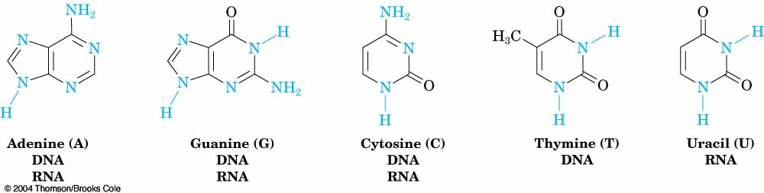
Heterocycles in DNA and RNA
Adenine, guanine, cytosine and thymine are in DNA
RNA contains uracil rather than thymine

Slide 8
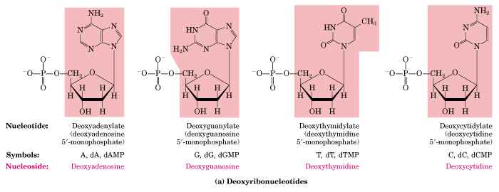
Deoxyribonucleotides found in DNA
dA
dG
dT
dC

Slide 9
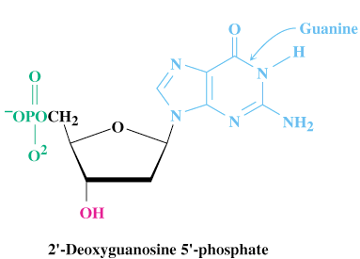
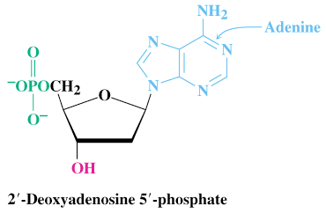
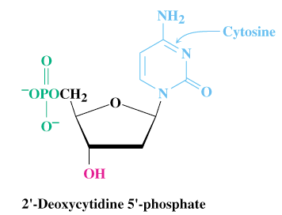
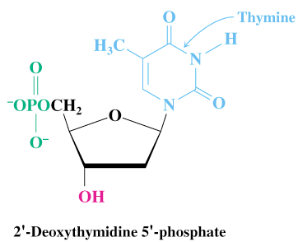
The Deoxyribonucleotides

Slide 10
Hydrogen Bonding Interactions
Two bases can hydrogen bond to form a base pair
For monomers, large number of base pairs is possible
In polynucleotide, only few possibilities exist
Watson-Crick base pairs predominate in double-stranded DNA
A pairs with T
C pairs with G
Purine pairs with pyrimidine

Slide 11
一、the building block molecule of nucleic acid--nucleotide
In RNA:
AMP、CMP、GMP、TMP
In DNA:
dAMP、dCMP、dGMP 、dUMP

Slide 12
Functions of
Nucleotides and Nucleic Acids
Nucleotide Functions:
  Energy for metabolism (ATP)
  Enzyme cofactors (NAD⁺)
  Signal transduction (cAMP)
Nucleic Acid Functions:
  Storage of genetic info (DNA)
  Transmission of genetic info (mRNA)
  Processing of genetic information (ribozymes)
  Protein synthesis (tRNA and rRNA)

Slide 13
二、the linkage ----
phosphodiester bridge
3’terminal
5’terminal
Nucleotide residues

Slide 14
DNA Nucleotides
Composition (3 parts):
1- Deoxyribose sugar (no O in 3rd carbon)
2- Phosphate group
3- One of 4 types of bases (all containing nitrogen):
- Adenine
- Thymine (Only in DNA)
- Cytosine
- Guanine

Slide 15
Base Pairing in DNA: The Watson–Crick Model
In 1953 Watson and Crick noted that DNA consists of two polynucleotide strands, running in opposite directions and coiled around each other in a double helix
Strands are held together by hydrogen bonds between specific pairs of bases
Adenine (A) and thymine (T) form strong hydrogen bonds to each other but not to C or G
(G) and cytosine (C) form strong hydrogen bonds to each other but not to A or T

Slide 16
The Difference in the Strands
The strands of DNA are complementary because of H-bonding
Whenever a G occurs in one strand, a C occurs opposite it in the other strand
When an A occurs in one strand, a T occurs in the other

Slide 17
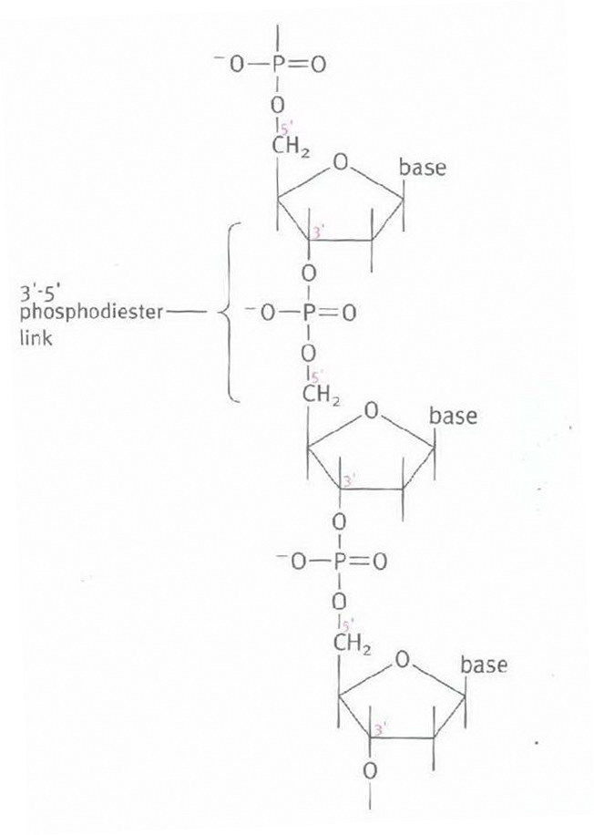

Slide 18
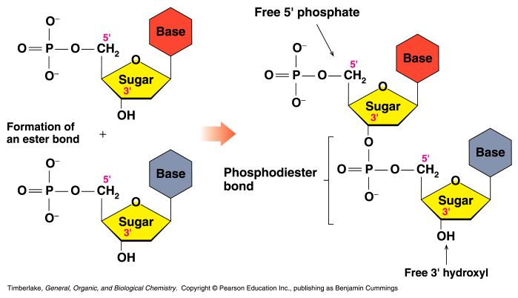
Primary Structure of Nucleic Acids
The primary structure of a nucleic acid is the nucleotide sequence
The nucleotides in nucleic acids are joined by phosphodiester bonds
The 3’-OH group of the sugar in one nucleotide forms an ester bond to the phosphate group on the 5’-carbon of the sugar of the next nucleotide

Slide 19
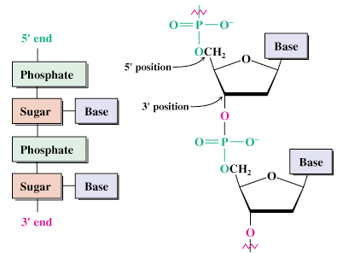
Generalized Structure of DNA

Slide 20
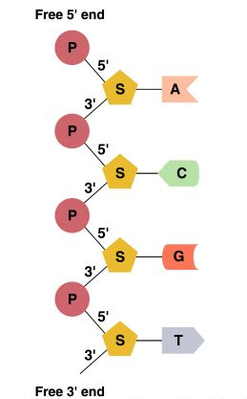
Reading Primary Structure
A nucleic acid polymer has a free 5’-phosphate group at one end and a free 3’-OH group at the other end
The sequence is read from the free 5’-end using the letters of the bases
This example reads
5’—A—C—G—T—3’

Slide 21
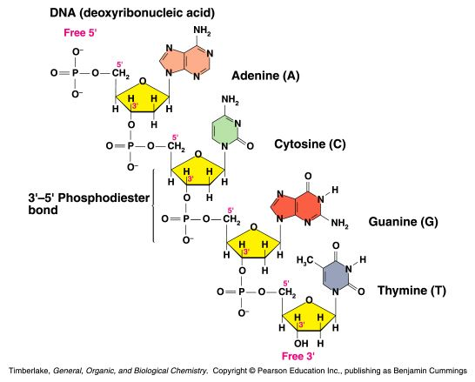
Example of DNA Primary Structure
In DNA, A, C, G, and T are linked by 3’-5’ ester bonds between deoxyribose and phosphate

Slide 22
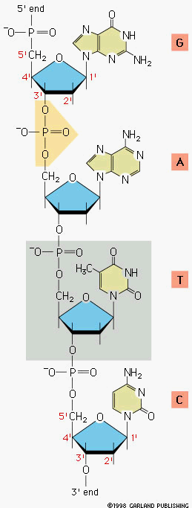
Nucleic Acid Structure
Polymerization
Nucleotide
Sugar Phosphate
“backbone”

Slide 23
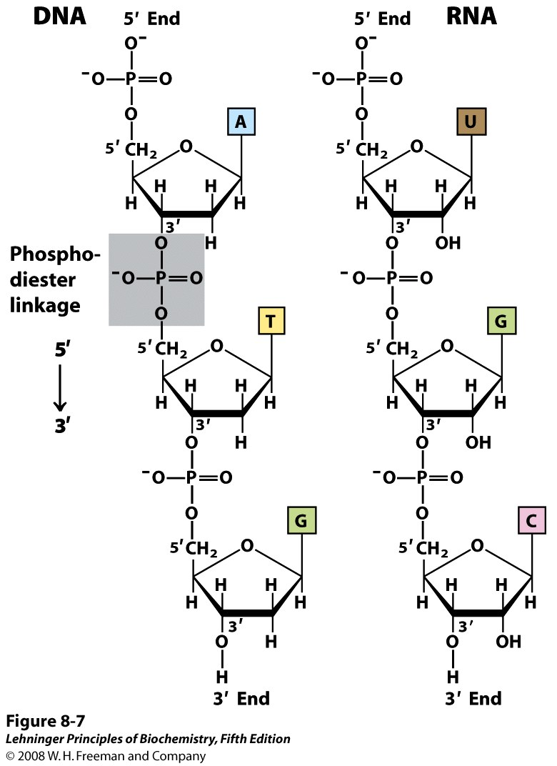
Notes:
FIGURE 8-7 Phosphodiester linkages in the covalent backbone of DNA and RNA. The phosphodiester bonds (one of which is shaded in the DNA) link successive nucleotide units. The backbone of alternating pentose and phosphate groups in both types of nucleic acid is highly polar. The 5′ end of the macromolecule lacks a nucleotide at the 5′ position, and the 3′ end lacks a nucleotide at the 3′ position.

Slide 24
Describing a Sequence
Chain is described from 5′ end, identifying the bases in order of occurrence, using the abbreviations A for adenosine, G for guanosine, C for cytidine, and T for thymine (or U for uracil in RNA)
A typical sequence is written as TAGGCT

Slide 25
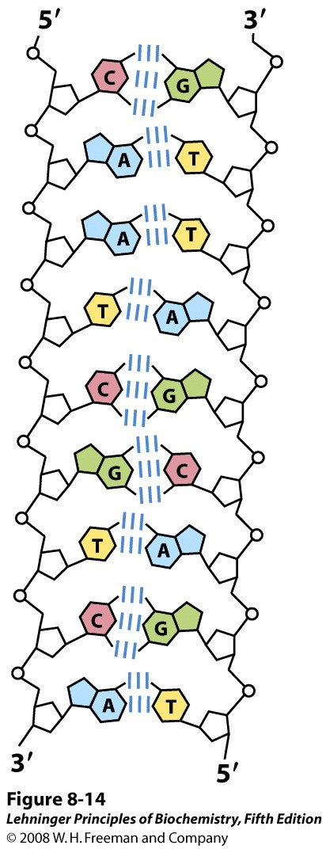
Properties of a DNA double helix
The strands of DNA are antiparallel
The strands are complimentary
There are Hydrogen bond forces
There are base stacking interactions
There are 10 base pairs per turn

Slide 26
