Slide 1
Nucleic Acids
DNA & RNA

Slide 2
The Double Helix (DNA)
Structural model:
Model proposed by Watson & Crick, 1953
Two sugar-phosphate strands, next to each other, but running in opposite directions.
Specific Hydrogen bonds occur among bases from one chain to the other:
A---T , C---G
Due to this specificity, a certain base on one strand indicates a certain base in the other.
The 2 strands intertwine, forming a double-helix that winds around a central axis

Slide 3
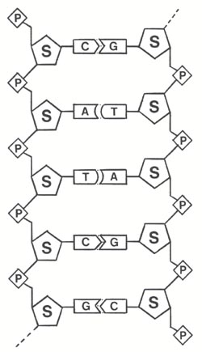
The sides of the ladder are:
P = phosphate
S = sugar molecule
The steps of the ladder are C, G, T, A = nitrogenous bases
(Nitrogenous means containing the element nitrogen.)
A = Adenine
T = Thymine
A always pairs with T in DNA
C = Cytosine
G = Guanine
C always pairs with G in DNA
Untwisted it looks like this:
(Apples are Tasty)
(Cookies are Good)
Nucleotide

Slide 4
Secondary Structure: DNA Double Helix
In DNA there are two strands of nucleotides that wind together in a double helix
- the strands run in opposite directions
- the bases are are arranged in step-like pairs
- the base pairs are held together by hydrogen bonding
The pairing of the bases from the two strands is very specific
The complimentary base pairs are A-T and G-C
- two hydrogen bonds form between A and T
- three hydrogen bonds form between G and C
Each pair consists of a purine and a pyrimidine, so they are the same width, keeping the two strands at equal distances from each other

Slide 5
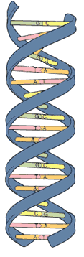
Model of DNA:
The model was developed by Watson and Crick in 1953.
They received a nobel prize in 1962 for their work.
The model looks like a twisted ladder – double helix.

Slide 6
Nucleic Acid Structure
“Base Pairing”
DNA base-pairing is antiparallel
i.e. 5’ - 3’ (l-r) on top : 5’ - 3’ (r-l) on
5’
3’
T
A
G
C
A
C
T
G
G
A
C
T
3’
5’

Slide 7
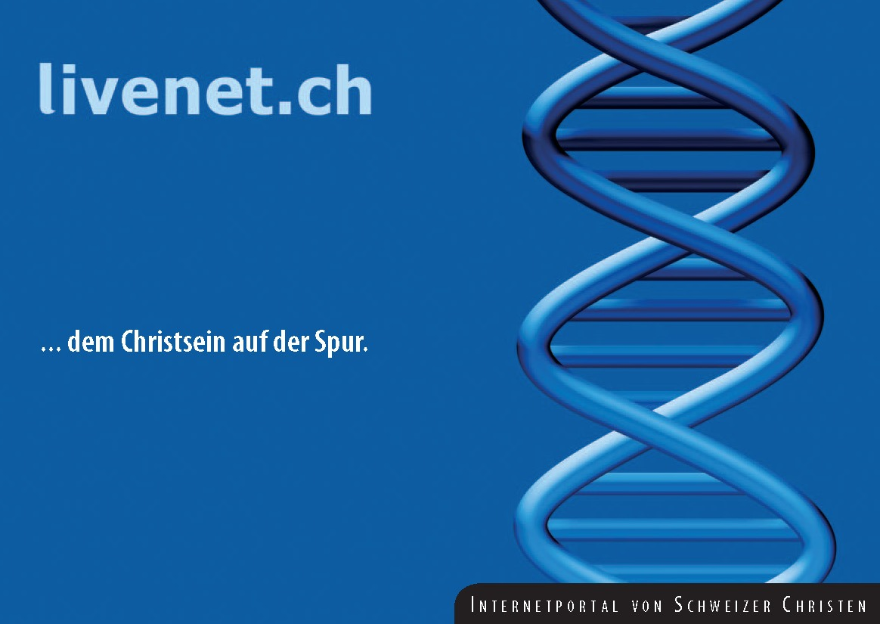
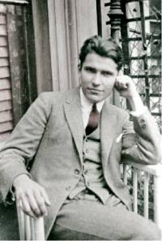
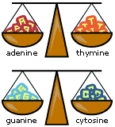
Discovering the structure of DNA
Erwin Chargaff – (1905-2002)
Columbia University, NY
Investigated the composition of DNA
His findings by 1950 strongly
suggested the base-pairings
of A-T & G-C
Met with Watson and Crick in
1952 and shared his findings
“Chargaff’s rule” A = T & C = G

Slide 8
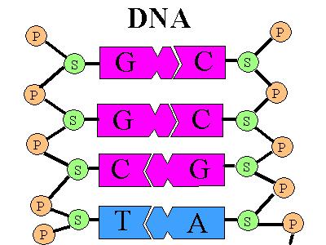
Discovering the structure of DNA
DNA = Deoxyribose nucleic acid
  Present in all living cells
  Contains all the information
Nucleotides:
a subunit that consists of:
  a sugar (deoxyribose)
  a phosphate
  and one nitrogen base – 4 different bases
    Adenine (A) and Thymine (T)
    Guanine (G) and Cytosine (C)

Slide 9
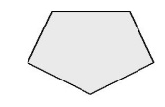
















The strands separate
PO₄
PO₄
PO₄
PO₄
PO₄
PO₄
PO₄
PO₄
PO₄
PO₄
PO₄
PO₄
PO₄
PO₄
PO₄
PO₄

Slide 10
Nucleic Acid Structure
“Base Pairing”
RNA [normally] exists as a single stranded polymer
DNA exists as a double stranded polymer
DNA double strand is created by hydrogen bonds between nucleotides
Nucleotides always bind to complementary nucleotides
A
T
(2 H-bonds)
G
C
(3 H-bonds)

Slide 11
Practice DNA Base Pairs
G A T T A C A
C T A A T G T
Notes:
“Gattaca” is a science fiction movie starring Uma Thurman, Ethan Hawke, and Jude Law

Slide 12
Complementarity of DNA strands
Two chains differ in sequence
(sequence is read from 5’ to 3’)
Two chains are complementary
Two chains run antiparallel

Slide 13
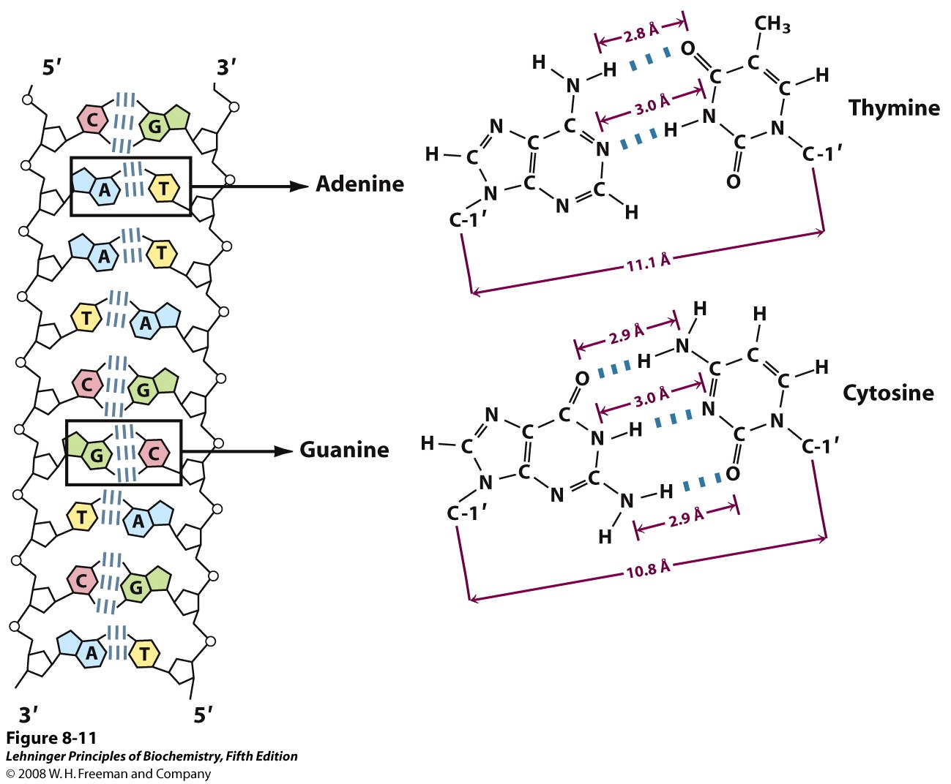
Notes:
FIGURE 8-11 Hydrogen-bonding patterns in the base pairs defined by Watson and Crick. Here as elsewhere, hydrogen bonds are represented by three blue lines.

Slide 14
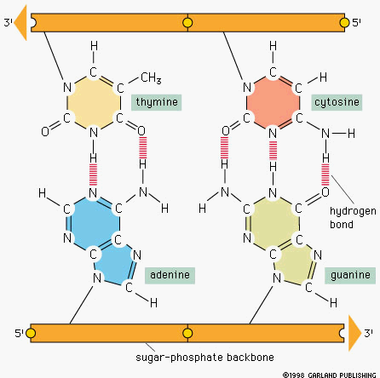
Nucleic Acid Structure
“Base Pairing”

Slide 15
Nucleic Acid Structure
Polymerization
5’
3’
Sugar Phosphate
“backbone”
T
A
G
C
A
C
Bases
5’
3’
TAGCAC

Slide 16
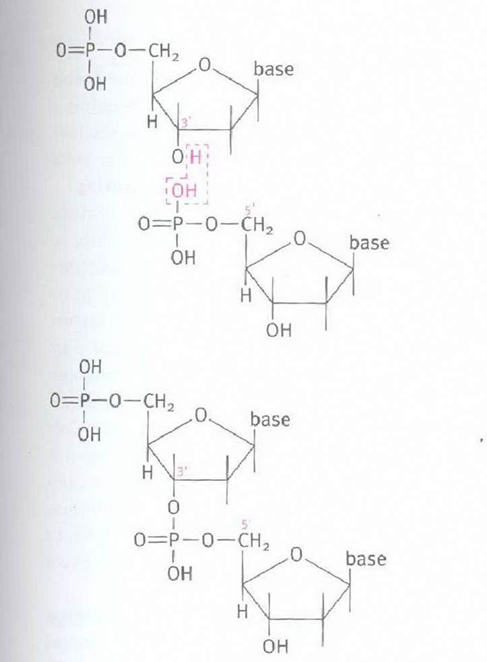

Slide 17
Nucleic Acid Structure
Polymerization
P
P
P
P
P
P
N
N
C
C
S
S
Phosphodiesterase
+
P
N
P
P
C
(PPi)
S
P
P
P
N
C
S

Slide 18
