Slide 1
Nucleic Acids
DNA & RNA

Slide 2
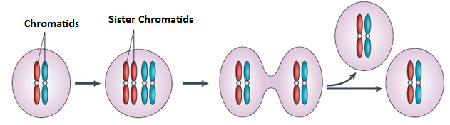
DNA Replication
Cell division involving mitosis produces 2 daughter cells that are genetically identical to each other and genetically identical to the parent cell
Remember that for this to happen, DNA in the parent cell must be replicated (copied) before the cell divides – this process occurs during Interphase in the cell cycle

Slide 3
replication
Before a cell divides, the DNA strands unwind
and separate
Each strand makes a new partner by adding
the appropriate nucleotides
The result is that there are now two double-stranded DNA molecules in the nucleus
So that when the cell divides, each nucleus
contains identical DNA
This process is called replication

Slide 4
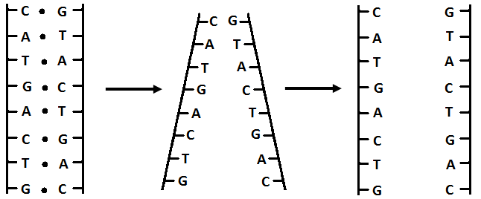
STEP 1
Hydrogen bonds between base pairs are broken by the enzyme Helicase and DNA molecule unzips
DNA molecule separates into complementary halves

Slide 5
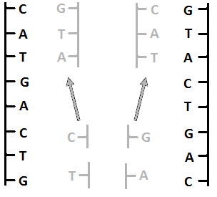
STEP 2
Nucleotides match up with complementary bases
Free nucleotides abundant in nucleus

Slide 6
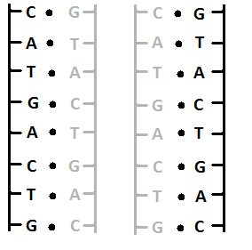
STEP 3
Nucleotides are linked into 2 new strands of DNA by the enzyme, polymerase—DNA polymerase also proofreads for copying errors
New Strand
Original Strand

Slide 7
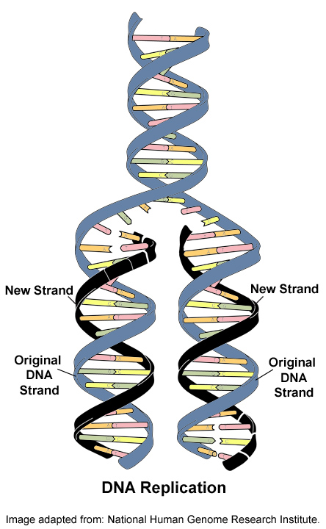
Mutations occur when copying errors cause a change in the sequence of DNA nucleotide bases

Slide 8
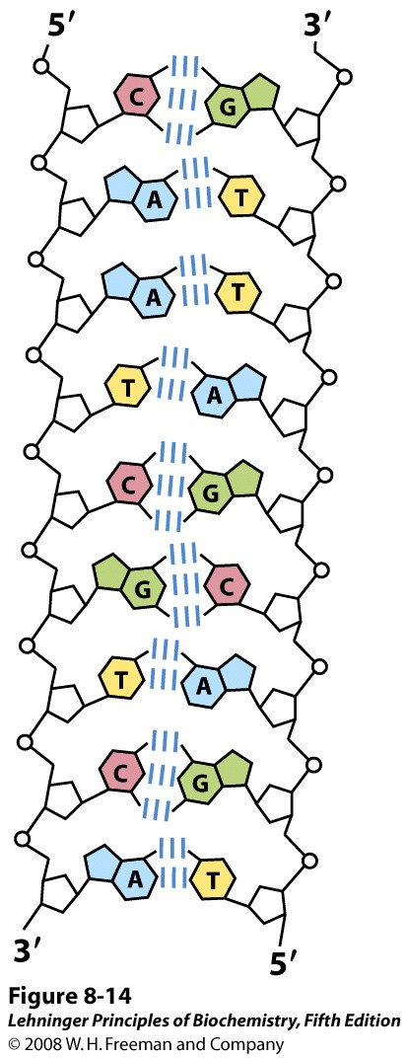
Notes:
FIGURE 8-14 Complementarity of strands in the DNA double helix. The complementary antiparallel strands of DNA follow the pairing rules proposed by Watson and Crick. The base-paired antiparallel strands differ in base composition: the left strand has the composition A₃ T₂ G₁ C₃; the right, A₂ T₃ G₃ C₁. They also differ in sequence when each chain is read in the 5′→3′ direction. Note the base equivalences: A = T and G = C in the duplex.

Slide 9
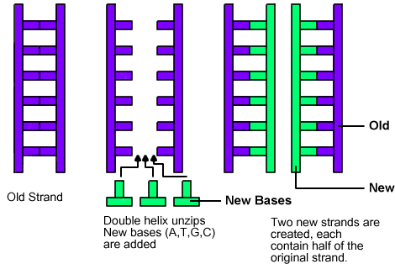
Diagram Examples of DNA Replication:
(You could see DNA replication represented different ways.)

Slide 10
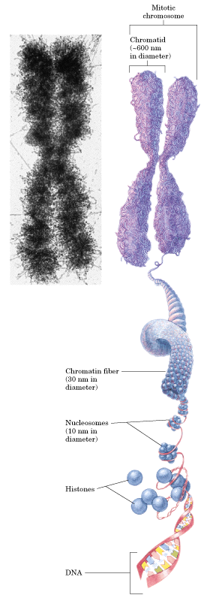

Slide 11
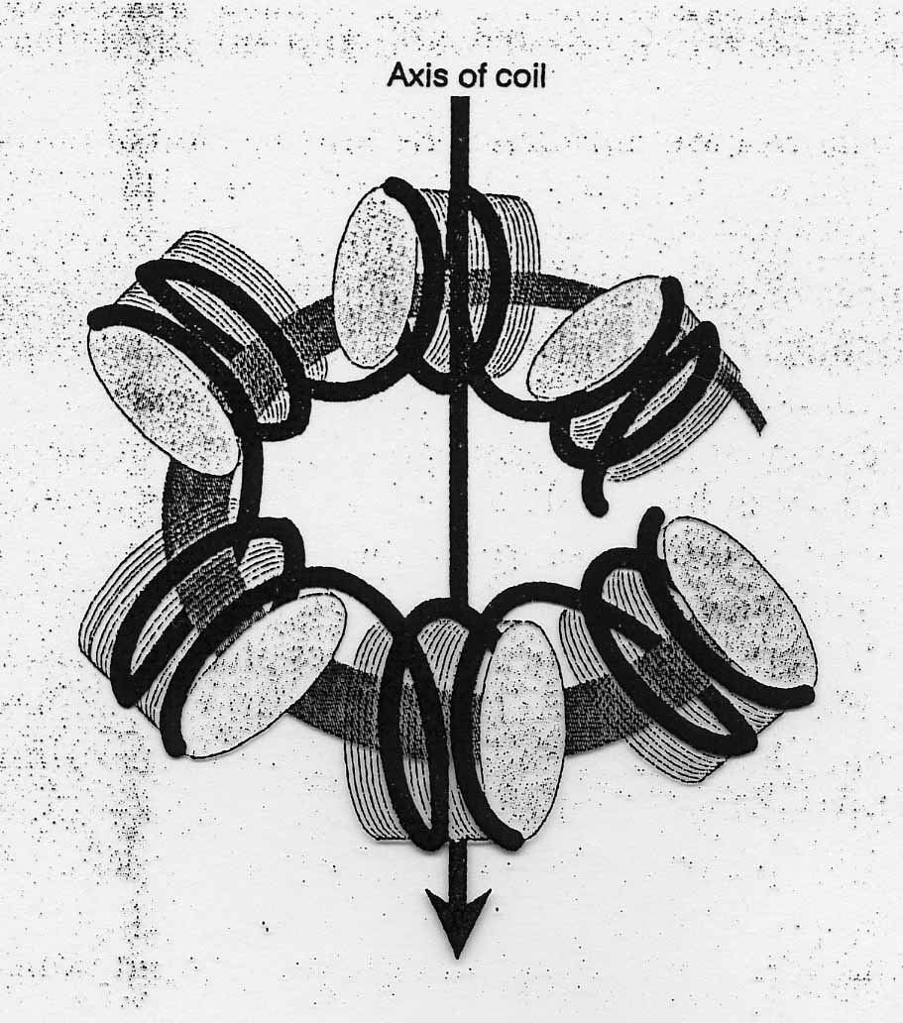
Storage of DNA
In eukaryotic cells (animals, plants, fungi) DNA is stored in the nucleus, which is separated from the rest of the cell by a semipermeable membrane
The DNA is only organized into chromosomes during cell replication
Between replications, the DNA is stored in a compact ball called chromatin, and is wrapped around proteins called histones to form nucleosomes

Slide 12
DNA Replication
When a eukaryotic cell divides, the process is called mitosis
- the cell splits into two identical daughter cells
- the DNA must be replicated so that each daughter cell has a copy
DNA replication involves several processes:
- first, the DNA must be unwound, separating the two strands
- the single strands then act as templates for synthesis of the new strands, which are complimentary in sequence
- bases are added one at a time until two new DNA strands that exactly duplicate the original DNA are produced
The process is called semi-conservative replication because one strand of each daughter DNA comes from the parent DNA and one strand is new
The energy for the synthesis comes from hydrolysis of phosphate groups as the phosphodiester bonds form between the bases

Slide 13
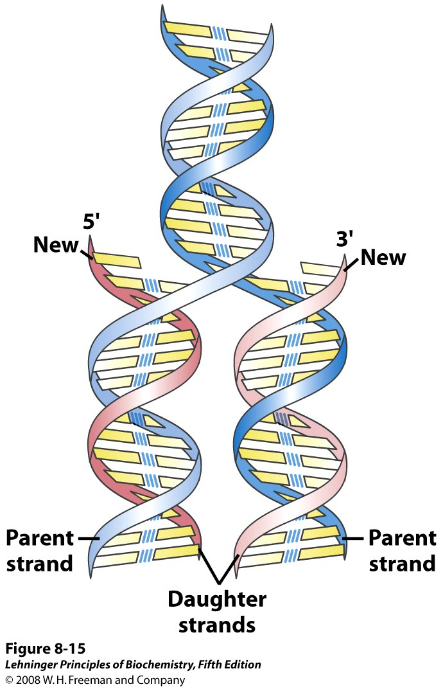
Notes:
FIGURE 8-15 Replication of DNA as suggested by Watson and Crick. The preexisting or "parent" strands become separated, and each is the template for biosynthesis of a complementary "daughter" strand (in pink).

Slide 14
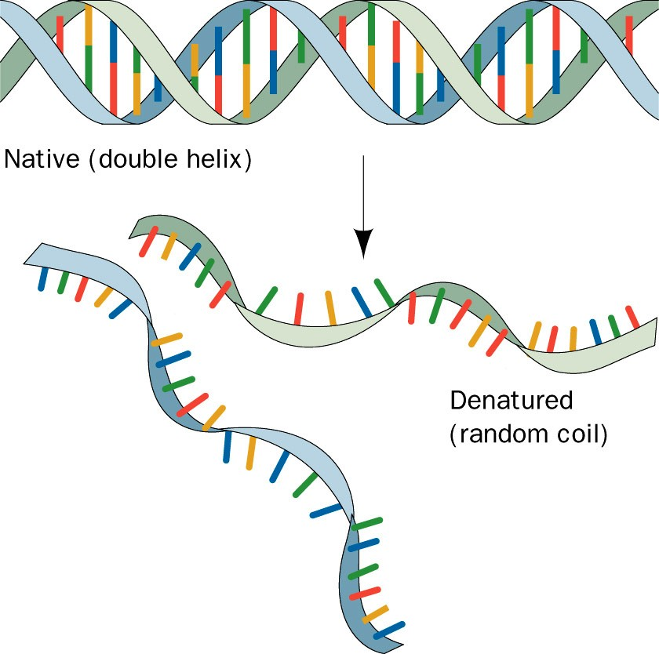
Schematic representation of the strand separation in duplex DNA resulting from its heat denaturation.

Slide 15
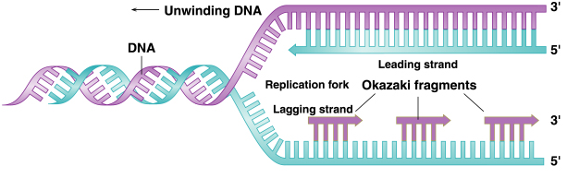
Direction of Replication
The enzyme helicase unwinds several sections of parent DNA
At each open DNA section, called a replication fork, DNA polymerase catalyzes the formation of 5’-3’ester bonds of the leading strand
The lagging strand, which grows in the 3’-5’ direction, is synthesized in short sections called Okazaki fragments
The Okazaki fragments are joined by DNA ligase to give a single 3’-5’ DNA strand

Slide 16
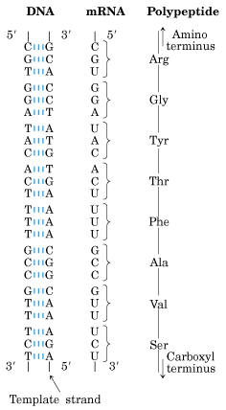
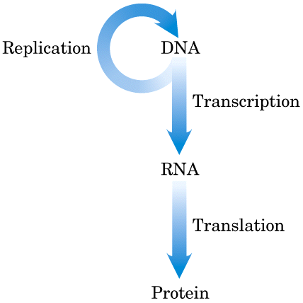

Slide 17
Ribonucleic Acid (RNA)
RNA is much more abundant than DNA
There are several important differences between RNA and DNA:
- the pentose sugar in RNA is ribose, in DNA it’s deoxyribose
- in RNA, uracil replaces the base thymine (U pairs with A)
- RNA is single stranded while DNA is double stranded
- RNA molecules are much smaller than DNA molecules
There are three main types of RNA:
- ribosomal (rRNA), messenger (mRNA) and transfer (tRNA)

Slide 18
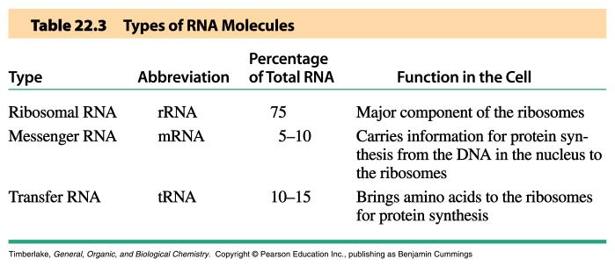
Types of RNA

Slide 19
Messenger RNA (mRNA)
Its sequence is copied from genetic DNA
It travels to ribsosomes, small granular particles in the cytoplasm of a cell where protein synthesis takes place

Slide 20
Ribosomal RNA (rRNA)
Ribosomes are a complex of proteins and rRNA
The synthesis of proteins from amino acids and ATP occurs in the ribosome
The rRNA provides both structure and catalysis

Slide 21
Transfer RNA (tRNA)
Transports amino acids to the ribosomes where they are joined together to make proteins
There is a specific tRNA for each amino acid
Recognition of the tRNA at the anti-codon communicates which amino acid is attached

Slide 22
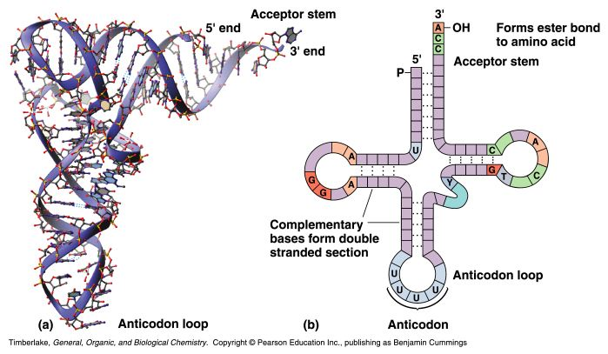
Transfer RNA
Transfer RNA translates the genetic code from the messenger RNA and brings specific amino acids to the ribosome for protein synthesis
Each amino acid is recognized by one or more specific tRNA
tRNA has a tertiary structure that is L-shaped
- one end attaches to the amino acid and the other binds to the mRNA by a 3-base complimentary sequence

Slide 23
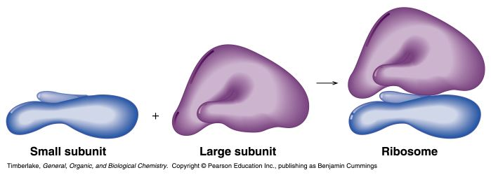
Ribosomal RNA and Messenger RNA
Ribosomes are the sites of protein synthesis
- they consist of ribosomal DNA (65%) and proteins (35%)
- they have two subunits, a large one and a small one
Messenger RNA carries the genetic code to the ribosomes
- they are strands of RNA that are complementary to the DNA of the gene for the protein to be synthesized

