Slide 1
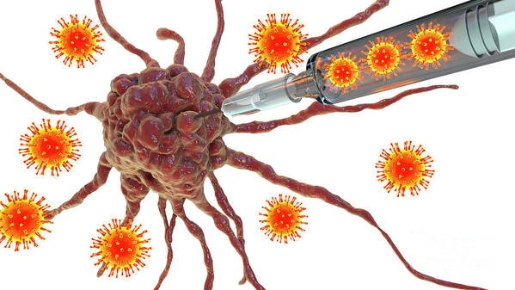
Oncolytic virus and cancer
أعداد
م.م علياء كريم عبود
قسم العلاج التجريبي –المركز العراقي لبحوث السرطان والوراثة الطبية

Slide 2
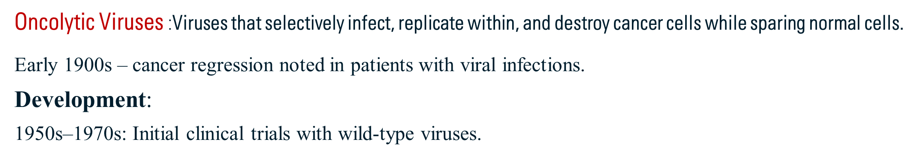
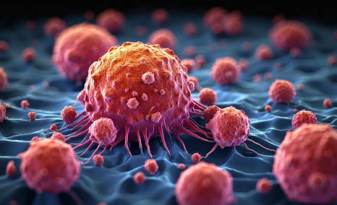
Oncolytic viruses usually divided into 2 main categories, i.e., naturally occurring and genetically modified OVs. Genetically modified viruses are obtained using genetic engineering technology to engineer common viruses and disable their ability to infect normal cells, which allows the specific lysis of tumor cells. OVs retain the high invasiveness, robust replication in tumors, while in normal cells, viral replication and expansion are hampered since tumor cells have an abnormal metabolism and a differential microenvironment compared to normal cells.

Slide 3
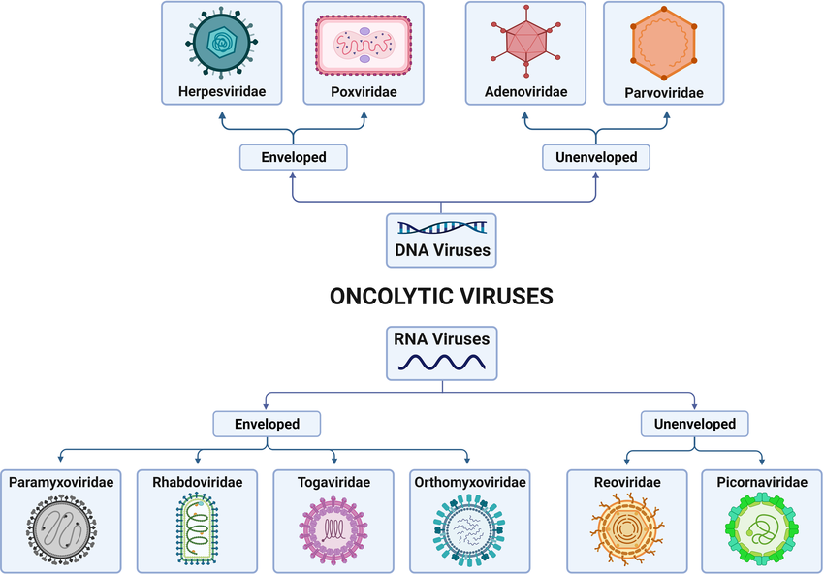
Commonly Used Oncolytic Viruses

Slide 4
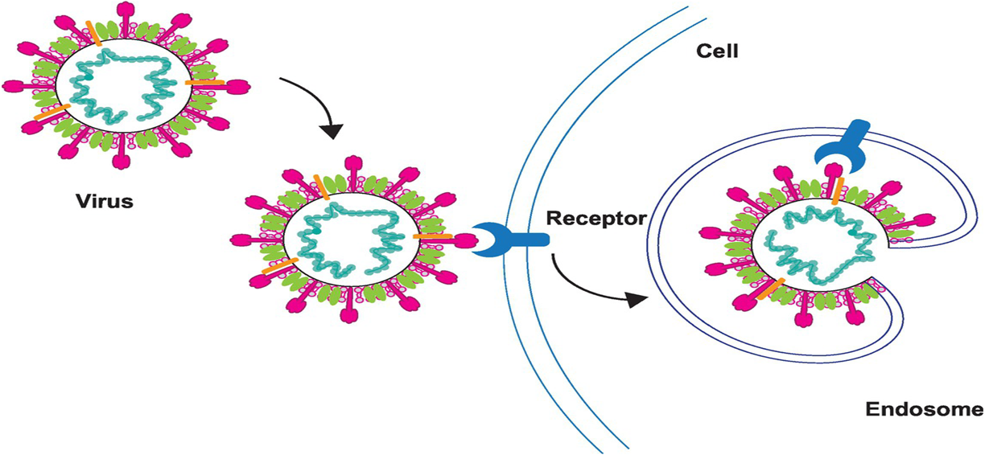
Mechanisms of Oncolytic Virus (OV) Action :
OV therapy is driven by several factors.
The first of these is cellular entry via virus-specific receptor. A specific viral entry receptor is often highly expressed on tumor cells.
Second, rapid cell division in tumor cells with high metabolic and replicative activity may support increased viral replication compared with normal cells.
Third, many tumor cells have deficiencies in antiviral type I interferon signaling, therefore supporting selective virus replication.

Slide 5
Characteristics of Oncolytic Viruses
1. Tumor Selectivity
Replication-specific to cancer cells: Exploits defects in antiviral signaling pathways (e.g. interferon pathways) normal cells remain largely unaffected.
2. Direct Cancer Cell Destruction
Oncolysis: Viral replication leads to the rupture of infected cancer cells, releasing viral progeny to infect neighboring tumor cells.
3. Immune System Activation
Release of tumor antigens during oncolysis triggers:
  Innate immunity: Activation of macrophages, natural killer (NK) cells, and dendritic cells.
  Adaptive immunity: T-cell-mediated recognition and destruction of tumor cells.

Slide 6
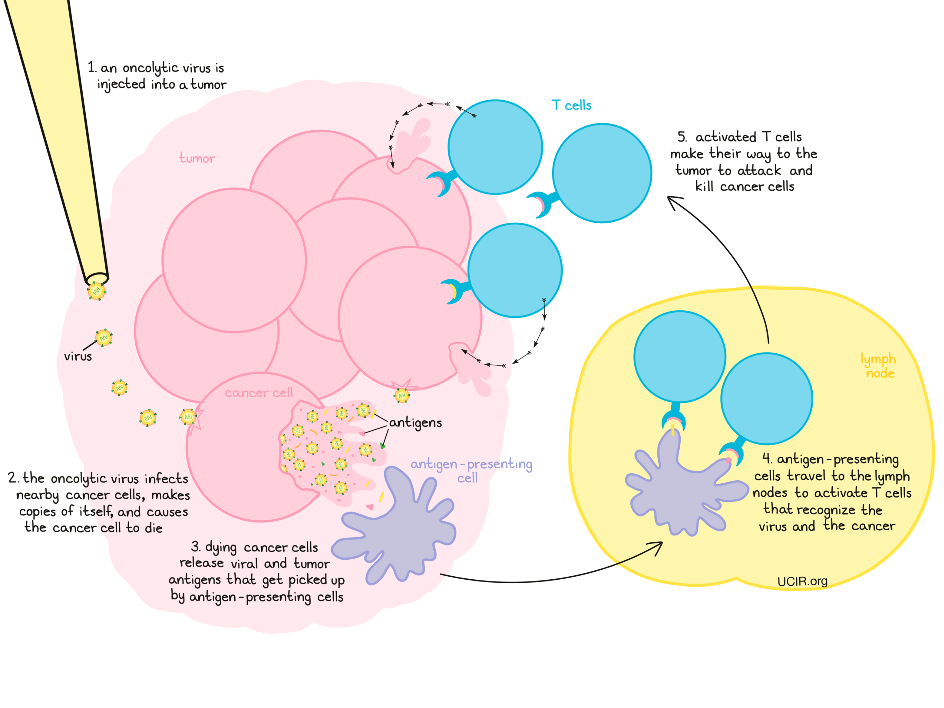

Slide 7
Combination Therapies of Oncolytic viruses with:
Immune checkpoint inhibitors.
Chemotherapy.
Radiotherapy.
Advantages of Oncolytic Viruses
Selectivity for cancer cells.
Immune stimulation.
Synergy with other treatments.
Disadvantage of oncolytic virus therapy:
Delivery deep ,resistance mechanism

Slide 8
A range of viruses has been investigated as potential cancer therapeutics:
1-Herpesvirus: Intertumoral injection of talimogene led to significant improvement response rate in patients with melanoma (16.3%) compared with controls (2.1%).
2-Adenovirus: approved for treatment of head and neck cancer in China under the name H101
3-Vaccinia Virus: Pexa-Vec is based on the vaccinia vaccine strain engineered to express human tested in more than 300 patients. increased survival in patients with liver cancer after intravenous injection.
4-Measles virus causes syncytia formation and cell death. A measles virus expressing the human is currently in a range of clinical trials have confirmed safety and demonstrated imaging of virus infection and tumor regression .

Slide 9
5-Coxsackievirus:Wild-type coxsackievirus A21 is in clinical trials under the name Cavatak leads to a robust immune response in melanoma.
6-Polio Virus :Polio virus has demonstrated oncolytic properties in brain tumors .PVS-RIPO is a cytotoxic and immunostimulatory virus and clinical responses in glioblastoma.
7-Reovirus: usually produces mild symptoms in humans and can readily enter human cells and activate innate and adaptive immune systems. Is marketed as Reolysin and has been examined in clinical trials alone in a range of cancers. Reolysin was given drug status for the treatment of malignant glioma by the FDA in 2015.
8-Parvovirus. A trial of parvovirus H1 (ParvOryx) in recurrent glioblastoma has been completed and this agent is currently in trials for metastatic pancreatic cancer.

Slide 10
Virus Cultivation :Viruses are obligate intracellular parasites so they depend on host for their survival.
They cannot be grown in non-living culture media or on agar plates alone, they must require living cells to support their replication.
Embryonated chick egg was used first for cultivation of viruses by Goodpasture in 1931. The method developed by Burnet was used for cultivation of viruses in different sites of the embryonated egg. Usually, 8–11 days’ old chick eggs are used for culture of viruses. The viruses are isolated in different sites of the egg, such as yolk sac, amniotic cavity, and allantoic cavity, and chorioallantoic membrane (CAM).
Yolk sac: Yolk sac inoculation is used for cultivation of West Nile virus.
Amniotic cavity: Inoculation in the amniotic cavity is used mainly for primary isolation of influenza virus.
Allantoic cavity: Inoculation in the allantoic cavity is used for serial passages and for obtaining large quantities of virus, such as influenza virus, yellow fever virus.
Chorioallantoic membrane: Inoculation of some viruses on CAM ex.pox viruses,

Slide 11
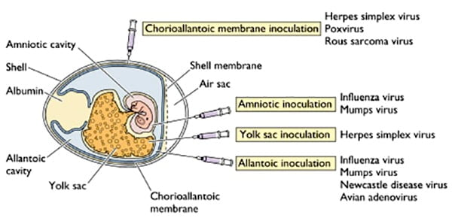
Tissue Culture
Cell culture is most widely used in diagnostic virology for cultivation and assays of viruses.
The tissue culture was first applied in diagnostic virology in 1913.
Ex: vaccinia virus by culture in tissues of rabbit cornea.
Organ Culture
This was used for the isolation of some viruses, which appear to show affinity for certain tissue organs. For example, coronavirus, a respiratory pathogen, was isolated in the tracheal organ culture.
Cell Culture : is now routinely used for growing viruses.
tissues are dissociated into component cells by treatment with proteolytic enzymes (trypsin )the cells are then washed, counted, and suspended in a growth medium containing essential amino acids and vitamins, salts, glucose. This medium is supplemented by up to 5% of fetal calf serum and antibiotics divide to form a confluent monolayer sheet of cells covering the surface within a week. The latter is useful for growth of some fastidious viruses

Slide 12
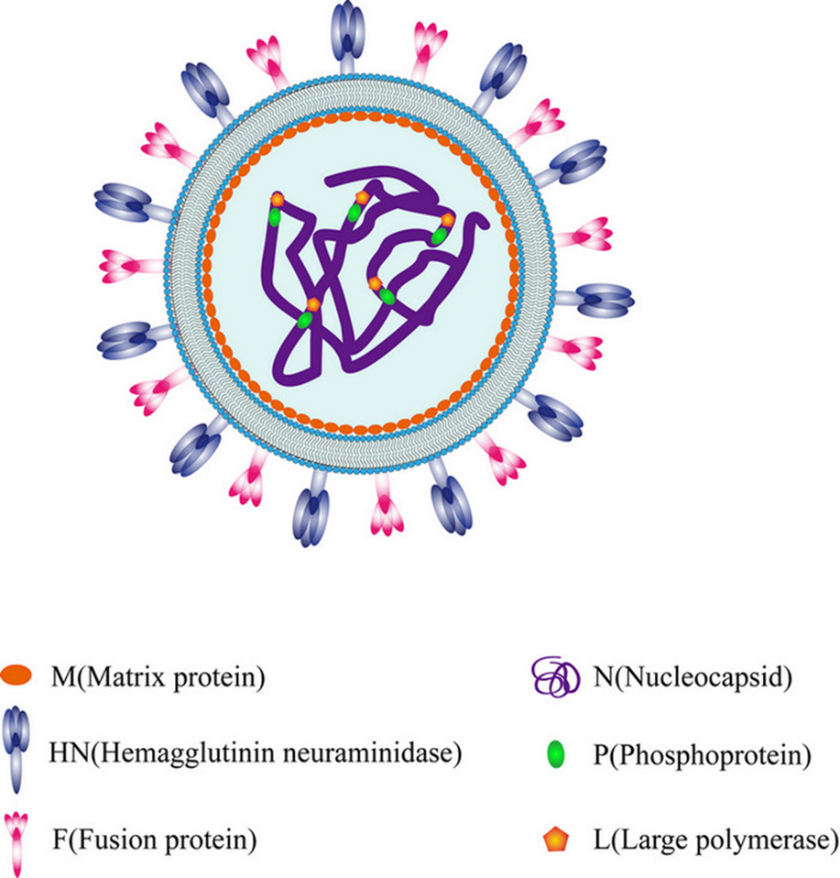
Newcastle Disease Virus (NDV):
Family a paramyxovirus, genus Avulavirus.
capable of causing serve respiratory, gastrointestinal, and neurological disorders in birds. As a cytoplasmic virus that does not integrate into the host genome or undergo recombination. , is a single-stranded, negative sense RNA virus with a lipid bilayer. The genome is composed of six transcriptional units that encode six main viral proteins: nucleocapsid protein (NP), phosphoprotein (P), matrix protein (M), fusion protein (F),
hemagglutinin-neuraminidase protein (HN), and large polymerase protein (L).

Slide 13
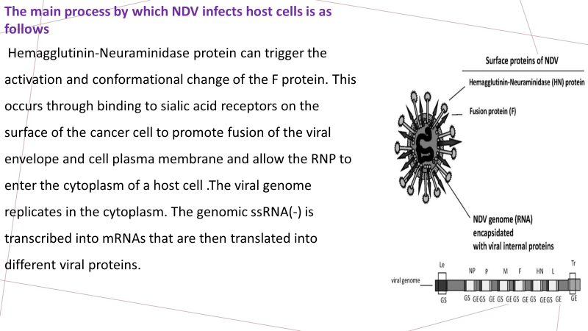

Slide 14
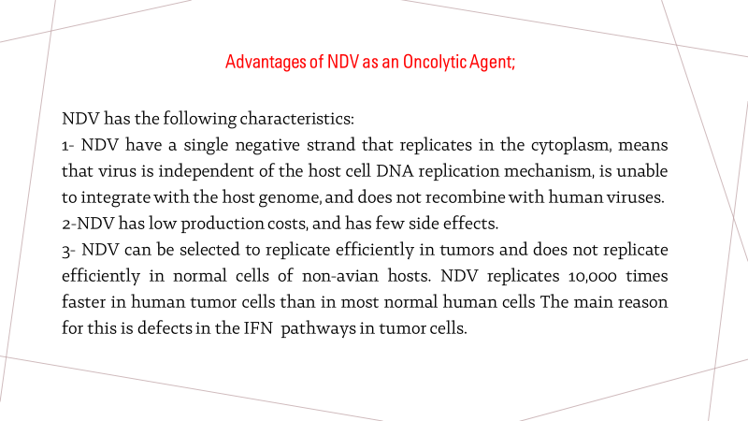

Slide 15
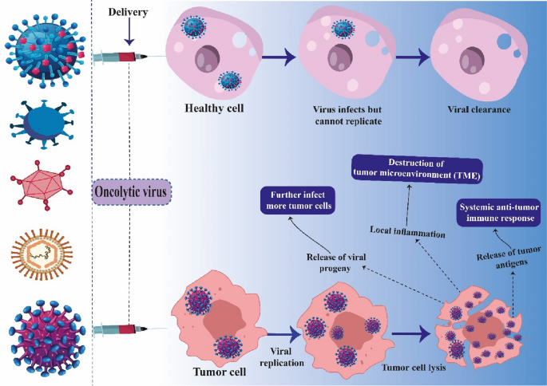

Slide 16
Application of NDV in Tumor Therapy
Since the oncolytic properties of NDV were discovered in the 1950s, it has been widely used in preclinical research as a novel anticancer drug for a variety of solid tumors and resistant tumors, such as gastric cancer, liver cancer, lung cancer , breast cancer , cervical cancer , prostate cancer , colorectal cancer , and glioblastoma. The first report of using NDV to treat a human cancer (acute leukemia) was published in 1964, and the patient experienced a brief anti-leukemic effect and clinical symptom remission. In 1965, Cassel et al. used the NDV as an antitumor agent to treat cervical cancer and the results showed extensive tumor shedding.

Slide 17
Delivery
Therapeutic delivery of OVs is dependent on virus and tumor type. Most often, OVs are injected directly into the tumor site. For example, tumors of the brain are treated using local delivery by multiple injections during surgery. Other, more accessible tumors can be treated with multiple doses and multiple injection sites over time. The experience with talimogene provides an indication that OV administration at a single tumor site can lead to regression of distant tumors, implying that the induction of local antitumor immunity can have systemic effects. Intravenous injection is also commonly used and allows systemic administration to multiple tumor sites. Cellular carriers may also be used, which may protect the virus from recognition by the host immune system before reaching the tumor.

Slide 18
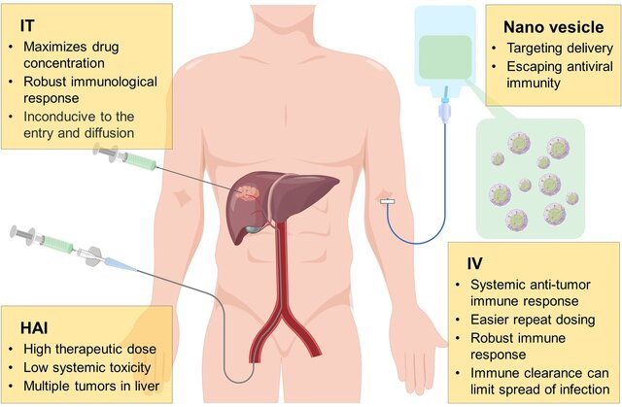
During the development of oncolytic virus, many drug delivery routes have been investigated, including hepatic arterial infusion (HAI), intertumoral (IT), intravenous (IV) injection

Slide 19
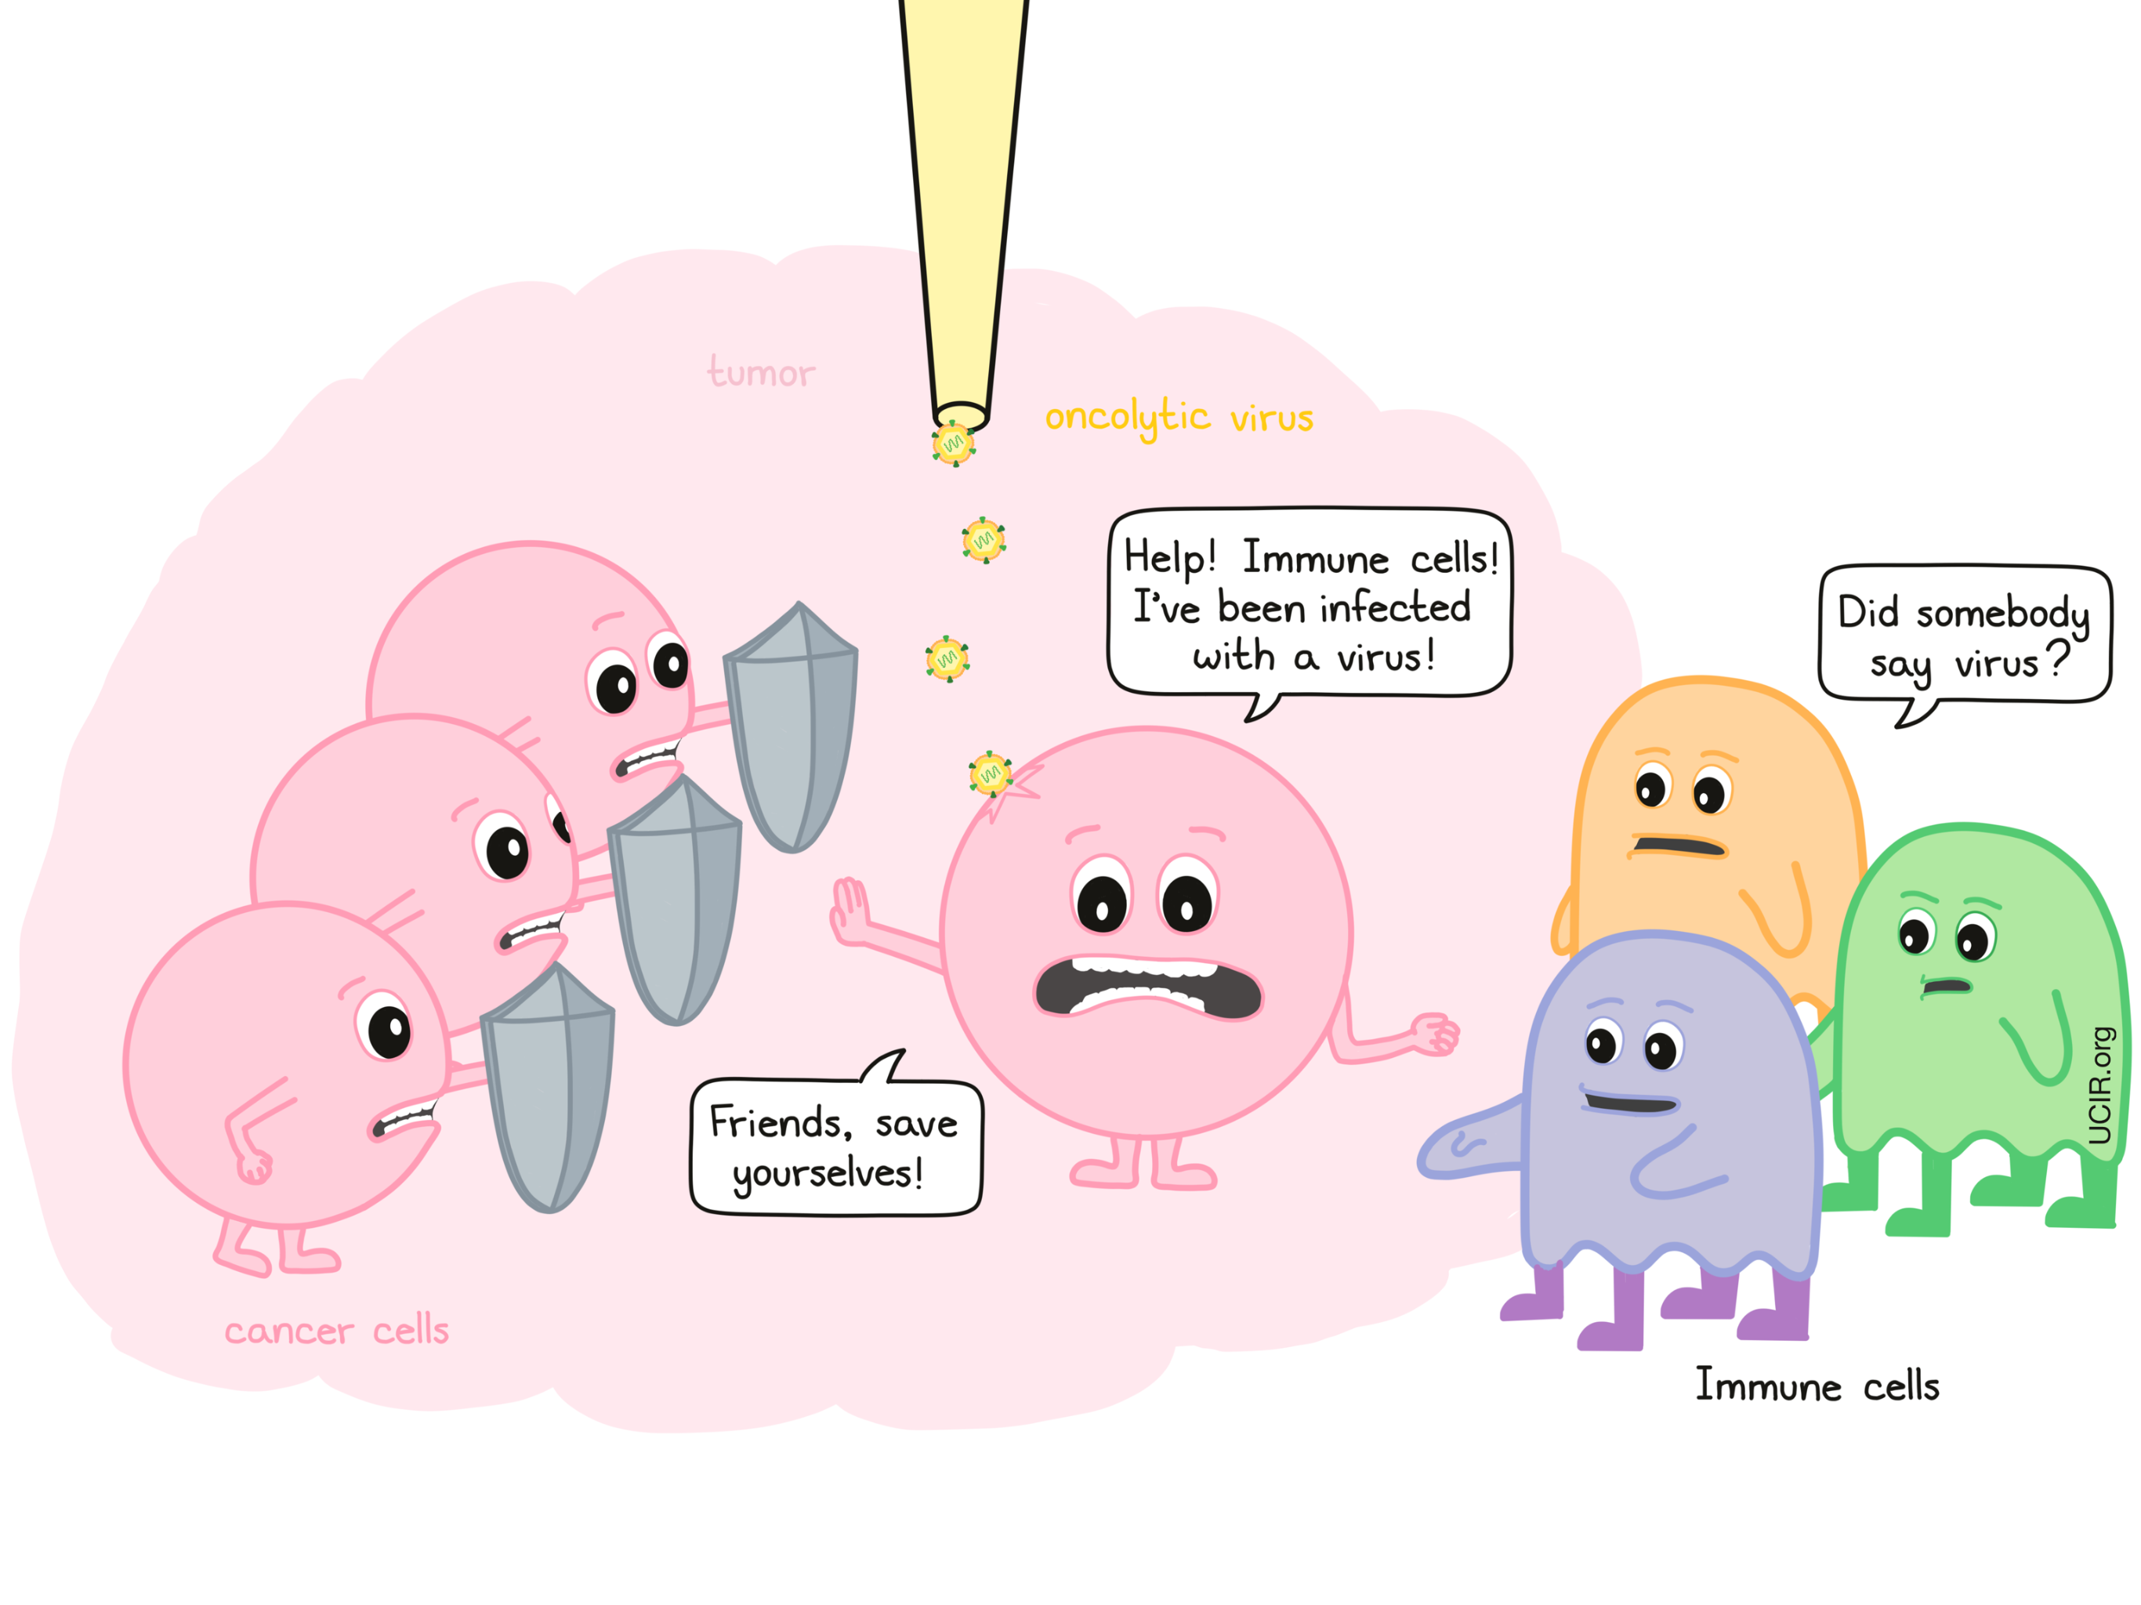
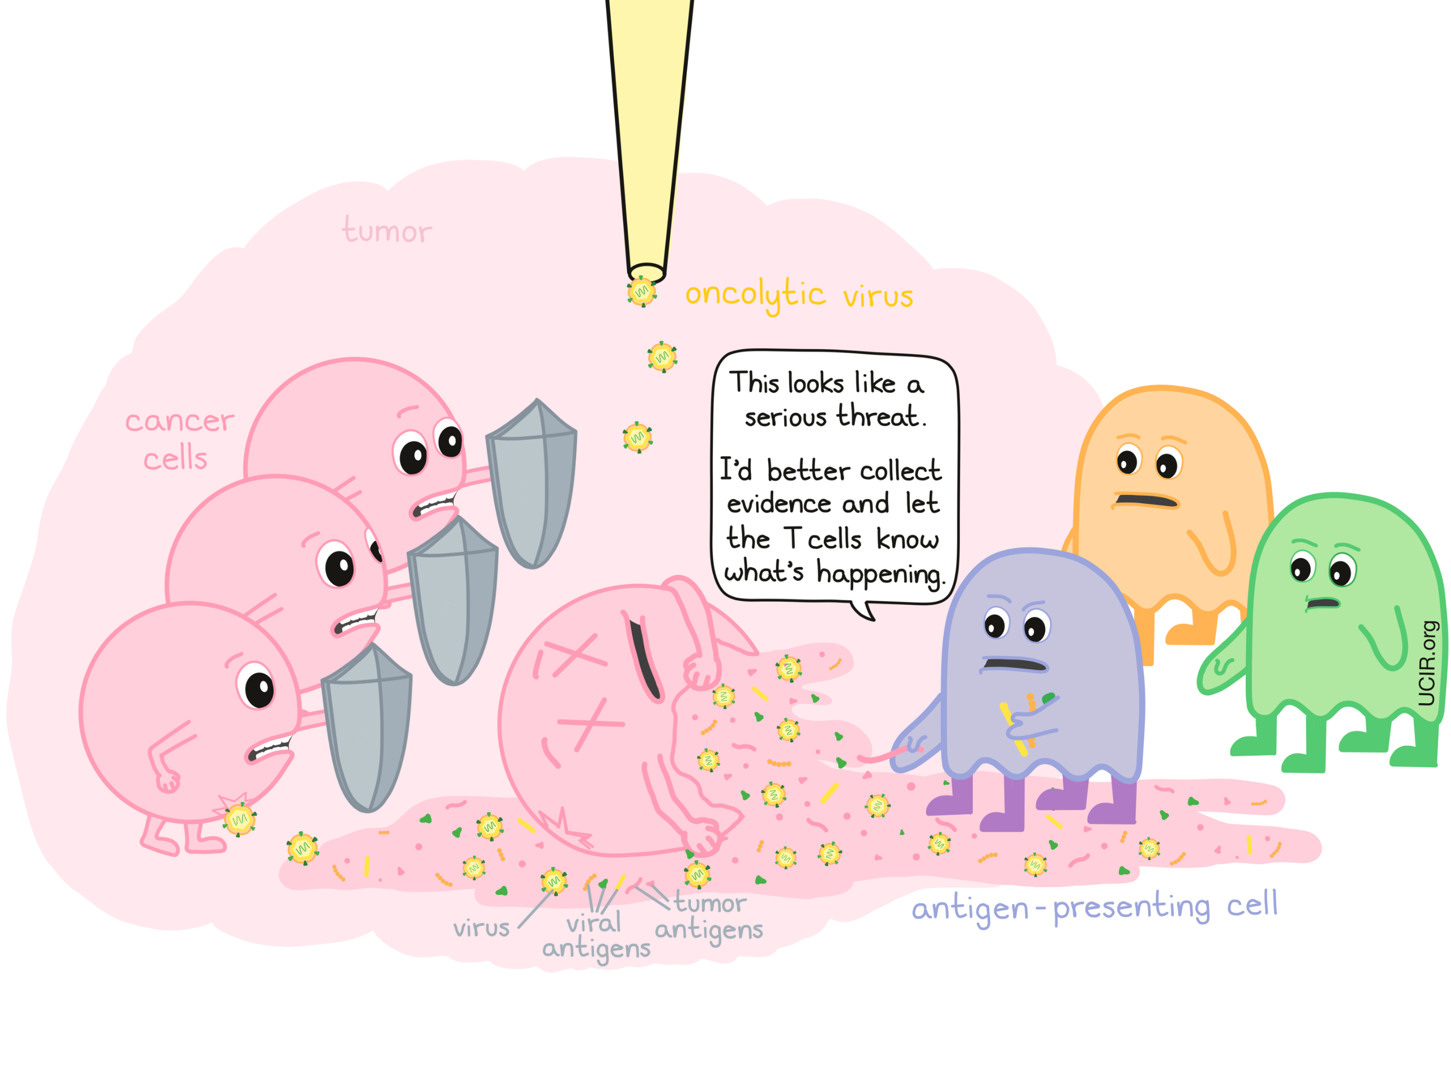
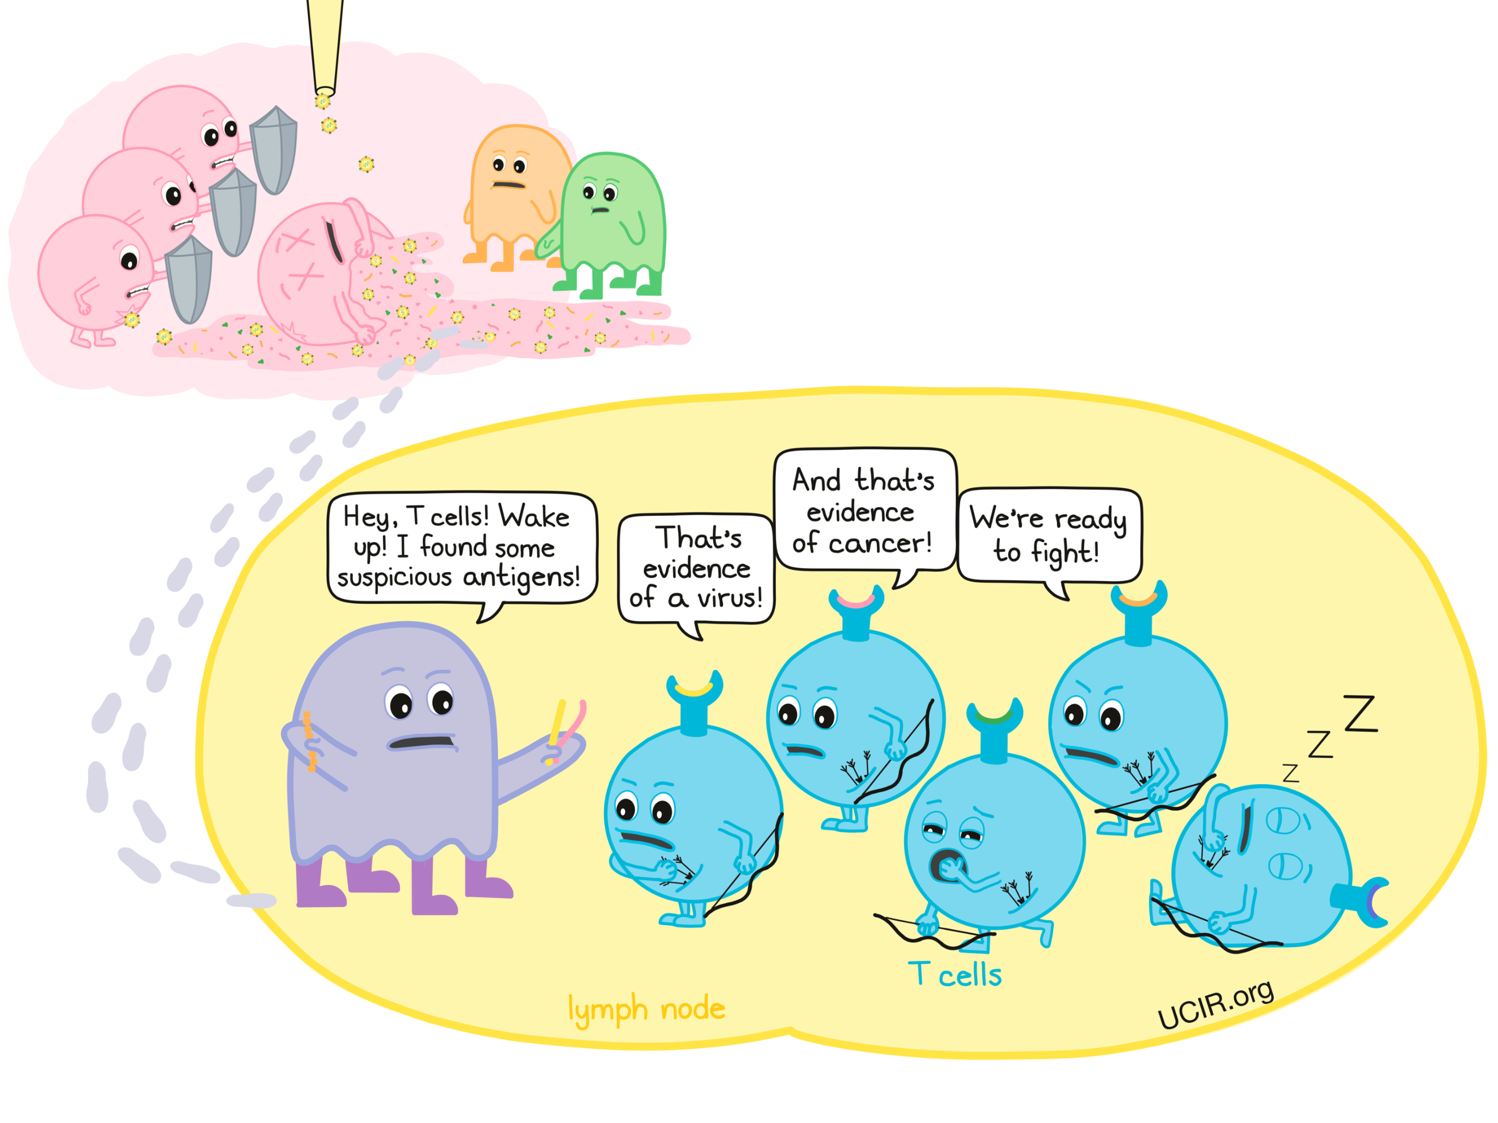
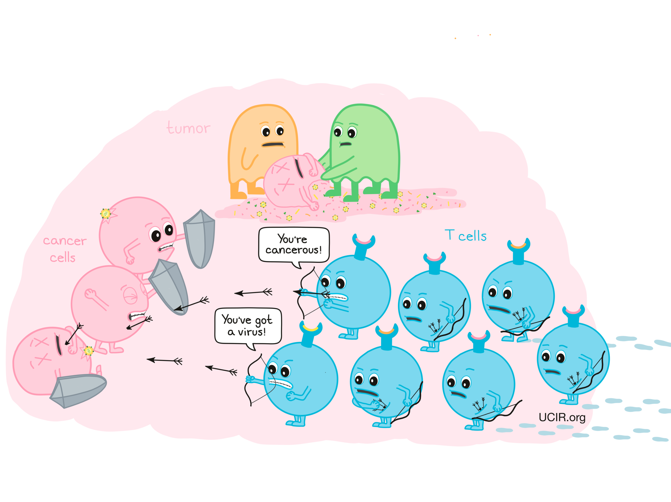

Slide 20
References:
1- Burman, B.; Pesci, G.; Zamarin, D. Newcastle Disease Virus at the Forefront of Cancer Immunotherapy. Cancers 2020, 12, 3552.
2-Zhan, Y.; Yu, S.; Yang, S.; Qiu, X.; Meng, C.; Tan, L.; Song, C.; Liao, Y.; Liu, W.; Sun, Y.; et al. Newcastle Disease virus infection
activates PI3K/Akt/mTOR and p38 MAPK/Mnk1 pathways to benefit viral mRNA translation via interaction of the viral NP
protein and host eIF4E. PLoS Pathog. 2020, 16, e1008610.
3-Burke, S.; Shergold, A.; Elder, M.J.; Whitworth, J.; Cheng, X.; Jin, H.; Wilkinson, R.W.; Harper, J.; Carroll, D.K. Oncolytic Newcastle
disease virus activation of the innate immune response and priming of antitumor adaptive responses in vitro. Cancer Immunol.
Immunother. 2020, 69, 1015–1027.
4- Huang, F.; Dai, C.; Zhang, Y.; Zhao, Y.; Wang, Y.; Ru, G. Development of Molecular Mechanisms and Their Application on
Oncolytic Newcastle Disease Virus in Cancer Therapy. Front. Mol. Biosci. 2022, 9, 889403

Slide 21
THANK YOU

