Slide 1
THYROID IMMAGING

Slide 2
The thyroid gland, or simply the thyroid /ˈθaɪrɔɪd/, is one of the largest endocrine glands in the body, and consists of two connected lobes. It is found in the anterior neck, below the laryngeal prominence . The thyroid gland controls rate of use of energy sources, protein synthesis, and controls the body's sensitivity to other hormones. It participates in these processes by producing thyroid hormones, the principal ones being thyroxine (T₄) and triiodothyronine (T₃), which is more active. These hormones regulate the growth and rate of function of many other systems in the body. T₃ and T₄ are synthesized from iodine and tyrosine. The thyroid also produces calcitonin, which plays a role in calcium homeostasis.
Hormonal output from the thyroid is regulated by thyroid-stimulating hormone (TSH) produced by the anterior pituitary, which itself is regulated by thyrotropin-releasing hormone (TRH) produced by the hypothalamus

Slide 6
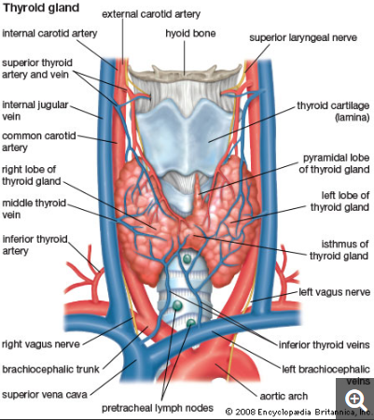

Slide 16
Radio-isotope studies
The thyroid gland arises from the thyroglossal duct which extends caudally from the pharynx to the neck .The adult gland lies in front of the thyroid cartilage , but may lie anywhere from the base of the tongue along the line of the thyroglossal duct. A normal gland consist of two lobes joined by central isthmus from which a small pyramidal lobe occasionally arises , usually on the left.
The ability of the thyroid gland to trap iodine or iodine analogs such as ^{99m} Tc- pertechnetate forms the basis of large number of thyroid function tests , as well as of thyroid scanning . The isotopes in common use for thyroid scanning are :
- ¹³¹ I , the biophysical properties of ¹³¹ I make it unsuitable for general diagnostic work , but it is a valuable therapeutic agent.
- ¹²³ I , this is the most suitable radionuclide physically , mainly for its gamma energy ( 159 keV) which is ideal for the gamma camera. It has a relatively short half-life ( 13.34 ) and a low radiation dose. Though cyclotron produced and relatively expensive ¹²³ I is being increasingly used .

Slide 17
- ^{99m} Tc , The pertechnetate ion is trapped by the thyroid in a similar way to iodine because they are analogs , but the pertechnetate ion does not take part in any further synthesis and this is a relative disadvantage. The usual activity given to an adult is 100 MBq .
Technetium differs from iodine in that the stomach is the critical organ for absorbed dose .
Sodium pertechnetate is given intravenously and scanning begins 30 minutes later . Sodium iodide is given by mouth and scanning begins 18-24 hours later .If technetium is used , a rapid sequence of images can be obtained immediately after injection in order to show the distribution of vascularity in the gland and to serve as a baseline for detecting cold areas and for determining the vascularity of palpable nodules .The anterior and oblique views are carried out with pinhole collimator with a 3 mm pinhole. When the collimator is as near as possible to the patient , the pinhole is approximately equidistance from gland and crystal .Therefore there will be no magnification .The normal thyroid images show two lateral lobes linked by a narrow isthmus , occasionally the isthmus may not be visible , or it may constitute the bulk of the gland .A pyramidal lobe arising from the isthmus is sometimes found

Slide 18
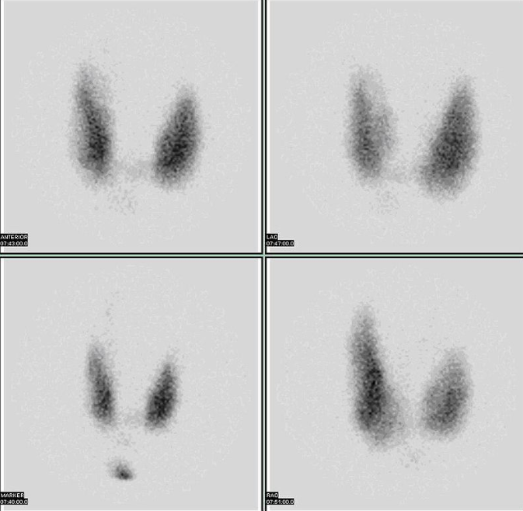
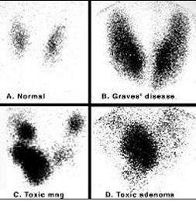

Slide 19
Radioactive isotopes are special forms of elements that undergo a process called decay in which they change from higher energy states to lower energy states. As they undergo this change, they release small bursts of energy in the form of radiation that can be detected by special cameras. The tissue that makes up the thyroid gland is unique in that it is able to take up and trap iodine and certain other molecules of similar size. When radioactive isotopes of these substances (tracers) are swallowed or injected into the bloodstream, they are taken up by the thyroid gland. As they decay, a special camera can detect the energy that is released, creating a picture of the thyroid gland. The radioactive isotopes that are most commonly used as tracers to perform thyroid scans are called 123-Iodine, 99m-Technetium pertechnetate and 131-Iodine.
Nuclear imaging and the thyroid scan can be used to distinguish a nodule as hot, warm, or cold, based on the relative amount of uptake of radioactive isotope. Hot nodules take up excessive amounts of isotope and indicate autonomously functioning nodules. They appear very dark on thyroid scan (see picture to right) in relation to normal thyroid tissue. Warm nodules appear gray and suggest normal thyroid function. Cold nodules take up minimal amounts of radioactive isotope and therefore indicate hypofunctional or nonfunctional thyroid tissue.
.

Slide 22
Ultrasonography is often the first imaging modality employed to evaluate a thyroid nodule since it is readily accessible, inexpensive, and noninvasive, and it requires no radiation exposure. Ultrasonography is effective at delineating intrathyroidal architecture, distinguishing cystic from solid lesions, determining if a nodule is solitary or part of a multinodular gland, and accurately locating and measuring a nodule. It has the added advantage of demonstrating any associated lymphadenopathy in the paratracheal region, the most commonly involved lymph node region for metastasis. However, a US scan is unable to provide any functional information or predict malignancy, and it is dependent on an ultrasonographer for the quality of images, regions of the neck covered, and interpretation. Several ultrasonographic features have been identified that suggest a higher risk of malignancy within a nodule, including microcalcifications and central blood flow. Serial US examinations enable the clinician to monitor disease progression, assess therapeutic response, and identify recurrence. US scans can be misleading if lateral neck nodal regions are not fully inspected for nodal disease, and a sensitivity of only 37% in the detection of regional nodal disease has been reported.

Slide 23
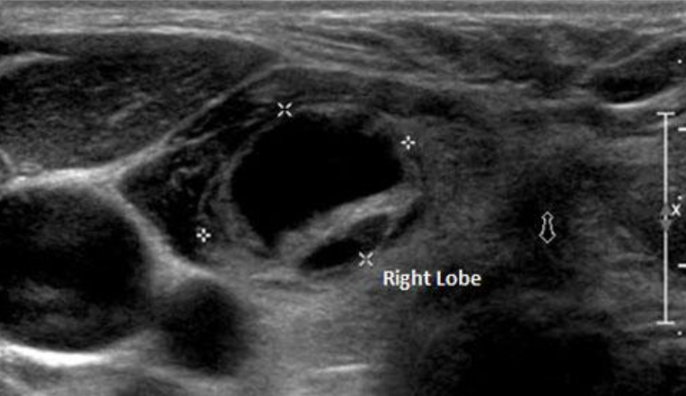

Slide 24
Two large, hypoechoic nodules associated with poorly defined borders, the left-sided nodules showing macro- and microcalcifications.

Slide 25
An abnormal lymph node, round in shape with microcalcifications (shown) and increased peripheral blood flow (not shown). These features are very consistent with thyroid metastasis.

Slide 28
Computed Tomography and Magnetic Resonance Imaging
In thyroid carcinoma, CT is particularly useful in identifying and delineating the full extent of any cervical lymphadenopathy and the relationship of the thyroid to surrounding cervical viscera.
Contrast CT in the assessment of thyroid carcinoma is associated with a short delay in scanning and radioactive iodine treatment for up to 6 to 8 weeks. For this reason it should be used judiciously and appropriately. CT can be performed without the administration of intravenous contrast, with somewhat more limited resolution. We limit the use of contrast CT to patients with associated lymphadenopathy on examination or US and to patients whose FNA is positive for PTC. The surgeon must appreciate that patients with preoperative FNA positive for papillary cancer are expected to have clinically significant nodal disease in one third of cases. Radiographic evaluation must be appropriately aggressive. We find that the combination of US and CT in these situations allows us to clearly assess the central and lateral neck nodes and the thyroid's relationship to central neck viscera. Lateral neck nodal disease sometimes not well investigated by US, as well as nodal disease in the parapharyngeal, retrolaryngeal, retrotracheal and retrosternal regions, are clearly and reliably seen on contrast CT.

Slide 29
This radiographic combination of US and contrast CT produces an effective preoperative nodal map that enables us to direct our nodal dissection at the time of surgery. We feel the added accuracy of this combined assessment allows for comprehensive nodal resection at first surgery, which is likely of greater value to patients with papillary cancer than prompt postoperative I131.
The resolution, standard representation of neck anatomy, and ease of interpretation of CT make it a superb modality for preoperative assessment in patients with FNA-revealing papillary cancer. MRI can also be used to evaluate the thyroid gland by utilizing a dedicated neck or surface coil. This provides excellent soft tissue resolution, with nodules as small as 4 mm being detected.

Slide 45
THANK YOU

