Slide 1
Adrenal imaging (Part 1): Imaging techniques and primary cortical lesions
Adrenal glands can be affected by a variety of lesions. Adrenal lesions can either be primary, of adrenal origin, or secondary to other pathologies. Primary adrenal lesions can further be either of cortical or medullary origin. Functioning adrenal lesions can also give clues to the histologic diagnosis and direct workup. Over the years, various imaging techniques have been developed that have increased diagnostic accuracy and helped in better characterization of adrenal lesions non-invasively. In the first part of the two part series, we review adrenal imaging techniques and adrenal cortical tumors such as adenomas, adrenocortical tumors, adrenal hyperplasia and oncocytomas

Slide 2
The adrenal glands play a vital role in the physiological regulation of the human body. Belying their small size, they can be affected by a variety of benign and malignant lesions in both children and adults. The classification of adrenal lesions can be complex reflecting the histologic complexity of adrenal glands. Adrenal lesions can be broadly divided into primary or secondary lesions. Primary adrenal lesions, that is, arising from adrenal gland itself can be either of cortical or medullary origin. Furthermore, primary adrenal lesions can be either functioning or non-functioning, with functional adrenal lesions being an important cause of referral to endocrinology department. The various adrenal lesions have been enumerated in the next table .

Slide 3
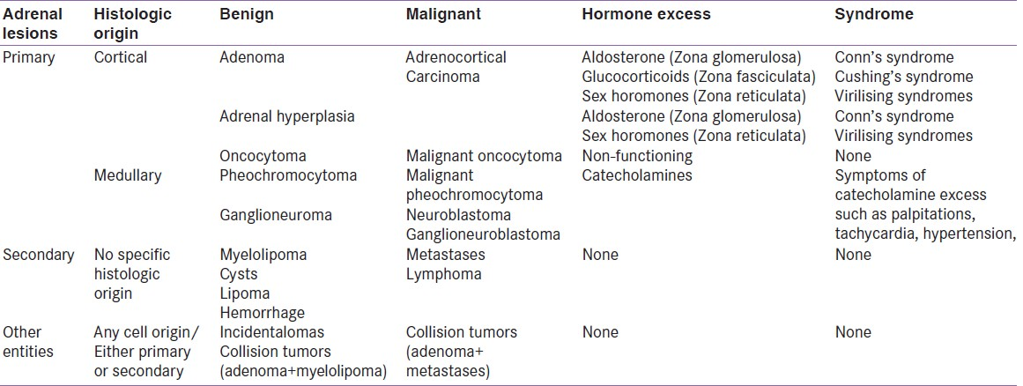
Comprehensive classification of adrenal lesions based on etiology, cell of origin and hormone-secreting status

Slide 4
Adrenal lesions can also be classified on basis of laterality, that is, unilateral or bilateral. Bilateral lesions can also manifest with syndromes of either hormone overproduction (Conn's syndrome due to bilateral adrenal hyperplasia, hypertension due to bilateral pheochromocytomas) or hormone deficiency (Addison's syndrome due to granulomatoses, hemorrhage, lymphoma).
Radiology plays an essential role in imaging of adrenal lesions and is complementary to functional imaging and hormonal evaluation in workup of functioning tumors. With advances in radiologic techniques, imaging can also obviate invasive sampling in many cases.
Thus, the two-part reviews provide an insight into radiological techniques used in imaging of adrenal glands and radiologic appearances of various adrenal lesions. The first part describes the adrenal imaging techniques, normal appearances of adrenal glands and primary adrenal tumors of cortical origin while the second part deals with primary adrenal medullary tumors, secondary adrenal lesions, bilateral adrenal lesions, adrenal incidentalomas and concludes by summarizing the current approach to adrenal lesions.

Slide 5
Imaging modalities and normal imaging appearances
The role of imaging in adrenal lesions is essentially to differentiate benign and malignant lesions, metastatic from non-metastatic lesions and provide definitive diagnosis wherever possible to obviate further invasive testing. Fortunately at present, with a wide array of imaging techniques at disposal, anatomic imaging can give the definitive diagnosis in most cases, thereby eliminating the need for further testing. Functional imaging however plays a greater role in imaging medullary tumors such as pheochromocytomas and occasionally in neuroblastomas.

Slide 6
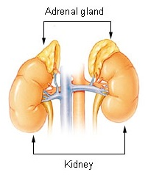

Slide 7
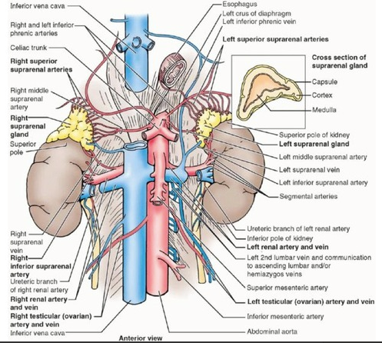

Slide 8
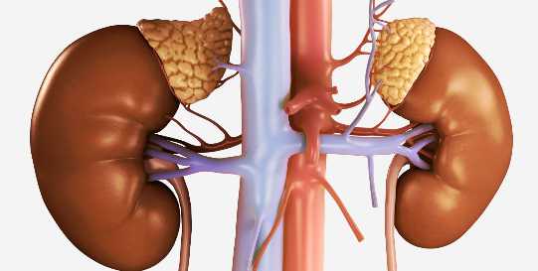

Slide 9
IMAGING INVESTIGATION
The methods available in the past and at present include
1.Simplx X-ray
2.IVP and high dose IVP
3.Retroperitoneal air insuflation
4. Arteriography
5. Phlebography
6.Vena caval and adrenal vein blood sampling
7.Radionuclide scanning
8.Ultrasound
9.CT
10.MRI
and latter Needle biopsy

Slide 10
ADRENAL TUMOURS
A. Neoplasms B. Other mass lesions
1.Cortical 1.Granulomas
Carcinoma Tuberculosis
Adenoma Histoplasmosis
2.Medullary 2.Bilateral hyperplasia
Neuroblastoma 3.Cysts
Pheochromocytoma 4.Hematoma
Ganglioneurma 5.Amyloid
3.Stromal
Lipoma
Mylolipoma
4. Metastases

Slide 11
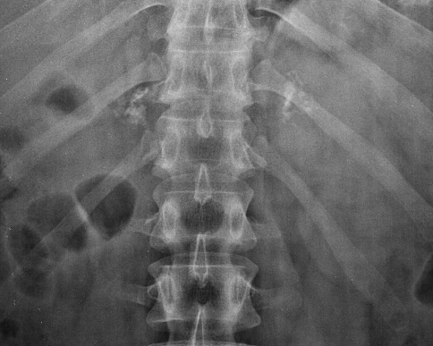

Slide 12
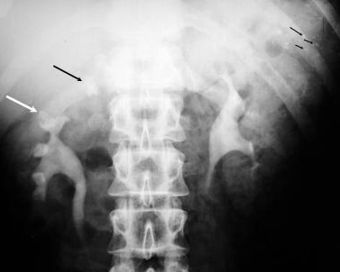

Slide 13
Ultrasonography (USG) is a readily available technique for evaluation of abdominal pathologies. Though the visualization of retroperitoneal structures like adrenals is difficult on USG, it still has a role in incidentally detecting adrenal masses, in monitoring the changes during treatment of already established pathology and enables visualization of other abdominal organs at the same setting without any risk of radiation exposure and is cost effective. USG shows adrenal glands quite accurately in infants and children as compared to adults where they may be obscured due to bowel gas and obesity. On USG, if no mass is seen with or without visualization of normal adrenals, it is considered to be specific for the absence of malignancy.

Slide 14
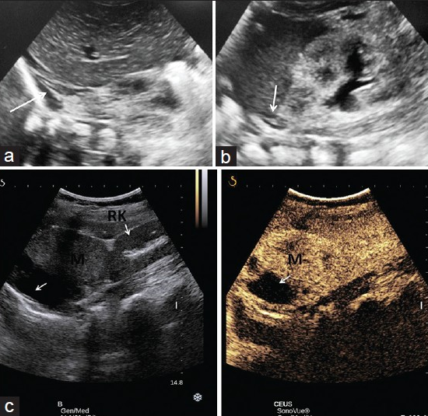
Normal ultrasound appearances. Ultrasound of a 3-day old infant showing V-shaped right adrenal (a) in suprarenal location formed by its two hypoechoic limbs. Hypoechoic limb of left adrenal is well visualized in left suprarenal location (b). Contrast enhanced ultrasound appearance. Right half of the image showing a large suprarenal mass (M) separate from right kidney (RK) with areas of necrosis (arrow). Left half of the image showing avid enhancement of the suprarenal mass (M) like the kidney with nonenhancing necrotic area (arrow) after intravenous injection of ultrasound contrast agent perflurocarbon (SonoVue) (c)

Slide 15
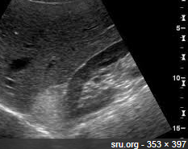

Slide 16
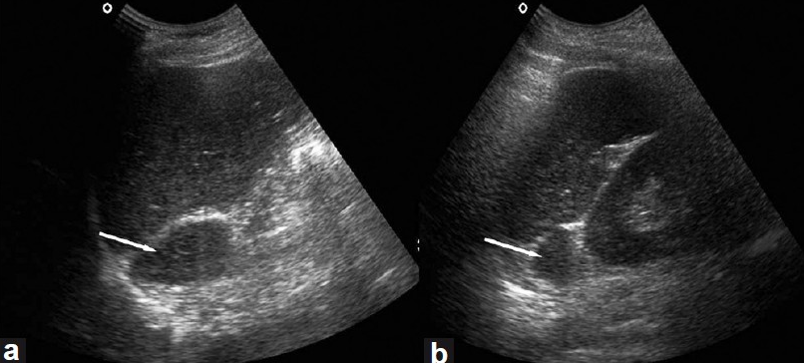

Slide 17
Computed tomography (CT) is undoubtedly the mainstay of adrenal imaging. But with the widespread use of multidetector CT, there has also been an increase in detection of incidental adrenal nodules/incidentalomas. Normal adrenal glands are seen as inverted V- or Y-shaped structures lying anterosuperior to the kidneys in the retroperitoneum . The glands are readily identified owing to the presence of abundant retroperitoneal fat in most patients. The two limbs are thinner as compared to the apex where two limbs join. Mean thickness of gland is 5-6 mm with maximum width of 10 mm and approximate length is 2-4 cm in one section of CT. Paucity of retroperitoneal fat may render visualization of adrenals difficult due to overlap of surrounding structures.

Slide 18
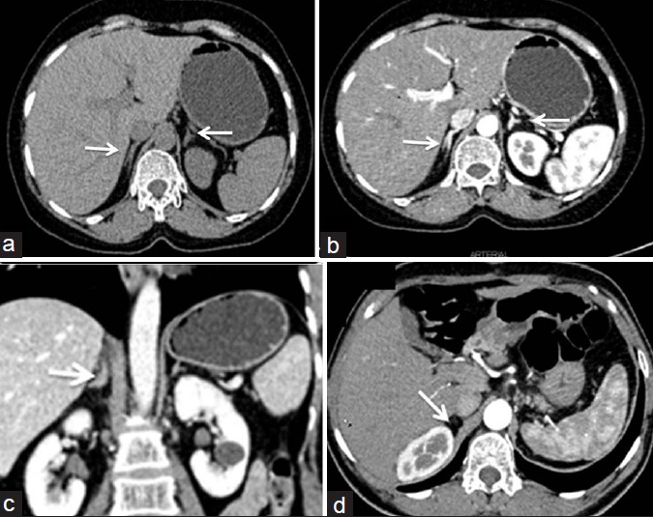
Normal CT appearance. CT axial section: (a) V-shaped right adrenal and Y-shaped left adrenal gland in the retroperitoneum; seen well due to abundant retroperitoneal fat. (b) Predominantly arterial phase scan showing uniform and homogeneous enhancement of both adrenals. (c) Coronal reformatted images showing suprarenal location of normal adrenal glands (white arrows in a,b,c). Post adrenalectomy CT (d) showing absent adrenal limb (arrow) behind IVC

Slide 19
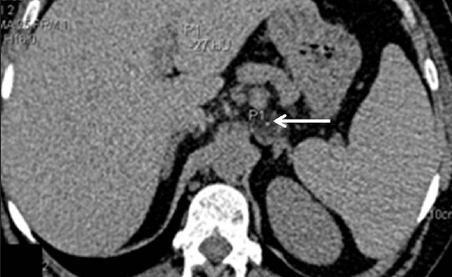
Utility of unenhanced CT. Unenhanced axial CT done for a patient with abdominal pain. A well-defined lesion in left adrenal has macroscopic fat (-27 HU) confirming benign nature of the mass
Both unenhanced CT and multiphase contrast-enhanced CT have role in adrenal imaging. On unenhanced CT, the presence of macroscopic fat confirms diagnosis of a benign myelolipoma while an attenuation of less than 10 Hounsfield units (HU) suggests diagnosis of benign adrenal adenoma and further testing is not required

Slide 20
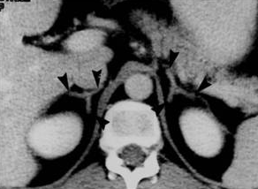

Slide 21
Multiphase CT (MPCT) protocols in adrenal imaging is based on the fact that while both adenoma and malignant lesions show rapid contrast enhancement, adenomas show rapid washout of contrast as well while malignant masses show slower washout. The CT protocol comprises of baseline non-contrast scan through adrenal glands followed by a contrast-enhanced scan at portal venous phase (60-70 seconds) followed by delayed scan at 15 minutes. From these scans, absolute percentage washout (APW) (Attenuation in contrast-delayed scan/attenuation in contrast-non contrast × 100) and relative percentage washout (RPW) (attenuation in contrast-delayed/attenuation in contrast scan × 100) can be calculated which helps in differentiating benign adenomas from other adrenal lesions. It is important to place ROI for estimation of attenuation value such that approximately one-half to two-third of the adrenal surface area is covered and care should be taken to exclude the necrotic component.

Slide 22
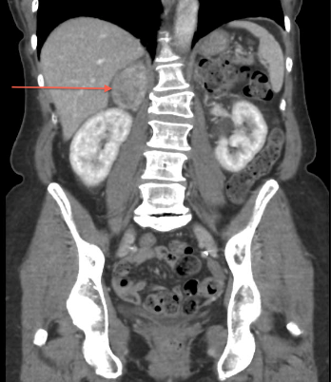

Slide 23
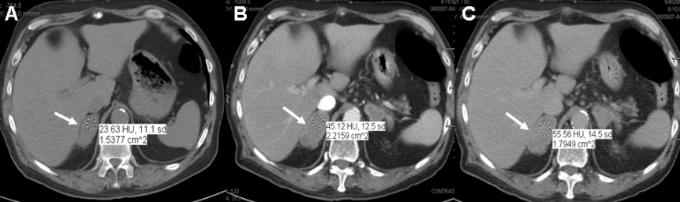

Slide 24
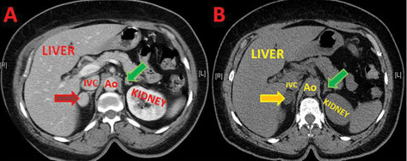

Slide 25
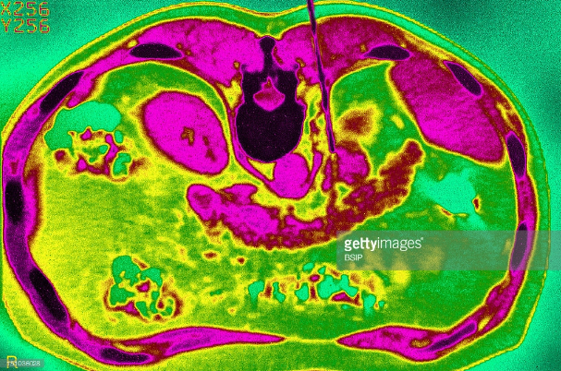

Slide 26
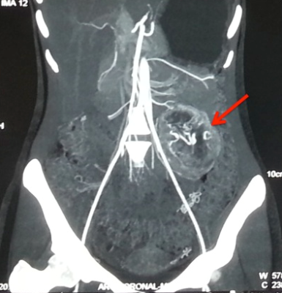

Slide 27
Magnetic resonance imaging (MRI) has very specific indications in adrenal imaging. While normal adrenal has low to intermediate signal intensity on both T1- and T2-weighted sequence , MRI does not offer additional spatial resolution and is chiefly used as an alternative to CT when contrast-enhanced CT is contraindicated. Chemical shift imaging (CSI) is a non-contrast MRI technique that can be used for diagnosis of adenoma when CT is contraindicated or washout values are equivocal. It is based on the principle that fat has a lower precession resonant frequency than water in the presence of an externally applied magnetic field. Thus, during T1-weighted gradient echo sequence (GRE), if fat and water are in the same voxel (i.e. microscopic fat) as seen in adenomas, the signal of lipid and water gets summated in the in-phase image but gets nulled out during out-phase sequence . This drop in signal intensity in CSI has sensitivity (81-100%) and specificity (94-100%) similar to unenhanced CT densitometry for the differentiation of incidental adrenal lesions. While for lipid-rich adenomas, there is effectively no difference between CT and MRI, CSI might be superior when evaluating lipid-poor adenomas.

Slide 28
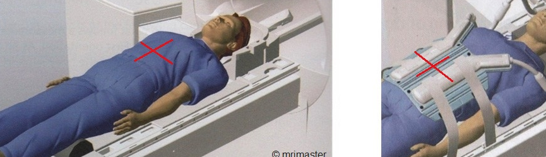

Slide 29
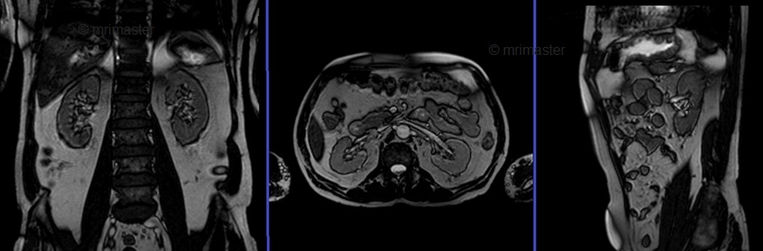

Slide 30
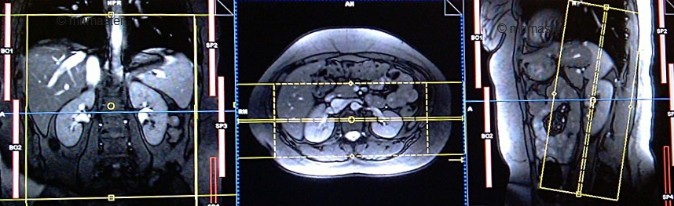

Slide 31
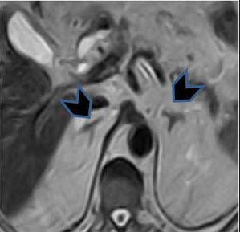

Slide 32
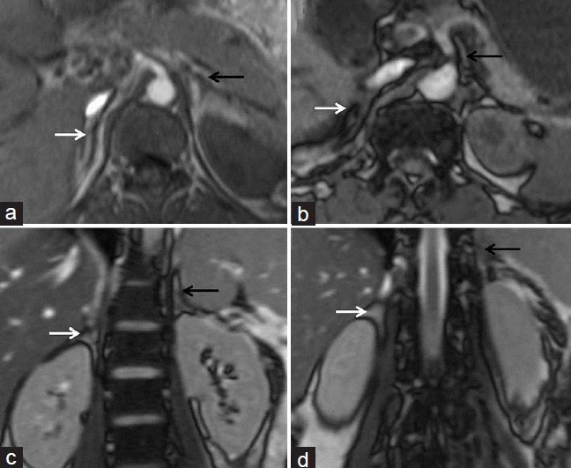
Normal MRI appearance Axial T1 weighted in phase (a) and opposed phase (b) images and coronal (c, d) images demonstrating normal adrenal glands as V- and Y-shaped structures with intermediate signal intensity on both sequences

Slide 33
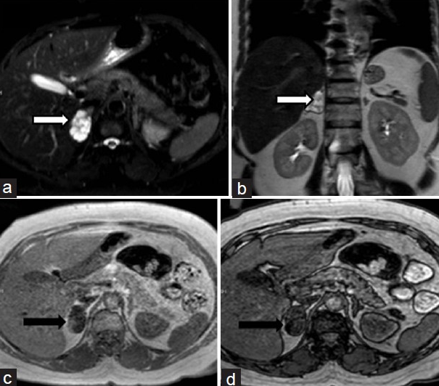
Chemical shift imaging in adenoma. Lady on follow up for incidentally detected asymptomatic right adrenal mass. Recent MRI showing well-defined hyperintense mass on T2-weighted images with hypointense foci within [White arrow in axial and coronal images, (a) and (b)]. The mass is hypointense on in-phase T1 sequence (c) with subtle hyperintense focus along the lateral margin which shows loss of signal on T1 out-of-phase sequence. The mass is diagnosed to be non-functioning right adrenal adenoma (lipid poor) which is stable over 2 years

Slide 34
Positron emission tomography (PET) and PET-CT combine the utility of HU measurements on unenhanced CT along with functional activity. With current high-resolution scanners, even lesions as small as 5 mm can be assessed .Both qualitative assessment (comparison of activity with liver) and quantitative assessment can differentiate benign and malignant adrenal lesions with high sensitivity (98-100%) and specificity (93-98%). FDG-PET can also help in response assessment in lymphomas and be used in disease staging by detecting total disease burden in both primary ACC, neuroblastomas and secondary metastases . FDG-PET/CT is also useful in detecting methyl-iodo- benzyl-guanimidine (MIBG)-negative pheochromocytomas as described by Shulkin et al. However, pitfalls include 5% false positive results due to uptake seen in functioning adenomas and inflammatory conditions such as sarcoidosis, tuberculosis or in adrenal cortical hyperplasia and false-negative results as metastases from primary low FDG avid tumors like bronchioalveolar carcinoma and carcinoid do not show significant FDG uptake.

Slide 35
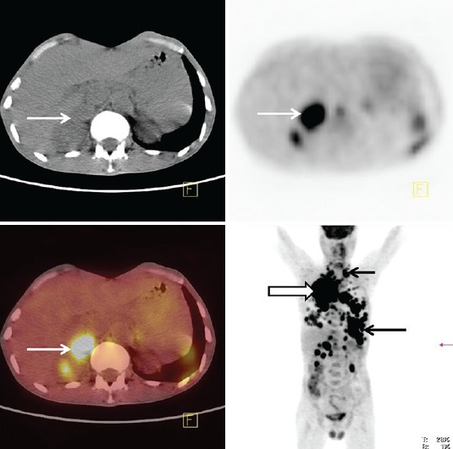
FDG-PET/CT scan for detection of metastases. FDG-PET/CT images of patient with right lung cancer showing avid FDG uptake by right adrenal mass. There are multiple other areas of FDG uptake in on PET image consistent with diffuse metastatic disease

Slide 36
Adrenal adenoma
The incidence of adenoma increases with age, being 0.14% in age group of 20-29 years increasing to 7% in patients more than 70 years. The adenomas can be functioning or non-functioning; latter being commonly encountered as an incidental lesion. Clinical presentation depends on the product secreted by the adenoma-Cushing's syndrome in cortisol-secreting tumors, Conn's syndrome with hyperaldosteronemia and adrenal virilization due to androgen-secretion.
On imaging, adenoma is usually small in size (<1 cm); however, size may range from 1 to 5 cm. They are well-defined, homogeneous masses with smooth contours. On unenhanced CT, attenuation less than 10 HU is suggestive of adenomas but varies from -2 HU (lipid-rich) to 60 HU (lipid-poor adenomas) depending on amount of intracellular/microscopic fat. Since only 70% of the adenomas are lipid-rich; MRI can help in detecting microscopic fat in lipid poor adenomas by showing signal dropout on opposed phase CSI . On contrast enhanced CT, adenomas show rapid enhancement and washout with APW >60% and RPW >40%.
Anatomic imaging cannot differentiate functioning from non-functioning adenomas; however; it has been postulated that functioning tumors cause suppression of release of ACTH (adrenocorticotrophin hormone) which causes atrophy of contralateral adrenal gland

Slide 37
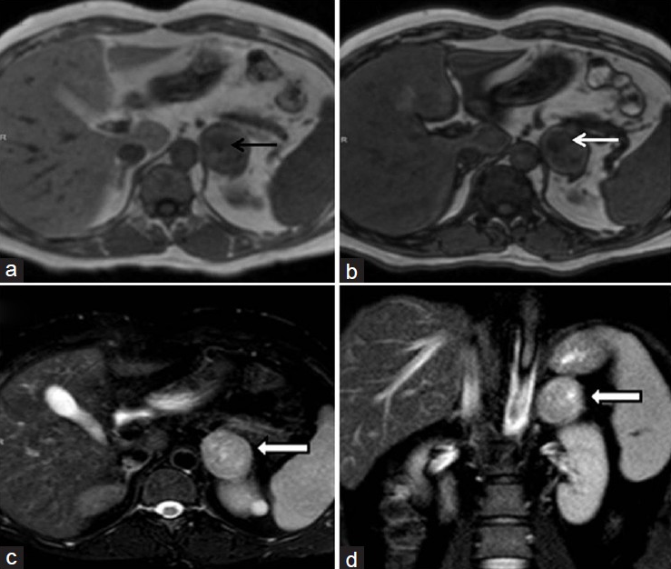
MRI of adenoma. Incidentally detected left adrenal mass in a boy during evaluation for abdominal pain. The mass is iso to hypointense on T1-weighted in-phase image (bold arrow in a) and showing signal drop in out-phase sequence (thin white arrow in b). The mass has hyperintense signal on T2 WI (white arrow in c and d)

Slide 38
Adrenocortical carcinoma
ACC is overall a rare tumor but represents the most common malignant adrenal tumor in a patient without an underlying malignancy. It has a bimodal age of presentation, affecting children in their first decade and adults in their fourth and fifth decades. In children, ACC are more likely to be smaller in size and functioning thus presenting early with endocrine dysfunction. In adults, tumors are larger in size, non-functioning and present late with abdominal pain and lump, local invasion and distant metastases. Hereditary ACCs have been described in various familial syndromes like Li-Fraumeni syndrome, Beckwith-Wiedemann syndrome, Carney's complex, familial adenomatoses polyposis coli and multiple endocrine neoplasia (MEN)-type 1.
On CT, ACCs usually present as large (more than 6 cm) and heterogeneous lesions with necrosis and hemorrhage replacing the entire adrenal gland. Enhancement can be peripheral or rim-like with central necrosis and absent contrast washout. Occasionally, they can be less than 5 cm and well-defined in children, thereby mimicking adenomas. The RPW and APW are typically less than 40% and 60% respectively thus differentiating from benign adenomas . Calcifications can be seen in up to 30% of these tumors, differentiating them from adenomas which do not show calcifications and pheochromocytomas which show calcifications in only 10%. CT also shows local invasion and contiguous tumor extension into liver, pancreas, kidney and diaphragm. Similarly invasion of inferior cava invasion, if seen in an adrenal mass, is typical for ACC. Metastases can be seen in up to 30% of cases to regional lymph nodes, liver, lungs and bones . Surgical resection, either curative or debulking is the treatment of choice for all ACCs irrespective of tumor size and local invasion. However, peritoneal carcinomatosis has also been reported in ACCs and is attributed to tumor spill and incomplete resection during surgery, both by laparoscopic and open techniques .

Slide 39
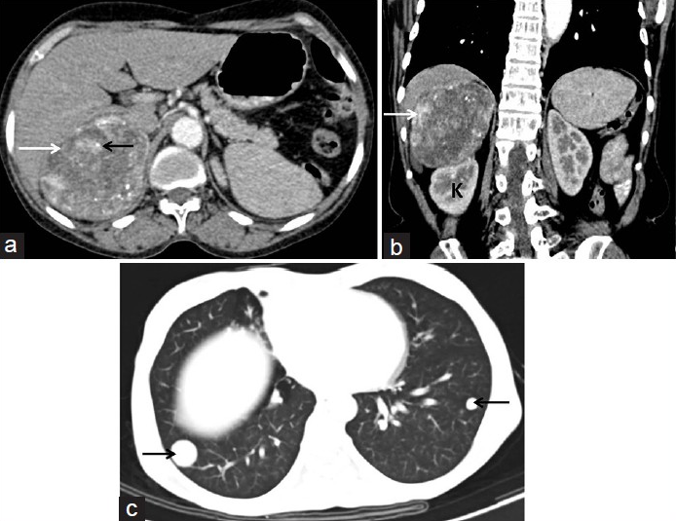
Adrenocortical carcinoma with lung metastases. Axial CT section (a) and coronal reformatted (b) images showing a heterogeneously enhancing, necrotic right suprarenal mass (white arrows) with intralesional calcifications (black arrow, a). The mass is displacing the right kidney (K) inferiorly. Lung window axial CT image (c) showing metastatic nodules in lower lobes of both lungs (arrows, c)

Slide 40
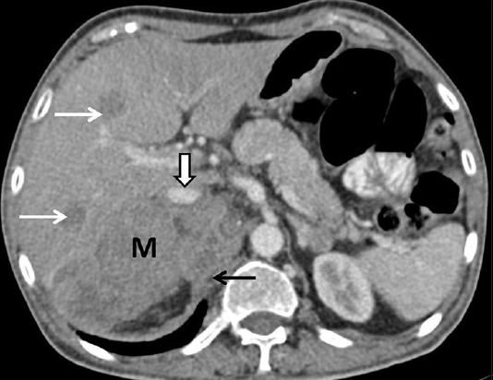
Adrenocortical carcinoma with liver metastases. CT axial image showing ill-defined, infiltrative right adrenal mass (M), displacing the inferior vena cava anteriorly (block arrow), invading right crus of diaphragm (black arrow) and multiple liver metastases (white arrows). There is focal loss of fat planes without any obvious infiltration of liver. The anterior displacement of inferior vena cava is consistent with an adrenal mass

Slide 41
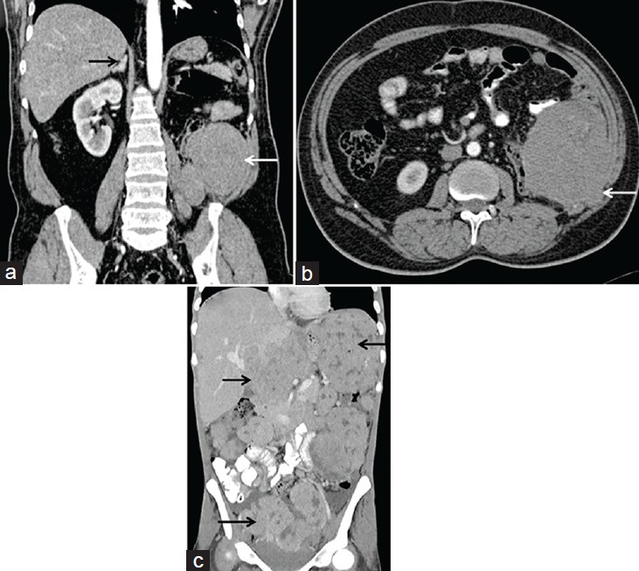
Recurrence of adrenocortical carcinomas. (a, b) Patient with previous history of left adrenocortical carcinoma, post left adrenalectomy and nephrectomy status. Coronal reformatted image (a) and axial CT section (b) show a locally invasive recurrent mass in the left flank region (white arrow a, b). The left adrenal and kidney are not seen, due to post-operative status while right adrenal gland is normal (black arrow, a). (c) Another patient with a prior right adrenocortical carcinoma resected laparoscopically. Coronal reformatted CT image shows tumor recurrence manifesting with multiple peritoneal deposits (black arrows) in abdomen and pelvis consistent with peritoneal carcinomatosis.

Slide 42
Bilateral adrenal hyperplasia
BAH is another cause of primary aldosteronemia/Conn's syndrome or ACTH-independent Cushing's syndrome and needs to be differentiated from functioning adenoma as the management is medical in BAH while it is surgical in adenoma. BAH can be diffuse or nodular. Diffuse AH manifests as diffuse and smooth increase in size of adrenal glands with maintained shape. Nodular hyperplasia can be identified on imaging if associated with macronodules. These appear as small hypo-to-iso-attenuating nodules on background of atrophied or normal appearing adrenal glands. Diagnosis of BAH can be suggested if adrenal vein sampling shows bilateral disease and scintigraphy using cholesterol-based radionuclides shows bilateral uptake

Slide 43
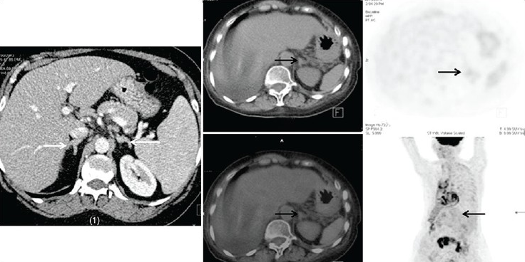
Adrenal hyperplasia Patient 1 is a male who is a follow-up case of primary malignancy of lung. CT done for staging revealed bilaterally symmetrical thickening of adrenals with no mass lesion in either of the glands. Note that the normal contour of the glands is maintained. Patient 2 is 5 years old girl with clinical suspicion of adrenogenital syndrome. CT showed hyperplasia of adrenals (only left adrenal seen in the image) and no uptake is seen on PET images

Slide 44
Adrenal cortical oncocytomas
Adrenal oncocytic cortical tumors or adrenal oncocytomas are rare tumors and can be either benign or malignant. These can be diagnosed only on histology. However, increased detection of adrenal lesions on cross-sectional imaging, improved awareness and retrospective reviews have led to an increase in reporting of this hitherto rare entity. While benign tumors cannot be differentiated from lipid-poor adenomas, malignant oncocytomas mimic ACC with similar large sizes, necrosis and poor contrast washout. Though oncocytomas can cause a mass effect on surrounding organs, direct organ invasion is uncommon due to the presence of fibrous capsule. Tirkes et al. in their retrospective review of nine oncocytomas have proposed that the absence of local organ or venous invasion even in the presence of large adrenal masses should lead to diagnostic consideration of an oncocytoma over ACC.

Slide 45
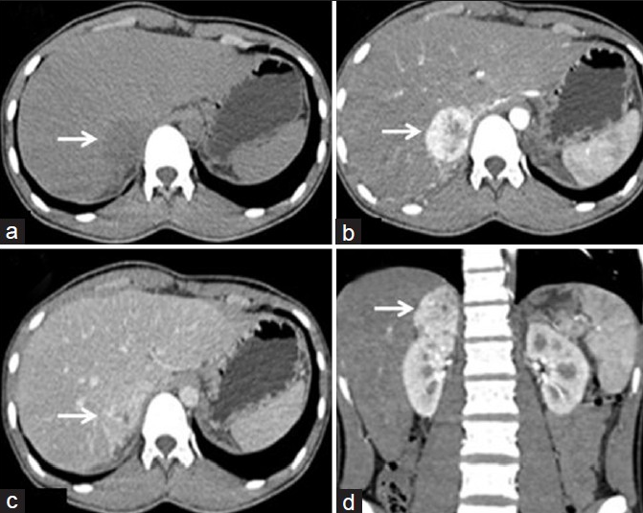
Washout in pheochromocytoma. NCCT (a), 1min post contrast (b) delayed- 15 minutes post contrast (c) axial sections and coronal reconstructed section (d) in a 19-years-male with right pheochromocytoma show well defined iso to hypodense lesion in right adrenal measuring 4.3 cms in size and 23 HU (not shown in image) on unenhanced scan with avid contrast enhancement (251 HU, not shown) with rapid washout (31HU)

Slide 46
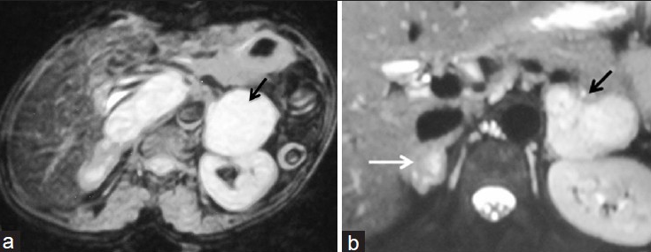
MRI of Pheochromocytoma. T2 weighted axial image (a) showing left suprarenal mass (arrow) which has uniform hyperintense signal intensity (light bulb sign). Similarly, bilateral hyperintense adrenal masses are seen in another patient with bilateral pheochromocytoma (b)

