Slide 1
ADRENAL IMAGING PART II

Slide 2
Radionuclide Scanning
The radionuclide tests are derived from the fact that cholesterol is stored in the adrenal as a long –chain fatty acid ester, prior to being metabolized to form steroid hormones . Cholesterol that has been labeled with ¹³¹ I or ⁷⁵ Se will be stored in the same way but the hydrolysis essential for metabolism does not take place , and therefore labeled substituted esters remain permanently in the adrenal. From elsewhere in the body , the labeled cholesterol is metabolized normally , being excreted in the bile and partly reabsorbed from the small gut .If the cholesterol is labeled with iodine its diodinated and the thyroid should be blocked. ⁷⁵ Se cholesterol is stable , does not required thyroid blocking , does not emit beta particles , has a lower photon energy , and is generally more acceptable
The usual administered activity is 10 MBq , images are taken at intervals for 5-7 days , the demonstration of the adrenals can be improved by computer enhancement and by doing a renal scan to aid localization.

Slide 3
Increased cortical function give rise to increased activity and in
Cushing’s syndrome the asymmetry of an adenoma is distinct from
the bilateral abnormality of hyperplasia .High activity over one
adrenal and no activity over the other usually represents a
functioning adenoma with suppression of the normal gland , but care
should be taken not to overlook the presence of a gland destroyed
by disease , with compensatory hypertrophy of the other gland.
In Conn’s syndrome , the aldosterone –secreting adenomas are
often too small to be shown by ultrasound and , if CT scanning also
fails , the provisional diagnosis is made on clinical grounds .The
syndrome is usually due to unilateral adenoma but may be due to
bilateral hyperplasia .There is some controversy over the value of
dexamethasone suppression .its advocates argue that it can
improve the sensitivity and specificity of the test.

Slide 4
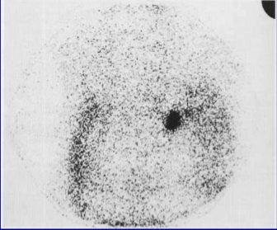
If 4 mg dexamethasone are given daily for 7 days before the test, normal adrenals are not visualized for 5 days after the test has begun. Earlier bilateral visualization indicates hyperplasia , whereas unilateral visualization indicates adenoma .After 5 days , both adrenals are shown and an adenoma is usually identifiable if present . The disadvantage of the test is that it may suppress bilateral hyperplasia, making it indistinguishable from normal .

Slide 5
Tumors of the adrenal medulla , pheochromocytomas , are usually diagnosed by detecting excessive production of the epinephrine and norepinephrine in urine .The method of choice for locating adrenal medullary tumors is CT scanning , supplemented by ultrasound. However if there is clinical suspicion of multiple tumors, or malignancy , or if the adrenal glands are normal on CT , a wider scheme of investigation is indicated .Recently ¹³¹ I and ¹²³ I labeled meta-iodobenzylguanidine ( MIBG ) has been used with high sensitivity and specificity for detection primary and secondary pheochromocytomas .
Some drugs notably reserpine , cimitidine and tricyclic antidepressants , should be discontinued before the investigation , and anterior and posterior images are taken up to 72 hours after injection

Slide 9
In- 111 octereotide , the second agent used to detect pheochromocytomas , is a synthetic octapeptide analog of somatostatin that shows uptake in variety of tumors that contain somatostatin receptors.
A total of 5 mCi ( 185 MBq) of In-111 octerotide is administered intravenously and whole body imaging is performed at 4 and 24 hours after injection.
In -111 octereotide has a sensitivity of 75 % - 90 % for detection of pheochromocytoma .

Slide 10
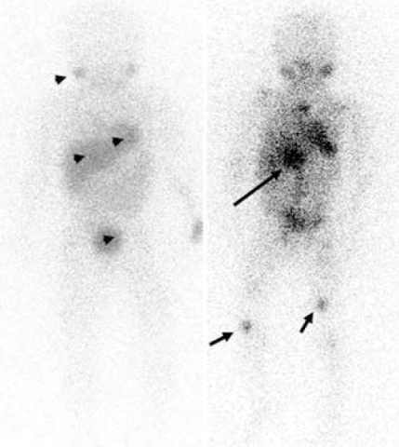
¹³¹ I labeled MIBG is also useful in detecting and monitoring neuroblastoma and considerable progress has been made in using it as a therapeutic agent

Slide 17
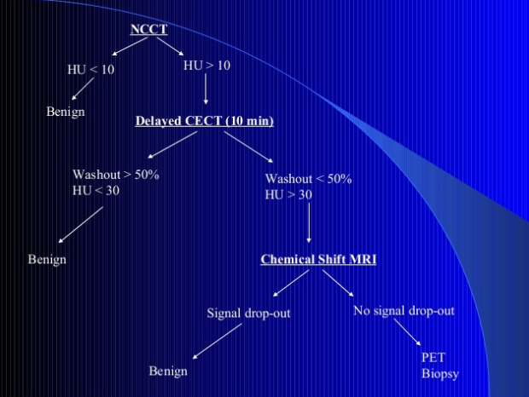

Slide 24
Adrenal Cortical Adenoma
Cortical adenomas , usually small ,are said to be present in 5 % routine necropsies .The vast majority of these are presumably non-functional and symptomless during life , but the figure implies that such adenoma will occasionally be seen as purely chance findings at CT.
Functioning adenomas may give rise to Cushing’s syndrome ( cortisol secreting ) , Conn’s syndrome ( mineralocorticoid secreting ) or very rarely a virilizing syndrome ( androgen secreting )

Slide 38
Cushing’s Syndrome Clinically , this is characterized by rounded “moon-like “ facies , plethora , and truncal obesity .Hypertension and osteoporosis also occur , and dementia or depression may be features.
Due to excess ACTH production
1.Pituitary dependent
a.pituitary microadenoma very common ( 80 %)
b.Alcoholic common
c.Depressive psychosis very rare
2. Ectopic ACTH production
a. Malignant tumor common
b. Benign tumor rare
Due to primary adrenal lesion
1. Adrenal cortical adenoma common ( 5-10 % )
2. Adrenal cortical carcinoma rare ( 1%)
3. Micronodular dysplasia very rare

Slide 39
There are many interesting simple radiological features in Cushing, these depend on the catabolic effect resulting in osteoporosis which mainly affects axial skeleton ( vertebral collapse ) is common , as are spontaneous rib fracture , often painless with excessive callus formation .Ischemic necrosis of the femoral heads ( avascular necrosis ) may also occur.
X- ray for skull now replaced by MRI for detecting microadenoma and also made petrosal vein sampling for raised ACTH abandoned which was previously used for lateralization .
Patient with ectopic ACTH production are most commonly suffering from malignant tumor , this is most likely to be lung carcinoma ( 60%), pancreatic carcinoma , malignant thymoma , and medullary carcinoma of the thyroid are also well-documented causes.
Benign tumors involved include carcinoid , benign thymomas , and very rarely pheochromocytoma and ganglioneuroma

Slide 41
Conn’s syndrome Primary hyperaldosteronism is characterized by hypokalemia , weakness , and hypertension .It is known that in most cases the cause is a small adenoma of the adrenal.
Adrenal vein sampling was carried out and practiced previously for aldosterone concentration in relation to cortisol are measured on the two sides .In adenoma patients the concentration is increased on the affected side and suppressed on the other .In patients with hyperplasia the raised concentrations are similar on the two sides .
With the advent of CT it became clear that even small adenoma could be identified without the need of invasive techniques. Since the tumors are usually small and may be under 1 cm in diameter , it is vital that CT exam should cover he whole gland by contiguous thin cuts ( 4-5 mm or even 2mm or less ) .Conn’s tumors are relatively low density , averaging about 20 HU , presumably due to their high cholesterol content .These tumor are unusual in children , and it would be desirable to use US before CT in a child .
Scintigraphy has been successfully used to demonstrate Conn’s tumors using labeled cholesterol during dexamethasone suppression ( 2 mg 6 hourly for 2 days previously ) .However CT is now generally accepted as the primary investigation choice .
Note : Functioning adrenal carcinoma may also present with Conn’s syndrome in
case the tumor may be quite large .

Slide 43
Androgen Excess The term adrenogenital syndrome is no longer favored by endocrinologist .
Several different adrenal lesions may give rise to excess androgen production including congenital adrenal hyperplasia( CAH ) ,adrenal adenoma , and adrenal carcinoma .
CAH is a complex group of disorders of adrenal steroid synthesizing enzymes with a wide spectrum of clinical presentation .These range from neonatal collapse , through intersex to adult presentation with sex hormone disorders.
Neonates may present with ambiguous genitalia , and older children with a verilizing syndrome in girls or isosexual precocity in boys .
In adults , hirsutes or masculinizing features may be the presenting features.

Slide 44
Neuroblastoma characteristically these tumors occur in children and present either with abdominal mass or with manifestation of secondary deposit. Over 50% arise in adrenal and remaining can arise from sympathetic tissue anywhere in the body .X-R can be very helpful , they may show abdominal mass visible by virtue of its size , or by downward displacement of the kidney , or by he presence of calcification , the latter has been note to occur in over 50% of cases .
sometimes it is very difficult to differentiate between renal mass such Wilms tumor , and a suprarenal mass on simple X-ray and even on IVP. calcification if present , is an important point in favor of neuroblastoma since it is uncommon in Wilms tumor .Non-functioning of the affected kidney occurs in10% of patients with Wilms tumor and favor that diagnosis. US is now most widely used primary investigation for abdominal mass in children , the appearances are variable , with mixed density from echogenic tumor and calcifications , and cystic areas from necrosis and hemorrhage. Major vessels such as the aorta and IVC may be surrounded and narrowed as well as elevated by the tumor mass. CT will show most of these features well and helps staging by confirming local invasion, liver metastasis and spread to para-aortic lymph nodes .Radionuclide imaging with MIBG can show both primary tumor and metastasis to bones , liver and orbits .

Slide 45
The mass is most commonly suprarenal with displacement but no involvement of the kidney. Neuroblastoma will encase the vessels without any invasion or displacement.

Slide 46
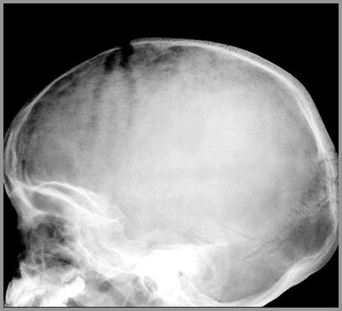
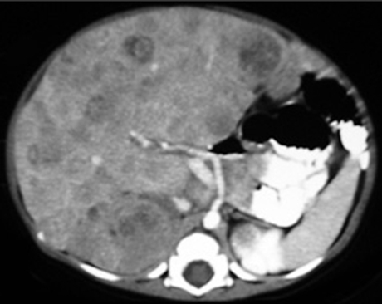

Slide 47
Ganglioneuroma This is a mature form of neurogenic tumor .Apart from arising in the adrenal , these tumors can , like neuroblastoma , arise from parasympathetic system elsewhere along the spine , particularly in the thorax only some 10% arise in adrenals.
Like neuroblastoma , they are commoner in children , 60% occur before the age 20 , but a good proportion also present in adults.
Ganglioneuroma occurring in children may also show calcification , which can help in suggesting a diagnosis of neurogenic tumor. Occasionally , ganglioneuroma invade the spinal canal .In these cases there is not only an extraspinal component but also intraspinal component , causing neurological symptoms either from cord compression or from involvement of the cauda equina .These rare cases are often mistaken foe dumb-bell neurofibromas and are best assessed by MRI .It is interesting that some of the recorded cases were first reported histologically as neuroblastoma , but a second and later biopsy show gangiolueuroma , it is now well recognized that neuroblastoma can some times mature into the more benign and well –differentiated tumor .These tumors are best defined by CT or by MRI if there is suspicion of an intraspinal extension.

Slide 48
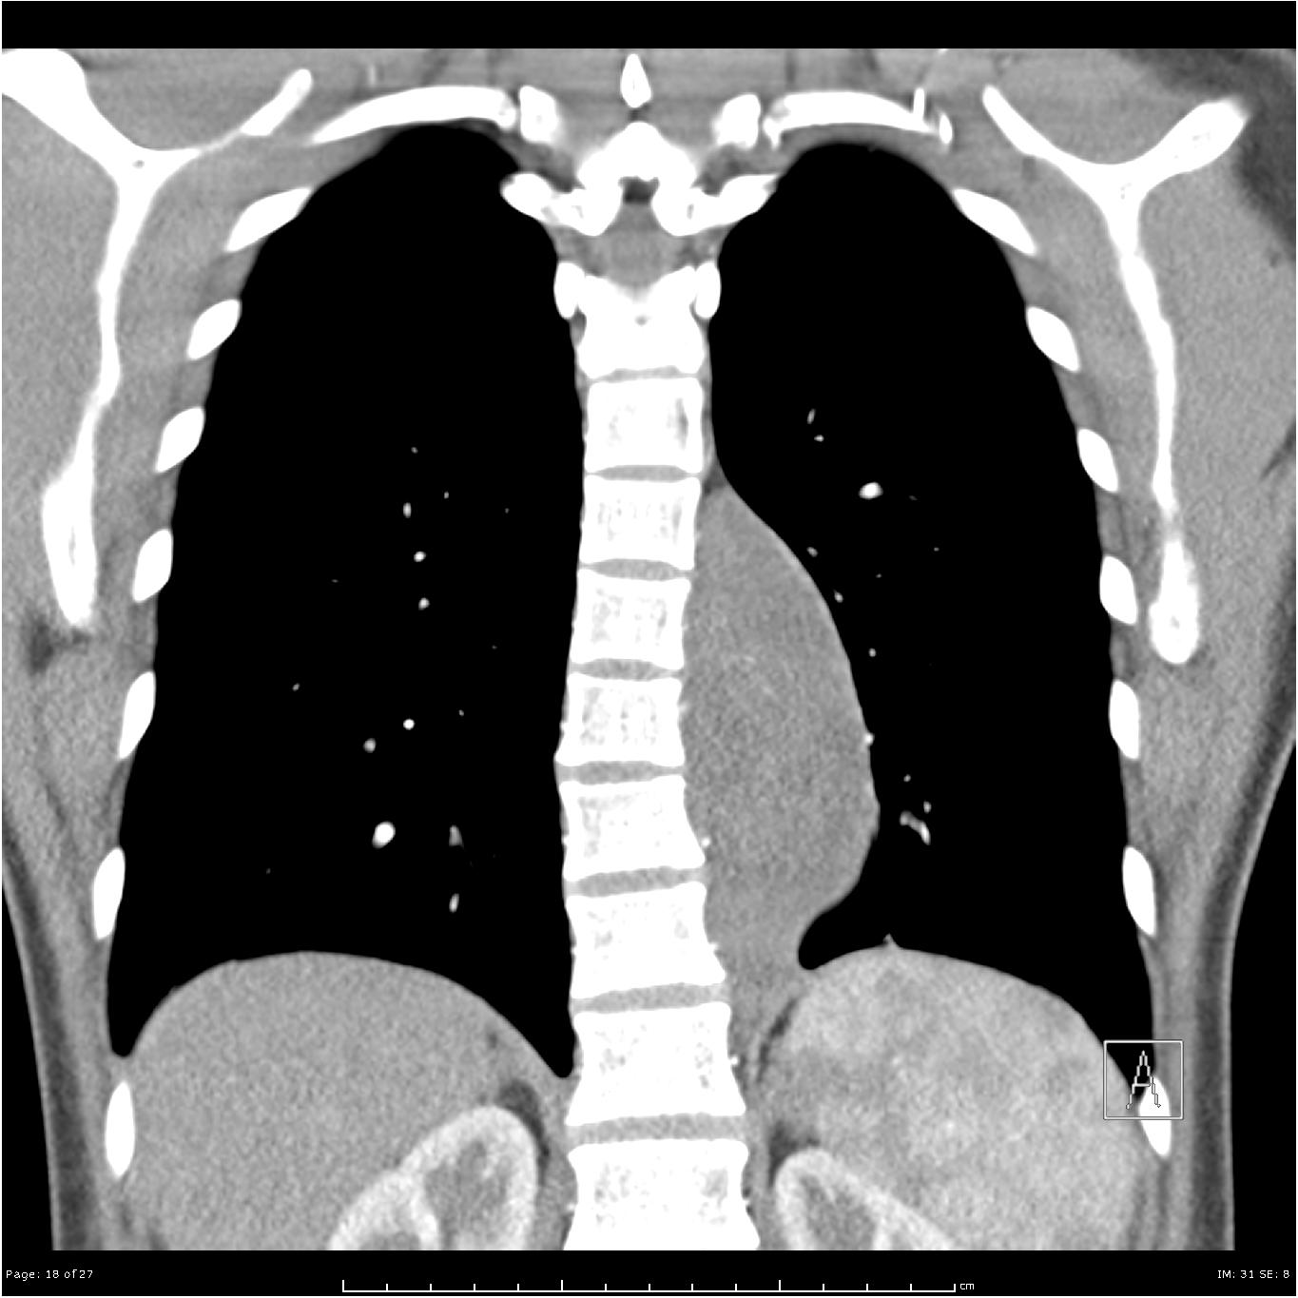
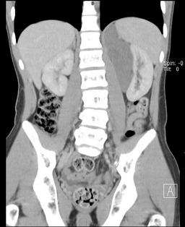

Slide 49
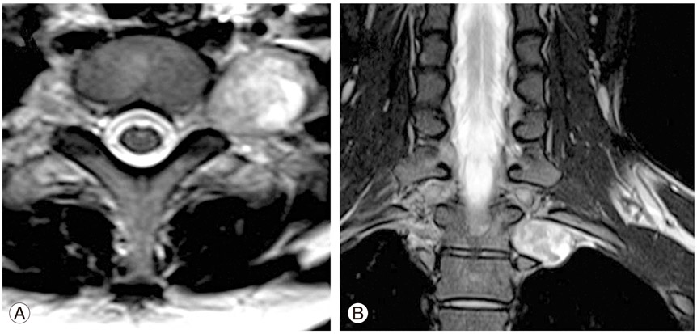
Typical ganglioneuroma show low attenuation and punctate calcification at CT .MRI shows intermediate intensity at T1 and T2 –weighted images , with early enhancement and little washout on dynamic images .Some 25% of ganglioneuroma are not truly benign but contain poorly differentiated components including ganglioneurobalstoma , neuroblastoma or malignant pheochromocytoma

Slide 50
Adrenal cortical carcinoma As with adenomas these tumors may be non-functional and appear so in some 50% of cases .Such tumors eventually present either with metastases or with a mass in the abdomen . Like adenomas , the functioning tumor can present in different way , depending on the type of secretion .Though commoner in adults –the average of diagnosis is 45 years –they are occasionally seen in adults .
Adrenal carcinomas are often quite large at discovery , particularly when non-functioning , average diameter was 15 cm , with such large masses , simple X-ray or IVU with tomography will often show the lesion well and there will be downward displacement of the kidney .About one third of such carcinomas show calcification at simple X-ray and even more do so at CT , this is usually patchy and irregular but can be nodular .Ultrasound will readily demonstrate large adrenal masses and can screen for liver metastases. CT is more specific in demonstrating spread to adjacent structures and will also show liver metastases and glandular involvement .

Slide 51
Metastases The adrenal glands may be involved on one or both sides by metastases from primary carcinoma elsewhere in the body and are commonly involved in patient with bronchial and breast carcinoma .Ct surveys of the liver and abdomen frequently made in these patients , and the adrenals should always carefully checked at such examinations. Bilateral adrenal masses may also be seen with lymphoma

Slide 54
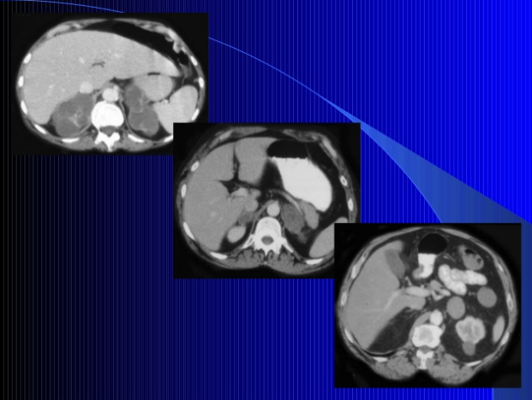

Slide 56
Pheochromocytoma This has proved to be the commonest adrenal tumor observed in clinical practice .The classical clinical presentation is with attacks of paroxysmal hypertension accompanied by headache , sweating , palpitation , anxiety , and tremor .The attacks may last from 15 minutes to an hour and may occur several times a week or even a day . However many cases are less typical , 50% of adult cases present with sustained hypertension .
90% of these tumors arise in the adrenals but remaining 10% may be found anywhere in the sympathetic system from neck to pelvis .
The majority of these ectopic tumors are adjacent to the kidneys and we have seen such tumors at the hilum of the kidney , medial to the inferior vena cava , and below the kidney .The organs of Zuckerkandle , adjacent to the aortic bifurcation , is also a common exrta-adrenal site. Other tumors have been found in the bladder wall , such patients have sometimes presented with attacks of hypertension brought on by micturition .

Slide 57
Thoracic tumors are usually paravertebral , but have been found in the mediastinum. Some 10% of these tumors appear to be familial , and similar proportion occur in children .Multiple tumors also occur in similar percentage , as do bilateral adrenal tumors and malignant tumors .The so-called rule of ten summarizes this by postulation that 10% of cases are familial , bilateral adrenal , multiple , extra-adrenal , children , malignant
Some 5% of cases are associated with neurofibromatosis , but the reverse is less common , since only 1% of patients with neurofibromatosis develop pheochromcytoma .
there is also a less common , but well-recognized , association with medullary carcinoma of the thyroid , and hyperparathyroidism which may be familial .This usually referred to as multiple endocrine neoplasia ( MEN ) type II or Sipple syndrome .When the medullary carcinoma of the thyroid and pheochromocytoma are associated with mucosal neuromas , involving cunjunctiva , eyelid , mouth and sometimes gut , and with marfanoid habitus , it is referred to as MEN type III .
Apart from the clinical aspects , the firm diagnosis of pheochromocytoma depend on biochemical assays of catecholamine in urine or blood or both , repeated assays may be necessary as hypersecretion may be paroxysmal

Slide 62
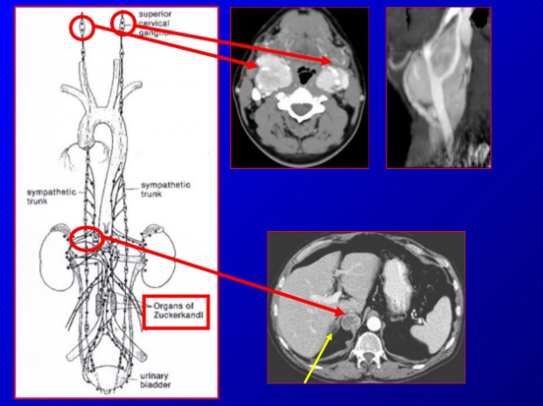

Slide 64
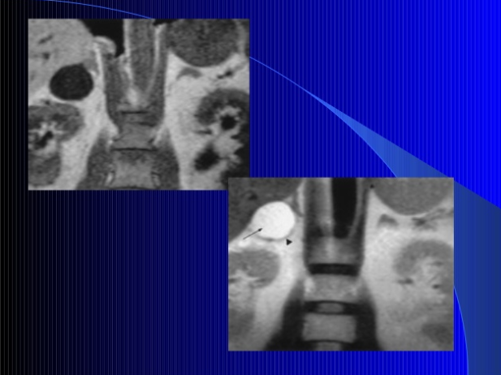

Slide 65
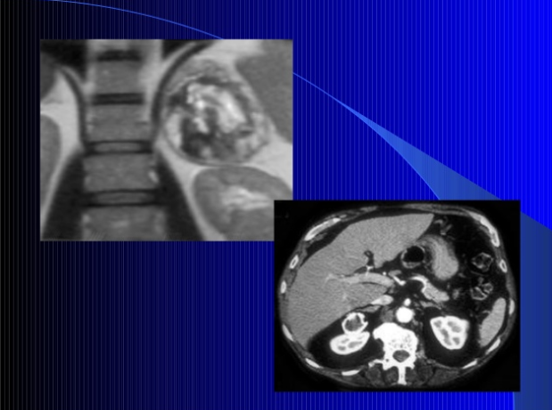

Slide 66
THANK YOU

