Slide 1
CHEST X-RAY METHODS OF INVESTIGATION

Slide 4
The X-ray beam is directed at the patient in a short pulse and is absorbed (attenuated) by the tissues of the body. Materials with high electron density, such as bone, attenuate the beam to a greater extent than soft tissue, water or air. Therefore the beam that emerges from the patient carries a pattern of intensity that reflects the physical anatomy through which it has passed.

Slide 5
METHODS OF INVESTIGATION
PA ( postero-anterior ) ,Lateral
AP (antero-posterior ) , decubitus , supine ,oblique
Inspiratory , Expiratory
Lordotic , apical , penetrated
Portable / mobile radiographs

Slide 6
PA VIEW
The patient faces the film chin up with shoulders rotated forwards to displace the scapulae from the lung fields .Exposure is made on full inspiration for optimum visualization of the bases , centering at T5.
The breasts should be compressed against the film to prevent them obscuring the lung bases

Slide 9
Low kVp ( 60-80 kV ) : produces a high-contrast film , with miliary shadowing and calcification being more clearly seen than on a high kV film
High kVp ( 120-170 kV): these use for large patient with grid reduces scattering and FFD is of 1.85 cm ( 6 feet ) reduces magnification and produces sharper image .The film with high kV are of lower contrast and with increase visualization of the hidden of the lung due to better penetration of overlying structure, the bones and pulmonary calcification are less well seen.

Slide 10
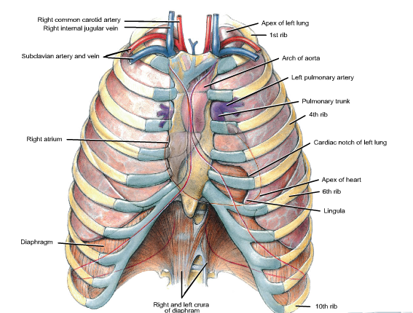

Slide 11
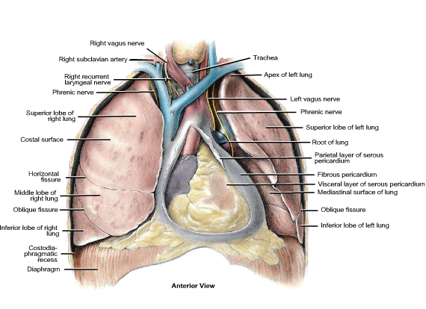

Slide 12
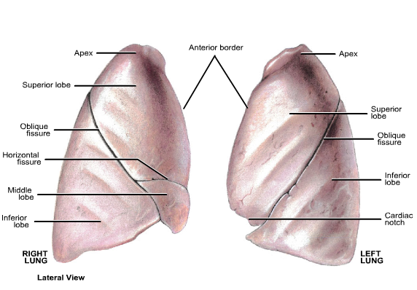

Slide 13
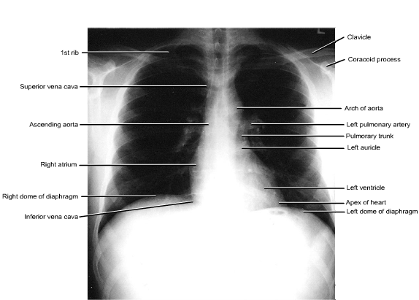

Slide 14
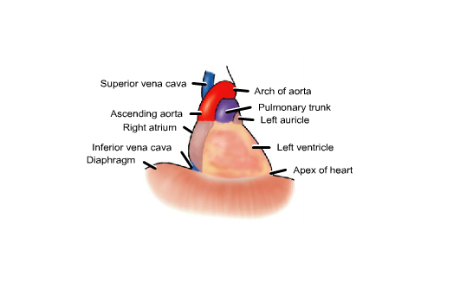

Slide 15
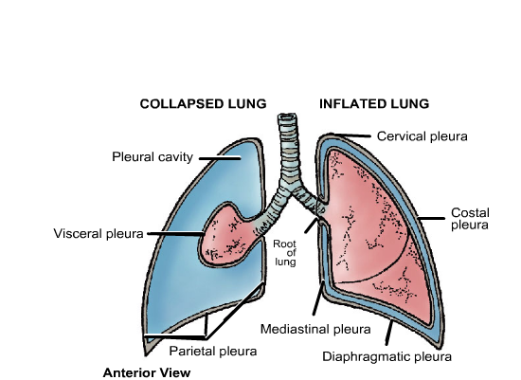

Slide 16
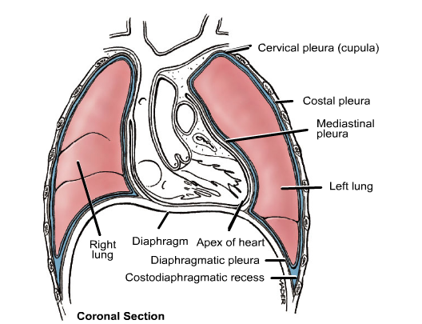

Slide 17
HOW TO VIEW THE PA- FILM
A suggested scheme is as follow, examining each point in turn
Technical : centering , position , markers , degree of inspiration
Trachea : position and outline
Heart and mediastinum :size , shape , displacement
Diaphragm : outline , shape ,relative position
Pleura : position of horizontal fissure ,costophrenic and cardiophrenic angles
Lung fields : local or generalized abnormality , compare the two sides for lung markings and translucency

Slide 18
Hidden areas : - Apices
- Diaphragm
- Mediastinum , hila
- Bones
Hila : Density , position , shape
Below diaphragm : Gas shadow , calcification
Soft tissues : Mastectomy , densities
Bones : Destruction , etc
Note :Comparison with previous chest radiographs is essential .

Slide 19
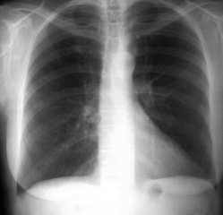

Slide 32
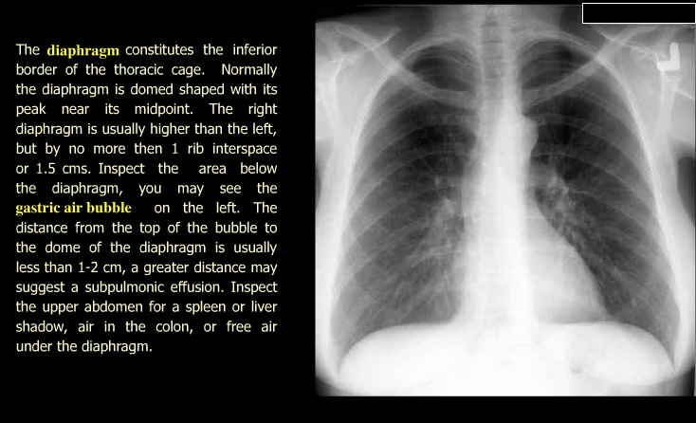

Slide 51
The left main pulmonary artery (in purple) passes over the left main bronchus and is higher than the right pulmonary artery (in blue) which passes in front of the right main bronchus.

Slide 65
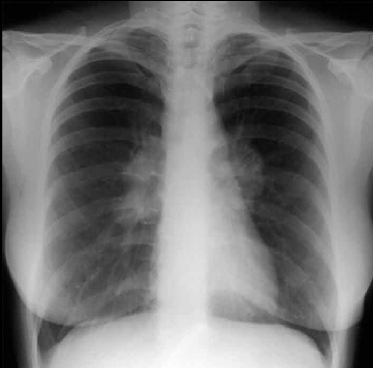

Slide 66
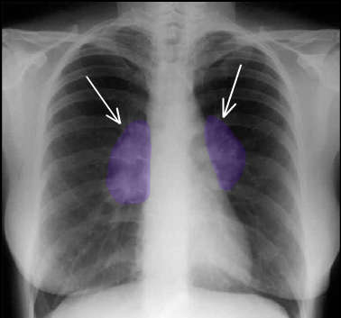

Slide 68
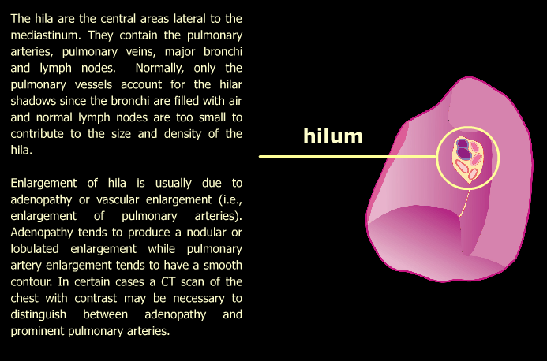

Slide 72
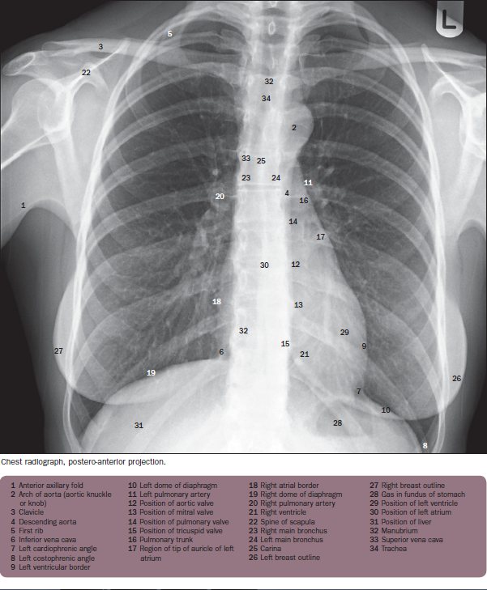

Slide 73
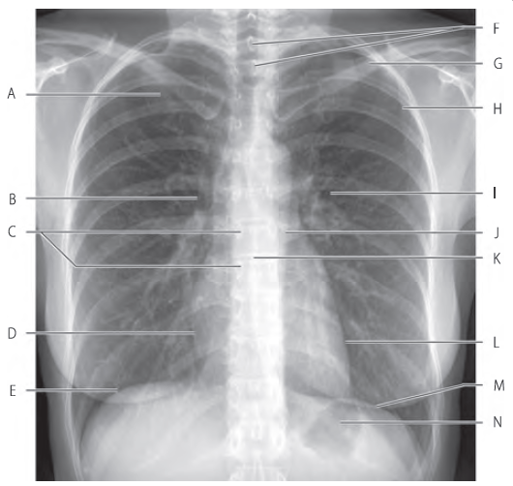

Slide 74
