Slide 1
CHEST X-Ray
Basic Interpretation II

Slide 2
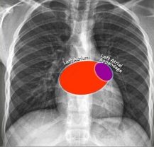
Left Atrium
Most posterior structure .Receives blood from the pulmonary veins that run almost horizontally towards the left atrium.
Left atrial appendage (in purple) can sometimes be seen as a small outpouching just below the pulmonary trunk.
Enlargement of the left atrium results on the PA-view in outpouching of the upper heart contour on the right and an obtuse angle between the right and left main bronchus. On the lateral view bulging of the upper posterior contour will be seen

Slide 3
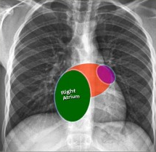
Right Atrium
•Receives blood from the inferior and superior vena cava.
•Enlargement will cause an outpouching of the right heart contour

Slide 4
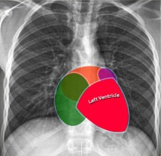
Left Ventricle
•Situated to the left and posteriorly to the right ventricle.
•Enlargement will result on the PA-view in an increase of the heart size to the left and on the lateral view in bulging of the lower posterior contour.

Slide 5
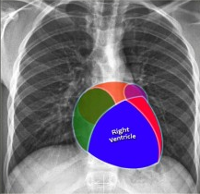
Right Ventricle
•Most anterior structure and is situated behind the sternum.
•Enlargement will result on the PA-view in an increase of the heart size to the left and can finally result in the left heart border being formed by the right ventricle.

Slide 6
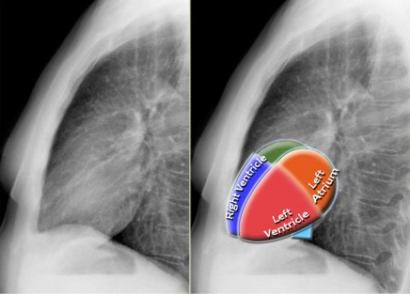
Left Atrium
•The upper posterior border of the heart is formed by the left atrium.
•Enlargement will result in bulging of the upper posterior contour
Left Ventricle
•Forms the lower posterior border.
•Enlargement will displace the contour more posteriorly.

Slide 7

Right Ventricle
•The lower retrosternal space is filled by the right ventricle.
•Enlargement of the right ventricle will result in more superior filling of this retrosternal space.

Slide 8
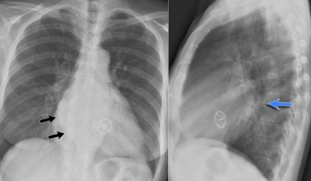
Left Atrium enlargement
This is a patient with longstanding mitral valve disease and mitral valve replacement.
Extreme dilatation of the left atrium has resulted in bulging of the contours (blue and black arrows).

Slide 9
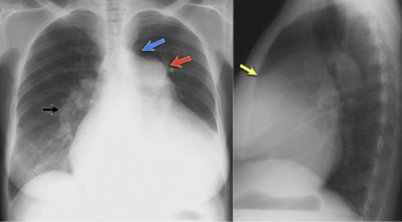
Right ventricle enlargement
On these chest films the heart is extremely dilated.
Notice that it is especially the right ventricle that is dilated. This is well seen on the lateral film (yellow arrow).
There is a small aortic knob (blue arrow), while the pulmonary trunk and the right lower pulmonary artery are dilated. All these findings are probably the result of a left-to-right shunt with subsequent development of pulmonary hypertension.

Slide 10
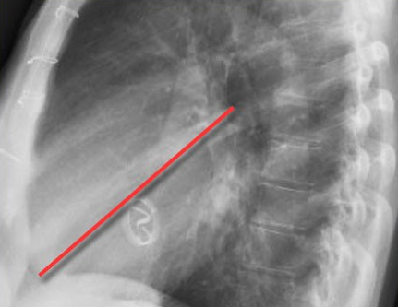
The location of the cardiac valves is best determined on the lateral radiograph.
A line is drawn on the lateral radiograph from the carina to the cardiac apex.
The pulmonic and aortic valves generally sit above this line and the tricuspid and mitral valves sit below this line
On this lateral view you can get a good impression of the enlargement of the left atrium.

Slide 11
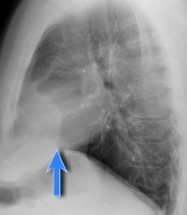
Cardiac incisura
On the right side of the chest the lung will lie against the anterior chest wall.
On the left however the inferior part of the lung may not reach the anterior chest wall, since the heart or pericardial fat or effusion is situated there

Slide 12
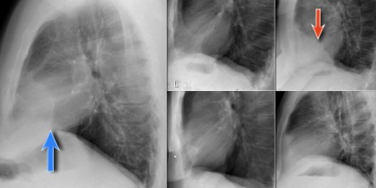
This causes a density on the anteroinferior side on the lateral view which can have many forms.
It is a normal finding, which can be seen on many chest x-rays and should not be mistaken for pathology in the lingula or middle lobe.

Slide 13
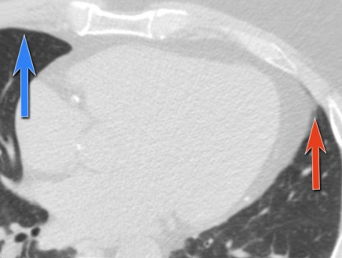
The explanation for the cardiac incisura is seen on this CT-image.
At the level of the inferior part of the heart we can appreciate that the lower lobe of the right lung is seen more anteriorly compared to the left lower lobe.

Slide 14
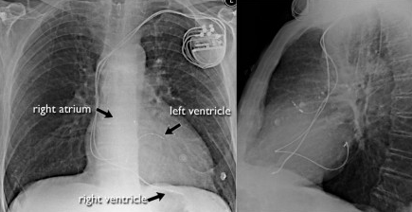
Pacemaker
There are different types of cardiac pacemakers.
Here we see a pacemaker with one lead in the right atrium and another in the right ventricle.
A third lead is seen, which is guided through the coronary sinus towards the left ventricle.
This is done in patients with asynchrone ventricular contractions.
Pacing both ventricles at the same time will lead to synchrone contractions and a better cardiac output.

Slide 15
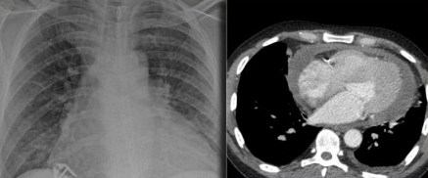
Pericardial effusion
Whenever we encounter a large heart figure, we should always be aware of the possibility of pericardial effusion simulating a large heart.
On the chest x-ray it looks as if this patient has a dilated heart while on the CT it is clear, that it is the pericardial effusion that is responsible for the enlarged heart figure.

Slide 16
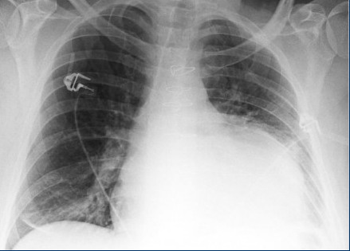
Especially in patients who had recent cardiac surgery an enlargement of the heart figure can indicate pericardial bleeding.
This patient had a change in the heart configuration and pericardial bleeding was suspected.
Ultrasound demonstrated only a minimal pericardial effusion.
Continue with the CT.

Slide 17
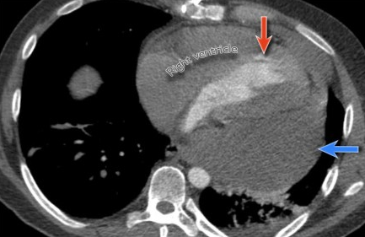
There is a large pericardial effusion, which is located posteriorly to the left ventricle (blue arrow).
The left ventricle filled with contrast and is compressed (red arrow).
At surgery a large hematoma in the posterior part of the pericardium was found.
Notice that on the anterior side there is only a minimal collection of pericardial fluid, which explains why the ultrasound examination underestimated the amount of pericardial fluid

Slide 18
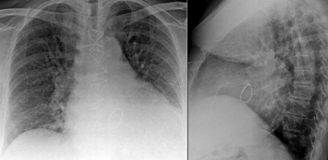
Here another patient who had valve-replacement.
Notice the large heart size.
There is redistribution of the pulmonary vessels which indicates heart failure.
Continue with the CT.

Slide 19
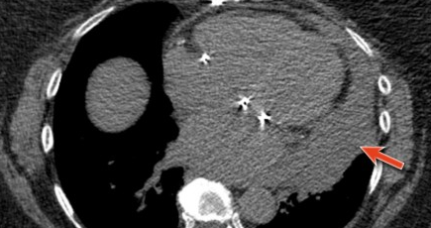
The CT-image shows a large pericardial effusion.
Always compare these post-operative chest films with the pre-operative ones

Slide 20
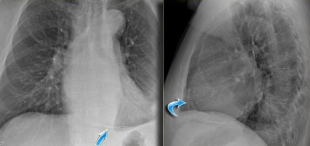
Calcifications
Detection of calcifications within the heart is quite common.
The most common are coronary artery calcifications and valve calcifications.
Here we see pericardial calcifications which can be associated with constrictive pericarditis.

Slide 21
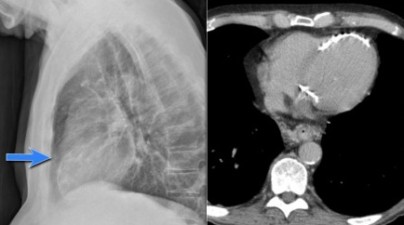
In this case there are calcifications that look like pericardial calcifications, but these are myocardial calcifications in an infarcted area of the left ventricle.
Notice that they follow the contour of the left ventricle.

Slide 22
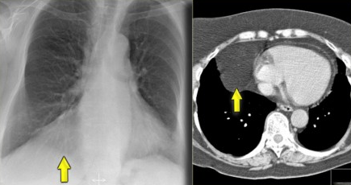
Pericardial fatpad
Pericardial fat depositions are common.
Sometimes a large fat pad can be seen (figure).
Necrosis of the fat pad has pathologic features similar to fat necrosis in epiploic appendagitis.
It is an uncommon benign condition, that manifests as acute pleuritic chest pain in previously healthy persons.

Slide 23
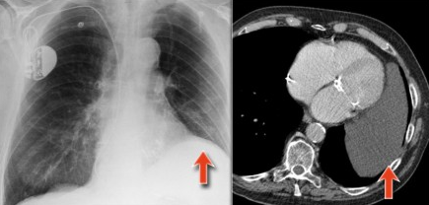
Pericardial cyst
Pericardial cysts are connected to the pericardium and usually contain clear fluid.
The majority of pericardial cysts arise in the anterior cardiophrenic angle, more frequently on the right side, but they can be seen as high as the pericardial recesses at the level of the proximal aorta and pulmonary arteries. Most patients are asymptomatic.
On the chest x-ray it seems as if there is a elevated left hemidiaphragm.
On CT however there is a cyst connected to the pericardium.

Slide 24
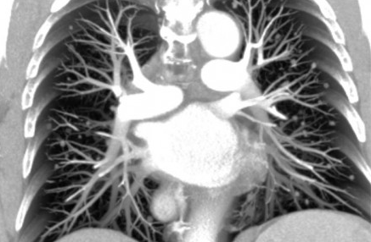
The normal hilar shadow is for 99% composed of vessels - pulmonary arteries and to a lesser extent veins .
The vessel margins are smooth and the vessels have branches.

Slide 25
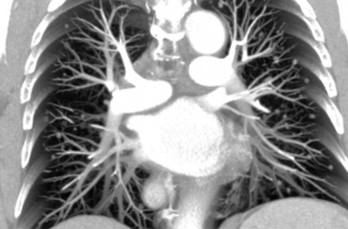
The left pulmonary artery runs over the left main bronchus, while the right pulmonary artery runs in front of the right main bronchus, which is usually lower in position than the left main bronchus.
Hence the left hilum is higher than the right.
Only in a minority of cases the right hilus is at the same level as the left, but never higher.

Slide 26
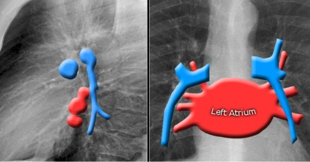
In this illustration the lower lobe arteries are colored blue because they contain oxygen-poor blood.
They have a more vertical orientation, while the pulmonary veins run more horizontally towards the left atrium, which is located below the level of the main pulmonary arteries.

Slide 27
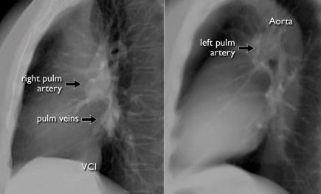
Both pulmonary arteries and veins can be identified on a lateral view and should not be mistaken for lymphadenopathy.
Sometimes the pulmonary veins can be very prominent.
The left main pulmonary artery passes over the left main bronchus and is higher than the right pulmonary artery which passes in front of the right main bronchus.

Slide 28
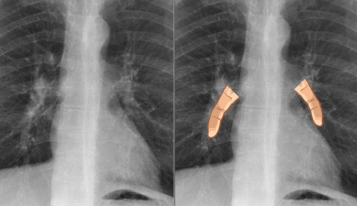
The lower lobe pulmonary arteries extend inferiorly from the hilum.
They are described as little fingers, because each has the size of a little finger (1).
On the right side the little finger will be visible in 94% of normal CXRs and on the left side in 62% of normals

Slide 29
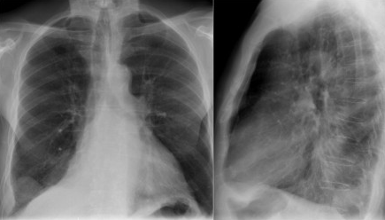
Study the CXR of a 70-year old male who fell from the stairs and has severe pain on the right flank..
Notice on the PA-film the absence of the little finger on the right and on the lateral view the increased density over the lower vertebral column.
What is your diagnosis?

Slide 30
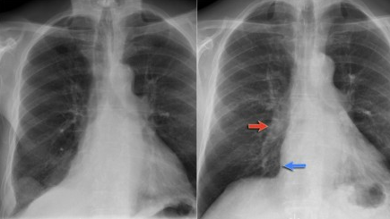
There is a right lower lobe atelectasis.
Notice the abnormal right border of the heart.
The right interlobar artery is not visible, because it is not surrounded by aerated lung but by the collapsed lower lobe, which is adjacent to the right atrium.
On a follow-up chest film the atelectasis has resolved.
We assume that the atelectasis was a result of post-traumatic poor ventilation with mucus plugging.
Notice the reappearance of the right little finger (red arrow) and the normal right heart border (blue arrow).

Slide 31
Hilar enlargement
The table summarizes the causes of hilar enlargement.
Normal hili are:
•Normal in position - left higher than right
•Equal density
•Normal branching vessels

Slide 32
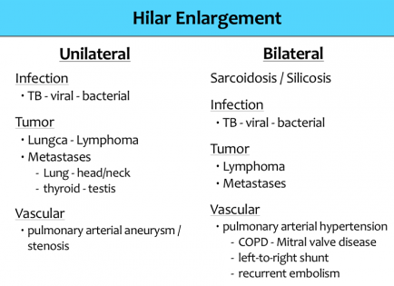

Slide 33
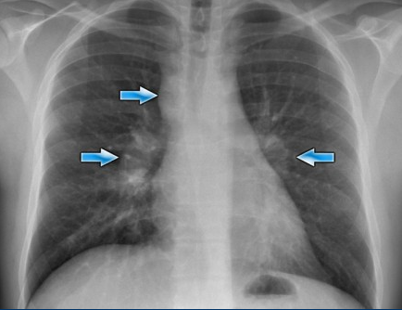
Enlargement of the hili is usually due to lymphadenopathy or enlarged vessels.
In this case there is an enlarged hilar shadow on both sides.
This could be the result of enlarged vessels or enlarged lymph nodes.
A very helpful finding in this case is the mass on the right of the trachea.
This is known as the 1-2-3 sign in sarcoidosis, i.e. enlargement of left hilum, right hilum and paratracheal.

Slide 34
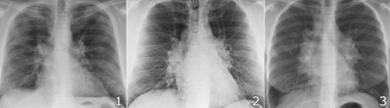
Here some more examples of sarcoidosis.
1.Lymphadenopathy and groundglass appearance of the lungs
2.Lymphadenopathy, 1-2-3 sign
3.Bulky lymphadenopathy

Slide 35
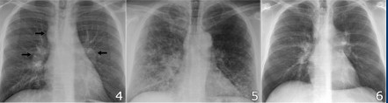
4.1-2-3 sign
5.Nodular lung pattern, no lymphadenopathy
6.Hilar and paratracheal lymphadenopathy

