Slide 1
RADIOLOGY IN METABOLIC AND ENDOCRINE DISORDERS AFFECTING BONE

Slide 2
In general , metabolic bone disease affects the skeleton in one of two ways : there is either too much or too little calcified bone .The latter change , which comprises the majority of metabolic bone disease , is due either to decrease in the amount of bone formed , or to excessive resorption of bone. In turn this may be due to a variety of causes but most commonly to abnormalities of vitamin D and calcium metabolism , which in turn arise from abnormality of diet or renal function , endocrine abnormalities ( particularly of the parathyroid gland) , drug therapy or poisoning .
For the most part metabolic processes involve the skeleton as a whole .The radiographic changes of metabolic bone disease are therefore predominantly diffuse or at least multifocal , involving many areas of the skeleton , although on occasion isolated lesions may be found , such as brown tumors in hyperparathyroidism .Another feature of metabolic bone disease is the tendency to involve specific locations , and to be symmetric in the body , as seen in the Looser’s zones of osteomalacia .Radiographic evaluation of metabolic disease , and in particular the evaluation of changes in bone density , is difficult , as up to 40% of bone mass may be lost before it becomes apparent radiographically .

Slide 3
BONE DENSITY MEASUREMENTS
RADIOGRAMMETRY : This measures the cortical thickness of the metacarpals and other tubular bones from standard radiographs , it is particularly useful in serial studies , and comparison with a large normal population can be made .Although inexpensive and easy to perform , it does not reliably reflect bone mineral content .
SINGLE PHOTON ABSORPTION : This couples a monoenergitic photon source such iodine -125 with a sodium iodide scintillation counter. The mineral content in the scan path is calculated from the difference in photon absorption between bone and soft tissue .
DUAL PHOTON ABSORPTOMETRY
QUANTATIVE COMPUTED TOMOGRAPHY
MAGNETIC RESONANCE IMAGING
BROAD BAND ULTRASOUND ATTENUATION
DUAL X-RAY ABSORPITIOMETRY : This technique uses X-rays , with a collimated beam , scanning over the region of interest in rectilinear fashion , while the tube potential is switched rapidly between two different Kvps ( usually 70 and 140 Kvp).The bone mineral density is calculated by determining the amount of mineral content related to the projected area of the region of interest.

Slide 4
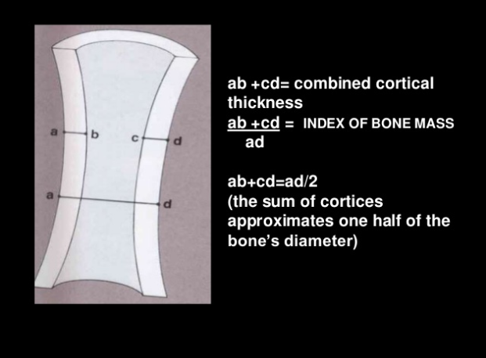

Slide 5
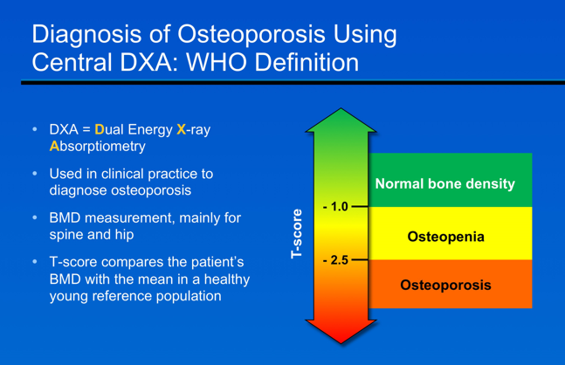

Slide 6
Normal bone mass is defined as a bone mineral density (BMD) value that is within 1 standard deviation (SD) of the young adult mean value (T-score ≥ -1)
Decreases in BMD are associated with increases in fracture risk .
BMD can be measured by dual energy X-ray absorptiometry (DXA). Central DXA (of the spine and hip) is commonly used for diagnosis of osteoporosis.
The World Health Organization (WHO) definition of osteoporosis based on BMD is:
Normal bone density: T-score ≥ -1. These women are at lower risk for fracture and usually not recommended for treatment;
Osteopenia: T-score < -1 and > -2.5. The majority of postmenopausal women who sustain fractures fall into this group;
Osteoporosis: T-score ≤ -2.5. Women with this T-score are at high risk of fracture and should receive appropriate pharmacologic therapy (after appropriate evaluation to exclude secondary causes), according to the National Osteoporosis Foundation (NOF).
An additional score includes the Z-score that compares the patient’s BMD with the mean value in age-matched subjects. This is widely used in children and younger women.

Slide 7
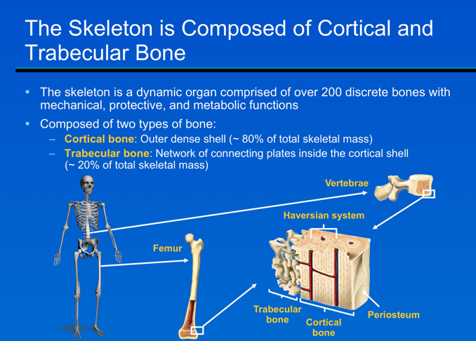

Slide 8
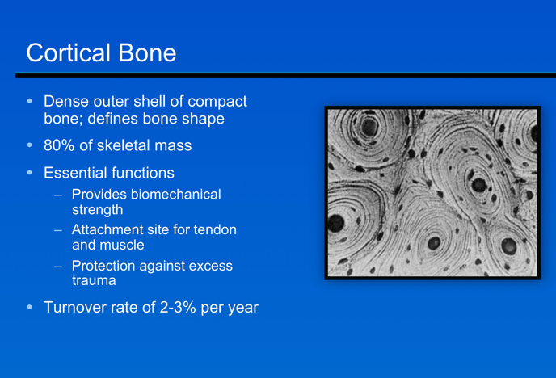

Slide 9
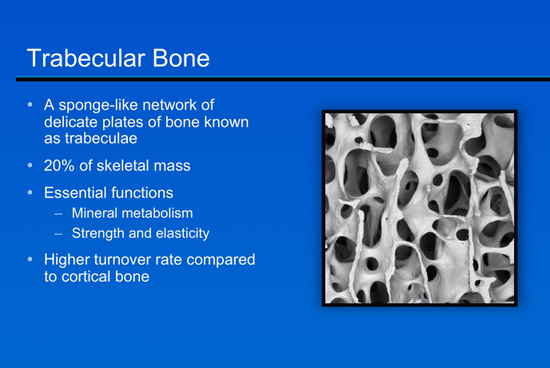

Slide 10
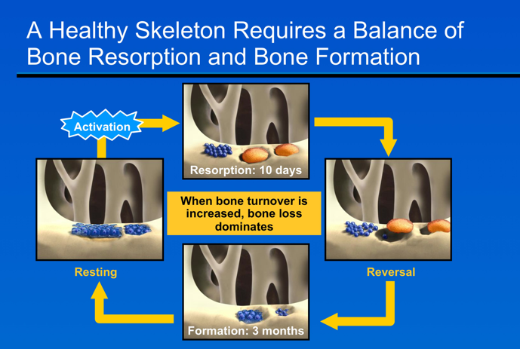

Slide 11
Remodelling is a combination of osteoclast activity (resorption) and
osteoblast activity (formation) replacing old bone tissue with new.
Remodelling is distinct from modelling (construction of new bone)
which results in a net gain in bone mass.
Remodelling occurs along lines of force generated by mechanical
stress, and incorporates 4 phases:
  Activation: Resting bone surface is converted to a remodelling surface. Osteoclast precursors are recruited and fused into multinuclear osteoclasts .
  Resorption: Osteoclasts erode bone matrix using acidification and proteolytic digestion within discrete scallop-edged Howship’s lacunae, subsequently leaving the resorption site or undergoing apoptosis.
  Reversal: Once osteoclasts have resorbed the bone matrix, osteoblasts are recruited to the bone surface.
  Formation: Osteoblasts replace the resorbed bone with new osteoid (un-mineralised collagen matrix) providing the basic structure for mineral deposition (predominantly hydroxyapatite). This matrix gradually hardens to form bone.
Resorption takes ~30 days in cortical and ~43 days in trabecular bone .
Formation takes ~90 days in cortical and ~145 days in trabecular bone.
In situations where remodelling is high, bone fragility can increase.

Slide 12
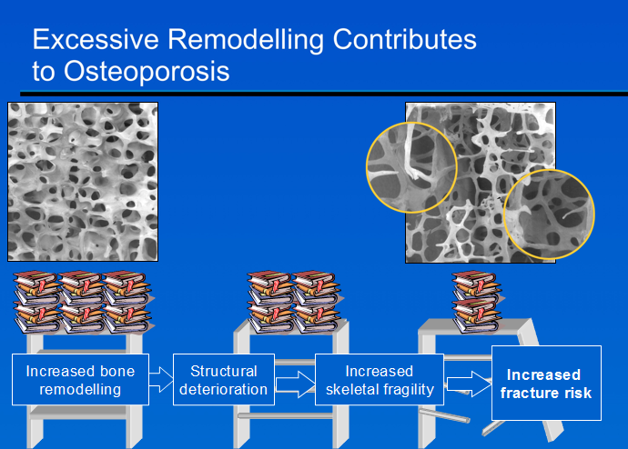
Osteoporosis is a skeletal disorder characterised by low bone mass and microarchitectural deterioration of bone tissue, predisposing a person to an increased risk of fracture.
Bone density and structural integrity dictate bone strength. Accelerated bone remodelling can result in net bone loss creating structural fragility and susceptibility to fractures.
Bone macroarchitecture (shape and geometry), microarchitecture (trabecular and cortical architecture), matrix and mineral composition, degree of mineralisation, microdamage accumulation, and rate of bone turnover all contribute to the structural properties of bone.

Slide 13
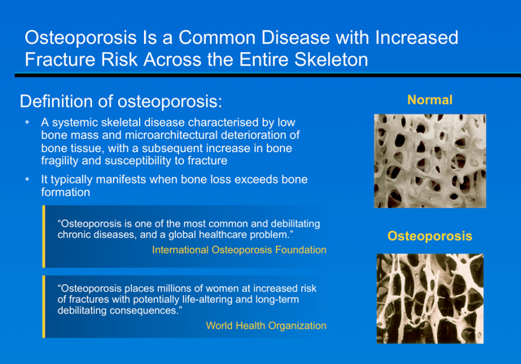

Slide 14
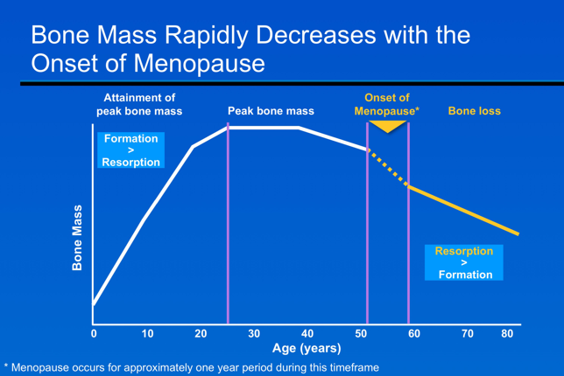

Slide 15
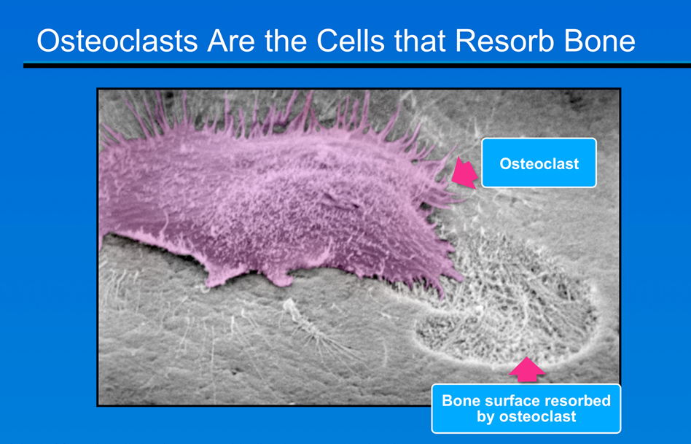

Slide 16
Osteoclasts differentiate from haematopoietic stem cells. Their function is bone resorption and so they play a vital role in skeletal development, growth, maintenance and calcium metabolism.
They resorb both the mineral and organic phases of bone by attaching to the bone matrix, polarising, and forming an irregular border at the bone surface to isolate the resorption compartment.
Bone mineral dissolution then proceeds through secretion of acids and collagen-degrading enzymes onto the bone surface.
Once the resorption products have been degraded, the osteoclast either relocates to another site (as depicted in the electron micrograph above), or undergoes apoptosis.
The collagen fragments, and solubilised calcium and phosphate generated by bone degradation, are released into the circulation³.
Research has identified RANK Ligand as essential mediator of osteoclast formation, function and survival.

Slide 17
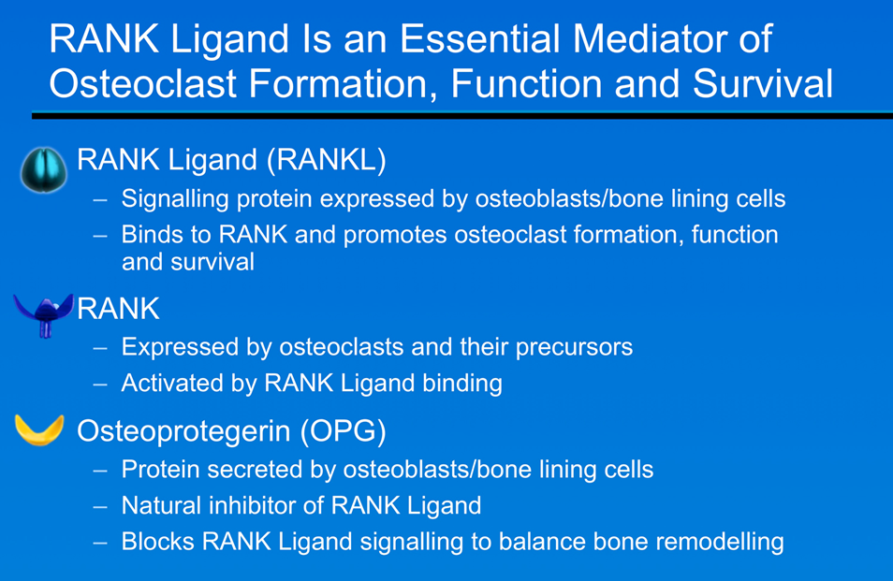

Slide 18
RANK Ligand, RANK and osteoprotegerin (OPG) constitute the RANKL/RANK/OPG pathway which regulates bone resorption; RANK Ligand and OPG work in counterbalance as regulatory partners.
RANK Ligand is a member of the TNF super-family. It stimulates maturation, attachment, activation and survival of osteoclasts .
RANK receptor is found on osteoclasts and osteoclast-precursors and is activated by RANK Ligand .
OPG counteracts the actions of RANK Ligand, i.e. inhibits the formation, attachment, activation and survival of osteoclasts, rapidly, but reversibly decreasing osteoclast count and slowing bone resorption.

Slide 19
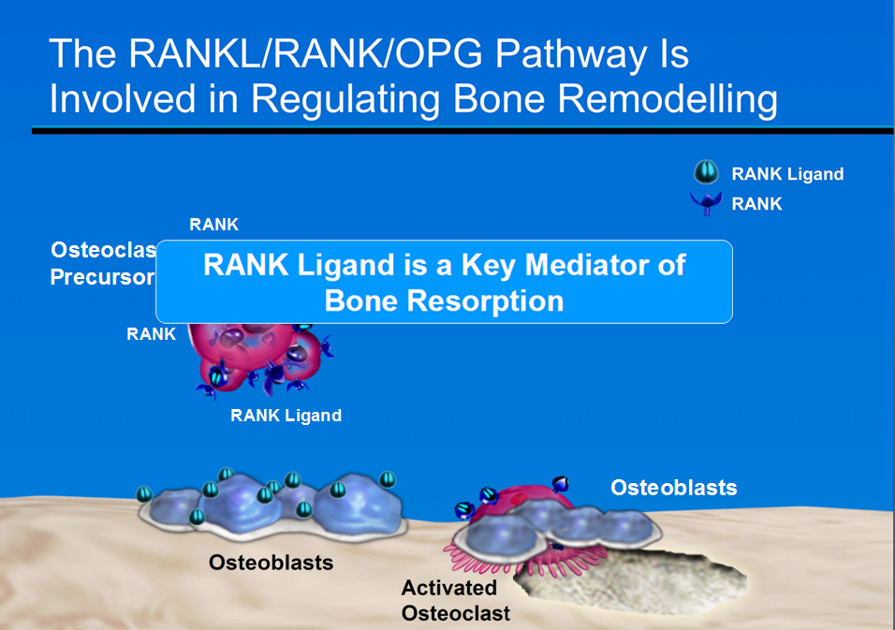

Slide 20
Bone resorption and formation are balanced in premenopausal women.
RANK Ligand is a key mediator of osteoclast formation, function and survival.
RANKL/RANK/OPG pathway is dependent on multiple signalling entities (including cytokines and hormones), which mediate the expression of RANK Ligand by osteoblasts and other cells, e.g. activated T cells .
The central role which RANK Ligand expression plays in bone remodelling is supported by the observation that receptors for the hormones, growth factors and cytokines involved are found on osteoblasts rather than osteoclasts, regardless of their regulatory function .
Evidence from gene knockout studies indicates that RANK Ligand is an essential mediator of osteoclast activity and a key factor in regulating osteoclastogenesis .
RANK Ligand can promote osteoclast maturation in vitro and produce rapid bone resorption in vivo through the activation of pre-existing osteoclasts .

Slide 21
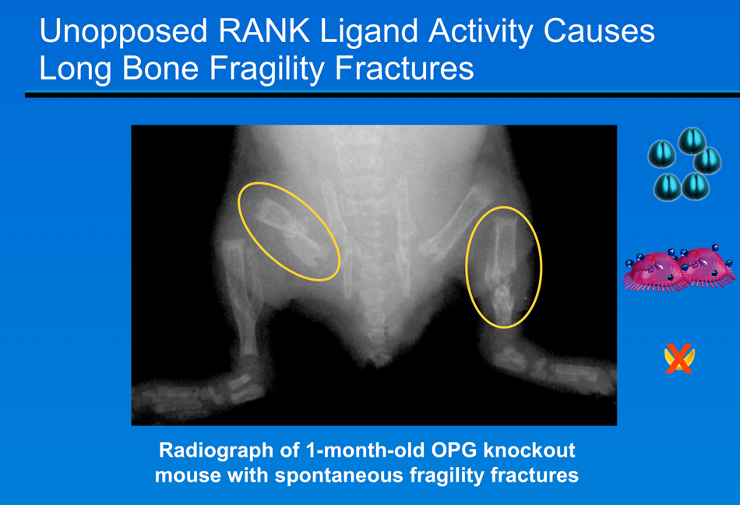

Slide 22
OPG has an essential role in protecting bone. In the absence of OPG (OPG knockout mouse model), unopposed RANK Ligand results in spontaneous fragility fractures.
The radiograph depicts a 1-month-old OPG knockout mouse with spontaneous fragility fractures.
  Osteoporosis (decrease in bone mineral density) develops due to increased osteoclast activity in the absence of OPG.
  These mice develop spontaneous fractures early in life.
  This severity of osteoporosis demonstrates that the skeleton is unable to compensate for the lack of endogenous OPG.

Slide 23
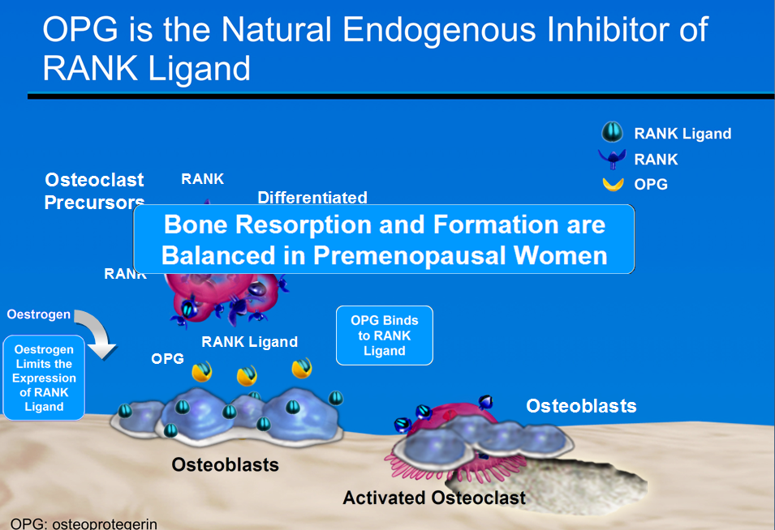

Slide 24
In premenopausal women bone remodelling is balanced.
Oestrogen limits RANKL expression and stimulates OPG production.
OPG acts as a decoy receptor for RANK Ligand and prevents its interaction with RANK, thereby inhibiting osteoclast formation, function and survival .
Expression of RANK Ligand and OPG are coordinated to regulate bone resorption and density positively and negatively by controlling the state of activation of RANK on osteoclasts.
Many factors regulate bone resorption and the RANKL/RANK/OPG pathway is the crucial mediator in their effect on bone metabolism.
RANK Ligand must bind to its receptor, RANK, on precursor/mature osteoclasts to initiate their differentiation, activation and ultimately bone resorption.
Remodelling is a coupled process; RANK Ligand expression by osteoblasts stimulates local bone resorption by osteoclasts, which in turn stimulates bone formation by adjacent osteoblasts

Slide 25
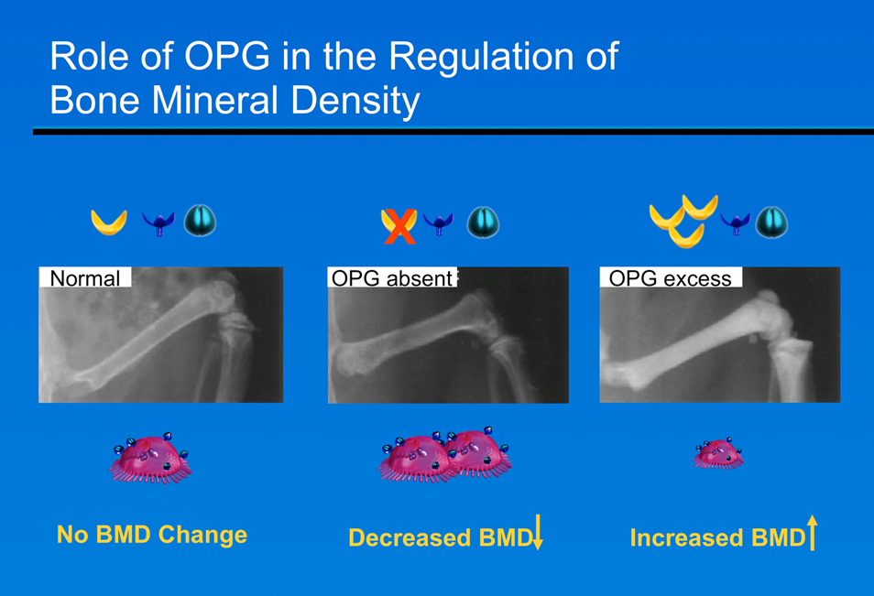

Slide 26
OPG levels regulate bone density in mice .
Preclinical studies demonstrate the critical role of RANK Ligand and OPG in bone remodelling.
The radiographs depict the femur in a normal mouse (left), an OPG-knockout mouse (middle), and a transgenic mouse overexpressing OPG (right).
In the OPG knockout mouse (left):
  Decreased bone density (osteoporosis) develops due to increased osteoclast activity in the absence of OPG.
  These mice develop spontaneous fractures early in life.
  The severity of osteoporosis in OPG knockout mice demonstrates that the skeleton is unable to compensate for the lack of endogenous OPG.
  This finding highlights the essential role for OPG in protecting bone.
In the OPG transgenic mouse (right):
  Increased bone density (osteopetrosis) is observed as a result of impaired osteoclast formation and hence reduced resorption
  Bones from these mice have a normal shape, but bone mineral density is dramatically increased .

Slide 27
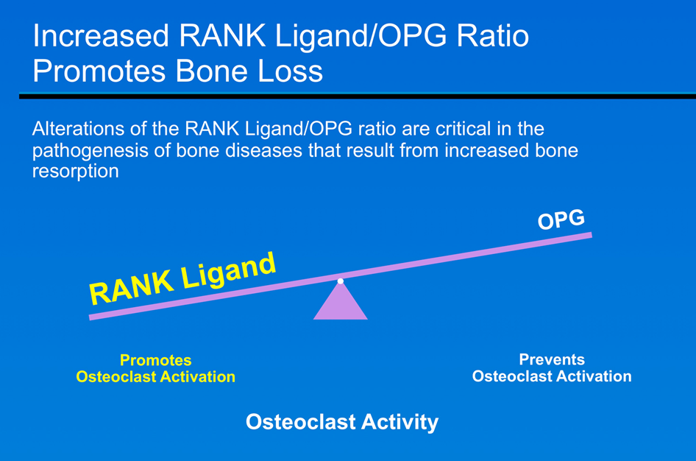

Slide 28
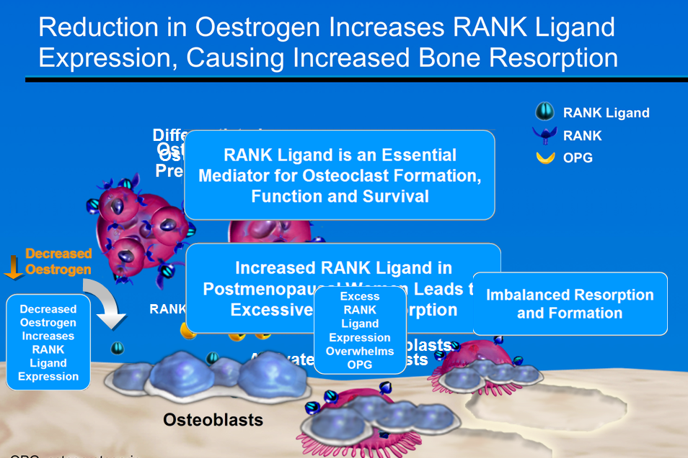

Slide 29
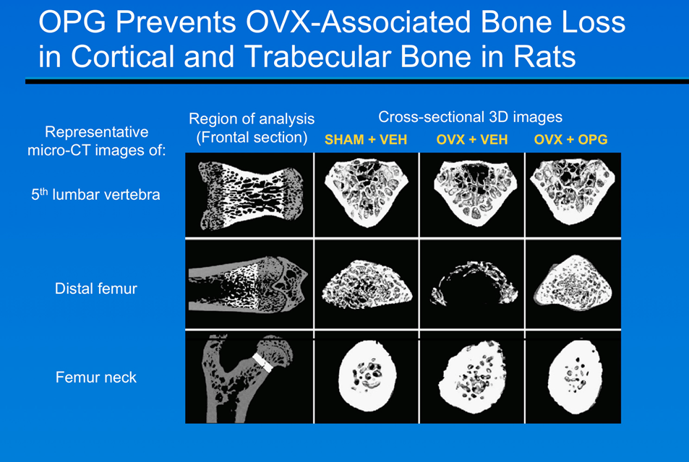

Slide 30
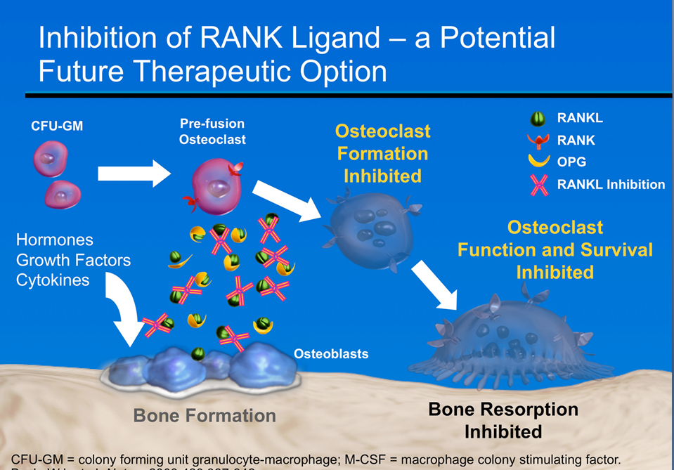

Slide 31
Metabolic bone diseases are a heterogeneous group of
disorders characterized by abnormalities in calcium
metabolism and/or bone cell physiology. They lead to an
altered serum calcium concentration and/or skeletal failure.
The most common type of metabolic bone disease in
developed countries is osteoporosis. Because osteoporosis
is essentially a disease of the elderly, the prevalence of
this condition is increasing as the average age of people
in developed countries rises. Osteoporotic fractures may
lead to loss of independence in the elderly and is imposing
an ever-increasing social and economic burden on society.
Other pathological processes that affect the skeleton, some
of which are also relatively common,

Slide 32
Structure of bone
Bone consists of an extracellular matrix and cellular constituents. The structure of the extracellular matrix is maintained throughout life by constant remodelling by its cellular constituents.
Extracellular matrix
• Type 1 collagen: forms a fibrillar structure by cross-linkage of the precursor peptide procollagen, and provides tensile strength. The fibrils are generally arranged in parallel or concentric sheets to form lamellar bone, but in newly laid ‘woven bone’ this arrangement appears more random
• Calcium- and phosphate-containing crystals: set in a
structure similar to hydroxyapatite and deposited in holes
between adjacent collagen fibrils, which provide rigidity.
• At least 11 non-collagenous matrix proteins (e.g. osteocalcin,
osteonectin): these form the ground substance and include glycoproteins and proteoglycans. Their exact function is not yet defined, but they are thought to be involved in calcification

Slide 33
Cellular constituents
• Mesenchymal-derived osteoblast lineage: consist of osteoblasts, osteocytes and bone-lining cells. Osteoblasts synthesize organic matrix in the production of new bone.
• Osteoclasts: derived from haemopoietic precursors , and resorb bone tissue by the local release of hydrolase enzymes.
Anatomy of bone
• Cortical bone: the external part of each bone consists of dense skeletal tissue known as cortical (compact) bone , which contributes to most of the skeleton’s mechanical strength.
• Trabecular bone: within the vertebrae and the ends of long bones, the internal space is filled with a fine network of bone tissue called trabecular (cancellous) bone. This is in intimate contact with the bone marrow and is largely responsible for the skeleton’s metabolic role as a reservoir for body calcium. In addition, trabecular elements are thought to contribute to the ability of vertebrae to withstand compressive forces, with loss of these contributing to the vertebral collapse seen in osteoporosis.

Slide 34
Function of bone
Bone has two main functions: to provide an endoskeleton and to act as a reservoir for body calcium (bone contains
1–2 kg of calcium compared with 1–2 g of calcium in the extracellular fluid). These two functions are normally independent. However, as 25% of extracellular calcium is replaced daily, prolonged calcium stress can ultimately affect skeletal integrity.
Skeletal maintenance
During growth, bone formation and resorption are regulated as part of the modelling process that results in the micro- and macroarchitecture of the adult skeleton.
• Modelling: involves resorption secondary to bone
formation
• Remodelling: consists of repeated cycles of bone resorption followed by formation, at discrete sites throughout the skeleton .The mechanisms regulating modelling and remodelling are not clear, but local responses to mechanical stimuli are thought to have a major role

Slide 35
Calcium balance
Many essential intracellular processes are critically dependent on the concentration of ionized extracellular calcium. The average western diet provides 0.5–1.0 g calcium/day; 20–40% of this is absorbed, which is usually sufficient to match minimal renal and intestinal losses . However, if calcium intake or absorption is reduced, or requirements increase, a negative calcium balance may ensue. As powerful homoeostatic mechanisms preserve the concentration of extracellular calcium by using skeletal calcium stores, this can ultimately lead to a significant loss of calcium from bone. The homoeostatic mechanisms affecting bone include parathyroid hormone , vitamin D and other factors.

Slide 36
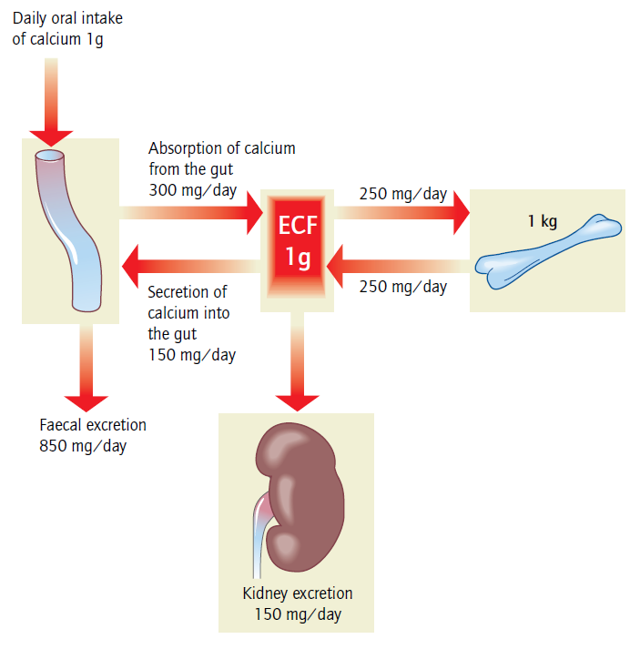
Pathways in calcium balance
The size of the extracellular fluid (ECF)and skeletal calcium compartments (1 g and 1 kg, respectively), the degree of exchange between them, the daily oral intake of calcium and the daily faecal and urinary excretion of calcium refer to a typical subject in zero calcium balance . A negative calcium balance may occur if calcium intake falls, the efficiency of calcium absorption from the gut is reduced and/or urinary calcium excretion is increased.

Slide 37
Vitamin D
Vitamin D is a steroid hormone, which is either ingested in the diet or produced in the skin from 7-dehydrocholesterol after exposure to sunlight.
Vitamin D is a pro-hormone; the active form (1,25-(OH)2-D) is produced by successive hydroxylations in the liver and kidney by the enzymes 25-hydroxylase and 1-α-hydroxylase, respectively . 1-α-Hydroxylase is stimulated not only by PTH, but also by low ambient inorganic phosphate, growth hormone, prolactin and oestrogen. This enables vitamin D levels to become adapted to the higher calcium requirements of growth and reproduction.
In conjunction with PTH, 1,25-(OH)2-D acts to maintain serum calcium levels by:
• Increasing the efficiency of calcium absorption from the proximal small intestine
• Stimulating calcium release from bone 1,25-(OH)2-D also acts to maintain phosphate levels by promoting phosphate absorption from the gut. In vitamin D deficiency, renal phosphate excretion is increased as a consequence of raised levels of PTH.

Slide 38
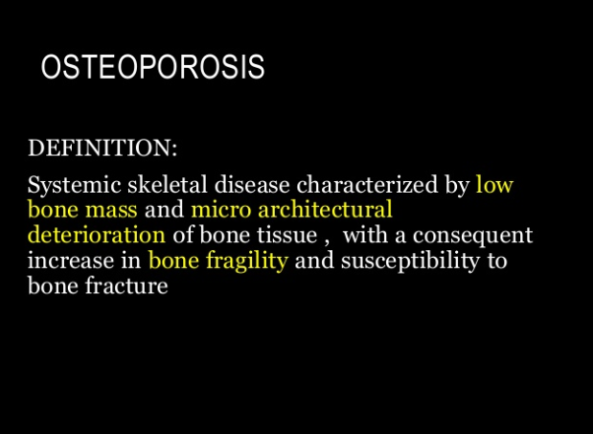

Slide 39
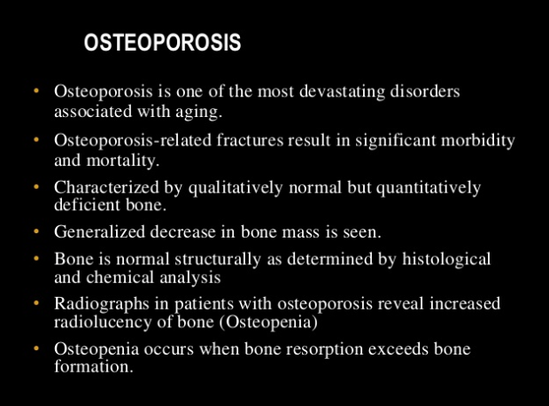

Slide 40
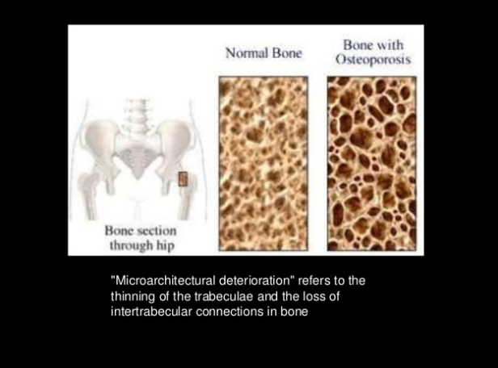

Slide 41
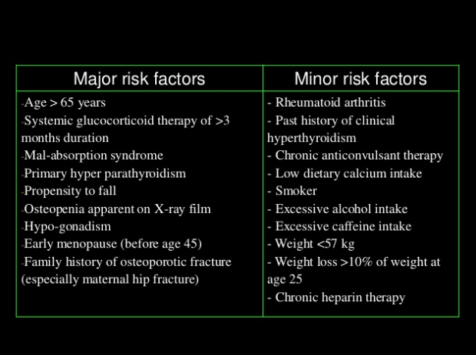

Slide 42
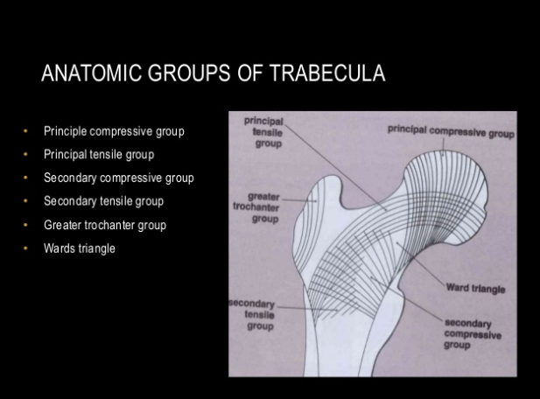

Slide 43
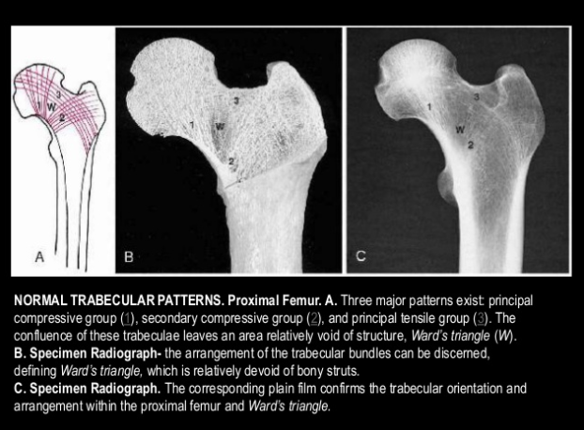

Slide 44
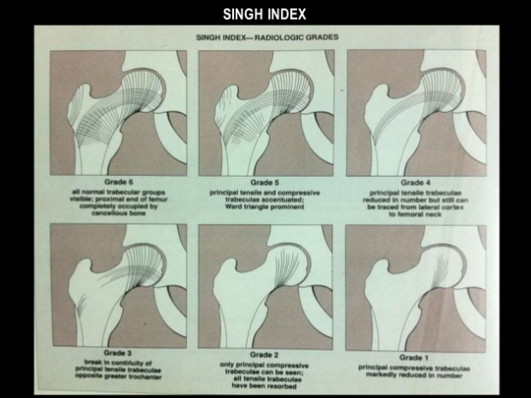

Slide 45
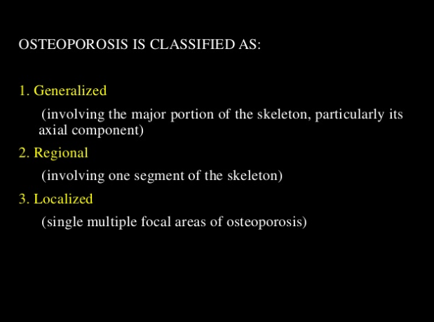

Slide 46
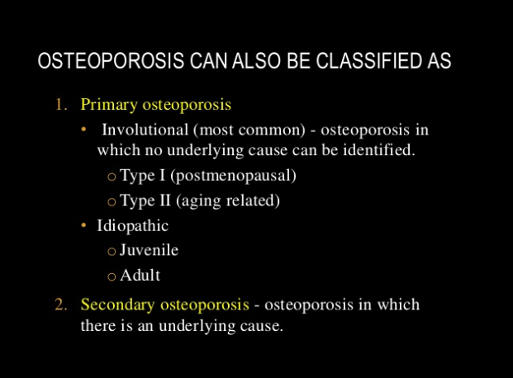

Slide 47
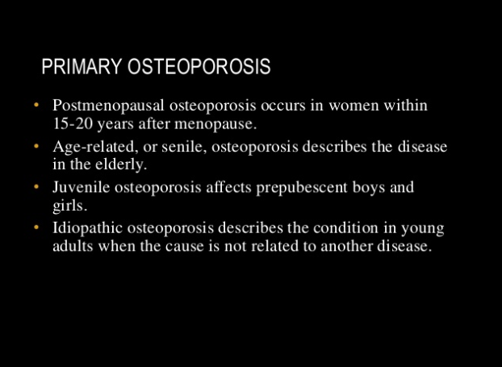

Slide 48
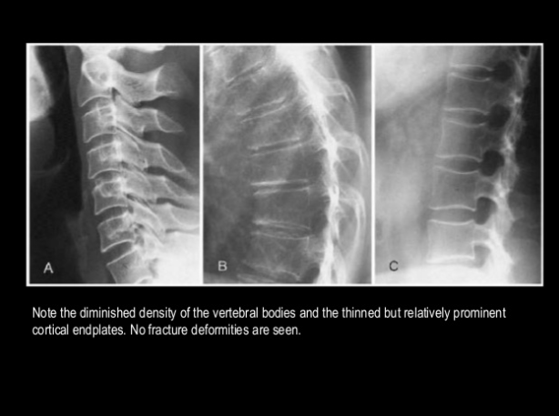

Slide 49
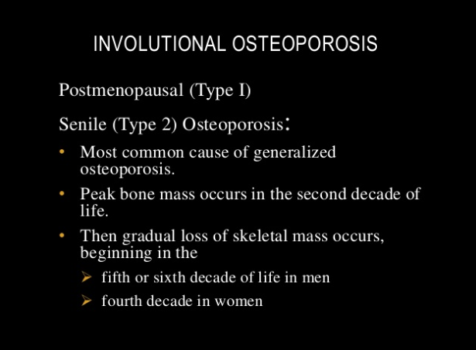

Slide 50
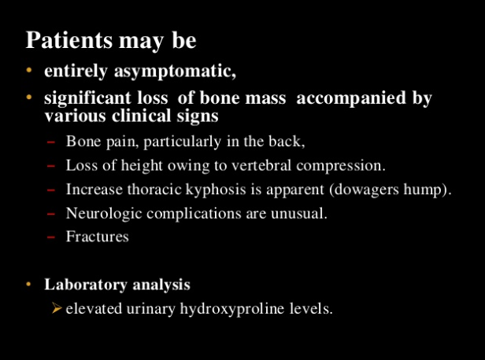

Slide 51
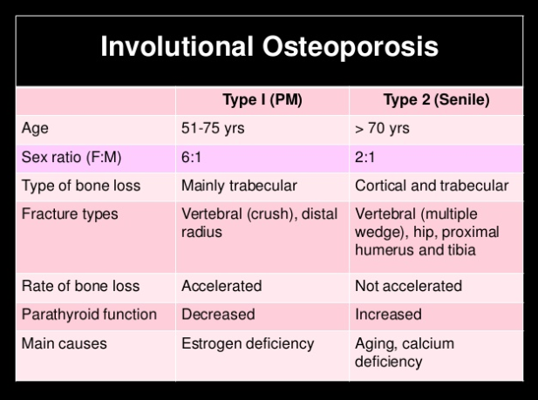

Slide 52
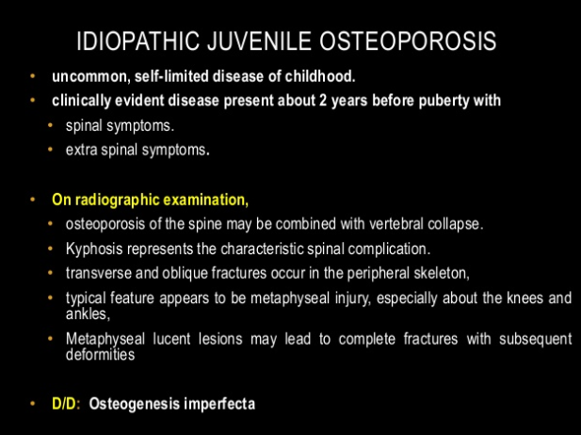

Slide 53
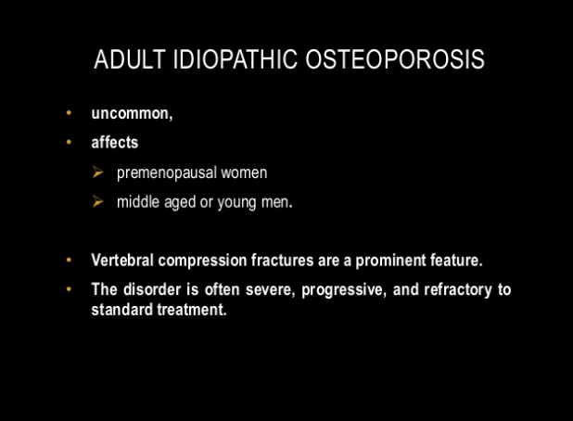

Slide 54
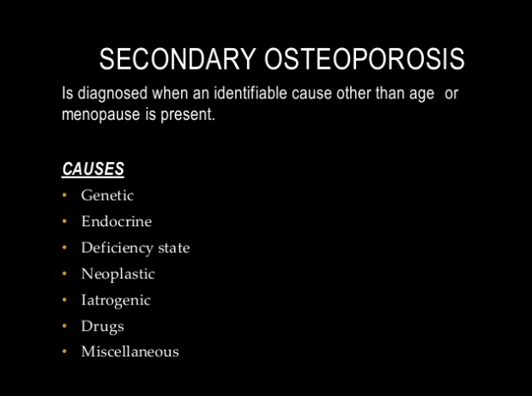

Slide 55
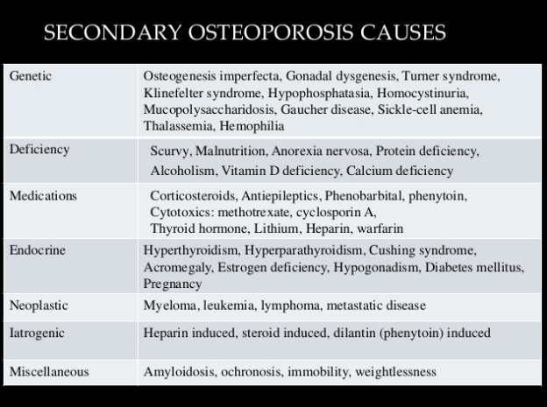

Slide 56
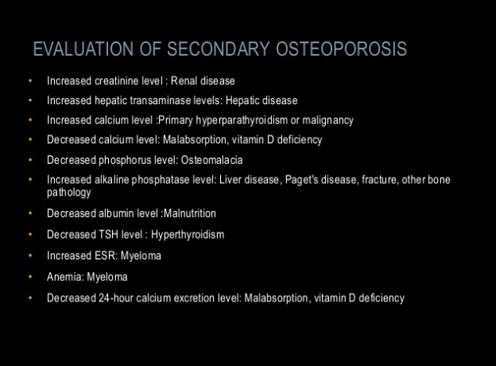

Slide 57
