Slide 1
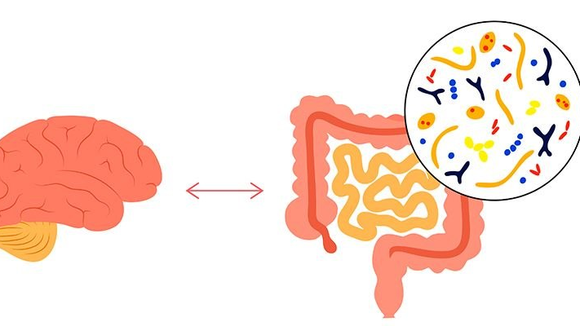
Biological insight into the gut microbiota and gut brain axis
Asst.Lec. Ghufran Salman Asst.Lec Lujain Ali

Slide 2
Introduction
In recent years, the gut microbiota has emerged as a key regulator of multiple biological processes, including metabolism, immune function, and protection against pathogens. Importantly, growing evidence highlights its critical involvement in the gut–brain axis, a bidirectional communication system linking the gastrointestinal tract and the central nervous system.
The human gastrointestinal tract hosts a complex and dynamic community of microorganisms collectively known as the gut microbiota. This community consists of trillions of microorganisms, including bacteria, viruses, fungi, and archaea, with an estimated population of 10¹³–10¹⁴ microbial cells, primarily residing in the colon. The collective genome of these microorganisms is referred to as the gut microbiome.

Slide 3
Introduction
Understanding the biological characteristics and functions of the gut microbiota is therefore essential for exploring how alterations in this microbial ecosystem may influence not only gastrointestinal health but also neurological and psychological outcomes.
In this lecture, we will focus on the biological aspects of the gut microbiota, including its composition, development, and functional roles, as a foundation for understanding its interaction with the brain.

Slide 4
Development of Gut Microbiota
Colonization begins at birth, Influenced by:
Mode of delivery (vaginal vs. cesarean section)
Breastfeeding vs. formula feeding
Antibiotic exposure
Diet and environment
Microbiota stabilizes around age 2–3 years.
Continues to change with aging.

Slide 5
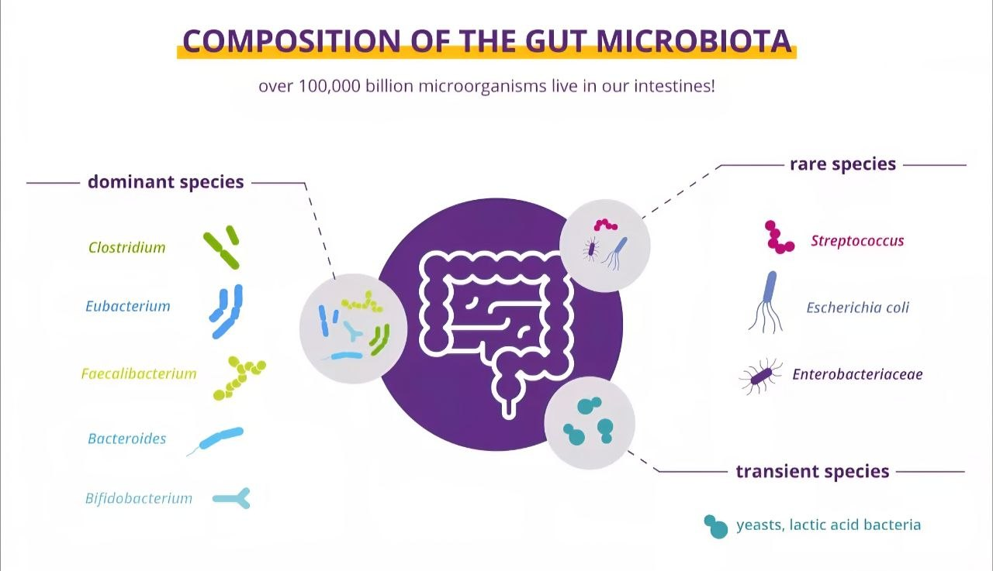

Slide 6
Functions of Gut Microbiota
A. Metabolic Functions
Fermentation of dietary fibers
Production of short-chain fatty acids (SCFAs):
Butyrate
Propionate
Acetate
Synthesis of vitamins:
Vitamin K
B vitamins
B. Protective Functions
Prevent colonization by pathogens
Maintain intestinal barrier integrity
Regulate mucus production

Slide 7
Functions of Gut Microbiota
C. Immunological Functions
Modulate innate and adaptive immunity
Promote immune tolerance
Prevent excessive inflammation
D. Gut–Brain Axis
Bidirectional communication between gut and brain Influences:
Mood
Anxiety
Cognitive function
Via neural, immune, and endocrine pathways

Slide 8
Dysbiosis
Associated diseases:
Dysbiosis refers to an imbalance in the microbial community.
Causes:
Antibiotic overuse
Poor diet (high fat, high sugar)
Chronic stress
Infections
Obesity
Type 2 diabetes
Inflammatory bowel disease (IBD)
Irritable bowel syndrome (IBS)
Allergies
Colorectal cancer
Depression and anxiety disorders

Slide 9
Gut Microbiota and Inflammation
Methods of Studying Gut Microbiota
SCFAs (especially butyrate) reduce inflammation.
Dysbiosis may increase intestinal permeability ("leaky gut").
Translocation of bacterial endotoxins (e.g., LPS) may trigger systemic inflammation.
Linked to metabolic syndrome and autoimmune diseases.
Stool sample analysis
16S rRNA sequencing
Metagenomics
Metabolomics
*These techniques help identify microbial composition and function.

Slide 10
Therapeutic Modulation of Gut Microbiota
A. Probiotics
Live beneficial microorganisms.
B. Prebiotics
Non-digestible fibers that promote growth of beneficial bacteria
C. Synbiotics
Combination of probiotics and prebiotics.
D. Fecal Microbiota Transplantation (FMT)
Transfer of stool from a healthy donor to restore microbial balance

Slide 11
Lifestyle Strategies to Support Gut Health
High-fiber diet
Future Perspectives
Fermented foods
Regular physical activity
Adequate sleep
Stress management
Avoid unnecessary antibiotics
Personalized microbiome-based therapy
Microbiota as diagnostic biomarkers
Precision nutrition
Microbiome-targeted drugs

Slide 12
The gut microbiota is a dynamic and complex ecosystem essential for metabolism, immunity, and overall health.
Maintaining microbial balance is crucial in preventing chronic inflammatory and metabolic diseases.
Understanding the gut microbiome opens new possibilities for personalized medicine and targeted therapeutic strategies.

