Slide 1
Introduction to disease vectors and vector borne diseases
Asst.Lec. Ghufran Salman

Slide 2
Title
Day 1 | Introduction to disease vectors and vector borne diseases
Day 2 | Water pollution and water borne diseases
Day 3 | Sexual transmission diseases
Day 4 | Antimicrobial perspective on the black death (plaque)
Day 5 | Food transmission diseases

Slide 3
Introduction

Slide 4
Public Health Importance
Vector-borne diseases account for over 17% of all infectious diseases globally, causing millions of infections and deaths each year.
Unlike direct transmission, these diseases require an intermediate living organism known as a vector to transfer pathogens between hosts.
Vectors not only transmit pathogens but, in many cases, are essential for the pathogen’s survival, development, or multiplication. This makes prevention and control more complex.
They are especially problematic in developing countries due to:
Weak infrastructure
Limited control programs
Favorable environmental conditions for vector breeding and survival
Poor public health systems

Slide 5
Definition of a Vector
A vector is a living organism—usually an arthropod—that transmits infectious agents from one host to another.
Pathogens transmitted include:
Bacteria
Viruses
Parasite

Slide 6
Key Characteristics of Vectors
For an organism to function effectively as a vector, it typically has the following features:
Hematophagous behavior (feeds on blood)
Ability to harbor and transmit pathogens
Sufficient lifespan to allow pathogen development
Close association with human habitats
High reproductive capacity
Adaptability to environmental conditions

Slide 7
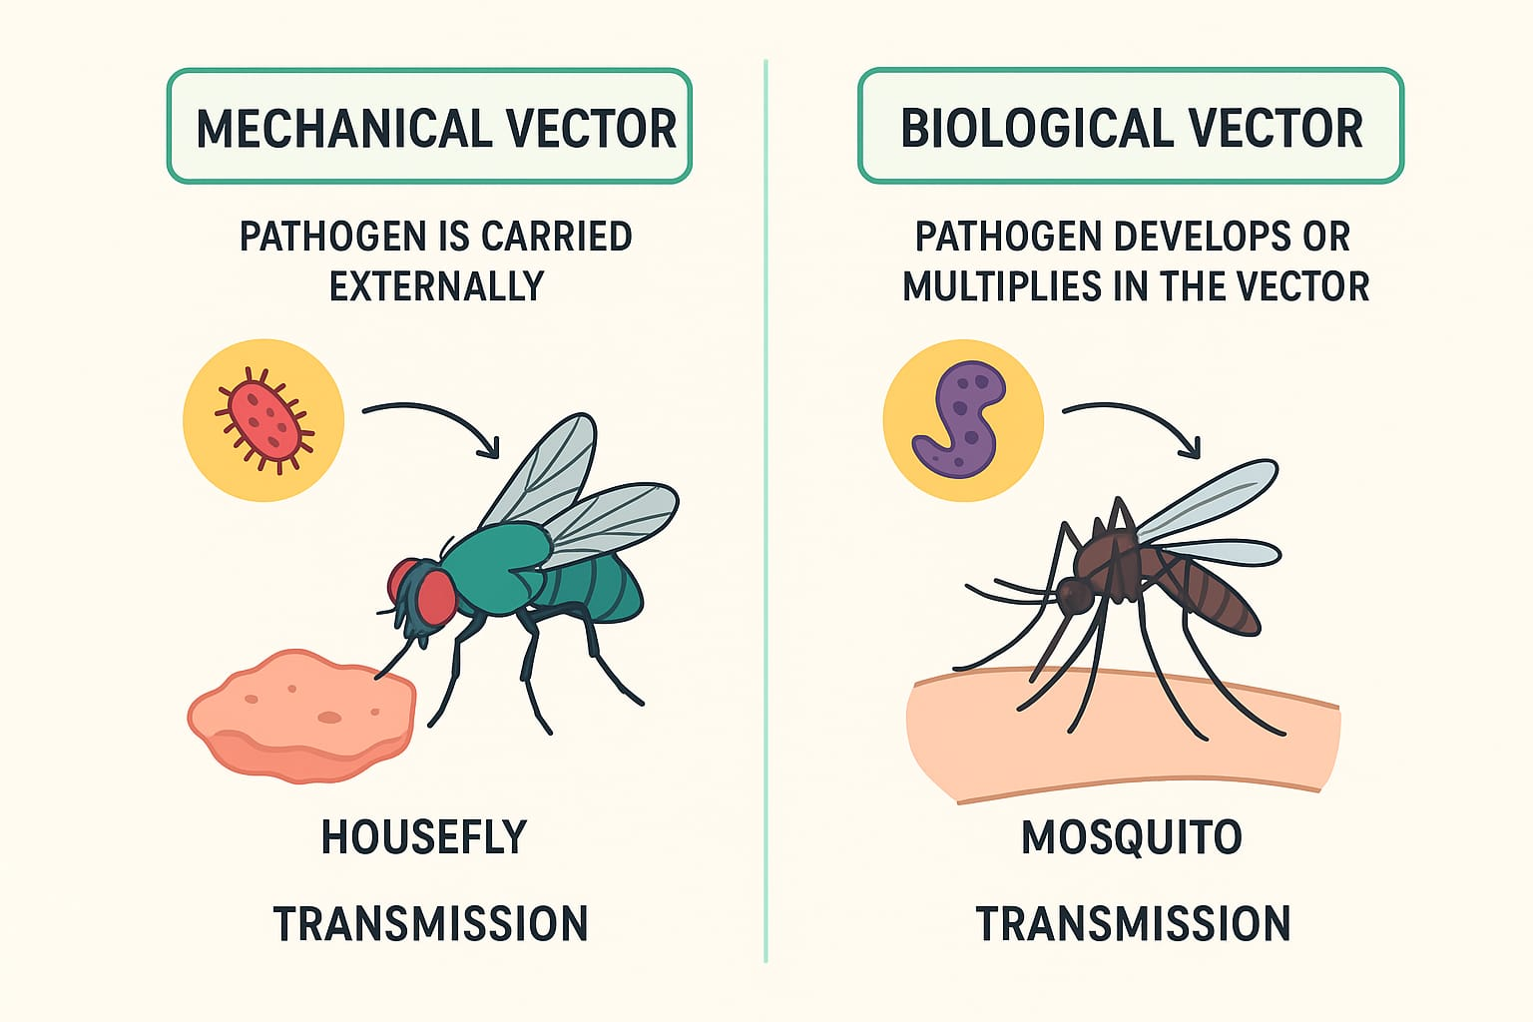

Slide 8
Types of Vectors
1. Biological Vectors
biological transmission, the pathogen:
Enters the vector’s body
Undergoes development and/or multiplication
Becomes infective before transmission to another host
.
🧪 Biological vectors include:
Propagative vector→ the pathogen multiplies only inside the vector
Example: Mosquito transmitting Plague
Cyclodevelopmental vector→ the pathogen develops (changes stage) but does not multiply
Example: Mosquito transmitting Filariasis
Cyclopropagative vector→ the pathogen both develops and multiplies inside the vector
Example: Anopheles mosquito transmitting Malaria

Slide 9
Types of Vectors
2.Mechanical Vectors
Do not support pathogen development
Carry pathogens externally (e.g., on body parts)
Transmit infection through contamination.
🧪 Mechanical vectors include:
Flies (especially Housefly)→ can transmit Cholera, Typhoid fever, Dysentery
Cockroaches→ can transmit Salmonellosis, Diarrhea
Contaminated food→ can transmit Food poisoning, Hepatitis A
Contaminated water→ can transmit Cholera, Typhoid fever, GiardiasisHumans (hands, clothing, fomites)→ can transmit Common cold, COVID-19, Conjunctivitis
Contaminated objects/surfaces→ can transmit Tetanus, Hepatitis

Slide 10
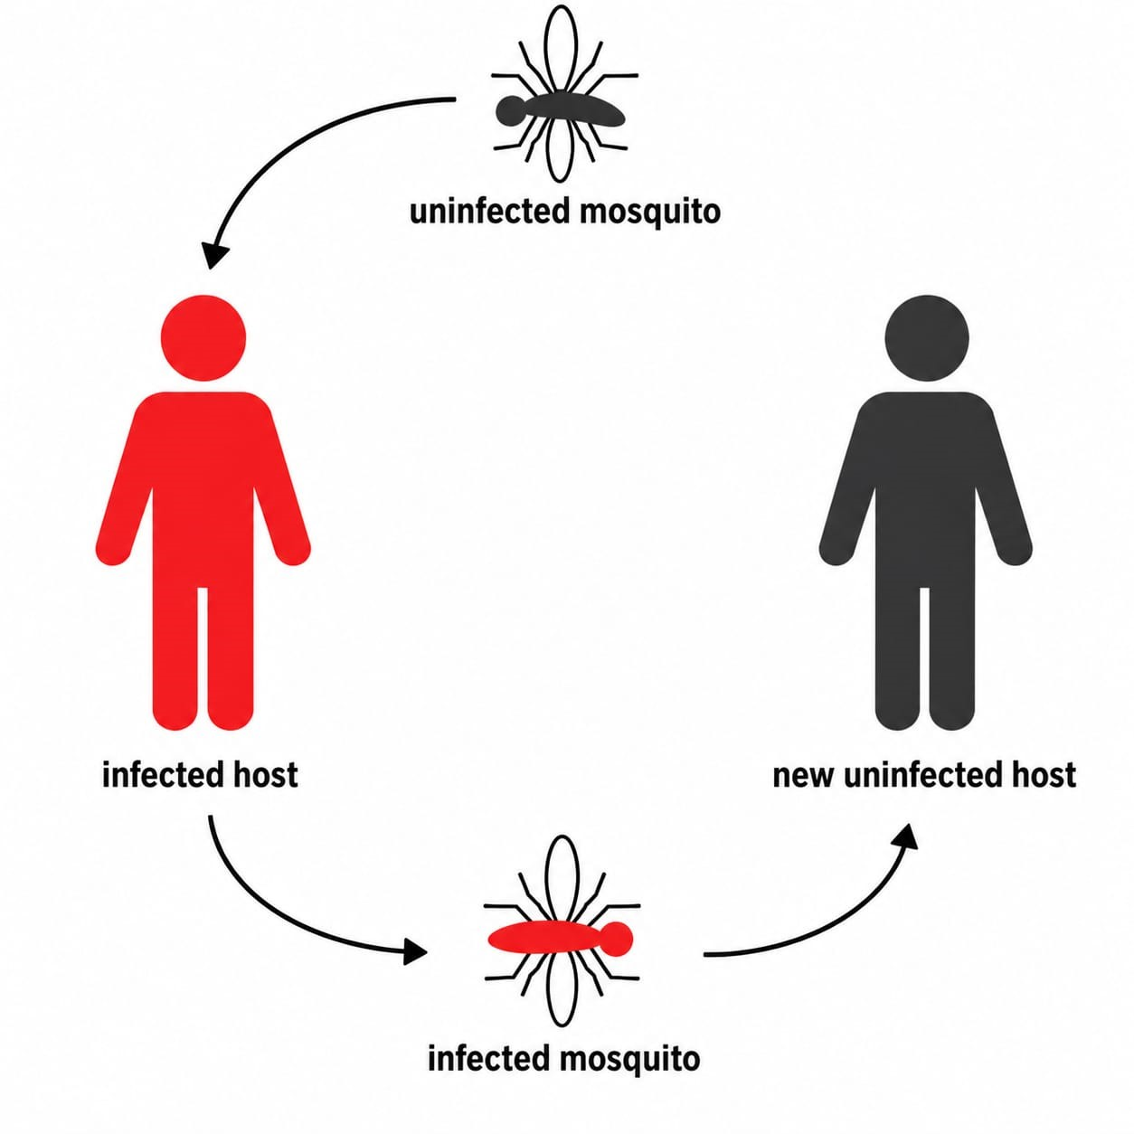
Transmission Cycle of Vector-Borne Diseases
The typical cycle involves:
Reservoir host (human or animal) carrying the pathogen
Vector acquires the pathogen during blood feeding
Pathogen develops inside vector (in biological transmission)
Vector transmits the pathogen to a new host.
📌 This cycle is often called the host–vector–pathogen interaction.

Slide 11
Major Vectors and Associated Diseases
🦟 Mosquitoes
The most important vectors worldwide.
Transmit:
Malaria (Plasmodium)
Dengue fever
Zika virus disease
Chikungunya
West Nile virus
🕷️ Ticks
Transmit:
Lyme disease (Borrelia burgdorferi)
Crimean-Congo hemorrhagic fever
🪰 Flies
Mainly mechanical vectors
Transmit:
Cholera
Typhoid fever
Dysentery
🐜 Fleas
Transmit:
Plague (Yersinia pestis)
🧷 Lice
Transmit:
Epidemic typhus (Rickettsia prowazekii)

Slide 12
Factors Influencing Transmission
1. Environmental Factors
Temperature (affects vector survival and pathogen development)
Humidity
Rainfall (creates breeding sites)
Climate change
2. Biological Factors
Vector lifespan
Feeding frequency
Extrinsic incubation period (EIP)
→ time required for pathogen development inside the vector
3. Socioeconomic Factors
Poor sanitation
Urbanization
Population density
Limited healthcare access

Slide 13
Prevention and Control Strategies
Vector Control
Insecticide spraying
Larval source management (removing standing water)
Biological control (e.g., fish that eat larvae)
2. Personal Protection
Insect repellents
Bed nets (especially insecticide-treated nets)
Protective clothing
3. Environmental Management
Proper waste disposal
Drainage systems
Improved housing
4. Public Health Measures
Surveillance programs
Health education
Vaccination (where available, e.g., dengue in some regions)

Slide 14
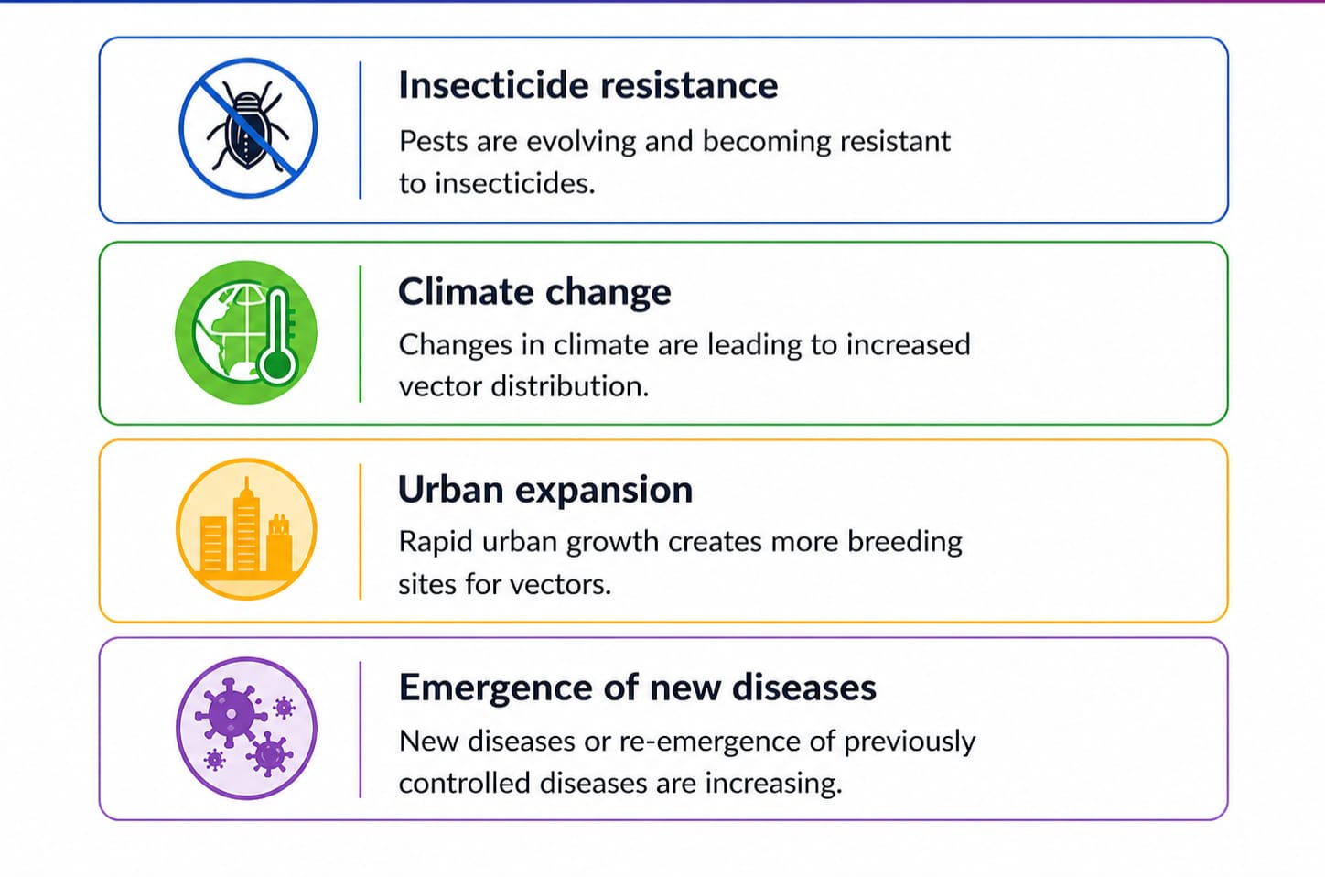
Emerging Challenges

Slide 15
Key facts
Vector-borne diseases account for more than 17% of all infectious diseases, causing more than 700 000 deaths annually.
They can be caused by either parasites, bacteria or viruses.Malaria is a parasitic infection transmitted by Anopheline mosquitoes.
It causes an estimated 249 million cases globally, and results in more than 608 000 deaths every year.
Most of the deaths occur in children under the age of 5 years.Dengue is the most prevalent viral infection transmitted by Aedes mosquitoes.
More than 3.9 billion people in over 132 countries are at risk of contracting dengue, with an estimated 96 million symptomatic cases and an estimated 40 000 deaths every year.
Other viral diseases transmitted by vectors include Zika virus fever, yellow fever, West Nile fever, Japanese encephalitis (all transmitted by mosquitoes), tick-borne encephalitis (transmitted by ticks)
Many of vector-borne diseases are preventable through protective measures and community mobilization.

Slide 16
Conclusion
Vector-borne diseases remain a major global health issue.
Effective control requires:
Understanding vector biology
Integrated control strategies
Community participation
Preventing these diseases is often more effective and less costly than treating them after infection.

Slide 17
Thanks

